Slide 1
Convicting the Innocent, Ch 2, 3 - False Confessions - Eyewitness mistakes
Announcements: Central Prison visit this coming Friday
Speaker tonight
Catch-up from last time:
Review of results from McGautha
Questions before we start?

Slide 2
Summary of Results

Slide 3
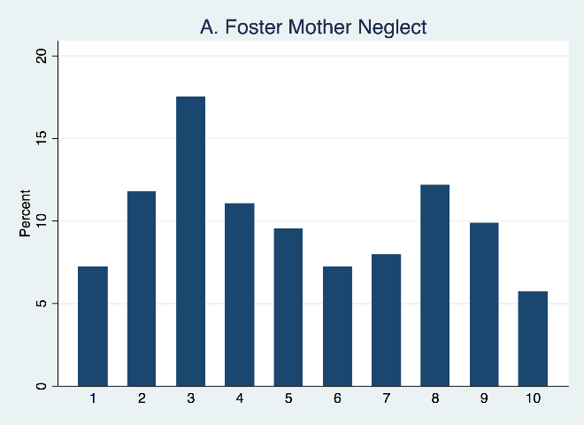
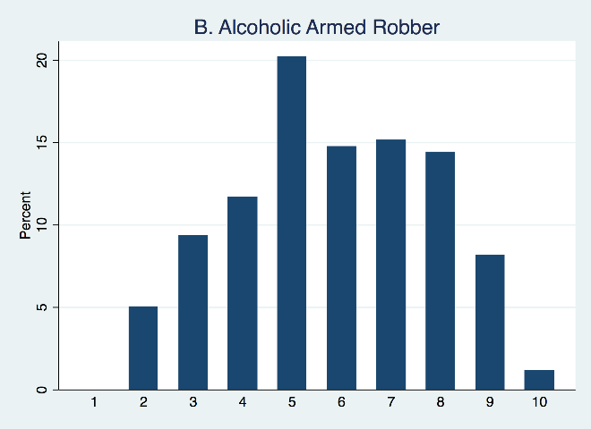
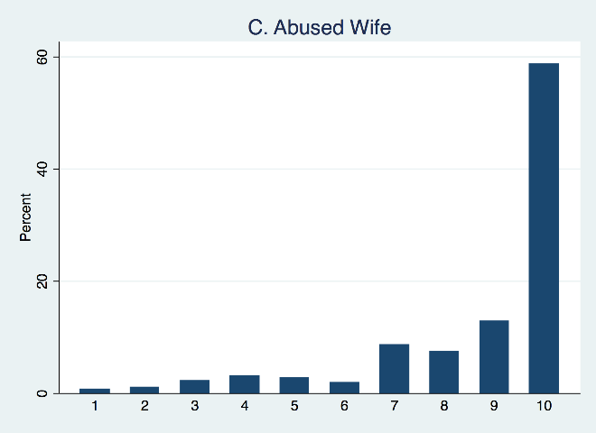
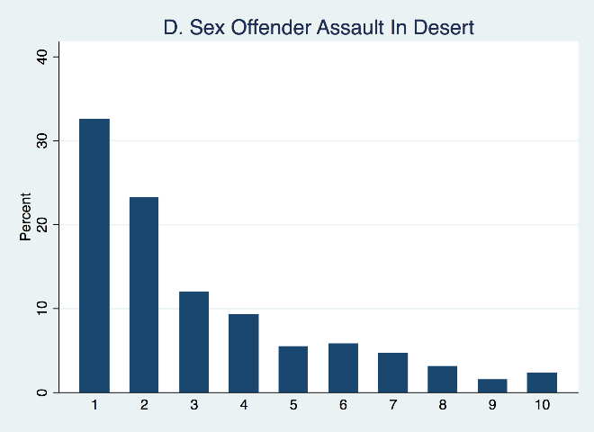
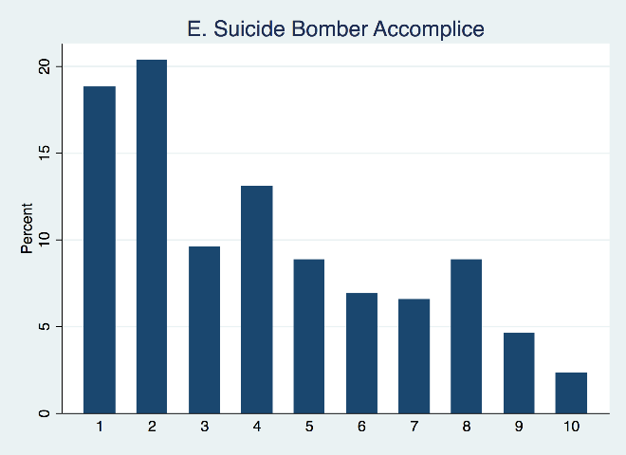
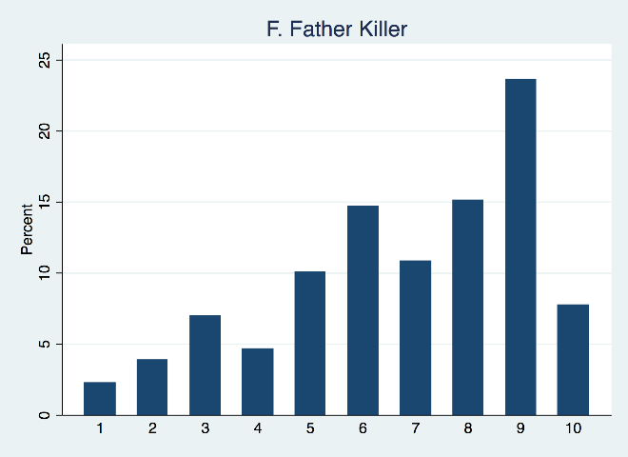
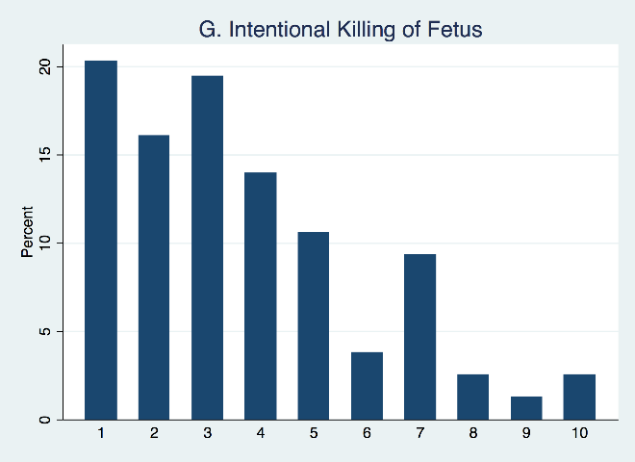
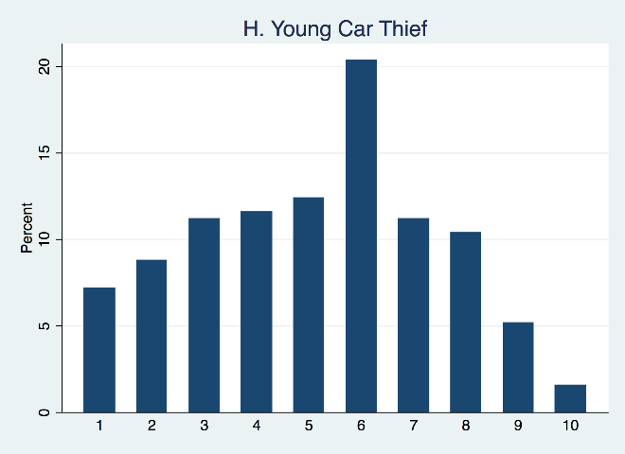
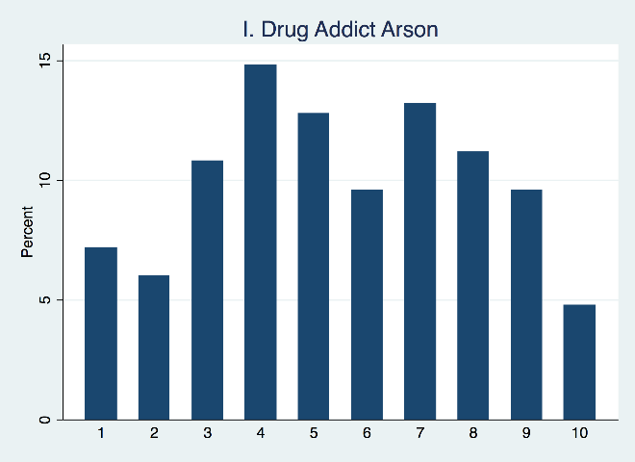
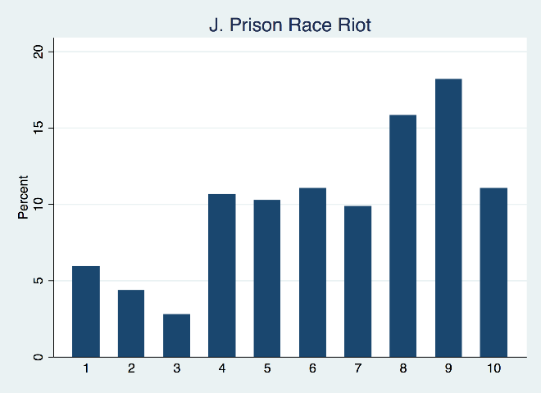
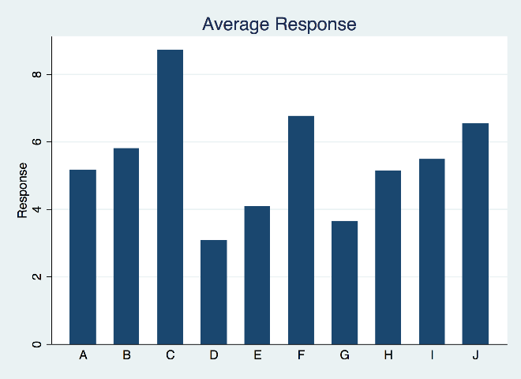

Slide 4
McGautha v. California (1971)
To identify before the fact those characteristics of criminal homicides and their perpetrators which call for the death penalty, and to express these characteristics in language which can be fairly understood and applied by the sentencing authority, appear to be tasks which are beyond present human ability.
No simple formula can take account of the innumerable degrees of culpability, and no formula which fails to do so can claim to be just or satisfy public opinion.
For a court to attempt to catalog the appropriate factors in this elusive area could inhibit, rather than expand, the scope of consideration, for no list of circumstances would ever be really complete. The infinite variety of cases and facets to each case would make general standards either meaningless "boiler-plate" or a statement of the obvious that no jury would need.
In other words, we can’t write down on paper which crimes merit death.

Slide 5
Convicting the Innocent
Obviously, this topic is about judicial train-wrecks, not about when the system works well.
Similar to how the National Transportation Safety Board, or a hospital, might investigate crashes and disasters, we can look at where the system breaks down to understand what contributed.
Review the National Registry of Exonerations for the most common causes of error

Slide 6
The leading causes
Perjury
Official misconduct
Mistaken eyewitness ID
Forensics
False Confession
Differs by type of crime
https://www.law.umich.edu/special/exoneration/Pages/ExonerationsContribFactorsByCrime.aspx

Slide 7
Would you confess to a crime you did not do?
Seems like a trick question!
But here is how it happens:
Vulnerable defendant (youth, mental capacity, mental illness)
No lawyer / parent / anyone to help them
Really bad crime, pressure on the police to solve / close the case
Either: torture, investigator with tunnel vision
Or: disclosure by the police of details of the crime, then use it when the defendant repeats or uses the information.

Slide 8
Question: Can the police lie to you?
Can they say they already have evidence linking you to the crime scene?
Can they say that your buddy already threw you under the bus?
Can they say they have a photo of you?
Can they say if you don’t plead guilty they will seek death, but if you plead guilty they will not?
Can they tell you that you failed a polygraph, even if you did not, or even if such evidence cannot be used in court, since polygraphs are unreliable?
Can they say that you can go home and see your mom if you just sign this paper? (That’s what they said to Henry McCollum and Leon Brown…)

Slide 9
Is recording a solution?
Yes and no. It needs to be done from beginning to end.
Chris Olchoa: Police turned off the recording machine each time he said something exculpatory or did not say what they wanted.
(Chris is now an attorney, btw)

Slide 10
Can the police take you to the crime scene?
Oh yes! Then, when you are there, naturally you will know things about the circumstances which are not public knowledge.
But maybe they need to take you there, and maybe they can convict guilty people by doing this…

Slide 11
David Vasquez “confession”, pp. 43-44
Read the confession.
Note that the judge at trial allowed it to be used.
What the heck?
Human actors, bad crimes, only one suspect, desire to get closure, make the community safe.
This can affect judges just as much as prosecutors and others.

Slide 12
Which is more convincing, a confession or an eyewitness?
People find both to be extremely convincing…
Many people have been put to death based on one or the other, with no physical evidence.
Crime victims / survivors: Certainly motivated to “get” the right person. No one wants to allow the perpetrator to go free.
But, eyewitness ID is less reliable than we think, especially when…

Slide 13
Factors associated with bad eyewitness ID
Stranger. Not a problem for those you know. But often used in stranger crimes.
Person of another race
Presence of a weapon
Stress
Inadvertent police behaviors: suggestive actions in photo line-ups, especially where the perpetrator is not in the line-up.
Why did they go to the trouble to have me come down here? They must have him in here, and he needs to pay!

Slide 14
Show-ups, photo line-ups, and physical line-ups
Show-up: Just one person, obviously the suspect. Yes or no?
Photo line-up, six photos, or an endless array one at a time?
Physical line-up, same individuals, or just one “match”?
Marvin Anderson: photo line-up gets a hit, one hour later a physical line-up where Anderson is the only person in both, and the one identified in the first one.
(Marvin is a fire chief today)
Best practice: double-blind, one photo at a time, care with choice of filler individuals.

Slide 15
False certainty
Crime
Investigation, police information, photo line-up, physical line-up, work with prosecutors to prepare testimony for the upcoming trial
Which implants more information in your brain / memory? The actual events, or your re-creation of them as you prepare for trial?
Crime victims and eyewitnesses are extremely convincing.

Slide 16
Tunnel vision
This can apply to any wrongful conviction, but in retrospect it often involves the investigation narrowing down to a particular suspect.
Eventually, of course, this has to happen. You build a theory of the case and see if it’s true.
The problem is when one suspect or theory of the case emerges as more important than the others, prematurely.
Proving a case is different from investigating a case. The goal becomes to “put him away” since you have concluded he is guilty.
Evidence, leads pointing to others are seen as unwelcome, threatening to “closure”
Can be inadvertent, human nature.

