Slide 1
Deadly Justice, Ch 10 Methods of execution
Announcements:
Questions?
Feb 12, 2020, or later if we don’t get to it that day

Slide 2
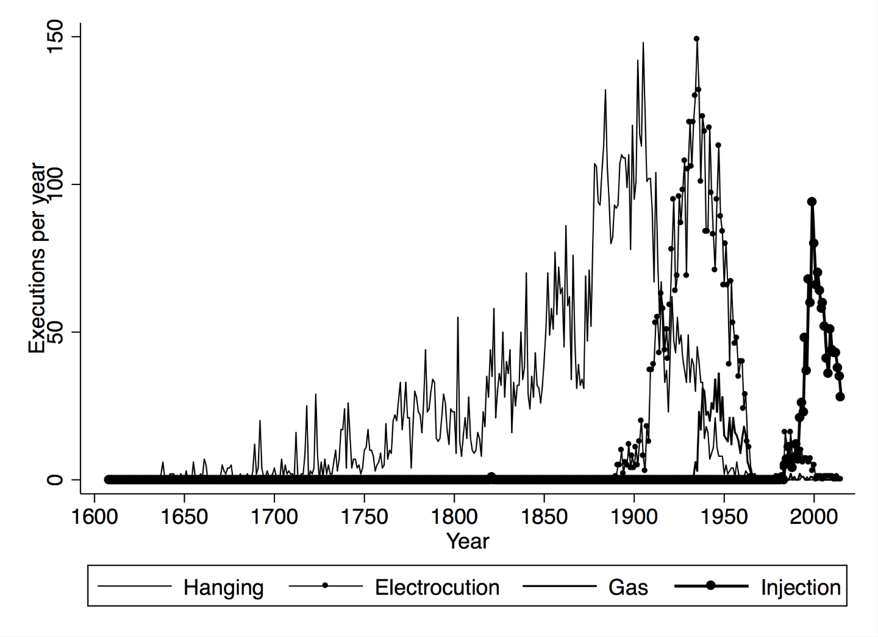
Methods: Hanging was most common once

Slide 3
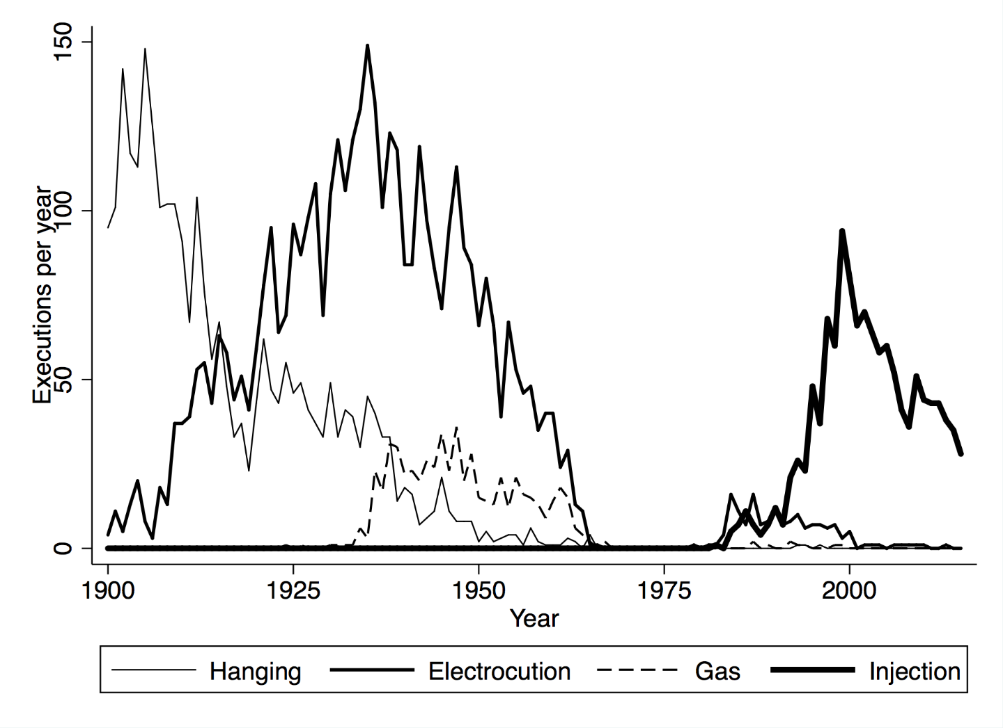
Modern methods: Hanging, then Electric Chair, Gas Chamber, then Lethal Injection

Slide 4
1886-88, State of New York Commission on Capital Punishment
Considering the barbaric state of executions by hanging, review all historical methods known to “civilization” and report back so that the state can carry out executions in the most civilized possible manner
Chair: Elbridge Gerry, grandson of Elbridge Gerry, Gov. of Mass and 5th US Vice-President. Also “Commodore” of the NYC Yacht Club and prominent NYC lawyer, part of the democratic machine of Boss Tweed. Created the NY Society for the Prevention of Cruelty to Children as well.

Slide 5
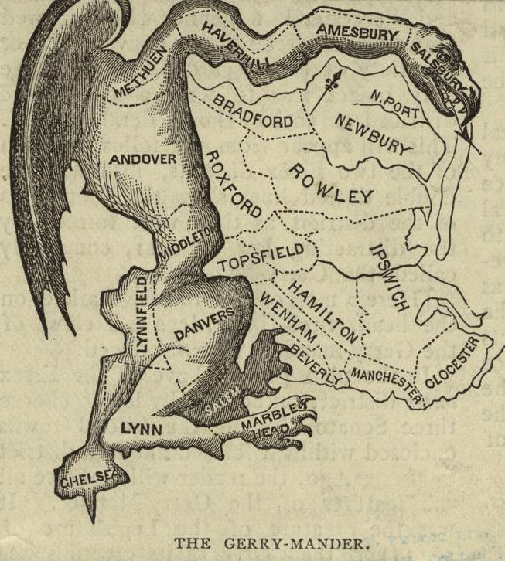
Contributions of the Gerry family to US history
Elbridge Gerry (elder): The original 1821 Gerrymander (first Governor of Massachusetts, 5th VP of the US)
Elbridge Gerry (younger): Chaired the State of New York commission to replace hanging with a more civilized method of execution. The choice: Electrocution

Slide 6
Westinghouse and Edison
No standard, AC or DC, huge commercial competition
Edison losing the “battle of the currents”
He promotes Westinghouse’s system as the ideal way to kill people.
Hopes this will discredit the rival and associate his system with danger.
Guarantees to lawmakers that it will “kill in the 10 thousandth part of a second”
Who is to argue, and they adopt it.
First electrocution in 1890, terrible botch.
More on this in a few minutes with a special guest from Electrical Engineering.

Slide 7
The War of the Currents
George Westinghouse, Nicholas Tesla, and Thomas Edison…
Let’s watch 5 minutes of this video: YouTube: “Nikola Tesla Master of Lighting” : 18:45 to 23:30

Slide 8
Gas Chambers
Pretty obvious how this came into disrepute, after World War 2.
However, it was still used in the 1970s through 1990s
NC death chamber was outfitted with double-pane windows.
A key problem for engineers and architects was how to have these rooms inside prisons, but ventilate all the toxic gas out of the building without exposing anyone to it…
Another problem was watching someone suffocate is unpleasant: they fight for breath, heave, and strain against the restraints…
Eventually this method was abandoned as well.

Slide 9
Lethal injections
Oklahoma medical examiner, let’s improve on the electric chair
3 drug cocktail
Sedative
Paralytic agent (stop all muscle movement, such as twitching, grimacing)
Stop the heart
Some key questions
If #1 fails, but #2 works, how would we know if #3 caused undue suffering?
What is the point of #2 anyway? Certainly not for the inmate’s benefit.
The Medicalization paradox

Slide 10
Post-mortem study of amount of anesthetic in the blood (Figure 10.4, from The Lancet)

Slide 11
Back to the firing squad?
We have never gone backwards.
Each generation has declared finding a higher level of civilization compared to previous ones: electrocution, gas chamber, lethal injection.
None has proven immune to botched application
(No one has much practice, after all)
For the Court: Isolated mishaps must be distinguished from systematic torture
Lethal injection:
No doctors, so can a prison guard do it?
No drug imports, so can states get them from just anywhere?
Very hard to regulate a medical procedure if no doctors involved…

Slide 12
NC: Restoring Proper Justice Act, 2015
https://www.ncleg.gov/Legislation/SummariesPublication/Summary/2015/7/H774-SMTJ-135(sl)/
https://www.ncleg.gov/enactedlegislation/statutes/html/bysection/chapter_15/gs_15-190.html
“For purposes of this section, a "medical professional other than a physician" means a physician assistant, nurse practitioner, registered nurse, emergency medical technician, or emergency medical technician-paramedic who is licensed or credentialed by the licensing board, agency, or organization responsible for licensing or credentialing that profession.”

Slide 13
Legal paradoxes
Clearly, if there is a death penalty, there must also be a constitutionally permissible manner to carry it out.
USSC justices arguing in support of the death penalty make the reasonable point that logically, one cannot eliminate all forms of death, since we have a death penalty.
Large-caliber bullet to the head: That would ensure a very fast death. But it would be gruesome, ugly, and messy, not “civilized”…
States are proposing such things as nitrogen gas hypoxia
How to try out new methods without human experimentation?
Our search for a painless form of death has generated a paradox.

