Slide 1
POLI 203, Results from the McGautha Quiz
We had 335 responses to the McGautha quiz, due last Friday
Here I review the results
March 29, 2020

Slide 2
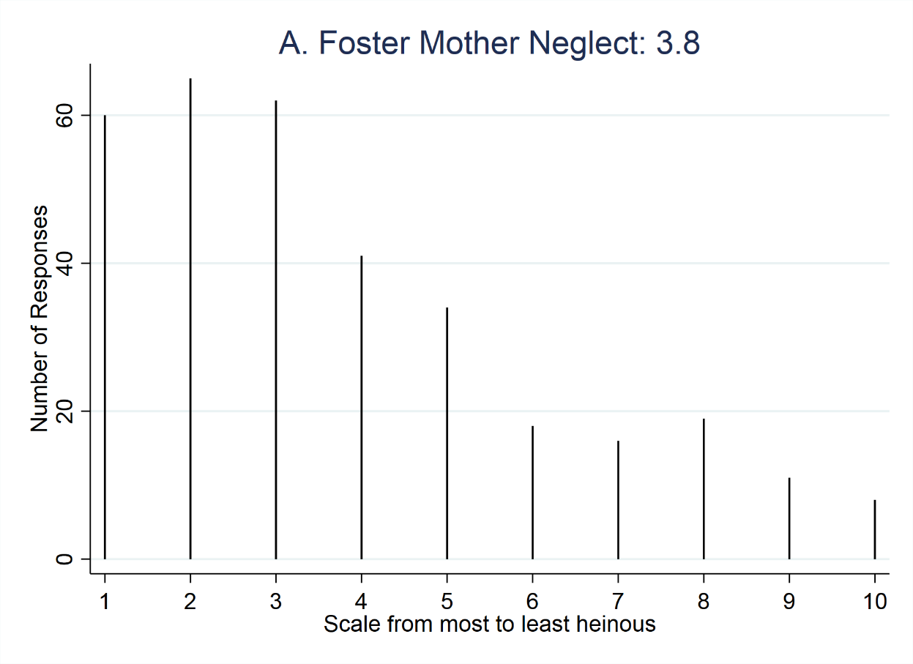
A. Foster mother neglect
A middle-aged woman with no substantial criminal record completely neglects a 3-year-old child who is placed with her for foster care, for which the foster mother receives a stipend sufficient to care for the child. The foster mother spends the stipend on her opioid addiction rather than the child, and the child slowly starves to death over a period of months.

Slide 3
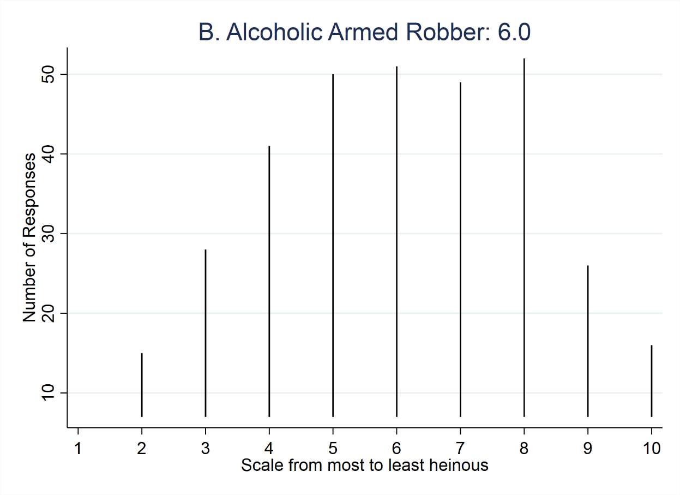
B. Alcoholic armed robber
A 30-year-old alcoholic with a substantial record of theft offenses commits an armed robbery of a liquor store. When the store clerk reaches for the alarm button, the defendant shoots him once in the chest, killing him.

Slide 4
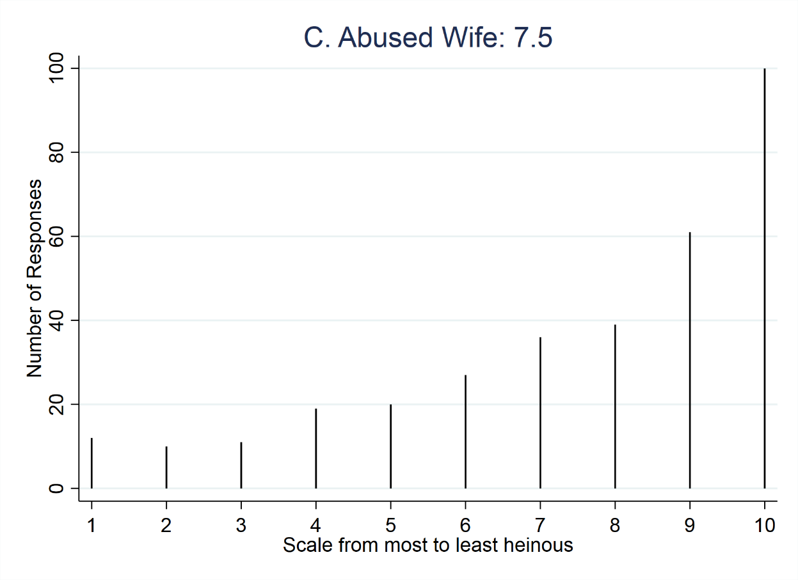
C. Abused wife
A woman who has been repeatedly physically abused by her husband (that is, badly beaten up, but not to the point of being in danger of death) hires a hit man, who kills her husband. The defendant to be sentenced is the wife.

Slide 5
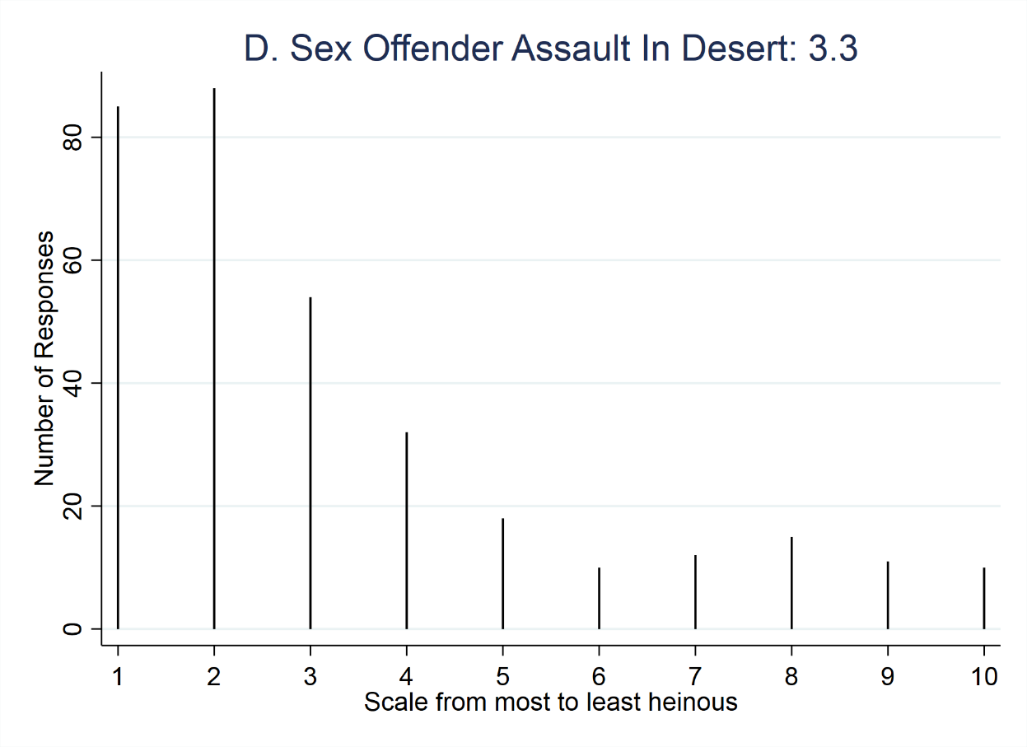
D. Sex offender rape in desert
A repeat sex offender—a 25-year-old of low intelligence (though not intellectually disabled) who was himself sexually abused as a child—kidnaps a college-age woman, drives her into the desert, and then rapes her, beats her, and leaves her there. She dies of exposure to the elements when she can’t find her way out of the desert before nightfall.

Slide 6
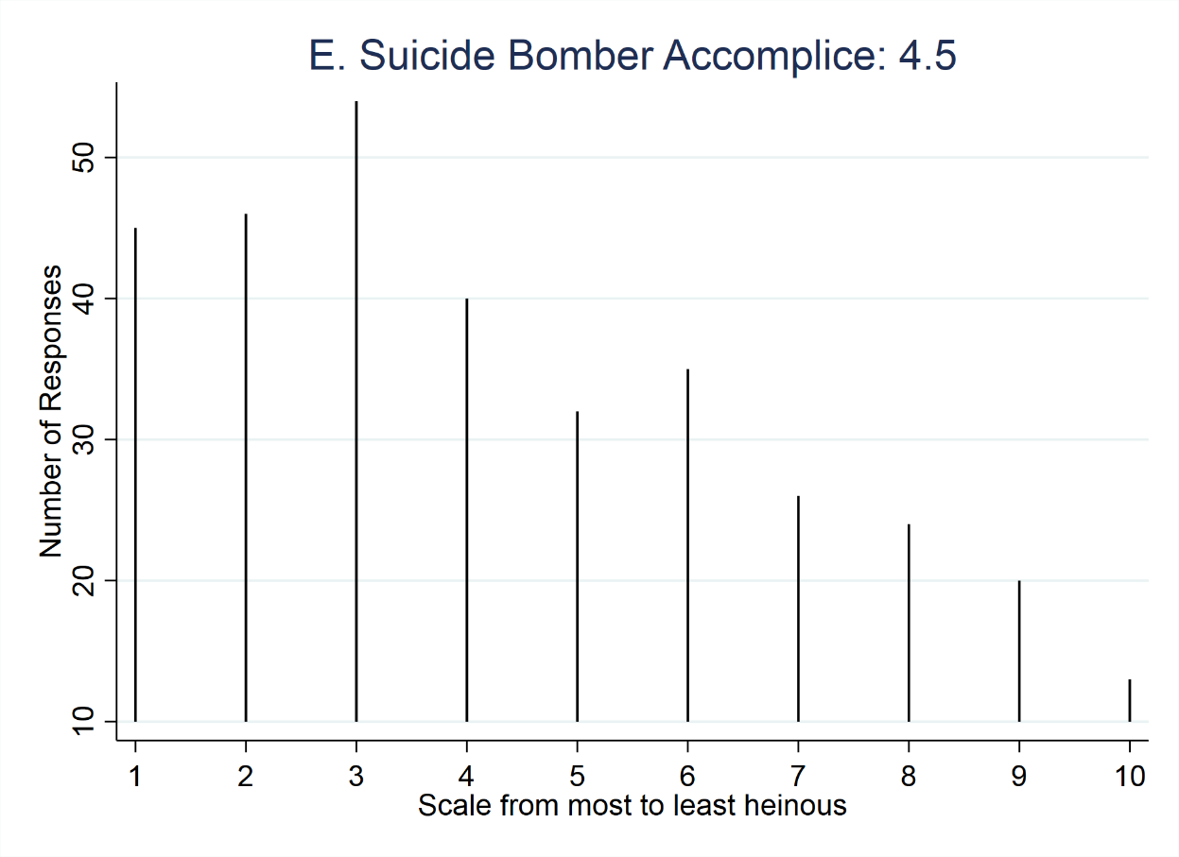
E. Suicide bomber accomplice
A suicide bomber detonates a bomb in a public place, killing 5 and injuring 12. Although the bomber himself is killed in the attack, the members of the radicalized religious “cell” who helped to plan the attack and make the bomb are arrested. They are two men in their late 20s and one 19-year-old, who has no prior record of adult or juvenile offenses. The defendant to be sentenced is the 19-year-old.

Slide 7
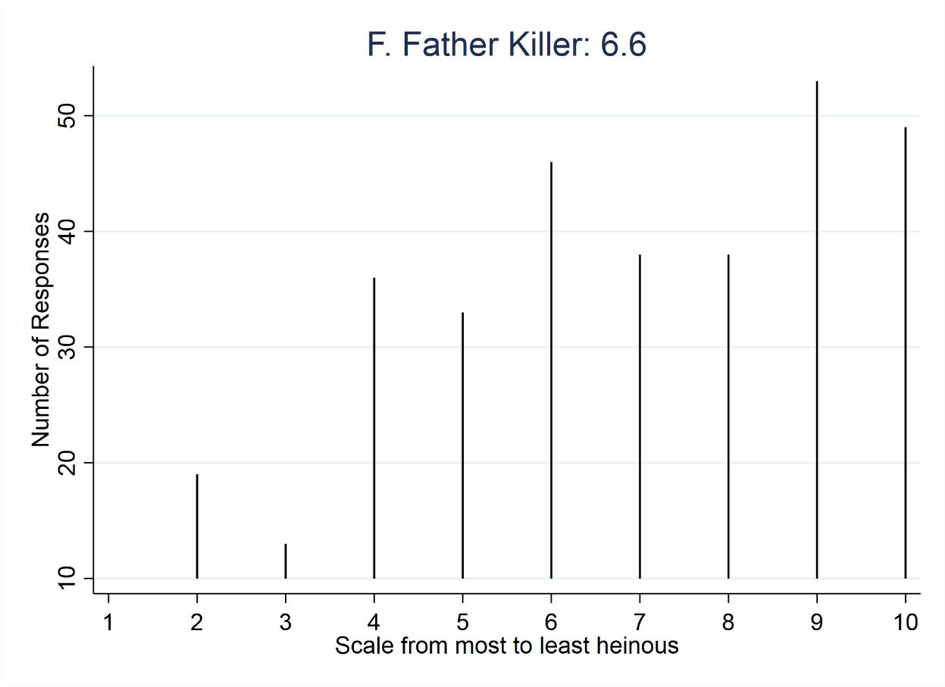
F. Father killer
A middle-aged man with no criminal record kills his elderly father who is in a permanent vegetative state in order to inherit his father’s estate.

Slide 8
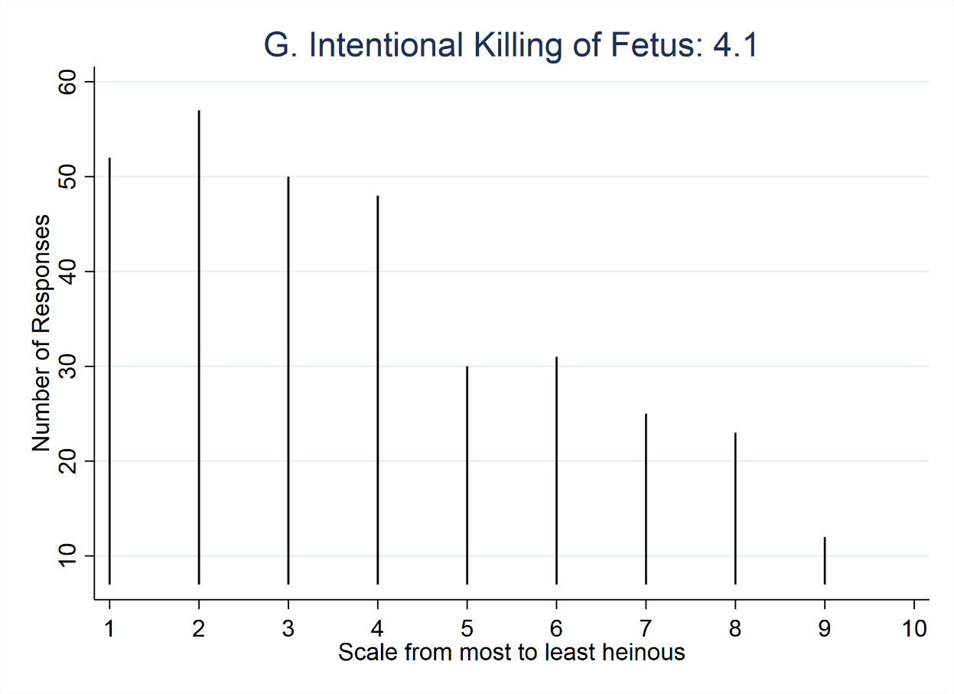
G. Intentional killing of fetus
A man beats up his pregnant ex-girlfriend with the express intent of killing her unborn child by another man, with whom she is 8-months pregnant. The mother lives, but the fetus dies. Note: this prosecution takes place in a state that designates the intentional killing of a fetus without the mother’s consent as first-degree murder.

Slide 9
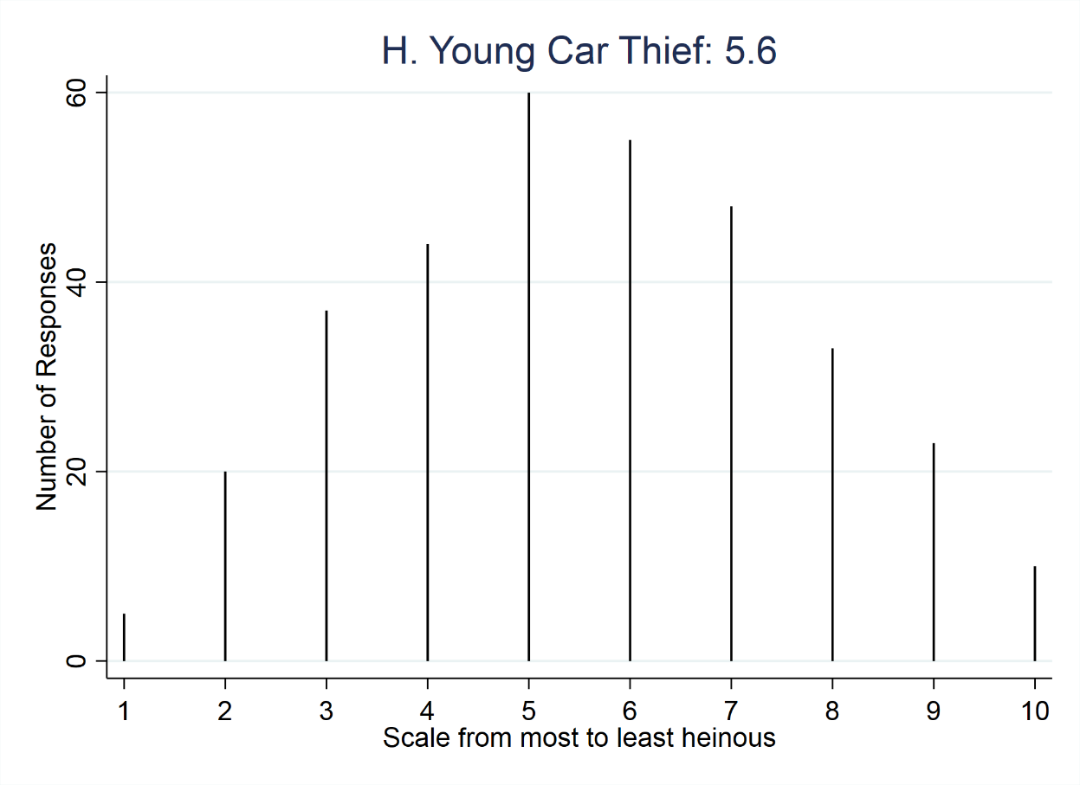
H. Young car thief kills police officer
An 18-year-old car thief is driving a stolen car when he is stopped by the police. When the officer approaches the driver-side window, the defendant shoots him. The defendant has a juvenile record of theft, assault, and weapons possession.

Slide 10
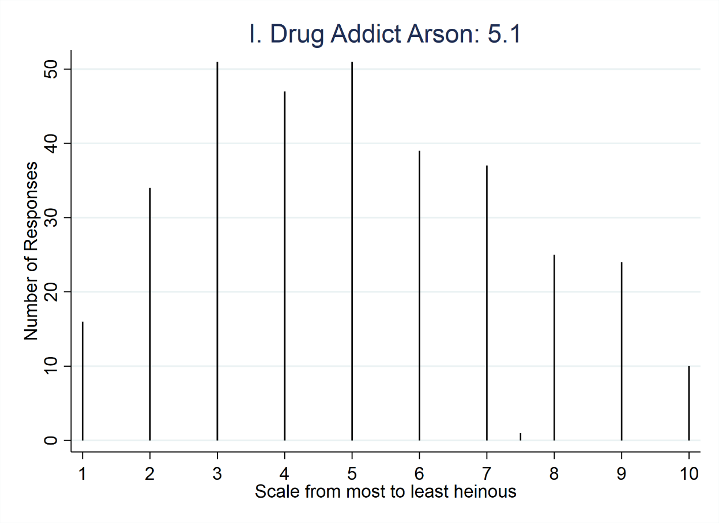
I. Drug addict arson
A drug addict burns down the triple-decker home that he inherited from his parents for the fire insurance. Four members of the family that rented the apartment on the third floor die in the fire. The defendant knew that the rental unit was occupied, but it’s not clear whether he knew that the renters were home at the time of the arson.

Slide 11
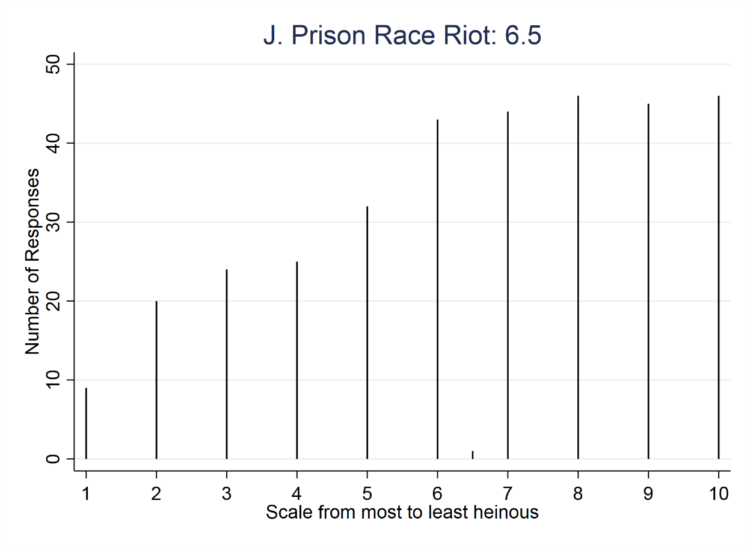
J. Prison race riot
A large-scale fight breaks out between warring racial gangs in prison, during which a white supremacist gang member kills a Hispanic gang member. The defendant was serving time for armed robbery at the time of the riot.

Slide 12
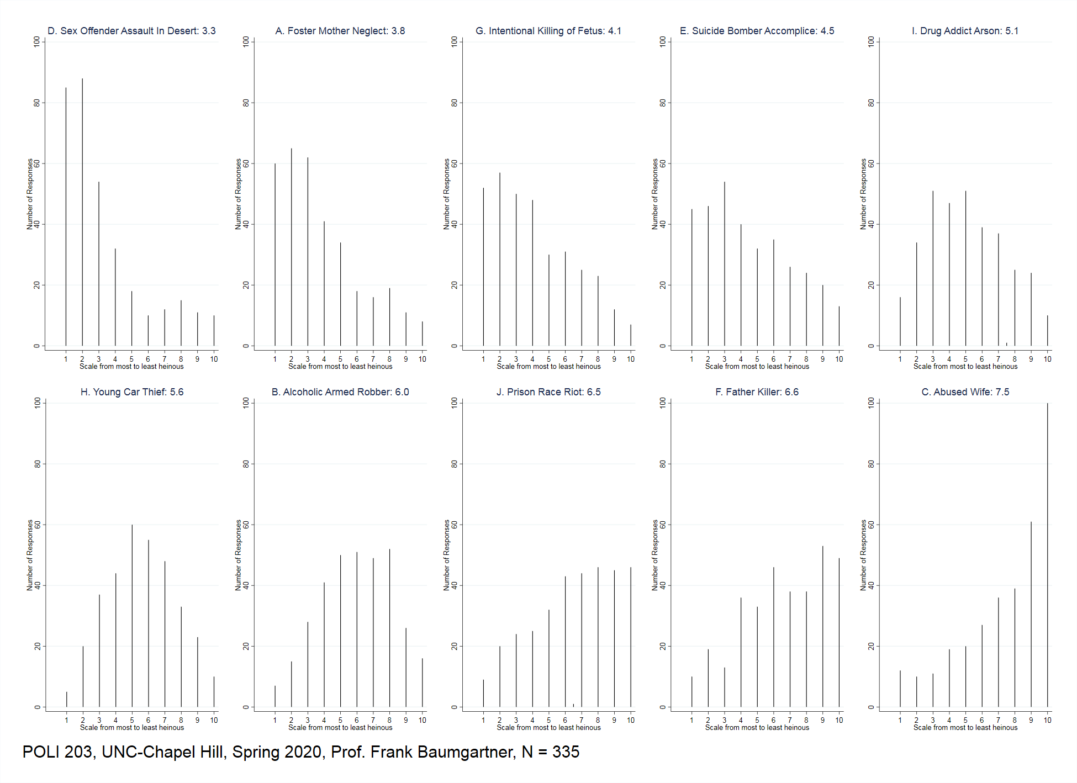

Slide 13
How to interpret?
On the one hand, we can tell that #3 (sexual assault and abandonment in the desert) and a few others skew left in the results: More of you thought these were extremely heinous than not.
Similarly, a few of the items skew right, indicating you collectively considered them to be among the least heinous.
However:
Every case had someone, generally many people, coding the case in each position from 1 to 10. That is, the FULL RANGE of responses occurred FOR EACH SCENARIO.
More generally, the range of responses is very wide.
Even in the case seen by most of you as most heinous, only about 85 of you rated that as the most heinous of the 10 scenarios; many more rated some other case as the most severe. Similarly in the abused wife case, the single one with the most consensus, just 100 out of 335 rated it the least deserving.

Slide 14
Two possibilities, one optimistic, one not. Here’s the optimistic side.
The law does not require sentencers (generally jurors, but sometimes judges) to rate different crimes; it only requires that the sentence choose between life and death. Maybe this is an easier call.
In an actual case, there would be LOT of information about the crime, the victim, and the offender. In fact, there would be an entire penalty phase designed only to look at these factors. (But: in Texas and Oregon, the question of future dangerousness would play a more important role.)
In an actual case, the judge would give some guidance about the law.
So, maybe we can have a reliable system.

Slide 15
What about the pessimistic side:
Following McGautha, the state can list the aggravating circumstances, but the list of things people can use as mitigators is not limited. Anything can be used. That might sound good, since it leads to “mercy”, but what if they apply that mercy only to certain kinds of people, and not others?
Texas and some other states do not explicitly call for an assessment like this. Rather it’s just: does the crime qualify; and is the defendant a future danger?
Generally, these results show you do not collectively agree very much even on a simple exercise on what crime is worse than another…

Slide 16
No wonder that:
Some get death and some do not, and it’s hard to figure out why.
Some get 1st degree, some 2nd degree, some manslaughter, and so on.
Recall that in the 1990s, a DA in Winston-Salem sought the death penalty against a drunk driver. It went all the way to conviction and the penalty phase, when the jury decided for life, not death. But, in most cases, a drunk driving case would be manslaughter, not first degree murder…
My point in this exercise: The many ambiguities of “who deserves death” can also be expanded to the many different levels of charging and convicting. Each is associated with a vastly different punishment.
Honest people doing their level best could not do this perfectly. Rather, there is a lot of wiggle-room in the system. That sounds fine until you think of what the stakes are.

