Slide 1
Deadly Justice, Ch 3-4
Understanding the US Epidemic of Homicides
Comparing Homicides with Execution Cases
Includes an update of the data through 2021.

Slide 2
Where do these statistics come from?
Centers for Disease Control
Whenever a person dies, a “death certificate” lists the cause of death
Hundreds of causes of death: pneumonia, heart attack, etc. Several fall into the category of “homicide”
These are aggregated by county and state
After 1995, privacy controls stop distribution of county except for largest counties. Gggrrrr! Frustrating to people like me who want good stats…
Good: Every death. Bad: no information about who killed them. Also, listed by county of residence of the person, not necessarily where they passed away.
FBI
“Supplemental Homicide Reports” – lists data on offender, victim, nature of the crime, etc. Great stuff, but often missing.
If the crime is not solved, no data.
If the local police department forgets to send in the form, no data.

Slide 3
Updates
FBI data now through 2019
Executions data through to Dec 31, 2021
Currently collecting 9,000 observations on all death sentences; this is very complete for offenders, but not victims.

Slide 4
Comparing FBI homicides stats with execution cases. FBI data through 2019; Execs through 2021.
Label | FBI | FBI DS States Only | Executions | Executions per 100 Homs, DS States Only
Total by Offenders | 829,305 | 714,076 | 1,538 | 0.215
By Offender Gender --
Female | 68,920 | 59,964 | 17 | 0.028
Male | 537,369 | 466,507 | 1,520 | 0.326
By Offender Race --
Black | 298,969 | 255,344 | 528 | 0.207
White | 224,026 | 194,951 | 860 | 0.441
Total by Victims | 874,016 | 752,377 | 2,402 | 0.319
By Victim Gender --
Male | 688,369 | 593,198 | 1,227 | 0.207
Female | 184,337 | 158,056 | 1,175 | 0.743
By Victim Race --
Black | 410,171 | 341,945 | 375 | 0.110
White | 337,670 | 294,489 | 1,804 | 0.613
By Victim Race and Gender --
Black Male | 342,688 | 284,441 | 196 | 0.069
Black Female | 67,417 | 57,449 | 180 | 0.313
White Male | 240,480 | 211,358 | 889 | 0.421
White Female | 97,111 | 83,070 | 916 | 1.103
By Offender-Victim Race Combinations --
Black kills Black | 245,856 | 209,403 | 183 | 0.087
White kills Black | 19,685 | 17,027 | 23 | 0.135
White kills White | 193,103 | 168,037 | 807 | 0.480
Black kills White | 41,628 | 35,805 | 312 | 0.871
Black male kills White female | 9,684 | 8,250 | 160 | 1.939

Slide 5
Homicides / Execution Comparisons
Offender Race: gets whiter…
Offender Gender: gets maler…

Slide 6
Homicides / Execution Comparisons
Victims get whiter…
Victims get more female…

Slide 7
Black male victims severely under-represented; white female victims strongly over-represented…

Slide 8
Who is over-represented? B-W, W-W; Who is under-represented? W-B, and B-B. Race of victim dominates…

Slide 9
A summary of the odds of execution, given demographic characteristics of the crime.

Slide 10
Deaths: 2.5million per year, homicides: 10-25k; gun-related homicides: 5-15k (CDC data)

Slide 11
Since 1972
100,000,000 deaths
900,000 homicides
600,000 gun-related homicides

Slide 12
US rate per population compare to others. We’re so much more violent than other OECD countries

Slide 13
These differ a LOT by: place, and by demographics. Some homicide rates compared, 2019
City | Chapel Hill | Durham | New Orleans | New York City | Baltimore
Population | 60,000 | 263,000 | 393,000 | 8,623,000 | 620,000
Homicides | 1 | 41 | 119 | 299 | 348
rate per 100k | 1.7 | 16 | 31 | 3.5 | 56

Slide 14
From Table 3.2: Homicide rates per 100,000
US total: about 5 per 100,000.
New Orleans: 70
St. Louis: 48
DC: 44
Baltimore: 44
Richmond: 42
Detroit: 29
Reference: Most violent countries in the world: Honduras (84); El Salvador (40); S. Africa (32); Colombia (32); Brazil (26).

Slide 15
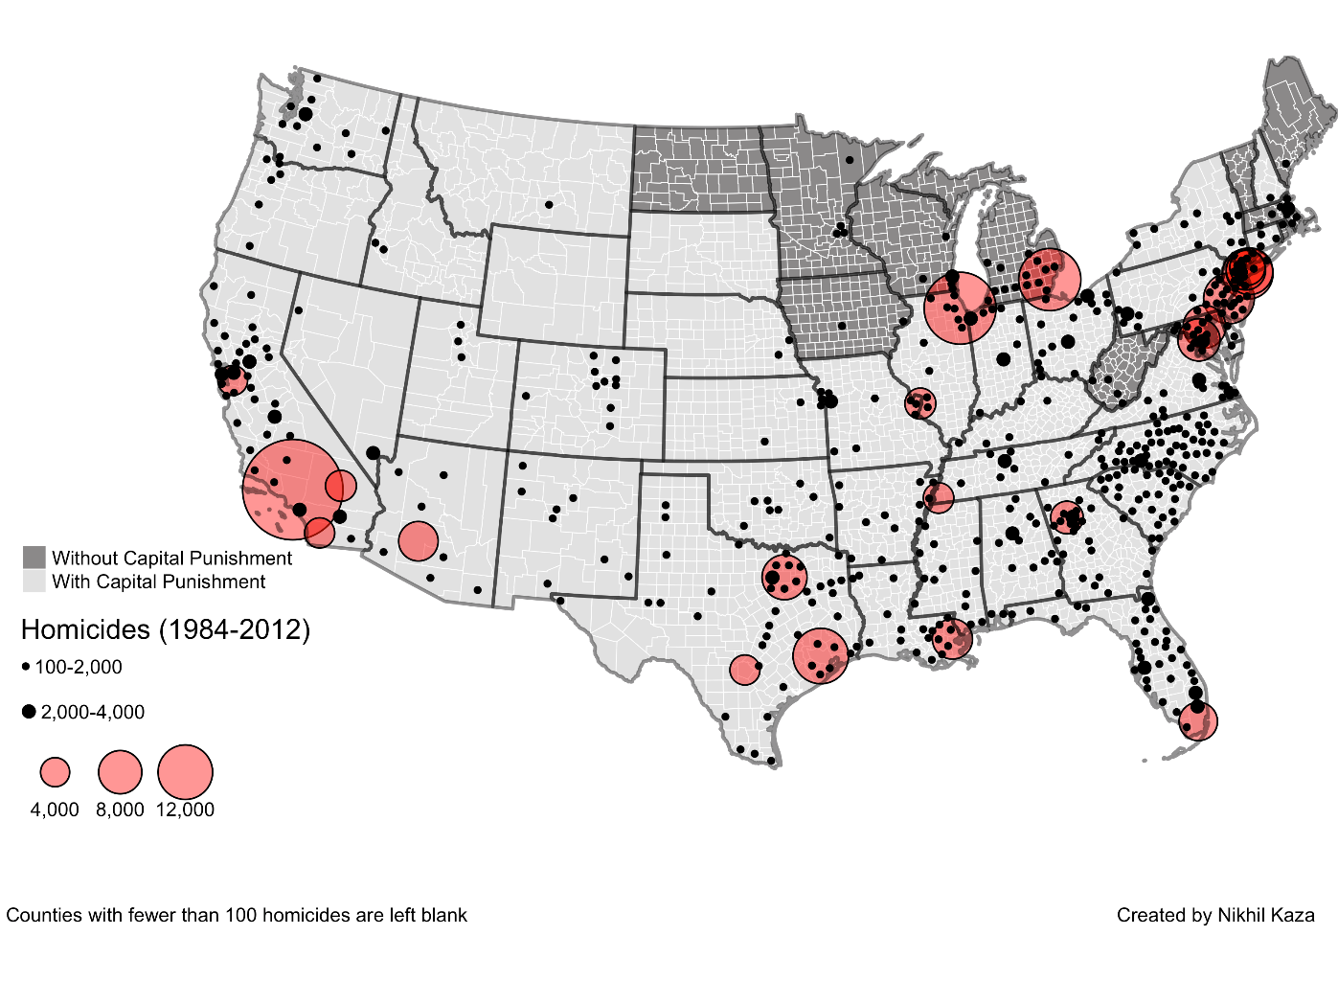

Slide 16
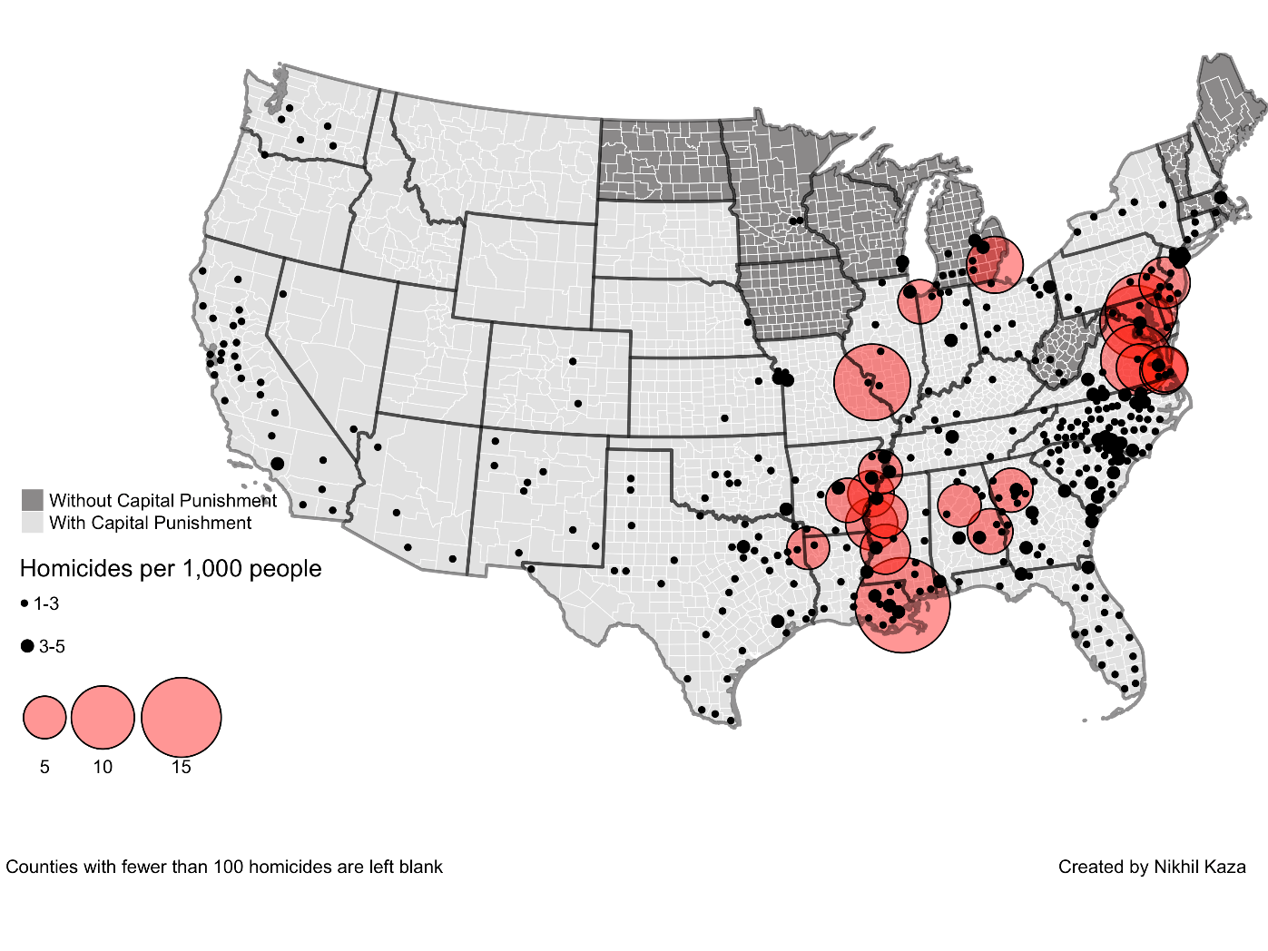

Slide 17
Racial breakdown of who dies, and who dies by homicide (males, blacks more likely)

Slide 18
Homicides tend to be: Male, within race, and there is a higher rate among blacks, both as offenders and as victims
Offenders
Victims

Slide 19
Who kills whom? Killers tend to be men, and they kill people of their own race, typically also men.

Slide 20
Homicide victimization varies not just by geography, but by demographics, as well. Black male victims of homicide, by age, wow.

Slide 21
A summary
Very high rates across the US.
Dramatic increase from 1960s to 1980s, big decline since mid-1990s.
New Orleans, some other hot-spots, crazy rates of homicide..
But homicide is very rarely random. Typically the people know each other, and typically they are from similar social backgrounds.
A young man’s game. Both offenders and victims are young men.
Generally (80-90 percent), within race. Generally male victims.
Target homicide victim: young black men.
(Their killers, however, are rarely targeted for capital punishment.)

Slide 22
Chapter 4: OK, we know about homicides; which of these lead to executions?
Data from Chapter 3 from FBI crime reports, and a summary database linking victims and offenders. Obviously, those require the police to be involved, and the victim-offender data require the crime to be solved.
This chapter: comprehensive database on all executions. Same as the DPIC database. https://deathpenaltyinfo.org/views-executions
For each person executed, who was their victim? Who were they?

Slide 23
Some drawbacks / caveats / imperfections
Executions are only a small fraction of death sentences, and some states have lots of death sentences but few executions.
Many homicides are not capital-eligible.
But: things correlate over time (e.g., more homicides = more capital eligible homicides); other studies with more detail confirm the same patterns; this approach is completely comprehensive and intuitive: all homicides v. all executions.

Slide 24
OK, the simple statistics
See also this article for a breakdown state-by-state:
Baumgartner, Frank R., Emma Johnson, Colin Wilson, and Clarke Whitehead. 2016. These Lives Matter, Those Ones Don’t: Comparing Execution Rates by the Race and Gender of the Victim in the US and in the Top Death Penalty States. Albany Law Review 79, 3: 797–860. http://www.unc.edu/~fbaum/articles/TheseLivesMatter-AlbanyLawReview2016.pdf

Slide 25
By Race and Gender of the Victim
Race
Gender

Slide 26
Executions as percent of homicides, by race and gender of victim

Slide 27
Whites rarely executed for killing blacks… (See Table 4.3)
Offender | Victim
 | White Female | White Male | Black Female | Black Male | Total | White | Black | Percent White
WF | 1 | 9 | 0 | 0 | 10 | 10 | 0 | 100.00
WM | 317 | 401 | 9 | 11 | 767 | 718 | 20 | 97.29
BF | 1 | 0 | 0 | 3 | 4 | 1 | 3 | 25.00
BM | 121 | 162 | 64 | 99 | 478 | 283 | 163 | 63.45
Total | 473 | 623 | 78 | 120 | 1,422 | 1096 | 198 | 84.70
White | 318 | 410 | 9 | 11 | 777 | 728 | 20 | 97.33
Black | 122 | 162 | 64 | 102 | 482 | 284 | 166 | 63.11

Slide 28
Multiple victims
Timothy McVeigh was white, and he had black victims. But he had 163 victims, and it just so happened that some were black. It was not a racial crime; it was an attack on the federal government…
20 whites have been executed for killing blacks… Think about that.
Among those with just a single victim, the number is even lower. Without going into the horrific details, these tend to be crimes of explicit racial animus: KKK, Aryan Nations, things like that.
Without explicitly claiming racial hatred (like Dylan Roof), it is almost statistically impossible for a white to be executed for killing a black…

Slide 29
In many states, it has never happened…
Louisiana: 61 percent of homicide victims are black males
Execution rates per 1,000 homicides:
Black male victim: 0.24
Black female victim: 2.06
White male victim: 3.01
White female victim: 11.52
Last execution of a white for killing a black: … drum roll… 1752. Under French rule.
Baumgartner, Frank R., and Tim Lyman. 2015. Race-Of-Victim Discrepancies in Homicides and Executions, Louisiana 1976-2015. Loyola University of New Orleans Journal of Public Interest Law 17: 128-44.

Slide 30
Female killers executed (Table 4.4)
16 females executed (the first was here in NC: Velma Barfield, aka the “black widow”). (Women: 10 percent of killers, but 1 percent of executed)
Together, they had 21 victims
Of these victims, only 4 were “strangers” The vast majority were:
Husband / partner
Child
Our greatest fears, toughest sanctions:
Man who attacks a random white female, especially if the killer is black male
Woman who kills her husband or child
Therefore, it’s logical to think that the opposite groups are under-valued:
Man who kills a spouse or acquaintance
Anyone who kills a black victim, especially if the killer is white

Slide 31
The patterns are pretty dang clear. There is a hierarchy of which cases are likely to lead to execution:
The hierarchy of victims
The hierarchy of offenders
White female
White male
Black female
Black male
Black male
White male
Black female
White female

Slide 32
Other things that increase the odds
Crime occurs in Houston TX
Crime occurs in another jurisdiction that is active (more on this in Chapter 6)
Crime occurs in the 1980s
You have a bad lawyer
You have other vulnerabilities (e.g., mental capacity, mental illness)
Your case generates media coverage
You are portrayed as an animal, a savage, a “predator” (Note: OJ Simpson was never even considered, though he was black and was charged with a double-murder of whites, with a knife. But he was too well known, could not be “othered” – everyone felt they knew him…)

Slide 33
“Garden-variety” v. “particularly heinous” murders
Inevitably, capital punishment, if not to be the automatic punishment for homicide, requires the creation of two classes of victims, or of homicides.
One class is “lower” – garden variety
One class is “higher” – more serious, worthy of the greatest punishment
Very difficult to make this distinction. Particularly given McGautha: no clear instructions!

