Slide 1
Deadly Justice Ch 5:
Is The Death Penalty Reserved for the Worst of the Worst?
POLI 203, January 31, 2022
Guest lecturer: Arvind Krishnamurthy
PhD candidate at Duke, and co-author of Deadly Justice

Slide 2
Are Those Who Are Executed Systematically Worse Than Those Who Are Not?
A key flaw noted by the Justices in Furman was that the death penalty was not systematically reserved for the “worst of the worst”
There is too much caprice or arbitrariness in who is actually selected for a death sentence

Slide 3
So What Changed?
The Court suggested a plan of “Guided Discretion” following Furman/Gregg.
Specifically, the Court wanted a quantitative narrowing of cases, so only a few cases qualified as death eligible, and a qualitative difference between those capital sentence crimes and those that are not capital sentence.
This led to aggravating factors that made a homicide or crime death eligible.

Slide 4
Aggravating Factors
These are additional factors that make some homicide eligible for a death sentence.
Specifically, the state needs to prove that these factors are present in the given crime, and often do so using witnesses or specific testimony.
They are meant to meet those quantitative narrowing and qualitative differentiating the court laid out

Slide 5
Did The Aggravators Actually Narrow Things

Slide 6
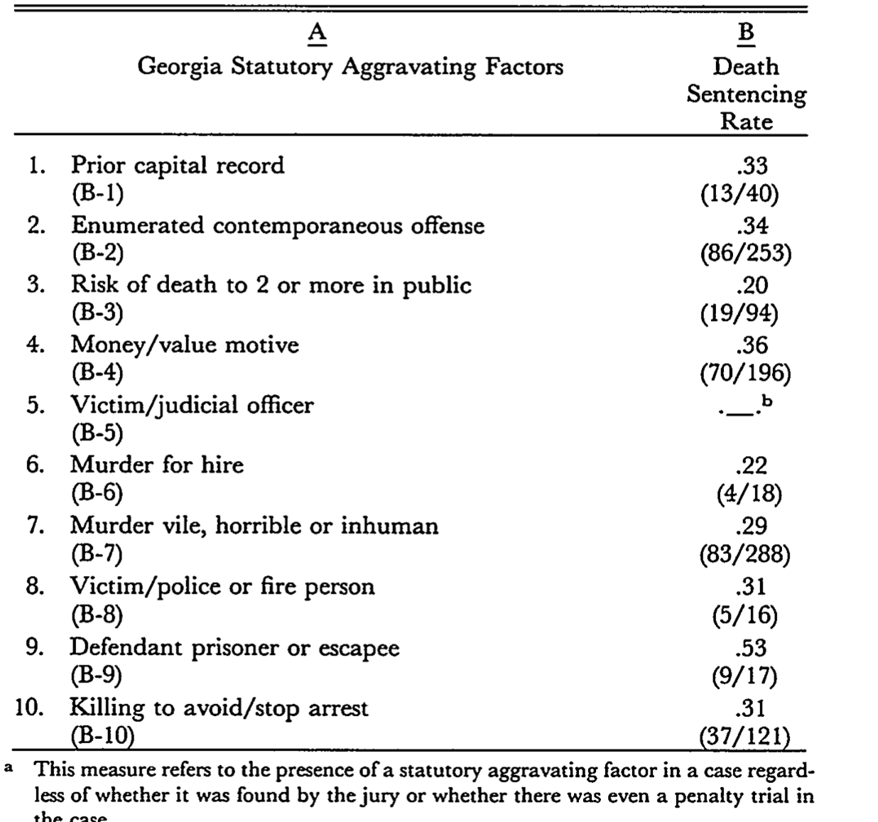
For an example, look at Baldus’s Study of (GA)
Baldus, David C., Charles Pulaski, and George Woodworth. "Comparative review of death sentences: An empirical study of the Georgia experience." The Journal of Criminal Law and Criminology (1973-) 74, no. 3 (1983): 661-753.
Approach: Baldus takes 594 sentencing decisions in post Furman Georgia.
463 /594 were death eligible (79%)
Of those 463, 100 (22%) actually received a death sentence

Slide 7
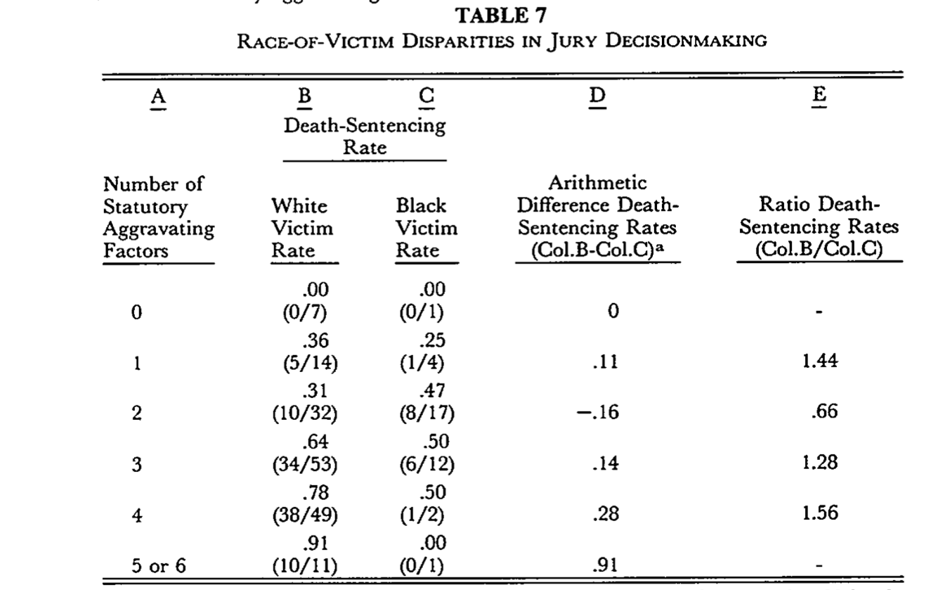
Is it Juries or Prosecutors?

Slide 8
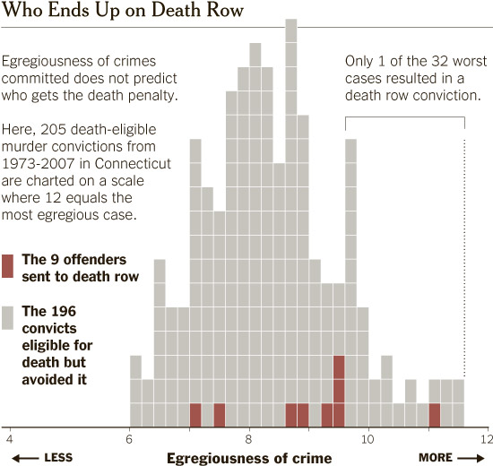
Similar Story in Connecticut..
Donohue III, John J. "An Empirical Evaluation of the C onnecticut Death Penalty System Since 1973: Are There Unlawful Racial, Gender, and Geographic Disparities?." Journal of Empirical Legal Studies 11, no. 4 (2014): 637-696.

Slide 9
Responses to Baldus..
These studies have consistently found that legally relevant factors matter….but so do legally IRRELEVANT factors like the race of the offender and victim.
But courts have a very specific approach to defining what constitutes evidence of say, discrimination
McCleskey v Kemp
You must prove specific intent to discriminate against a given defendant, rather than prove patterns of discrimination or inequality in application.

Slide 10
Why Didn’t The Aggravators Narrow Eligible Offenses?
1) Because aggravating factors are overly broad, vague and ambiguous
2) There are a large number of aggravating factors within each state

Slide 11
Common Aggravators

Slide 12
Compare that to common mitigators…

Slide 13
Vague / Broad Aggravators
The court in Gregg said that the death penalty needed to be narrowly targeted
But instead, the ambiguity present allows prosecutors substantial discretion…
But the aggravators are particularly vague and subjective
“Risk to many?”
“Heinousness”
“For personal or pecuniary gain”

Slide 15
But Capital Eligibility Criteria Are Not Just Vague…
They are also idiosyncratic
Sometimes remnants of historical circumstances
And do not target “worst of worst” crimes

Slide 19
Takeaways
1) In Furman the Court said that 20% of death eligible cases receiving the death penalty allowed for too much caprice.
2) But overly vague, broad and idiosyncratic aggravating factors determine death-eligibility, meaning the pool of cases is not meaningfully narrowed.
3) Instead substantial prosecutorial and judicial discretion is introduced into the criminal legal system through these aggravators
4) This lays the framework for a decision making process where social, racial, economic and gender biases are likely to occur

