Slide 1

Race Effects, part II
Plan for the day:
Catch-up on race as well as discussion of LWOP
Foreshadow the assignment for Wednesday
Note, no travel for me to Kansas, completely unclear what will occur; I will let you know.
April 11, 2022

Slide 2
Read up for Wednesday
We’ll discuss the Life Without Parole paper.
I also want you to review the NC punishment grid and all the ways you can break the law here in NC. (Remember, ignorance of the law is no excuse!).
See class website for spreadsheets and the grid. Each crime is associated with a “Class”, and each Class is associated with a punishment (e.g., how many months in prison will you be sentenced to if you are convicted of that crime). Spend 30 minutes with this before class on Wed.

Slide 3
Object of attention > cognitive response
When you think of a particular object, be it a political leader, a policy issue such as gun control, abortion, climate change, or whatever it may be, you think of various attributes.
Photos and visual cues can affect this very powerfully, not just words.
Some common visual cues in politics:
  Nice suits and ties; flags; good (preppy) grooming; professional attire
  Flags, flags, flags, patriotic images, families, children, farmers, haystacks, etc.
  Or: chaos, strife, anger, etc.
Useful to think of the power of these visual cues.

Slide 4
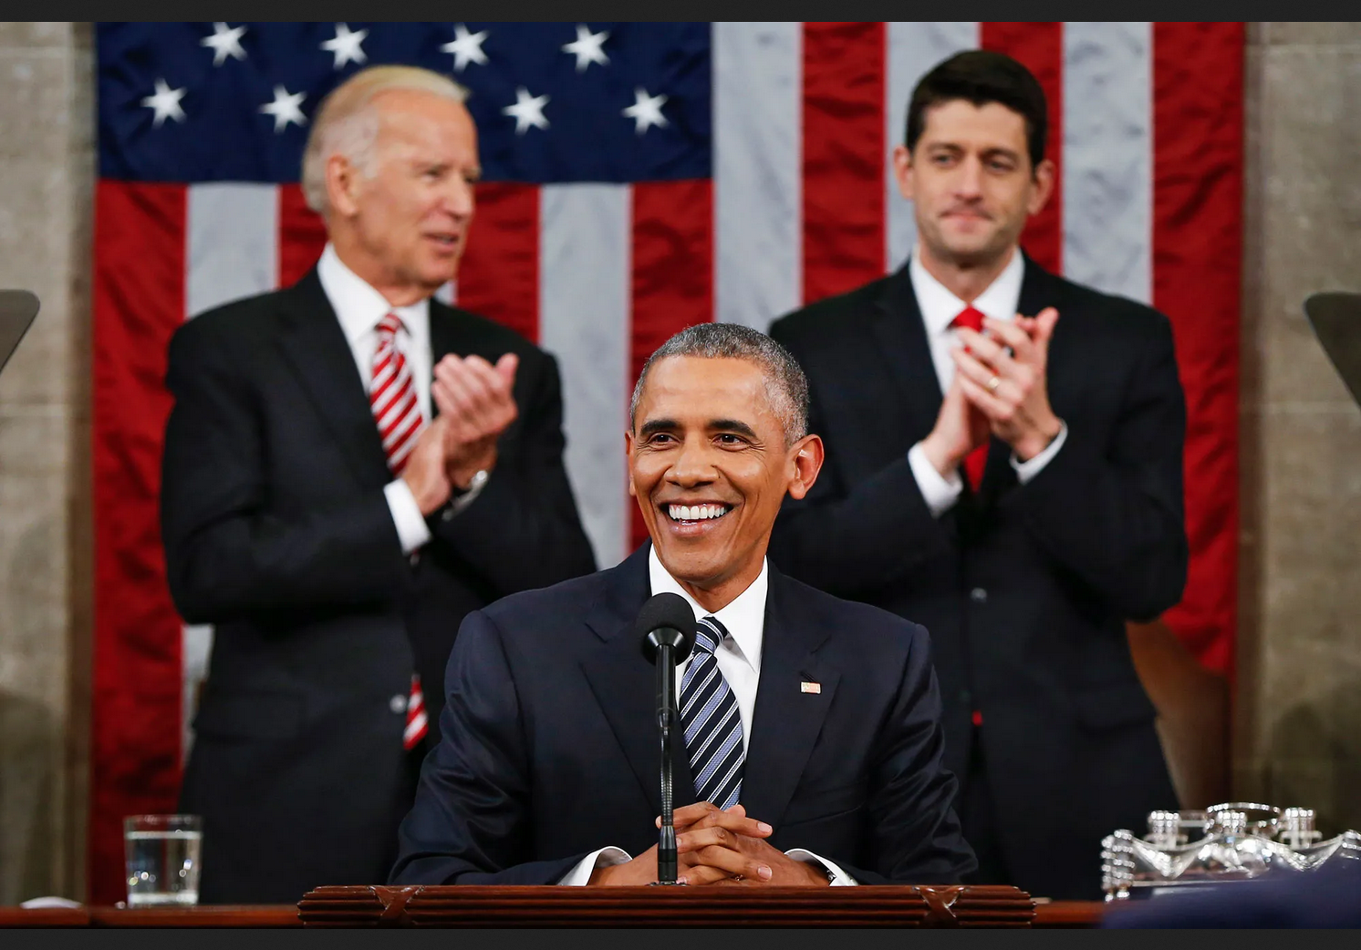
Politicians never leave these images to chance

Slide 5
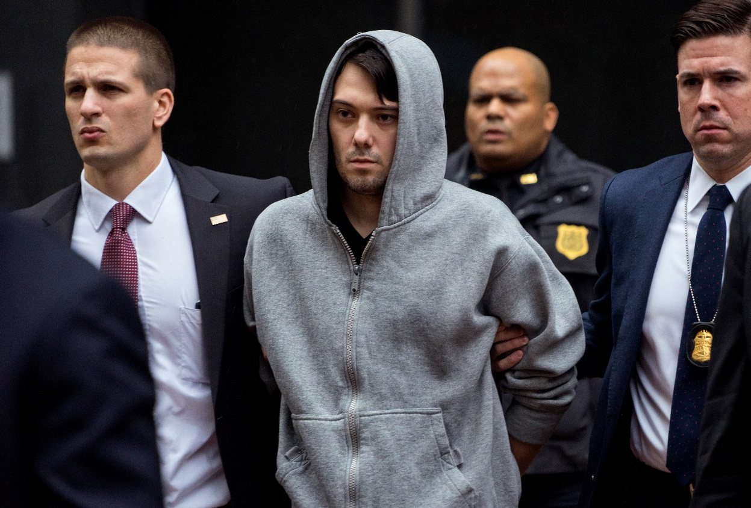
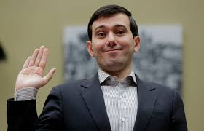
Martin Shkreli, no good PR here; (“pharma boy”)

Slide 6
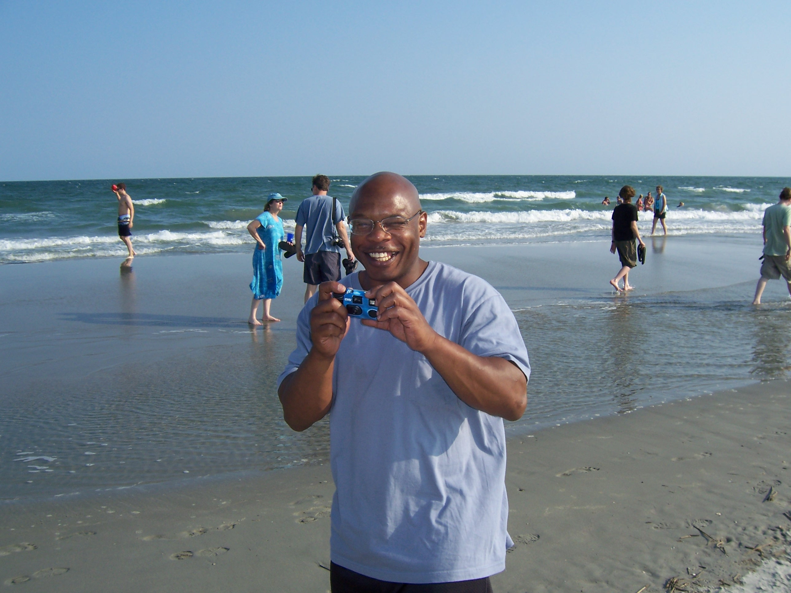
Ed Chapman’s “perp” photo, then after he was released.

Slide 7
The power of visual images
Most studies of framing focus on text, words
But think of photos; they convey a lot of information
Certainly a good research project would be to analyze widely shared photos, particularly of cases involving the police, criminal investigations. The DA typically releases certain photos or stages a “perp walk” where photos can be taken…
Feel free to use / analyze images in your papers, if appropriate. What images show up in the paper? How are victims of police shootings portrayed by their supporters and by the authorities? Which images do mainstream news outlets pick up?

Slide 8
Rattan, Levine, Dweck and Eberhardt
Who is a juvenile, who is an adult?
These are psychologists, so they did an experiment…
Main questions:
‘‘To what extent do you support life sentences with no possibility of parole for juveniles when they have been convicted of serious violent crimes (in which no one was killed)?’’ (not at all ‘‘1’’ – extremely ‘‘6’’).
‘‘How much do you believe that juveniles who commit crimes such as these should be considered less blameworthy than an adult who committed the same crime?’’ (juveniles are less blameworthy than adults ‘‘1’’ – juveniles and adults are equally blameworthy ‘‘6’’).

Slide 9
The manipulation
N = 658, national sample of White Americans…
They read a description of a US SC case about LWOP for juveniles.
“Embedded in the materials, participants read about an example recipient of this sentencing option: a 14-year-old male with 17 prior juvenile convictions on his record who brutally raped an elderly woman.”
(This was an actual case.)
“We manipulated just one word across the two study conditions. In the description of the example recipient of the sentencing option, the juvenile was described as either Black or White (i.e., ‘‘a [black/ white] male with 17 prior juvenile convictions…’’).”

Slide 10
The results

Slide 11
Peffley and Hurwitz, Persuasion and Resistance: Race and the Death Penalty…
Good review of the literature on who supports the death penalty.
They do a survey experiment, very similar to the previous study.
They break the sample into 3 groups (see Table 1, p. 1002)

Slide 12
Three conditions
Race of Respondent | Baseline condition | Racial condition | Innocence condition
 | Do you favor or oppose the death penalty for persons convicted of murder? | Some people say that the death penalty is unfair because most of the people who are executed are African Americans. Do you favor or oppose the death penalty for persons convicted of murder? | Some people say the death penalty is unfair because too many innocent people are being executed. Do you favor or oppose the death penalty for persons convicted of murder?
White | 65% favor | 77 % favor | 64% favor
Black | 50% favor | 38 % favor | 34% favor
N | 120 | 211 | 244

Slide 13
Let’s look at that with some care…
Race of Respondent | Baseline condition | Racial condition | Innocence condition
White | 65% | +12 | -1
Black | 50% | -12 | -16
Whites: Racial condition, they go up., Innocence condition they don’t move from general support.
Blacks: They go down in either case.

Slide 14
Their explanation for this, Table 2
In the racial condition, what really drives things, among whites?
Black crime attribution – the idea that black people commit more crime
General crime attribution – the idea that crime comes from personal choices, not structural factors
Punitiveness – general support for harsh punishments
Education level
Male (huge predictor)
Income
Profile: Poorly educated, wealthy male, who is punitive, attributes crime to personal choices, and thinks blacks choose this path more than whites do.

Slide 15
Note that the other conditions show different predictors and the same model does not work for black respondents
Generally, predictors are:
Punitiveness, education, gender
Some things that don’t matter, perhaps surprisingly: ideology and Party ID

Slide 16
Slight detour into one of the reports I wrote for Kansas litigation.
Media Coverage of Sedgwick County Capital Prosecutions (https://www.aclu.org/legal-document/media-coverage-sedgwick-county-capital-prosecutions-frank-r-baumgartner-university)
24 people faced capital prosecutions in Sedgwick County (Wichita)
20 of the 24 cases had at least one female victim; 14 had at least one white female victim
How many newspaper stories on the case?

Slide 17
Newspaper coverage of capital prosecutions
Characteristics of the crime | N | Number of stories
No female victim | 4 | 25
Female victim | 20 | 63
White female victim | 14 | 77
Plea | 7 | 25
Capital trial | 11 | 89
Death imposed | 6 | 124

Slide 18
Six death sentences out of 24 prosecutions
Big media interest in those cases, of course
All six cases had white female victims…
In fact, 30 percent of all homicide victims in Kansas are Black males, but no black male case has ever gone to a capital trial.
Which comes first, the DA’s decision, or the media coverage?

Slide 19
Racial resentment and the death penalty
Article is on the class website, co-authored with PhD student Christian Caron and Sociology professor Scott Duxbury
We take the 50 states and count how many death sentences are imposed each year, in each state.
How can we predict / understand the relative use of the death penalty across the states?

Slide 20
The Racial Resentment Scale
“Do you agree strongly, agree somewhat, neither agree nor disagree, disagree somewhat, or disagree strongly with each of the following statements?
(1) Irish, Italians, Jewish and many other minorities overcame prejudice and worked their way up. Blacks should do the same without any special favors.
(2) Generations of slavery and discrimination have created conditions that make it difficult for blacks to work their way out of the lower class.
(3) Over the past few years, blacks have gotten less than they deserve.
(4) It’s really a matter of some people not trying hard enough; if blacks would only try harder they could be just as well off as whites.”

Slide 21
Our predictive model includes these variables
Population size
Homicides in the previous year
Violent crime rate in the previous year
Percent black in the population
The history of lynchings in the state (number)
Republican governor (yes / no)
Republican share of the state legislature (percent)
Whether they elect or appoint judges in the state
Whether the state is in the south
How many death sentences have been previously imposed, from 1976 to the current year (e.g., momentum)
Year

Slide 22
But our model also includes these:
Racial Resentment
  Measured by cumulative response to 4 questions previously discussed
  Then aggregated by year and by state. So we get an aggregate measure of racial resentment for the entire state.
  Lowest resentment, VT, OR, MA, RI, WA, all from the early 1990s
  Highest resentment, AR, WV, TN, SD, IN, ND, LA, all from later years
  (Resentment is generally growing over time, and it differs from state to state.)
Conservative v. liberal ideology score
  Separately measured based on a similar method, taking huge numbers of surveys and estimating the average score on a left-right scale, for each state, year by year. (Someone else did this.)

Slide 23
What do the results show?
Year: Decline over time
Momentum: big effect for previous usage
Elected Judges impose more
No effect for partisanship of legislature or governor
Violent crime, but not homicides, controlling for population size
Conservative ideology: Yes
Racial resentment: Yes

Slide 24
Also, an indirect effect for race and lynchings
No direct effect.
However, states with a history of lynchings tend to have more black population still today.
These states have higher levels of racial resentment, and more conservative political ideology.
We can show that that history of lynchings operates still today by exacerbating racial resentment and ideology.

Slide 25
Main effect
Controlling for all those variables, including general ideological conservativism, states with higher levels of racial resentment have higher levels of use of the death penalty.
Others have shown that responses to that set of questions strongly affect death penalty attitude at the individual level. (see the paper for the citations)
We show that this actually affects the number of sentences imposed…
Pretty ugly stuff

