Slide 1
Roberts, Jessica L., and Elizabeth Weeks. 2018. Healthism: Health-Status Discrimination and the Law. New York: Cambridge University Press
March 26, 2019

Slide 2
Health status: choice or situation
Initial quote from Reb. Mo Brooks (R, AL): make sicker people pay more for health insurance, so that those who “lead good lives” and who “have done the things to keep their bodies healthy” can get the benefits of that, not paying for those who have made other choices.
Let’s talk about that first.

Slide 3
From Prof. Andy Reynolds
Research with PhD student Gabriele Magni
Surveys in 4 countries, asking the question: would you vote for this candidate
The candidates are hypothetical and differ in various ways
Their main theoretical interest: LGBT candidates and how much they suffer at the polls.
But their questions had a lot of different prompts, including some health characteristics
Followingslides come from Prof. Reynolds

Slide 4
Conjoint design
5 pairs of candidates
Political party kept constant
8 independently-randomized attributes:
Sexual orientation: gay, straight
Gender identity: man, woman, transgender
Health: healthy, in wheelchair, overweight with diabetes, HIV+, HIV+ since birth
Race/ethnicity, religion, education, age, political experience
Reduces social desirability concerns by offering multiple ways to justify choice.

Slide 5
“Imagine that the party for which you are more likely to vote for is considering these individuals as candidates for the House in your district:”
Candidate 1
Candidate 2
Gay | Straight
Man | Man
Healthy | Healthy
White | Black
Not religious | Christian
College degree | Master degree
56 years old | 44 years old
No previous political experience | Member of state legislature

Slide 6
Outcome and mechanism questions
“Which of these two candidates would you be more likely to vote for?”
“In your opinion, which of these two candidates…
…is more liberal?
…represents a sign of social progress?
…represents a threat to traditional values?
…would you prefer to have as a neighbor?
…has better chances to win the election?

Slide 7
Fall 2018
Fall 2018

Slide 8
Fall 2018
Spring 2018

Slide 9
Predicted Probabilities Gay and lesbian candidates
 | Penalty for gay man candidates compared to
 | Straight men | Straight women
United States | - 7% | - 11%
United Kingdom | - 5% | - 9%
New Zealand | - 4% | - 6%
 | Penalty for lesbian candidates compared to
 | Straight men | Straight women
United States | - 3% | - 7%
United Kingdom | // | - 5%
New Zealand | + 3% | - 4%

Slide 10
Gay man by race (USA)
 | Penalty for gay male candidates compared to white straight men USA
White gay | - 5%
Black gay | - 10%

Slide 11
Transgender and HIV+ candidates
 | Penalty for transgender candidates compared to
 | Cis-gender men | Cis-gender women
United States | - 11% | - 16%
United Kingdom | - 11% | - 15%
New Zealand | - 9% | - 12%
 | Compared to HIV- candidates, penalty for
 | HIV+ | HIV+ since birth
United States | - 12% | - 8%
United Kingdom | - 12% | - 6%
New Zealand | - 13% | - 7%

Slide 12
Candidates with health conditions
 | Compared to healthy candidates, penalty for
 | overweight/ diabetes* | in a wheelchair
United States | - 10% | - 5%
United Kingdom | - 12% | - 3%
New Zealand | - 14% | - 3%
* Similar magnitude to penalty experienced by HIV+ and transgender candidates

Slide 13
Overweight/diabetes candidates Voter attitudes by race
 | Penalty by respondent group
White | -10.2
Latino | -8.4
Black | -6.7

Slide 14
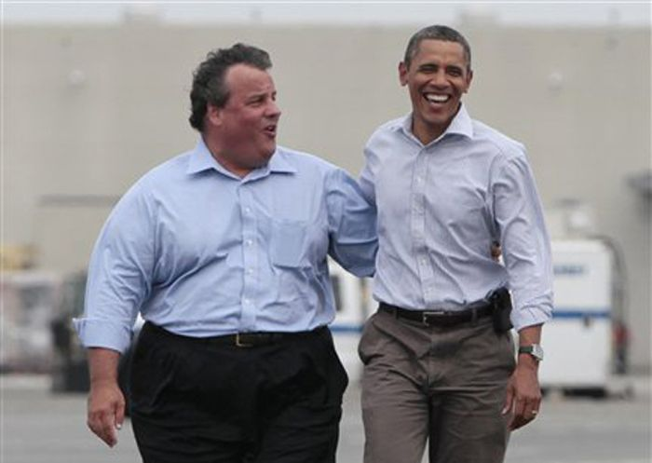
So, according to this research
Being overweight and with diabetes is about as off-putting to voters as seeing a candidate who is HIV+
Who was elected, Barack Obama or Chris Christie?
Not that many Chris Christies in high elective office….

Slide 15
Healthism, a definition (p. 16)
“… intentional and unintentional differentiations that disadvantage people based on either their health status or their perceived unhealthiness”

Slide 16
Some public policies they question
Taxes on tobacco and prohibitions on youthful smoking
Taxes on tanning beds (The “Snooki tax”)
Big Gulp ban (taxes, limitations, on soda)
These are relatively “soft” paternalistic policies, they write (p. 29)
P. 44, concern about the “slippery slope”: drinking alcohol, eating red meat, not sleeping enough, failing to exercise, to use sunscreen, to get a flu shot…

Slide 17
Their concern:
Categorization > Value Assignment > Discriminatory Acts
We certainly value health; is it ok to categorize people on the basis of health?
If we do, can we avoid a value judgment?
If we cannot, can we avoid discriminatory acts?
Let’s talk about this. Are they crazy, or on to something we have not focused on?
Is it workable? How to distinguish between allowable and unallowable health-based distinctions?

