Slide 1
Deborah Stone, Causal Stories, January 14, 2019
Discussion Points

Slide 2
Explain the difference between a “condition” or a “situation” and a political problem.
Give an example or two of things that are currently seen as political problems, but were once seen as conditions.
Let’s say I’m sick / poor / angry about my career prospects. What are the conditions where that becomes a public problem? Let’s say 1,000,000 people are in my same boat, same question.

Slide 3
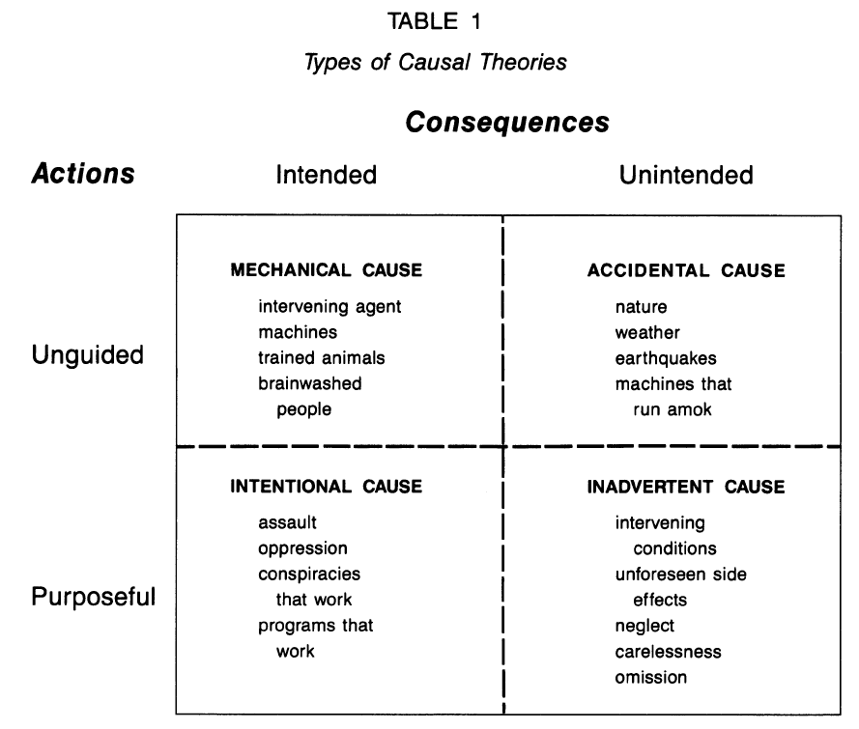
Explain / analyze / understand / critique / question:

Slide 4
“There are many strategies for pushing responsibility onto someone else.” (p. 289)
Common strategy: what was understood as an “accident” is actually the result of human will, either indirectly or directly.
She discusses “workers comp” laws.
Explain how that relates to intentional v. inadvertent causation.

Slide 5
Pick a recent hurricane, flood, or other natural disaster
Was a natural event or a man-made disaster?
Discuss the implications of your answer, given her theory.
How do advocates move it from one category to the other?

Slide 6
How do we distinguish between “carelessness” or “inadvertence” and “gross negligence.”
How does the law distinguish between these killings:
Self-defense
Involuntary manslaughter (reckless)
Voluntary manslaughter (intentional, unpremeditated, heat of passion, mental disturbance)
Second degree murder (intentional, no premeditation)
First degree murder (intentional, premeditated)
Justified homicide (soldier in battle, police officer, “stand your ground”)
“defense of infancy”: perpetrator is a child…

Slide 7
Let’s say a loved one is killed by a drunk driver, and you want that person to pay a heavy price.
What’s your causal story?
Let’s say you’re the drunk driver, what’s your causal story?
Let’s say you’re the District Attorney. What do you do?

Slide 8
On p. 291 she discusses court rulings about “disparate impact” and “discriminatory intent.”
Why does this matter so much, in the context of her theory?

Slide 9
At the top of p. 294 she explains some things that are related to success in promoting this v. that causal story:
Proponents have: Visibility, access to media , prominent positions
Theory accords with cultural values
Theory captures the “national mood”
Solution entails no radical redistribution of power or wealth
Legal acceptability
Scientific acceptability
How rigid v. flexible are these ideas?
Do the last two really matter, especially the last one?
How did we ever get an income tax?
What does it take for one side to win?

Slide 10
On pp. 295 and following she discusses social dominance, social control, and power.
What is her point there?
Illustrate the argument with some social groups that are traditionally weak and powerless, versus groups that are traditionally awarded more deference.
(We’ll come to this again on Wednesday with Schneider and Ingram, and return to it often in the course.)

