Slide 1
Carpenter, International Organizations, 2011
International Norms oppose landmines and blinding laser weapons, but not weapons based on depleted uranium or autonomous killer robots. Why?
April 1, 2019

Slide 2
Why do we ban some weapons but not others?
Chemical warfare widely condemned…
Also: landmines, cluster mines, small arms proliferation
But:
Thermobaric weapons (fuel-air explosives, create huge fireballs to suffocate and burn people)
Psychotropic weapons: mood altering aerosols…
The puzzle: Ethical outrage about certain weapons but not others…

Slide 3
Agenda-vetting and gatekeeper organizations
Same theory as last time
Idea of the “norms entrepreneur” similar to last time as well
Cases analyzed are different: weapons

Slide 4
“International law” and the “law of war”
The Hague Conventions and the Geneva Convention generally restrict certain types of actions in warfare.
(These rules, of course, have limited power, but the point is that they reflect an international consensus that war should be conducted in certain ways, not others.)
So, what is barred, and what is allowed?

Slide 5
Table 1, salience of various weapons in the “human security network”
Top issues: Landmines, cluster munitions, small arms, disarmament (nuclear), chemical weapons.
Medium issues: nuclear, biological, nonlethal weapons, arms trade, remnants
Issues not on anyone’s agenda: Depleted uranium weapons, directed energy, blinding lasers, white phosphorous, autonomous weapons, psychotropic, thermobaric, explosive weapons, napalm…

Slide 6
Major players in the Human Rights Network
World Heath Organization
International Committee of the Red Cross
Human Security Network
Org. for Security and Cooperation in Europe
Human Rights Watch
International Crisis Group
Stockholm Peace Research Institute
Etc.

Slide 7
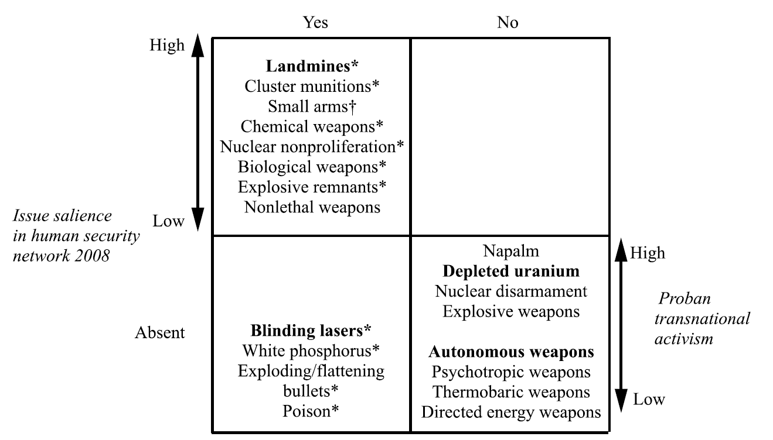
Figure 3, selecting 4 cases for study

Slide 8
Landmines
Used by the millions in virtually every war
Jody Williams, International Campaign to Ban Landmines, won Nobel Peace Prize
1973 beginning of advocacy to limit them
1991: activists seek to ban them completely
1992 Human Rights Watch got on board
1997, Princess Diana, Nelson Mandela, the Pope, Queen Noor…
1997, 122 nations sign a Mine Ban Treaty

Slide 9
Blinding Lasers
US, UK, USSR militaries develop these weapons in the 1980s
Maybe “dazzle” or disorient the pilots of attacking planes, use in anti-aircraft defense missiles and surface to air guns….
Or maybe just make lots of people go blind…
1986 Sweden and Switzerland propose a ban at the UN
1996, prohibition of lasers designed specifically to blind…

Slide 10
Depleted Uranium
Developed by the major powers in the 1960s, “armor piercing” weapons to penetrate tanks, bunkers, etc.
Gulf War, Kosovo (1990s), some concern about health effects
Campaign Against Depleted Uranium starts in the UK in 1999
No action at all…

Slide 11
Autonomous Weapons
Different from drones, which have a controller in Tampa or Orlando or somewhere else actually driving the thing and shooting the weapons
These are robots with guns, and no human participation
Not the same as a booby-trap or a trip-wire
Use artificial intelligence to see a threat and respond with lethal force
All major governments have developed these…
No success in banning these

Slide 12
How would you frame a ban on killer robots? How would the other side counter?

