Slide 1
Baumgartner, Framing, Spring 2023
Stone, Deborah A. 1989. Causal Stories and the Formation of Policy Agendas. Political Science Quarterly 104, 2: 281–300.
Schneider, Anne L., and Helen Ingram. 1995. Social Construction: Response. American Political Science Review 89, 2: 441–46.
Jan 18, 2023

Slide 2
Logistics
Thank you for bearing with me as we figure out the enrollment issues in this class.
Some are enrolled directly in poli 421. Some had to be moved to another enrollment, poli 490. There is no difference.
There is limited room for additional students to enroll, but it has to be this week, before Friday.
If you are not currently enrolled, and want to be, email me with your legal name and PID along with that request.
Do it soon!

Slide 3
Let’s start with Stone…
Explain the difference between a “condition” or a “situation” and a political problem.
Fact of life
Something the government can solve
Naturally occurring and inevitable, no one’s fault
Created by human action, should be solved by the one responsible
Give an example or two of things that are currently seen as political problems, but were once seen as conditions.
Duh, climate change, weather patterns

Slide 4
Is this a problem or a condition?
I’m depressed and can’t get out of bed.
I graduated from college but can’t get a job.
I immigrated to a new country and don’t know the language.
100,000 people immigrated to a new country because of war back home.
I started a successful business but am letting go of workers because of the trade war with China.
I lost my job because
of the trade war with China.
I had to care for my elderly parent and missed work too many times.
the city cancelled the bus / subway route I depend on to get there on time.
my boss finally figured out I don’t know how to do the job.

Slide 5
Explain / analyze / understand / critique / question:

Slide 6
“There are many strategies for pushing responsibility onto someone else.” (p. 289)
Common strategy: what was understood as an “accident” is actually the result of human will, either indirectly or directly.
She discusses “workers compensation” laws.
Explain how that relates to intentional v. inadvertent causation.
Note also how it would be natural for labor unions to focus on one side of this, unsafe work conditions purposefully allowed by management in order to save money / increase profits.
Business owners would naturally counter to say: you slipped because you were not paying attention, and that’s not my fault.
These are basic issues of contention we see all the time.

Slide 7
How do we distinguish between “carelessness” or “inadvertence” and “gross negligence.”
How does the law distinguish between these killings:
Self-defense
Involuntary manslaughter (reckless)
Voluntary manslaughter (intentional, unpremeditated, heat of passion, mental disturbance)
Second degree murder (intentional, no premeditation)
First degree murder (intentional, premeditated)
Justified homicide (soldier in battle, police officer, “stand your ground”)
“defense of infancy”: perpetrator is a child…

Slide 8
Let’s say a loved one is killed by a drunk driver, and you want that person to pay a heavy price.
What’s your causal story?
Let’s say you’re the drunk driver, what’s your causal story?
Let’s say you’re the District Attorney. What do you do?

Slide 9
On p. 291 she discusses court rulings about “disparate impact” and “discriminatory intent.”
Why does this matter so much, in the context of her theory?
(BTW, see this NYTimes article about housing discrimination: https://www.nytimes.com/2019/08/20/upshot/housing-discrimination-algorithms-hud.html

Slide 10
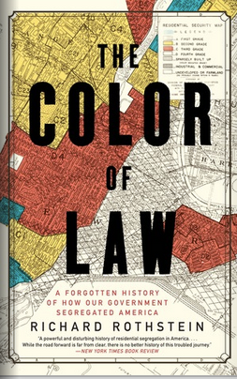
Systemic or institutional racism
Much of the current conversation about race centers on whether systems that lead to racially disparate outcomes show unintended outcomes (e.g, inadvertent cause), versus systems working as intended, to CREATE racial disparities.
Interesting book on this topic, related to housing discrimination:

Slide 11
At the top of p. 294 she explains some things that are related to success in promoting this v. that causal story:
Proponents have: Visibility, access to media , prominent positions
Theory accords with cultural values
Theory captures the “national mood”
Solution entails no radical redistribution of power or wealth
Legal acceptability
Scientific acceptability
How rigid v. flexible are these ideas?
Do the last two really matter, especially the last one?
How did we ever get an income tax?
What does it take for one side to win?
This implies different “causal stories” should work in different countries. A good topic for a term paper!

Slide 12
On pp. 295 and following she discusses social dominance, social control, and power.
What is her point there?
Illustrate the argument with some social groups that are traditionally weak and powerless, versus groups that are traditionally awarded more deference.
(This is a perfect seque to Schneider and Ingram, and we will return to it often this semester…)

Slide 13
Target Populations, from Schneider and Ingram

Slide 14
Government Policy Towards Different Groups

Slide 15
Burdens and Benefits

Slide 16
Some questions
Can a group move from one box in their rubric to another over time?
Examples?
How did that occur?
Can frames make that happen?
Who has the power to do this?

Slide 17
More questions: Would we agree on these social groups? Code into the 4 boxes
Big Pharma
Big banks / Wall Street
Farmers
Family farmers
Police
Children
Poor children
Mothers
Poor mothers
Nonviolent drug offenders
Former felons
Terrorists
Planned parenthood
Chancellor Guskiewicz
Homeowners
College Students
Prisoners
Criminal defendants awaiting trial
ISIS
Immigrants
Undocumented immigrants
Criminal aliens
Dreamers
Oil companies

Slide 18
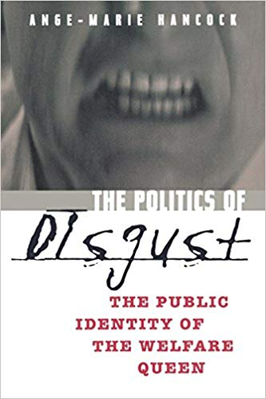
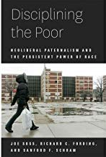
Some books / examples to consider

Slide 19
Bureaucracies that like / dislike their clients?
What does that look like?
Prisons? Welfare / unemployment offices?
Postal Service? Schools?
University admissions offices?
Could you categorize government agencies by how pleasant it is to deal with them?

Slide 20
Do you buy the theory?
Policy towards groups is “nasty or nice,” depending… ?
Is it fixed or can it change?
How can it be changed?
Who determines the “social construction” of a given group?
Student anti-racist activists v. white nationalist activists. How are they “constructed” by different groups? By the mainstream media?

Slide 21
Some extensions by a colleague here at UNC
Kreitzer, Rebecca and Candis Watts Smith. 2018. Reproducible and Replicable: An Empirical Assessment of the Social Construction of Politically Relevant Target Groups. PS: Political Science and Politics 51, 4: 768–774.
Kreitzer, Rebecca, Elizabeth A. Maltby, and Candis Watts Smith. 2022. Fifty shades of deservingness: an analysis of state-level variation and effect of social constructions on policy outcomes. Journal of Public Policy 42: 436–464.

Slide 30
Then they show these things really affect state policies: Number of prisoners…

Slide 31
ICE arrest rates…

Slide 32
State spending on public assistance to the poor…

Slide 33
Conclusions
These two articles are foundational to this course.
They imply that there is no “right” answer to any public policy.
It depends on:
Your theory (“causal story”) of where the problem comes from, its cause.
Whether you like or dislike the constituency that is going to be affected.
Perhaps more importantly, whether government decision-makers like or dislike them.
These are such simple ideas we can easily forget them.
Please keep them in mind…

