Slide 1
Baumgartner, Framing, Spring 2023
Baumgartner, Frank R. and Bryan D. Jones. 1991. Agenda Dynamics and Policy Subsystems. Journal of Politics 53, 4 (November): 1044–74. Rose, Max, and Frank R. Baumgartner. 2013. Framing the Poor: Media Coverage and US Poverty Policy, 1960–2008. Policy Studies Journal 41, 1: 22–53.
February 15, 2023

Slide 2
Nuclear power as an example of rapid policy change
This was the first article from a research project that led to a book in 1993, Agendas and Instability in American Politics, and a long research program that still continues today.
We had a very hard time getting the initial work published, including this paper.
But eventually we introduced a lot of new ideas…
Punctuated Equilibrium Theory of policy change (PET)

Slide 3
Our basic idea
For most policy issues, most of the time, policies will change only marginally.
This is the theory of “incrementalism”.
However, occasionally there are dramatic shifts.
We developed the P-E Theory to explain both of these.
Negative Feedback: For every action in the political realm, the policy subsystem responds with a reaction, to keep things stable. (Explains equilibrium outcomes / incrementalism.)
Positive Feedback: Sometimes, however, one action builds toward the next, resulting in momentum and dramatic change. This explosive change explains the punctuations. These are rare but have long-lasting impacts.
To understand policy change, you have to understand both the Punctuations and the forces of Equilibrium.

Slide 4
In the book…
We explore lots of issues:
Nuclear power, smoking and tobacco, pesticides, Child abuse, drug treatment v. drug enforcement, aid to cities, traffic safety, alcohol abuse and treatment
In another book, Politics of Attention (2005), we study all government activity.
In another book, Politics of Information (2015), we look at the impact of growth in government since World War 2.
Our most recent book, Comparative Policy Agendas (2019), expands the project to 25 countries.
So this article kind of led to an entire industry…. Let’s get to the article then.

Slide 5
The basic idea: Image x Venue = Policy
If you think of most issues most of the time, they are understood in a certain way, by most “reasonable” actors in politics. At any given time, some are undergoing revision (e.g., abortion, right now), but most are not.
Similarly, we typically understand “who” or what government institution is “in charge” of the issue.
The image and the venue reinforce each other.
BUT, when one begins to erode or change, the other can fall apart as well. This can lead to an interactive process where both collapse very quickly.

Slide 6
Nuclear power in the 1950s
“Atoms for peace” would generate electricity “too cheap to meter”
Google any of those words, and throw in “Eisenhower” and you’ll see all kinds of amazing propaganda about America’s scientific prowess and its post-war economic boom.
Joint Committee on Atomic Energy (House / Senate committee, both secret defense oversight as well as civilian oversight)
Atomic Energy Commission: Federal agency charged with promoting the use of nuclear for electricity

Slide 7
How successful were they?
1954 Price-Anderson Act: your parents’ homeowners insurance does not cover in case of nuclear accident by Duke energy… (I brought mine to class; ask me to read it if I forget.)
Over 100 nuclear plants built. Westinghouse and General Electric become the pre-eminent companies world wide. They export the technology and make lots of money.
Things are going great…
But then…

Slide 8
The rapid reversal of the nuclear image
Mid-1960s, Union of Concerned Scientists began to voice concern that plants were getting too big
Elected officials starting working on NIMBY strategies
Environmental movement just starting (EPA created in 1971)
1968: Percent positive stories on nuclear in the mass media moves from about 60% to about 10 %, and attention begins to rise dramatically.
Note the timing: Three Mile Island was in 1979, AFTER the shift in image.

Slide 9
Political leaders respond to this very quickly
From a “wave of enthusiasm”, we move to a “wave of criticism”.
Everyone piles on board to criticize an industry just recently so favorably viewed.
Why not break up the Joint Committee on Atomic Energy? We do.
Why not break up the Atomic Energy Commission? (We create the Nuclear Regulatory Agency, on the one hand, and the Department of Energy, on the other)
Why not let Governors, Mayors, and local players have more say? We do.
These institutional changes reinforce the framing catastrophe for the nuclear industry, as those “in charge” no longer have a positive view

Slide 10
How far the mighty can fall
Nuclear power plants were abandoned even after billions of dollars in investments.
Electrical companies that were heavily invested in nuclear lost stock value, very dramatically.
People focused on waste and danger rather than scientific advance.
Note that the 1970s-era focus on danger and radioactivity is just as incomplete as the 1950s-era focus on gung-ho confidence in American Science…
(In the book, we showed the same for pesticides, tobacco, and a few others.)

Slide 11
What’s the point?
Think about Facebook, electric cars, any new technology that is going to generate billions of dollars and millions of jobs. Nuclear was seen that way in the 1950s, after the War.
Governments compete to see who can help the new industry.
They also buy a lot of industry propaganda and ignore other less appealing facts.
This might change 30 years later…
Complex issues get simplified in politics. Experts understand their multifaceted implications, but when they get onto p. 1 of the newspapers, they get very simple… This is a recipe for inefficiency. However, it also seems inevitable.

Slide 12
Best quote that sums up this approach:
“Congress does two things best: Nothing, and over-reacting.”
This is true of governments in general…
They tend to lurch from not paying attention to something (because they are involved in crisis management on some other topic) to suddenly realizing that they have to fundamentally alter their approach to something. The timing of these “alarmed discoveries” is basically impossible to predict. However, it happens all the time.

Slide 13
Framing the poor
Max Rose a senior thesis student
April 2011 completion of thesis
Sept 2011 submission
Feb 2012 revisions after reviews
June 2, 2012 conditional acceptance
June 16, 2012 revisions completed
Jan 2013 published.
(Reviews are on my web page, “tips and pointers” on the left hand column… Interesting to read if you are thinking of academics.)

Slide 14
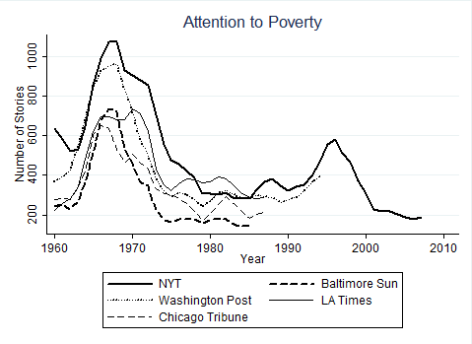
A surge and decline in attention

Slide 15
Keywords for poverty:
ENHAI(welfare OR poverty OR "low-income" OR "public housing" OR needy OR ghetto OR indigent OR impoverished) AND PDN(>1/1/2000) AND PDN(<12/31/2007) AND NOT ("endangering the welfare" OR Haiti OR Nazi OR Brazil OR China OR Africa OR India OR Iraq OR Europe OR Afghanistan OR animal) AND NOT AT(review)
Note: these changed (slightly) every decade

Slide 16
Keywords for Frames:
Underclass | poverty-stricken OR "urban renewal" OR despair OR shelter OR bleak OR blight OR hunger OR ghetto OR "neediest cases" OR homeless OR slum
Social Disorder | anger OR police OR killing OR violence OR "civil right" OR crime OR gang OR riot OR demonstrator OR (strike W/3 rent OR welfare OR worker OR union) OR protest OR ("community action" AND NOT "community action agency")
Economic and Physical Barriers | (student W/1 aid OR needy OR loan OR disadvantaged) OR industrial OR wage OR economy OR "affordable housing" OR "unemployment rate" OR disabled OR "poor children" OR elderly OR aged
Laziness and Dysfunction | able-bodied OR dependency OR "work requirement" OR mother OR "welfare family" OR father OR "welfare hotel" OR (drug AND NOT Medicaid OR Medicare OR company OR prescription) OR abortion OR "child welfare" OR workfare OR "welfare to work"
Cheating | chiseler OR cheat OR fraud OR ineligible OR overpayment OR corruption OR audit

Slide 17
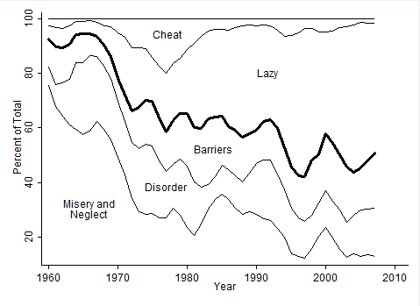
Increased attention to “lazy” over time…

Slide 18
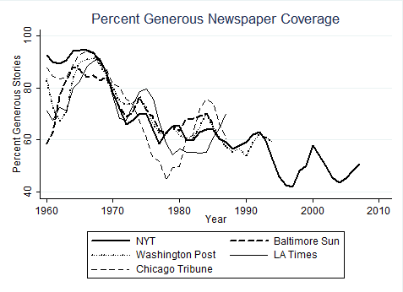
Many newspapers show the same results

Slide 19
We did a bunch of stuff you don’t need to do.
Developed a measure of the seriousness of the problem.
“Poverty gap” = number of poor x depth of poverty
Say the poverty level is $12,880 for a single person
Say you make $5,000
Then your poverty gap is the amount needed to get you out of poverty: $7,881.
Do that for every person in poverty; result is the national poverty gap.
More people in poverty > greater gap
People have less money > greater gap
Both the number and the level of poverty matter.

Slide 20
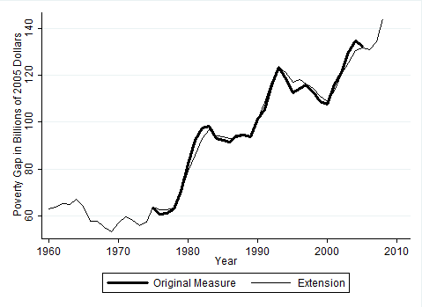
The Poverty Gap = (# of Poor) x (Depth of Poverty)

Slide 21
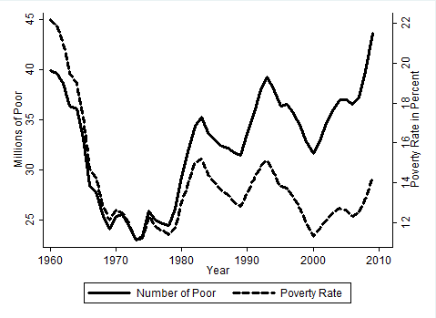
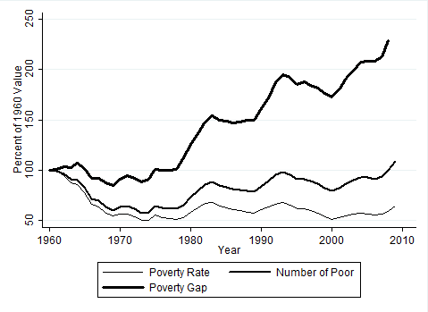
Three measures of poverty: number, rate, gap

Slide 22
We measured government spending, considering the level of the problem
Generosity index = all spending on poverty assistance / poverty gap.
If the gap is decreasing, then naturally the spending might decrease as well, but that’s not because they are getting stingy.
If the gap is increasing, but spending stays the same, then it’s getting less generous.
So it controls for the seriousness / size of the problem.

Slide 23
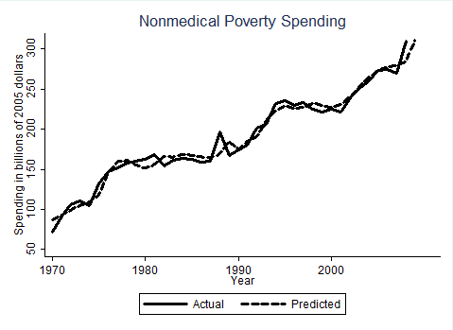
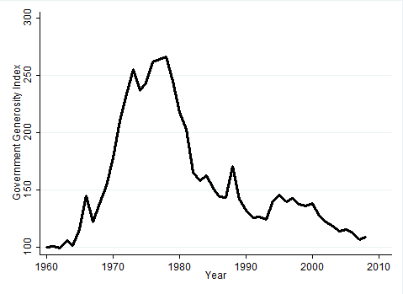
Spending goes up, but the demand changes, so the generosity is different: meet the gap, or no?
Spending is going up…
But the need was going up even faster, so generosity declines since about 1980. Still, it was at 2.5 times its 1960 value then.

Slide 24
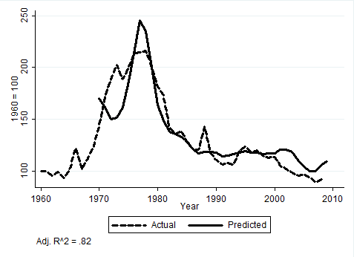
We can predict the generosity by the framing (lagged by… 10 years!) The generous frame worked for a while, then the stingy frame over.
Net Generous frame, and spending

Slide 25
So, framing drives government policy
For a paper:
Maybe just measure the frames, that’s plenty
But this article got published because we were able to show that it actually affected policy outcomes, though everyone (including us) was puzzled that the delay appears to be 10 years.
Why do people struggle to explain what explains poverty?
Because the answer to that question generates a causal story that suggests that more or less government spending is appropriate.

