Slide 1
Preliminary assessments and questions, NC AOC database for District 15B
Frank R. Baumgartner, UNC-Chapel Hill
Graduate students:
Christian Caron, UNC-CH
Kaneesha Johnson, Harvard
Marty Davidson, Michigan
August 23, 2019

Slide 2
Outline
Nature of database
Estimating income based on housing value
Targeting demographic groups
Wealth extraction
Harshness of punishment
Questions

Slide 3
Unit of analysis: the Arrest-Charge
AOC database is organized by individual x arrest x charge: ~ 9 million
multiple charges per arrest incident for the same person
Arrests from Jan 1, 2013 through Dec 31, 2017
Arrest incident: fewer observations
all charges to the same individual for the same incident combined
Count of how many offenses of each class were listed; arrests and charges
Resolution incident: fewer observations
All arrests and charges combined, as well as conviction
(Same individual may appear more than once; in 15B, one person has about 50 arrest-incidents, with multiple resolution incidents as well.)

Slide 4
Identifying individuals who appear in the AOC file at different times
In some cases a person may be arrested on different occasions, but the way the data are set up, there is no way to tell if this is the case. We use a probabilistic matching algorithm to identify those appearing on more than one occasion. This involves:
Isolating the individual’s name, DOB, sex, race, and an address indicator
Closer matching on DOB, sex, race; looser matching on name, address
Identifying those that have a > 85% chance of being the same person
Creating a new unique id for that person
This reduces the ~150k charges to ~40k individuals, for 15B

Slide 5
Assessing judicial outcomes: How harsh was the punishment, given the initial charges?
Identify individuals facing similar risks at the moment of arrest
Add up all potential punishments based on the arrest or charge codes.
Punishments come in different types: active prison time, fines, and everything in between
Multiple, but separate, analyses for different categories of initial charges
Compare to conviction codes and punishments
One person faced 10 years in prison, as the worst case scenario based on the original arrest or charge codes, and gets a punishment of 5 years.
Another faces the same 10 years, and gets a punishment of 8 years…
Use SES, race, gender, age, Judicial District, type of attorney, type of plea to predict this outcome: who does well, who does poorly, given the initial charges.
Note we can’t study over-arresting, as the database starts at the moment of arrest.

Slide 6
Use street address to estimate income level
Corelogic Housing Database (150,000,000 buildings across the US)
Compare price-per-square-foot
Convert price-per-square-foot to standardized rank scores
Map out each home using Long/Lat coordinates
Partition homes into neighborhoods based on price similarity
Identify 26,677 neighborhoods for NC
These range in size from 15 to 3,000 individuals, but all with similar housing values.
Assign a score from ~ -2 to +2 based on value of homes
Use this to estimate the income / wealth / Social Economic Status of people in those neighborhoods.
Note: everyone in the neighborhood gets the same estimated income.
By definition, neighborhoods are homogeneous with respect to housing value

Slide 7
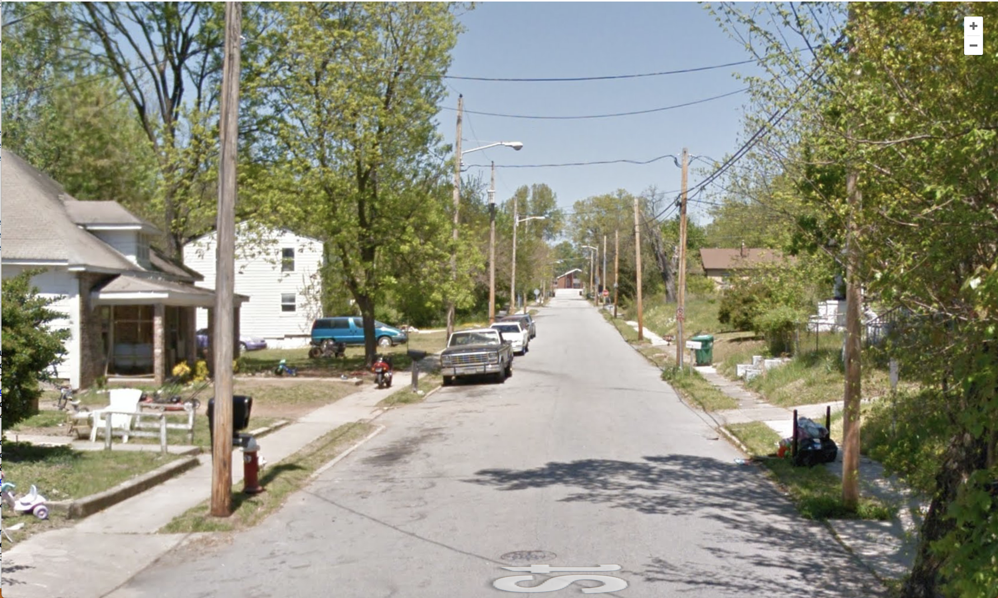
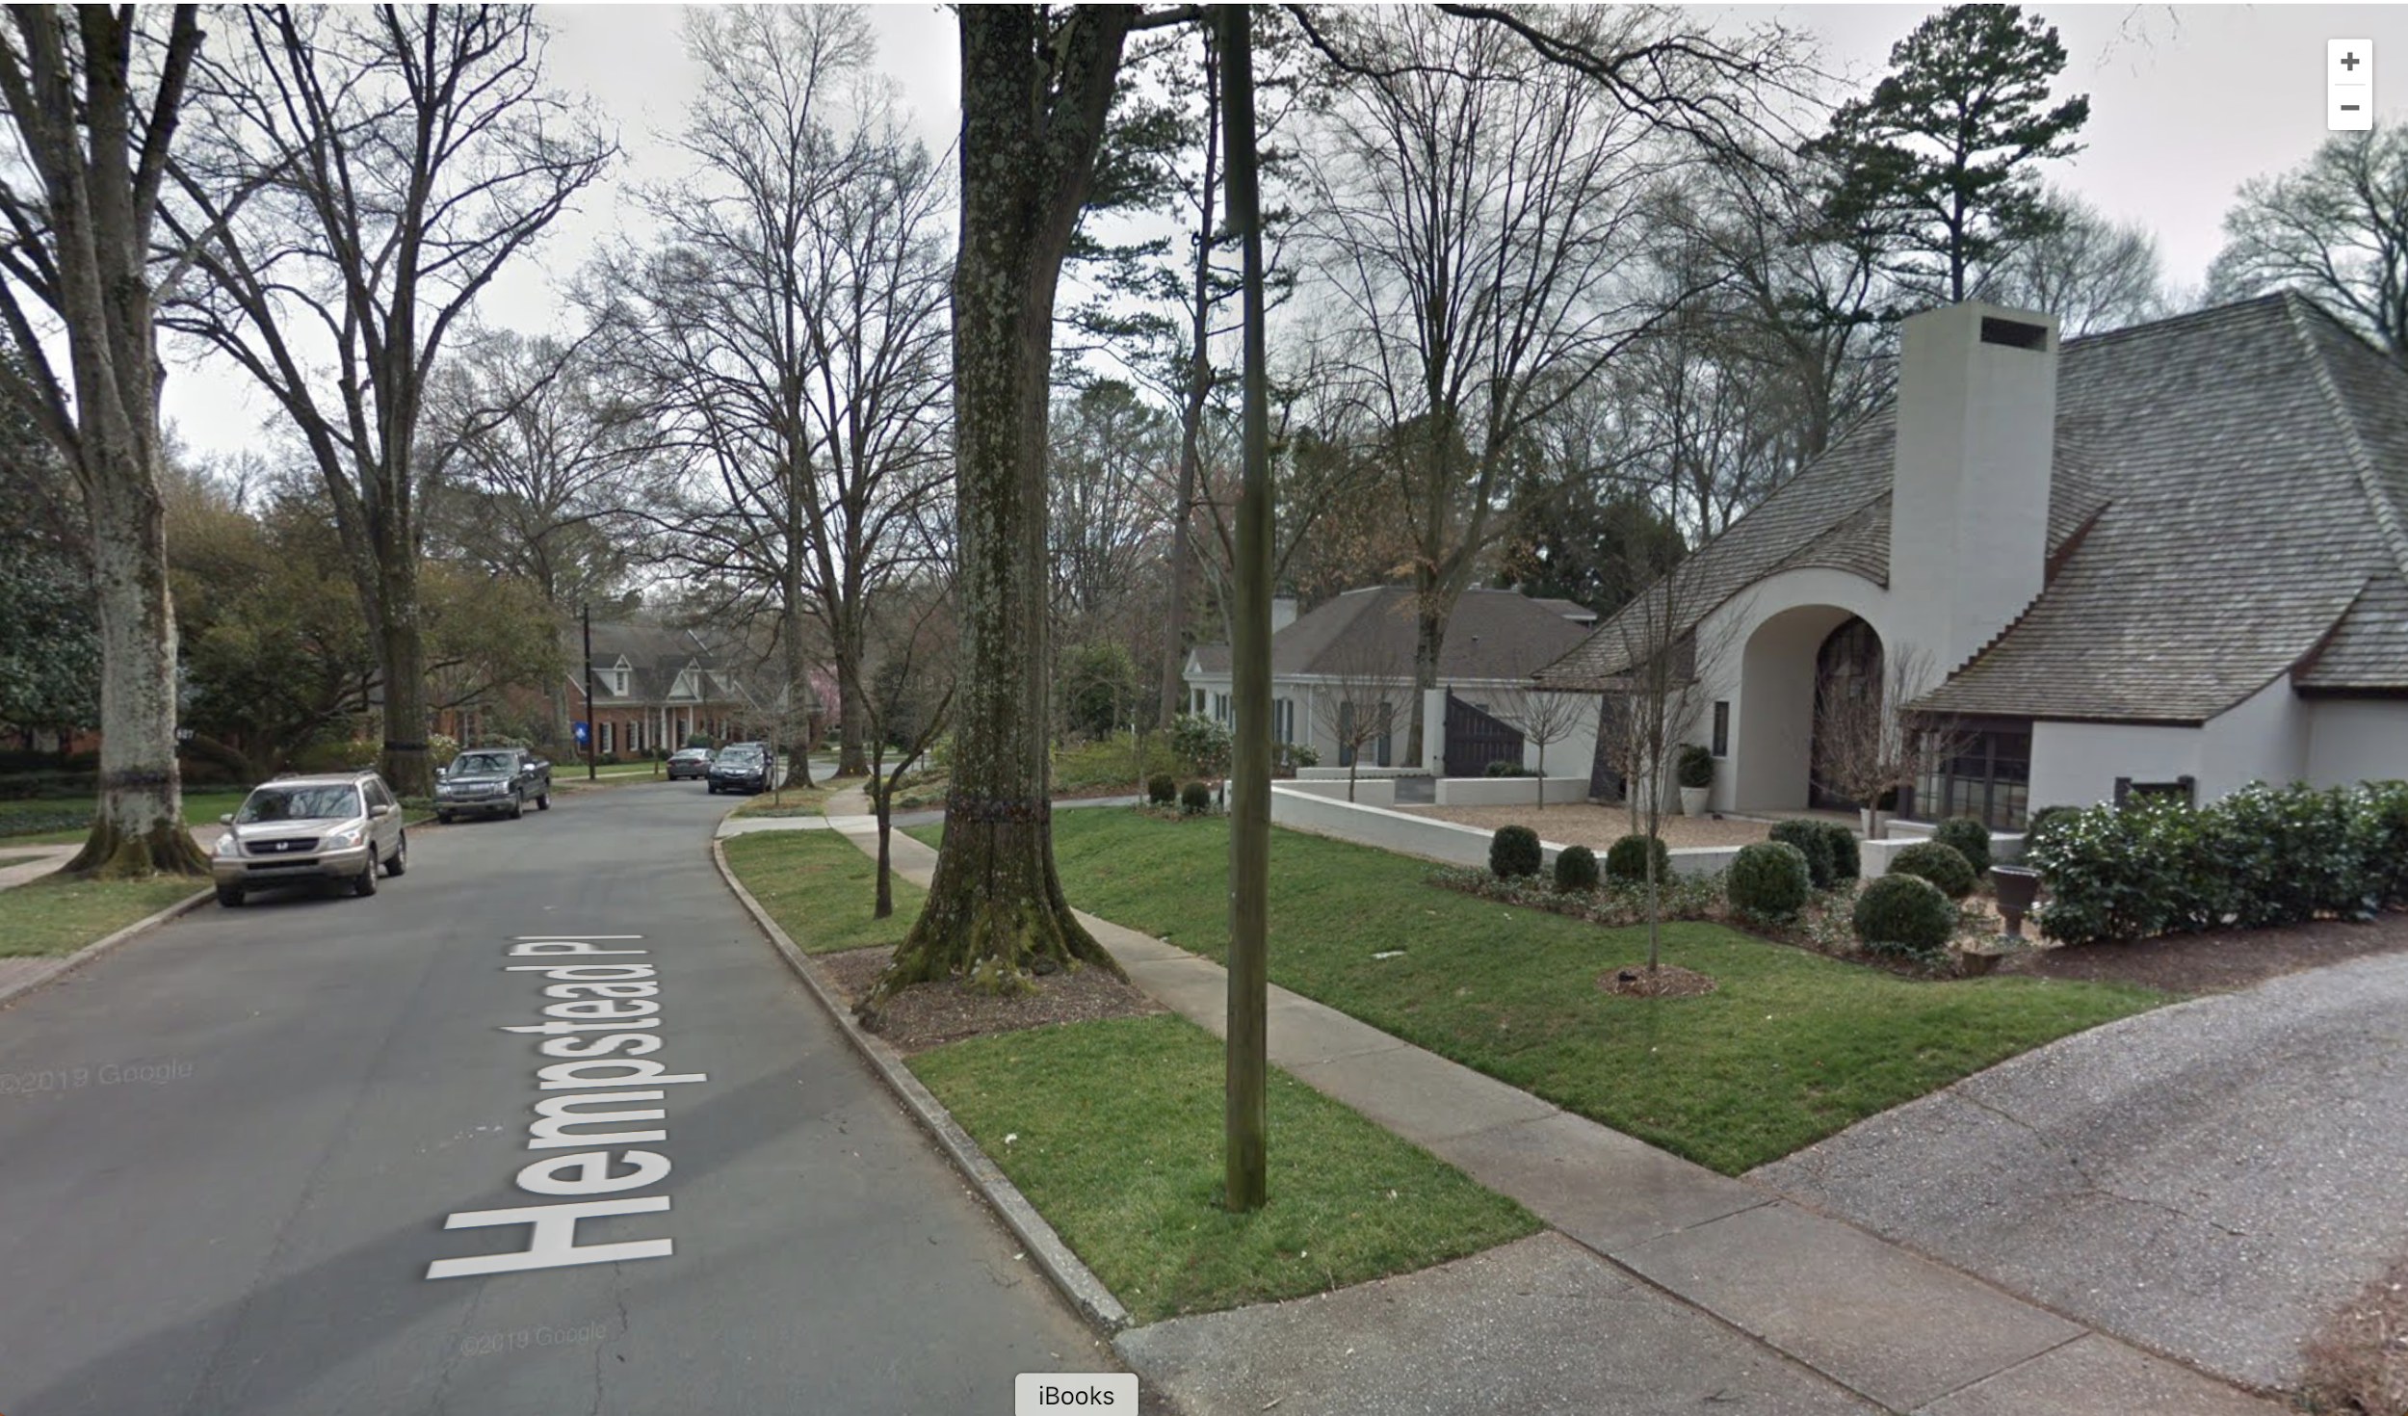
Neighborhood Examples
37081013900 Neighborhood- 4 (Guilford)
Score: - 1.67
Number of Homes: 555
Percent Black – 82%
Percent Impoverished – 58%
Median Household Income - $16,160
37119002800 Neighborhood- 4 (Mecklenburg)
Score: 1.69
Number of Homes: 381
Percent Black – < 1%
Percent Impoverished – 3%
Median Household Income - $211,250

Slide 8
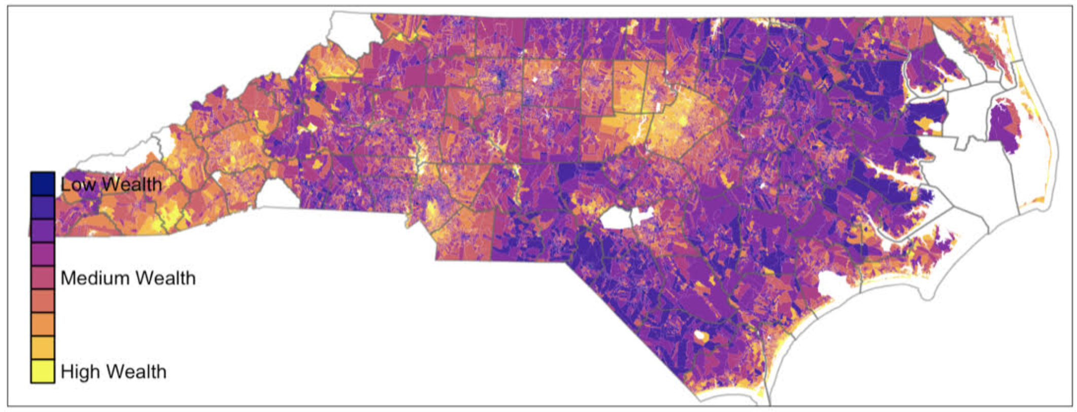
26,000 neighborhoods across NC

Slide 9
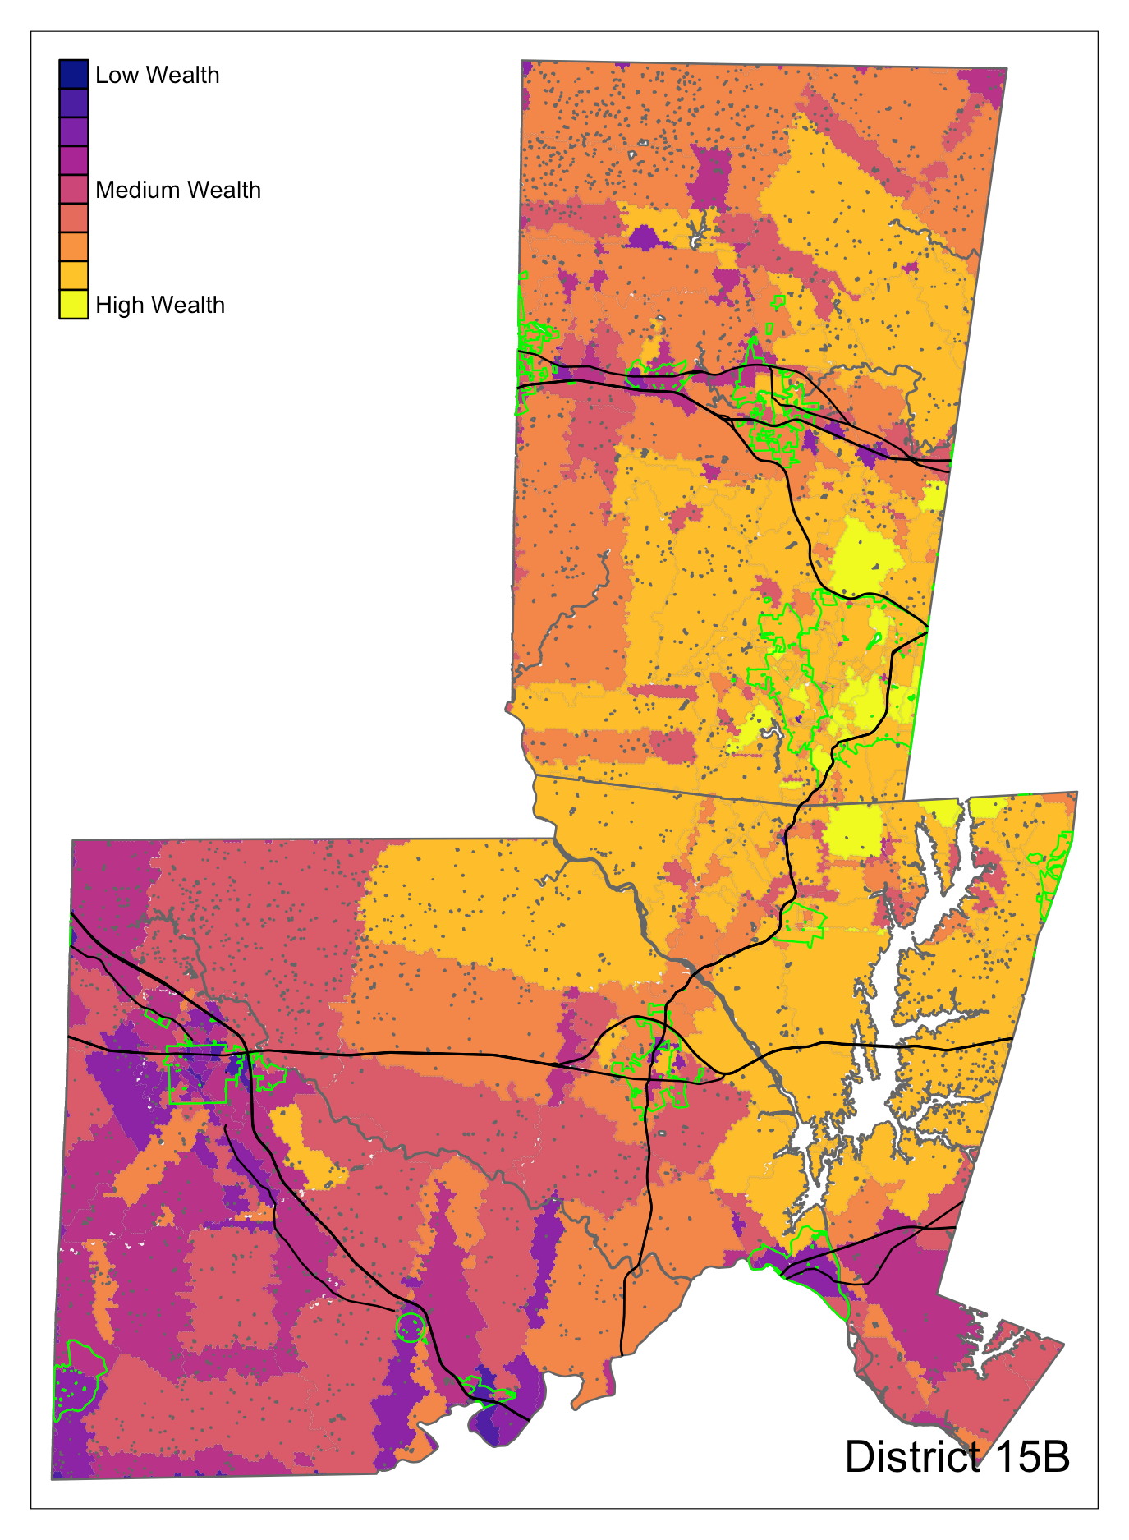
District 15B (953 neighborhoods)
Poorest Neighborhoods in Siler City
Wealthiest Neighborhoods in Chapel Hill
More fine-tuned than the 41 Census Tracts in the district

Slide 10
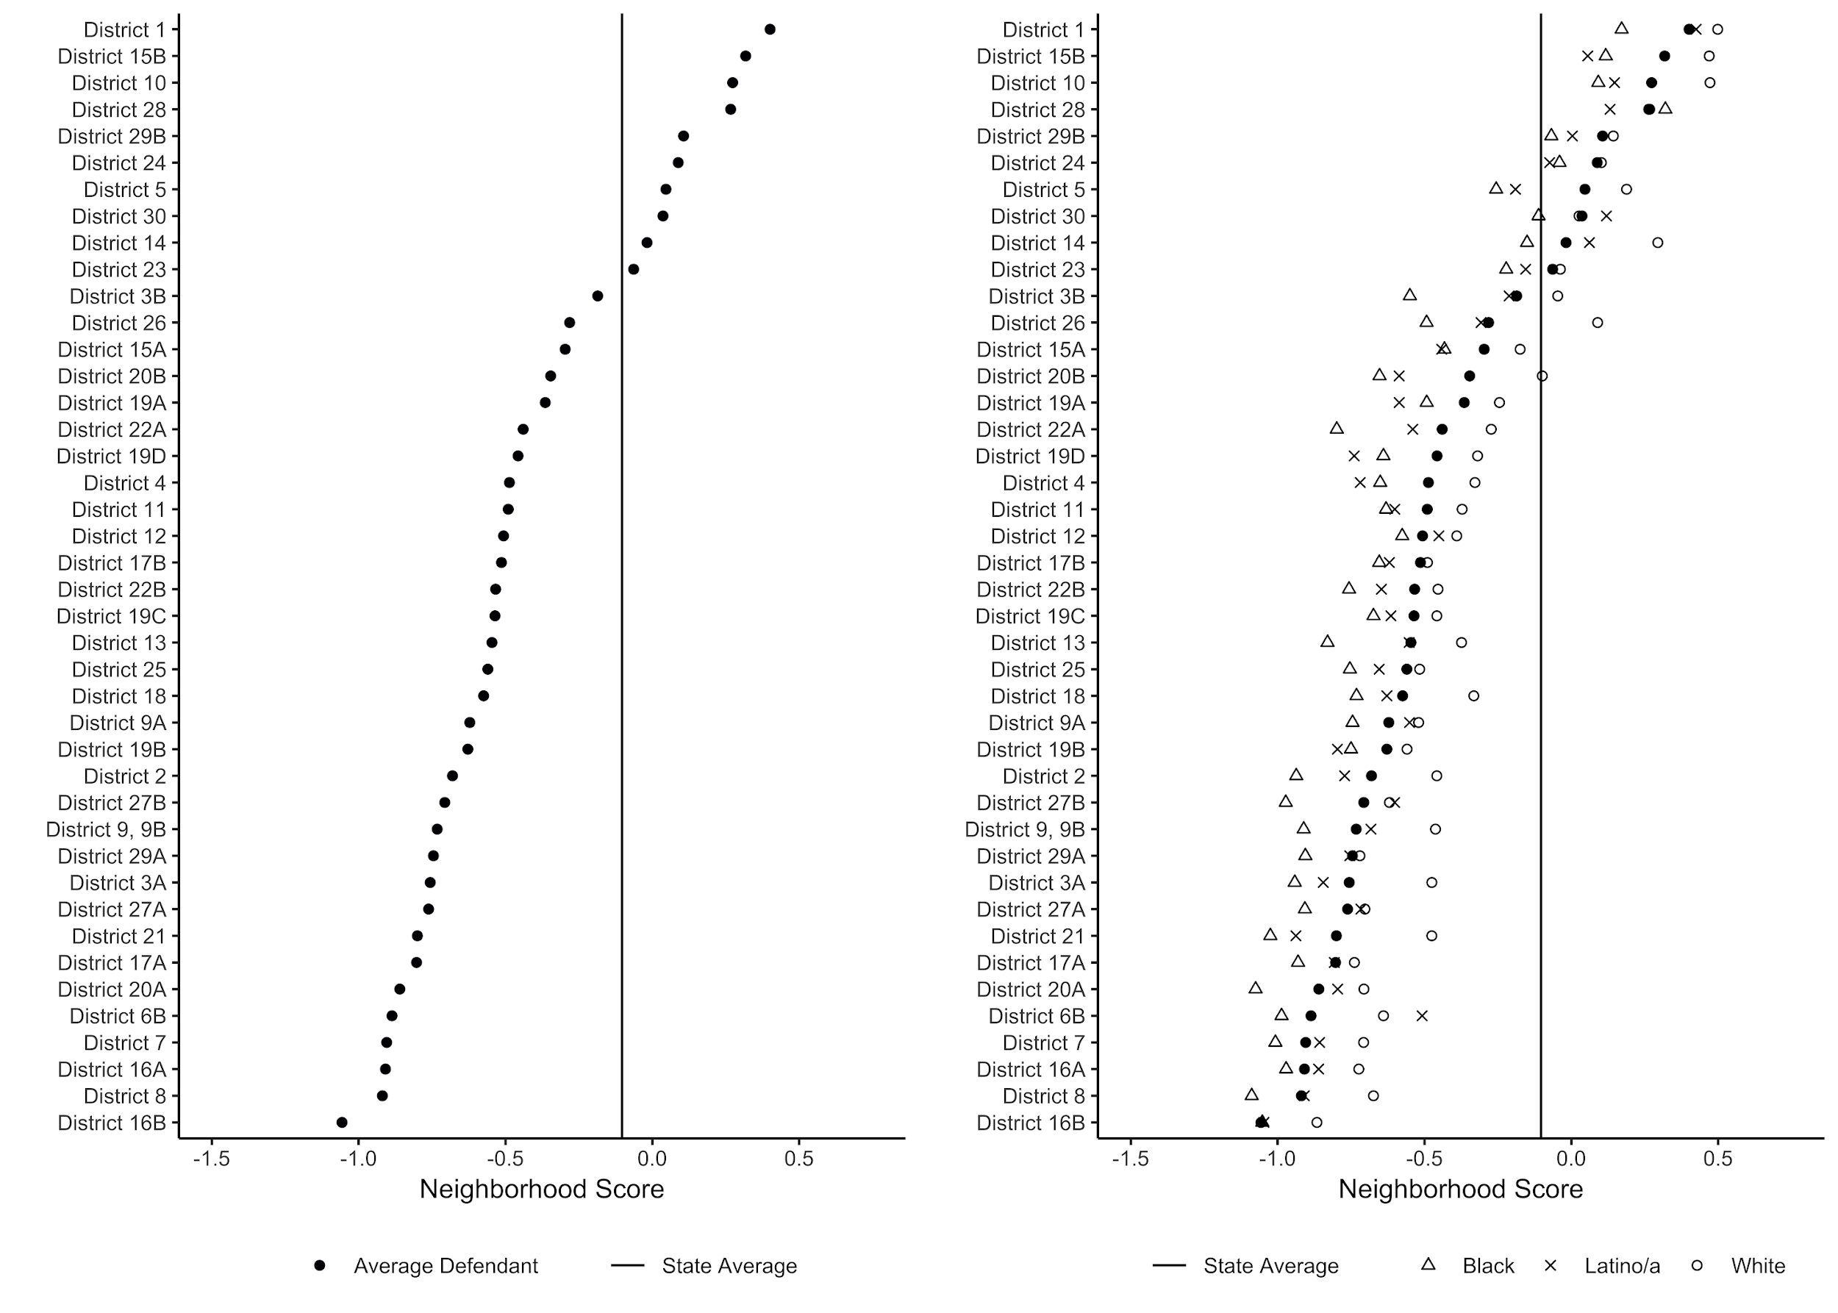
Income profiles of NC Judicial Districts

Slide 11
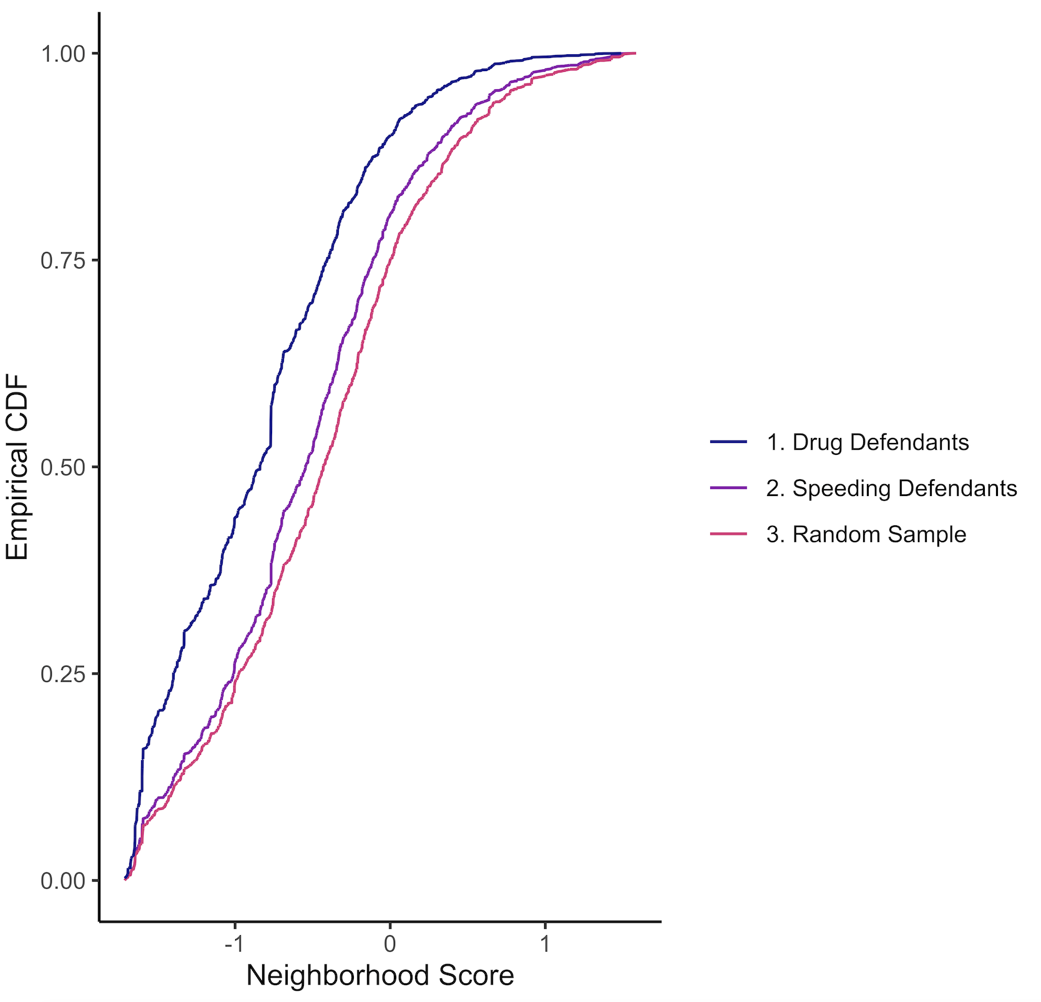
Some offense codes affect the poor more than others… Random sample: All people with equal odds, what is their income? Speeding defendants: close to random. Drug defendants: noticeably poorer. (Data for Forsyth County)

Slide 12
Demographic profiles of offense codes
Following slides compare, for the 19 most common offense codes in District 15B:
The RELATIVE over- and under-representation of groups, compared to their US Census population share
Groups defined by gender, age (<25, 25-44, 45+), race (W,B)
These are illustrative of what we can do. We can also add in income levels.

Slide 13
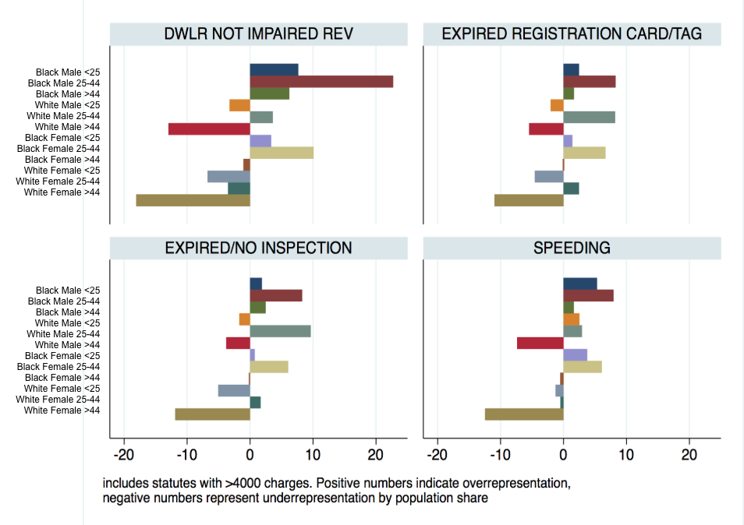

Slide 14
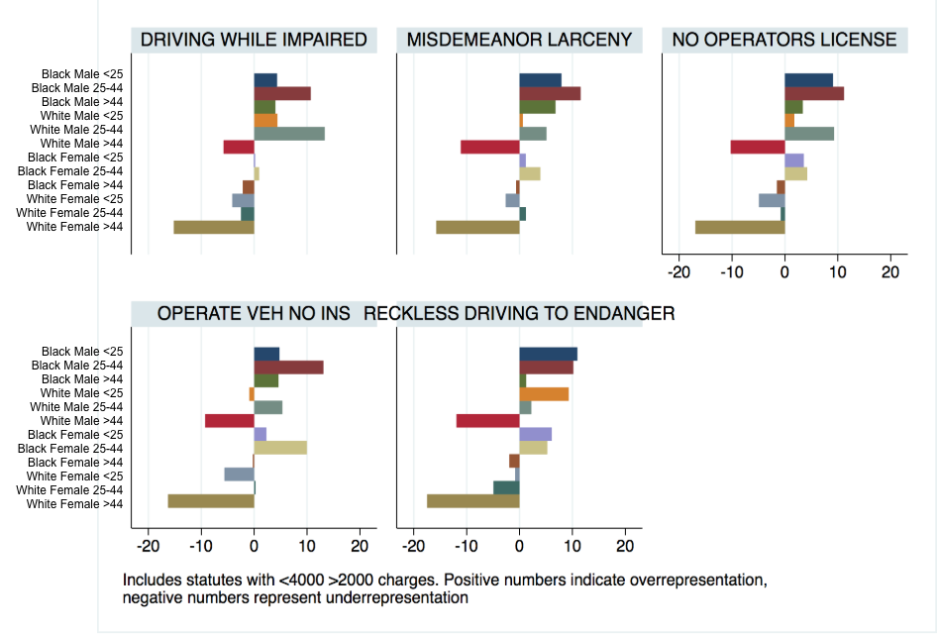

Slide 15
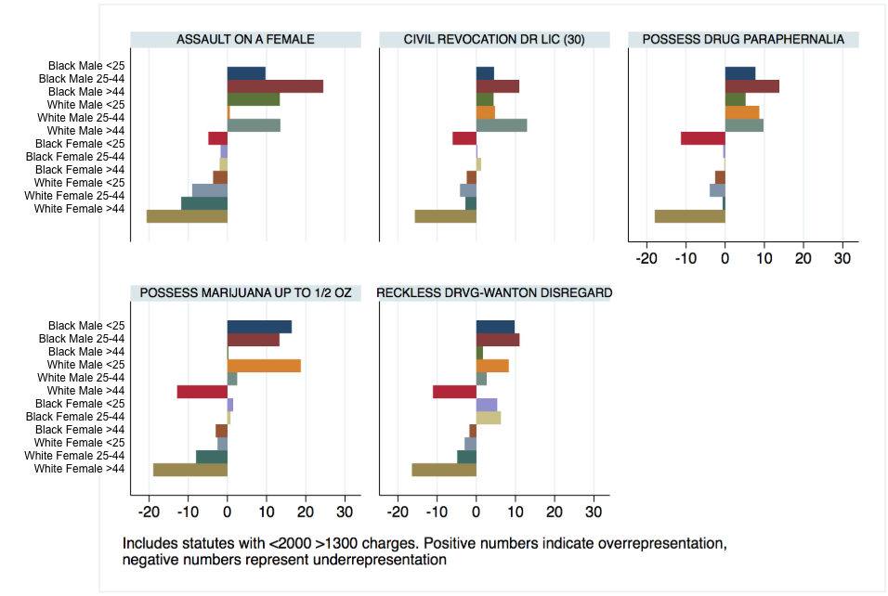

Slide 16
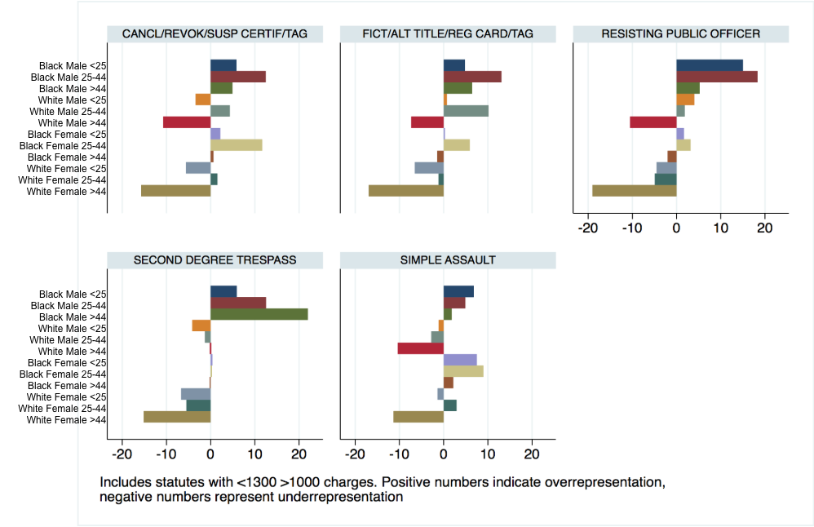

Slide 17
Wealth extraction
How much do different groups and communities end up paying to the courts? We plan on creating a variable that sums all of the potential financial costs faced by an individual/group/neighborhood.
Looking first at probation and parole fees we see...
For district 15b there were a potential of up to 78,171 months served on probation and/or parole
If we take the fees as defined under G.S. 15A-1343(c1) ($30 dollars per month by the person serving the sentence), then there was a total potential collection of $2,345,130 from those serving the sentence

Slide 18
Wealth extraction by identity group (example)
Identity group | Parole/probation length | Probation/parole cost (in dollars) | Other fees paid by the defendant | fines | subtotal
Hispanic_F_over45 | 12 | 360 |  | 8063 | 8423
Hispanic_F_u25 | 156 | 4680 |  | 18118 | 22798
Hispanic_F_25-44 | 287 | 8610 |  | 41930 | 50540
Hispanic_M_over45 | 804 | 24120 |  | 21908 | 46028
Black_F_over45 | 1185 | 35550 |  | 33249 | 68799
Black_F_u25 | 1212 | 36360 |  | 61731 | 98091
Hispanic_M_u25 | 1914 | 57420 |  | 149088 | 206508
Hispanic_M_25-44 | 2484 | 74520 |  | 115240 | 189760
Etc.

Slide 19
Comparing outcomes of high- and low-level offenses
A-D Felonies.
N = 6,040, all cases arrested after Oct 1, 2013, and resolved before Dec 31, 2017.
Harshness of outcome measured in months of active prison time, compared to the worst possible, aggravated, punishment based on offense codes at the moment of arrest
Speeding Tickets.
1,211,988 drivers charged with speeding, offense code 4450, with no additional charges, 2013-2017.
Guilty? Guilty to lesser (e.g., broken speedometer)? Not Guilty?
Use the same statistical model to predict these outcomes.
Thanks to UNC class of ’19 students Luke Beyer and Sarah McAdon who wrote senior theses on these topics.

Slide 20
Outcomes compared
A-D Felonies: Harshness Index = Punishment / Potential Punishment
Speeding: Guilty of speeding, or reduced to equipment malfunction?
Outcome | N | %
Acquitted | 121,199 | 10
Reduced | 472,675 | 39
Guilty | 618,114 | 51
Total | 1,211,988 | 100

Slide 21
Results:
A-D Felonies
Speeding
Prior points: -4.9% per point (so, less punitive than the grid)
Plea:
Guilty to lesser: baseline
Guilty: + 46%
Not guilty: + 36%
Alford: +18%
Race / gender / age: not sig. (White Males + 2%, compared to white females)
Attorney type: not sig.
District: generally not sig.
Increased odds of “convicted of lesser”:
Younger than 20 (43% increase)
Retained attorney (320%)
Court appointed attorney (65%)
Judicial district: Every one is statistically significant, from – 99% (District 28) to 689% (District 7)

Slide 22
No attorney > plead guilty > guilty as charged > higher penalties. Attorney > plead guilty to an equipment malfunction
Pleas
Outcomes

Slide 23
Speeding ticket outcomes: high variability by judicial district / county
Dark: Increased odds of a reduced penalty; light: reduced odds of reduction
Percent of speeding tickets reduced
Note: For A-D felonies, we found almost no variation by county or judicial district. Here, it is very high.

Slide 24
Questions
What are “comparable” offense codes or groups of codes?
What are potentially revealing targets for our future analyses?
We have offense codes at three moments: arrest, charge, and resolution. Is the shift from arrest to charge worth a lot of attention?
We plan to look BOTH at what kinds of people get arrested for what kinds of offense, AND at how different individuals come out of the process with harsher or more lenient results.
How can we analyze prior points? This seems an important driver of harsh outcomes.

Slide 25
Contact
Frank Baumgartner, Frankb@unc.edu
Christian Caron, cjcaron@unc.edu
Marty Davidson, martydav@umich.edu
Kaneesha Johnson, krjohnson@g.harvard.edu

