Slide 2
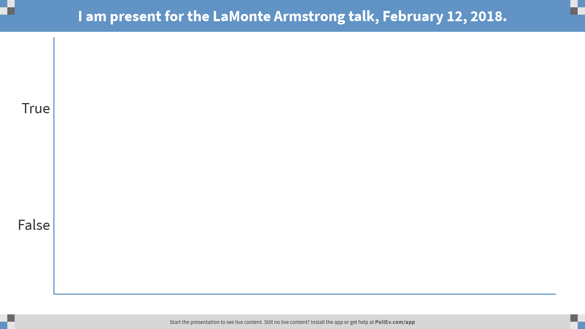
Notes:
Poll Title: I am present for the LaMonte Armstrong talk, February 12, 2018.
https://www.polleverywhere.com/multiple_choice_polls/njH9rDFWQitIgCL

