Slide 1
Racial Justice Act, Part I
Feedback on our quiz from last week: people were cheating
OMG, what the heck? This is a class on justice.
Questions before we start?

Slide 2
Courts unresponsive to statistics
McCleskey v. Kemp, 1987
Baldus study: review of all Georgia death-eligible cases, same as Donohue did for Connecticut (2,500 murders, 39 non-racial variables, killers of whites 4.3 times more likely to be sentenced to death in Georgia than killers of blacks)
(Attorney arguing the case before the USSC: Jack Boger, until recently the Dean of UNC Law School)
McCleskey v. Kemp: the Dred Scott of the 20th century. Statistics don’t matter. Must prove “intent to discriminate” in the individual case.
McCleskey as the “bitter end” or a litigation strategy based on racial disparities
Huge legal investment in this idea, from 1940s through the 1980s, ends in complete failure

Slide 3
Batson v. Kentucky (1986)
You may not reject all the blacks from the jury pool.
OK, great.
However, no such challenge has ever been successful.
DA must provide “a reason” other than race to strike the person. “He shuffled” is accepted. He’s a member of the NAACP is accepted.

Slide 4
So a turn to the legislature
If the US SC will not use statistical evidence, pass a law specifically to allow this
From lawyering to lobbying…

Slide 5
Feb 2001 RJA proposed
Rep. Ronnie Sutton (D-Pembroke)
Passed through committees, postponed indefinitely in Oct 2002

Slide 6
April 2007
Larry Womble, Earline Parmon, (D-Forsyth)
Died in committee

Slide 7
March 2009
Floyd McKissick Jr (D-Durham)
(Note: his dad was the first Black student at UNC Law)
Legislative Black Caucus pushes hard

Slide 8
Outside actors
NAACP, Rev. Barber, much more aggressive, public tone of pressure than previous president of NAACP
Death penalty reform advocates
Had already had lots of successes restricting use, many reforms since 2000 / 2001: eyewitness ID reform, discretion not to seek death, creation of Innocence Inquiry Commission, and so on…
Democratic caucus has a closed session, people come out unanimously in favor.
Black caucus within the democratic party: Don’t think representation does not matter; it does.

Slide 9
Timing is everything
NC as a leader in reforms from 2000 through 2009, eyewitness ID, many other reforms
Exonerations: lots of them here in NC
Lobbying by exonerees, including Bo Jones, Darryl Hunt, Jonathan Hoffman, Ed Chapman

Slide 10
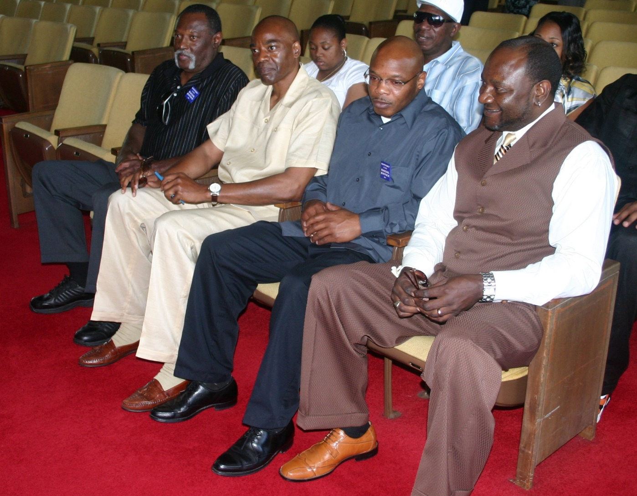
Lobbying the General Assembly: Bo Jones, Jonathan Hoffman, Ed Chapman, Darryl Hunt

Slide 11
2009 RJA
Read the law, it is only 3 pages long…
Show racial disparity in:
Decision to seek or impose death:
In the county, prosecutorial district, judicial division, or state
At the time that death was sought or imposed

Slide 12
Relevant evidence to demonstrate disparities
Statistical or other evidence including but not limited to:
Sworn testimony of attorneys… or other members of the criminal justice system

Slide 13
Any of three findings
Inmate’s race
Victim’s race
Peremptory challenges in jury selection

Slide 14
Kentucky passed the first Racial Justice Act (1999), but it was severely watered down
From the Winston Salem Journal, Dec 25, 2011:
The North Carolina and Kentucky laws, although they are known with the same name, couldn't be more different. The law in Kentucky isn't retroactive for defendants sentenced to death before 1998, and they can only raise a claim before a trial. They also have to prove by clear and convincing evidence that racial bias played a role in their individual case, which limits the use of statewide statistics. The law also prohibits defendants from claiming racial discrimination in a jury's decision to impose the death penalty.

Slide 15
States seek death, juries impose it
Thinking back to Deadly Justice, chapter 4 on racial bias, you will see separate analyses of:
DA’s decision to seek a death sentence (e.g., “charging”)
Juries’ decisions to impose death (“sentencing”)
Should we constrain the actions of jurors? Kentucky said no. Is the jury a state actor? Interesting philosophical / legal question.

Slide 16
Defendant has burden of proof
State may offer rebuttal evidence, including statistical evidence
Court may consider evidence of programs designed to eliminate race as a factor

Slide 17
Relief
Death sentence shall be vacated and the inmate resentenced to LWOP

Slide 18
Some details
Some caveats at the end:
“… comply with G.S. 15A-1420, 15A-1421, and 15A-1422.“
Follow procedures for MAR
Court costs up to judge for indigent defendants
Appeals follow normal procedures
http://law.justia.com/codes/north-carolina/2009/Chapter_15A/Chapter_15A.html

Slide 19
OK, what is clear and what is not clear?
Clear:
Inmate
Victim
Jury selection
Statistical evidence can be used

Slide 20
Unclear, needs to be litigated…
What if I show bias in the county, but the state rebuts that there is no bias in the district or state?
What if I show bias in a certain time frame? Which time frame is appropriate? Can’t just be the day of my trial, obviously.
What if the state counter-argues that it was 10 years ago, and therefore not relevant, or in a different county / judicial district?

Slide 21
What is enough disparity?
40% for whites v. 41% for blacks? Is that enough?
Judge has to rule on this, unclear
Judge Weeks: BOTH statistically significant at .05 level (1 in 20 chance of occurring by random chance), AND a 20 percent difference in value. This was taken from employment law.
(His ruling shows that for jury strikes, the actual probability level was more like 1 in 10,000,000,000,000,000,000,000,000,000,000.)

Slide 22
10,000,000,000,000,000,000,000,000,000,000.
ten commas?
1: thousand
2: million
3: billion
4: trillion
5: quadrillion
6: quintillion
7: sextillion
8: octillion
9: nonillion
10: decillion
So the odds were 1 in 10 decillion, not very likely.

Slide 23
How to rebut?
Statistical evidence, clearly
But also “sworn testimony” of people involved in the system
I did not intend to discriminate
We have programs in place to eliminate discrimination
Unclear how such evidence would / should be weighed by a judge or the NC SC

Slide 24
How did this ever pass???
O’Brien and Grosso article
Our focus on Wednesday: debates, 4 cases that were heard, revision in 2011, repeal in 2013, current law (2015) designed to speed up executions: Restoring Proper Justice Act

