Slide 1
POLI 203 Results of Anonymous Survey and factual questionnaire
Note this point of comparison for survey results, the Gallup Poll historical collection of results for their death penalty questions. Our survey used the same question wordings as the Gallup Poll.
https://news.gallup.com/poll/1606/death-penalty.aspx

Slide 2
Q1. Are you in favor of the death penalty for a person convicted of murder?
 | POLI 203 | Most Recent Gallup Poll
Favor | 24 | 56
Oppose | 76 | 42
Total | 100% (349) | 100%

Slide 3
Q2. If you could choose between the following two approaches, which do you think is the better penalty for murder?
 | POLI 203 | Most Recent Gallup Poll
the death penalty | 13 | 36
life imprisonment, with absolutely no possibility of parole | 87 | 60
Total | 100% (351) | 96%

Slide 4
Q3. Regardless of whether or not you think it should be legal, for each one, please tell me whether you personally believe that in general it is morally acceptable or morally wrong. How about the death penalty?
 | POLI 203 | Most Recent Gallup Poll
Morally acceptable | 32 | 60
Morally wrong | 68 | 35
Total | 100% (349) | 95%

Slide 5
Q4. In your opinion, is the death penalty imposed -
 | POLI 203 | Most Recent Gallup Poll
Too Often | 67 | 29
About the right amount | 27 | 28
Not often enough | 6 | 37
Total | 100% (351) | 94%

Slide 6
Q5. Generally speaking, do you believe the death penalty is applied fairly or unfairly in this country today?
 | POLI 203 | Most Recent Gallup Poll
Fairly | 89 | 49
Unfairly | 11 | 45
Total | 100% (351) | 94%

Slide 7
Q6. Apart from your opinion about the death penalty, what form of punishment do you consider to be the most humane?
 | POLI 203 | Most Recent Gallup Poll
Firing squad | 11 | 9
Hanging | 3 | 5
Lethal injection | 83 | 65
Electric chair | 1 | 4
Gas chamber | 1 | 4
Total | 100% (351) | 87%

Slide 8
Q7. Do you feel that the death penalty acts as a deterrent to the commitment of murder, that it lowers the murder rate, or not?
 | POLI 203 | Most Recent Gallup Poll
Yes, does | 10 | 32
No, does not | 90 | 64
Total | 100% (350) | 96%

Slide 9
Q8. How often do you think that a person has been executed under the death penalty who was, in fact, innocent of the crime he or she was charged with -- do you think this has happened in the past five years, or not?
 | POLI 203 | Most Recent Gallup Poll
Yes, has | 93 | 59
No, has not | 7 | 31
Total | 100% (350) | 90%

Slide 11
Q10. Which comes closer to your view?
 | POLI 203 | Most Recent Gallup Poll
allow lethal injection | 57 | 75
lethal injection should not be permitted | 43 | 21
Total | 100% (350) | 96%

Slide 12
Do you favor or oppose the death penalty for: (Percent opposed)
 | POLI 203 | Gallup
Women | 72 | 29
Mentally Ill | 90 | 75
Mentally retarded | 95 | 82
Juveniles | 94 | 69

Slide 15
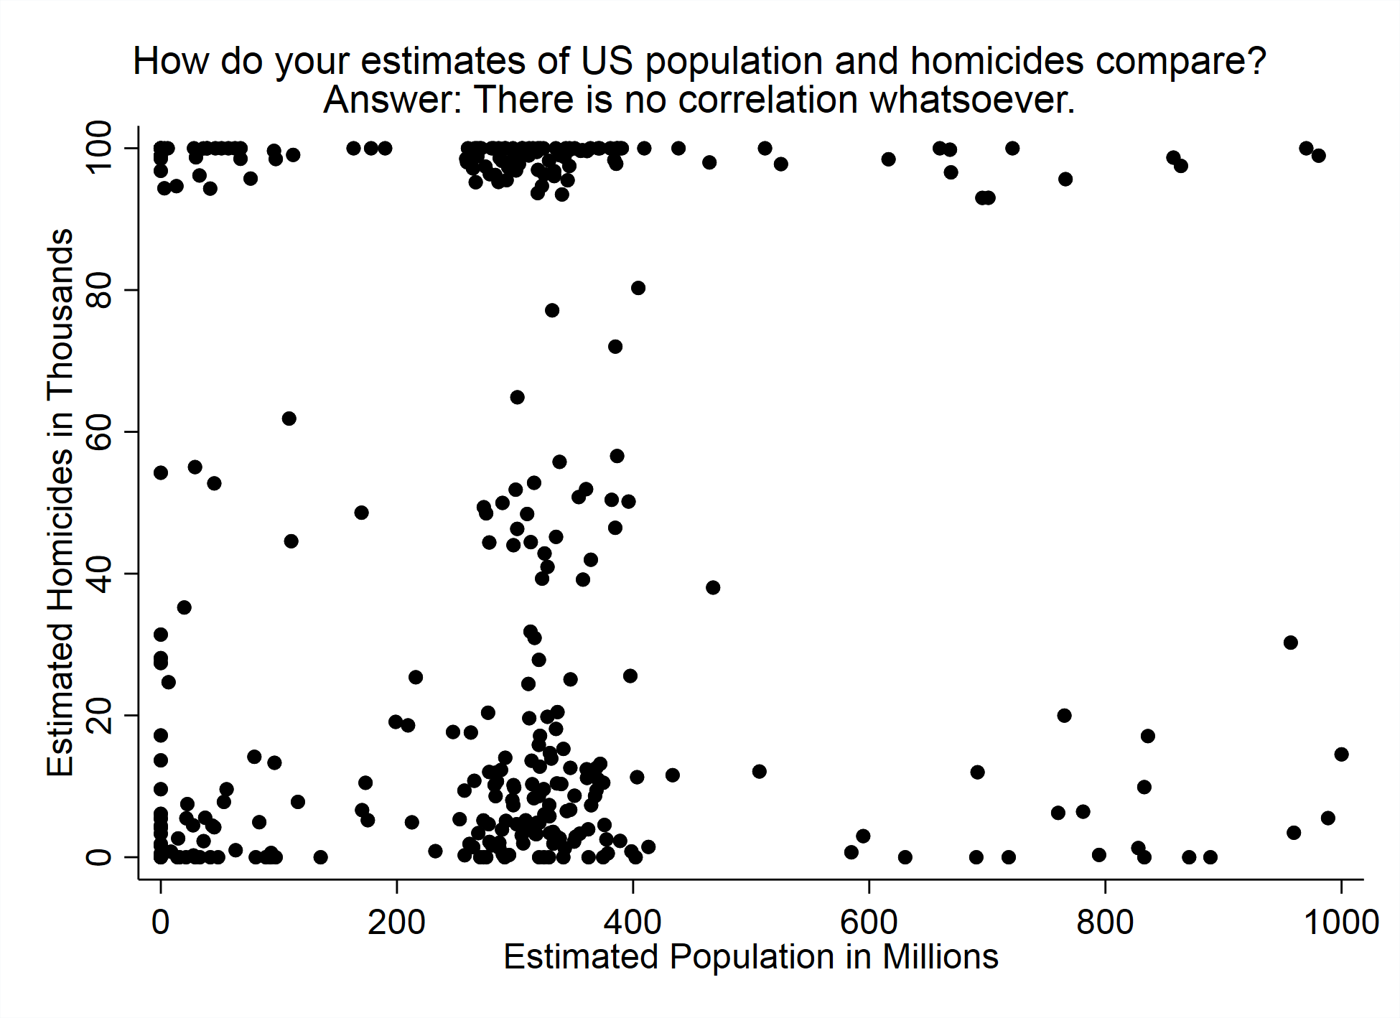

Slide 17
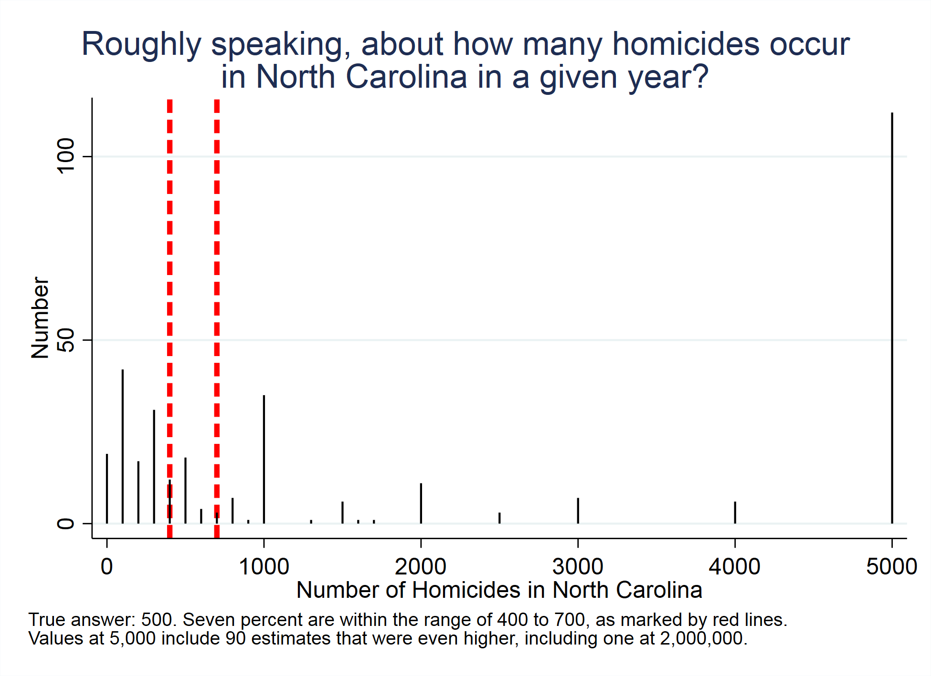

Slide 18
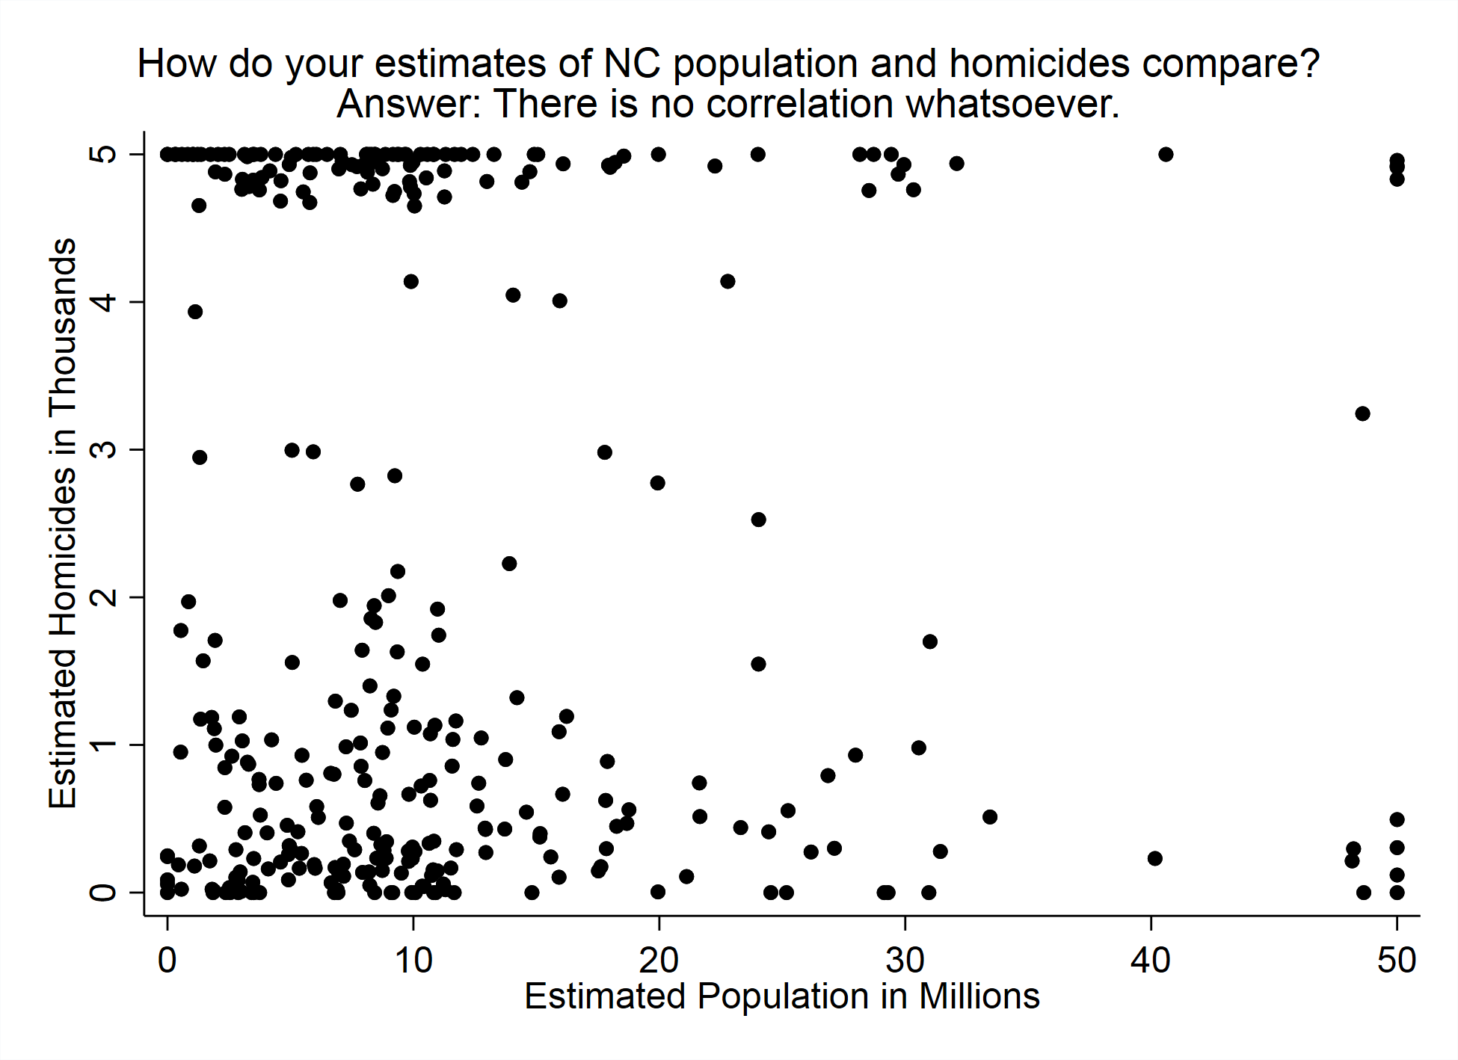

Slide 19
Maximum homicide rates:
Roughly speaking, what was the maximum number of homicides in the US in any single year from 1972 to present?
In North Carolina?
These results were so crazy I did not graph them.
US: 300,000,000 max estimate
NC: 10,000,000 max estimate
Note: that’s the entire population!

Slide 20
True or false: It costs more to maintain the death penalty than to have Life without Parole as the most severe punishment?
True: 58%
False: 42%

Slide 21
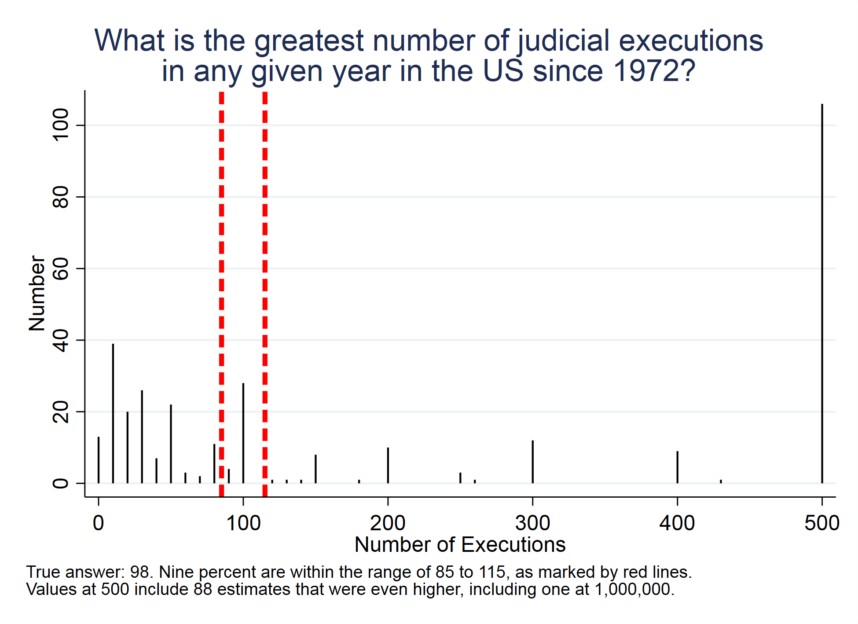

Slide 22
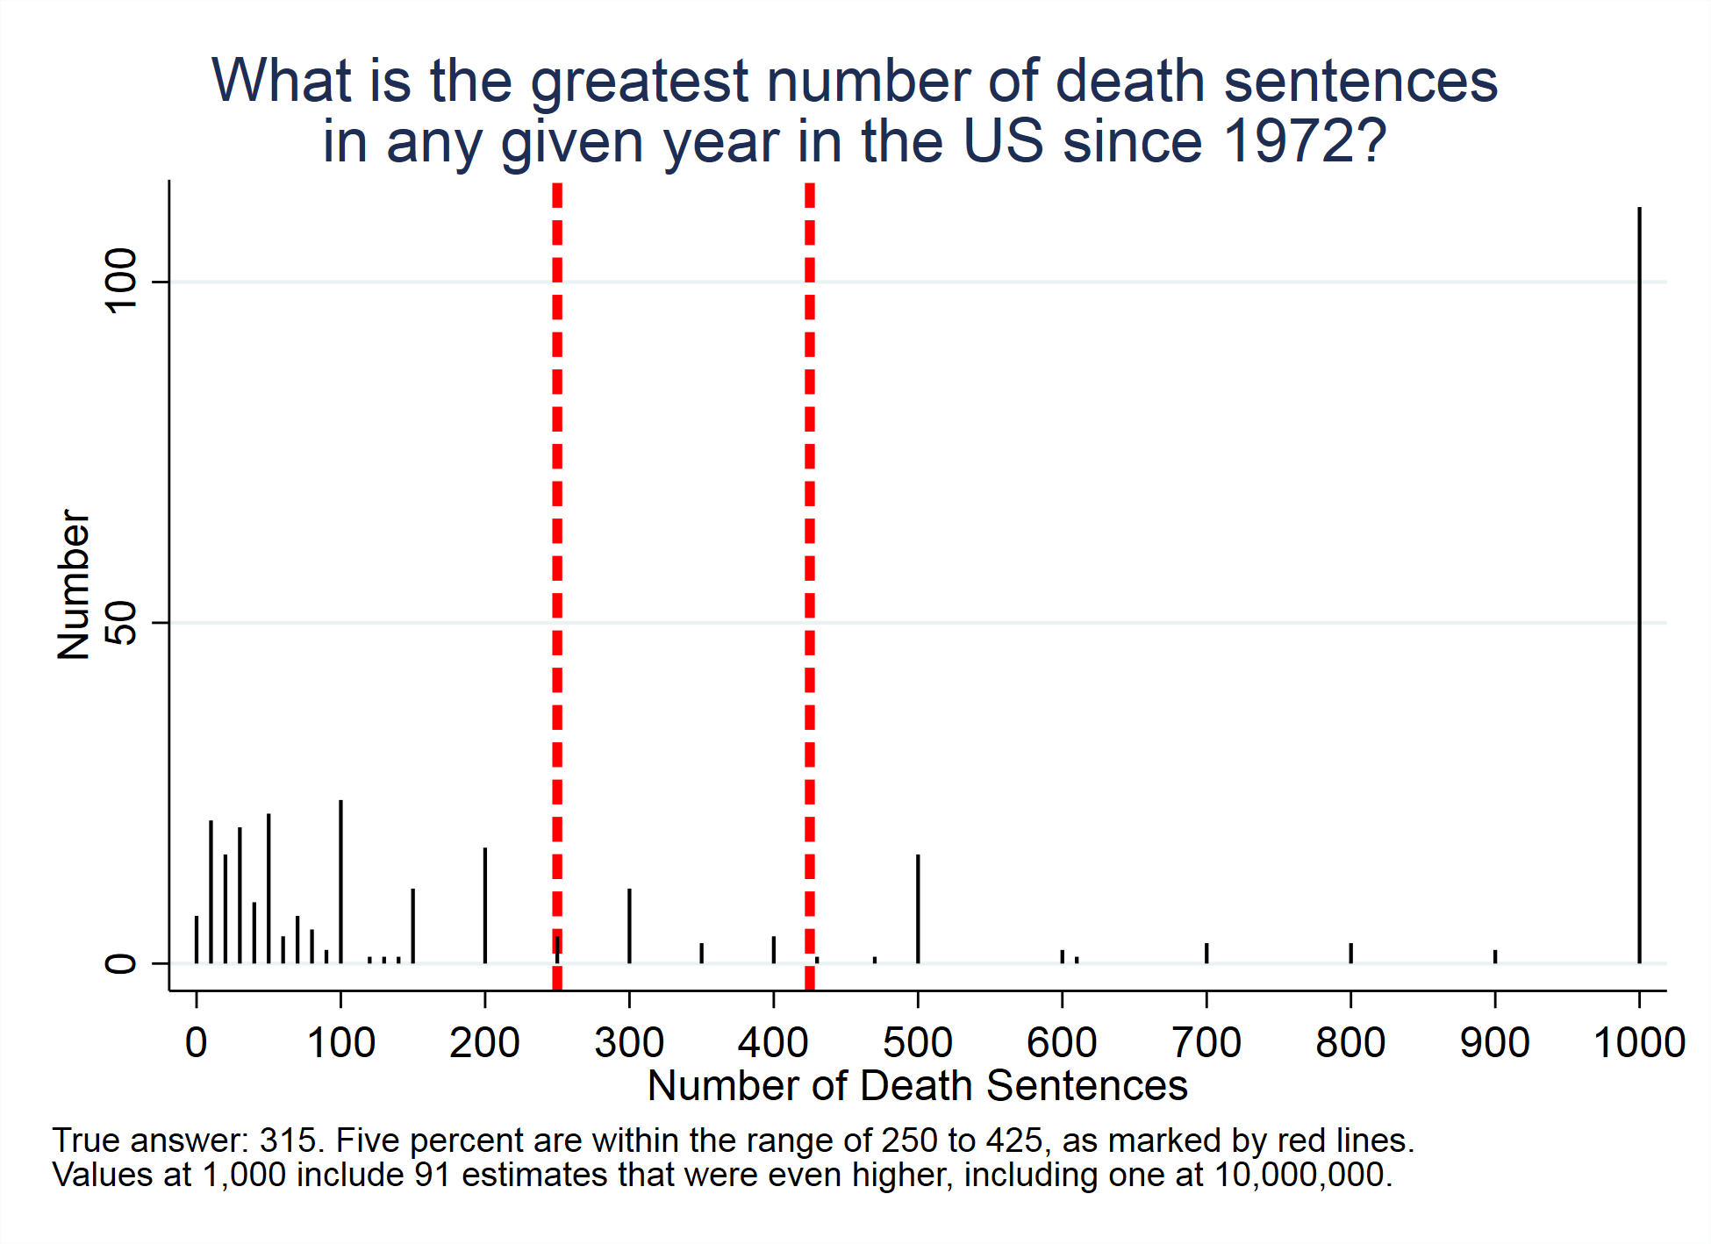

Slide 23
True or false: No one in the US may serve on a jury in a capital case unless they believe in the death penalty.
True: 25%
False: 75%

Slide 24
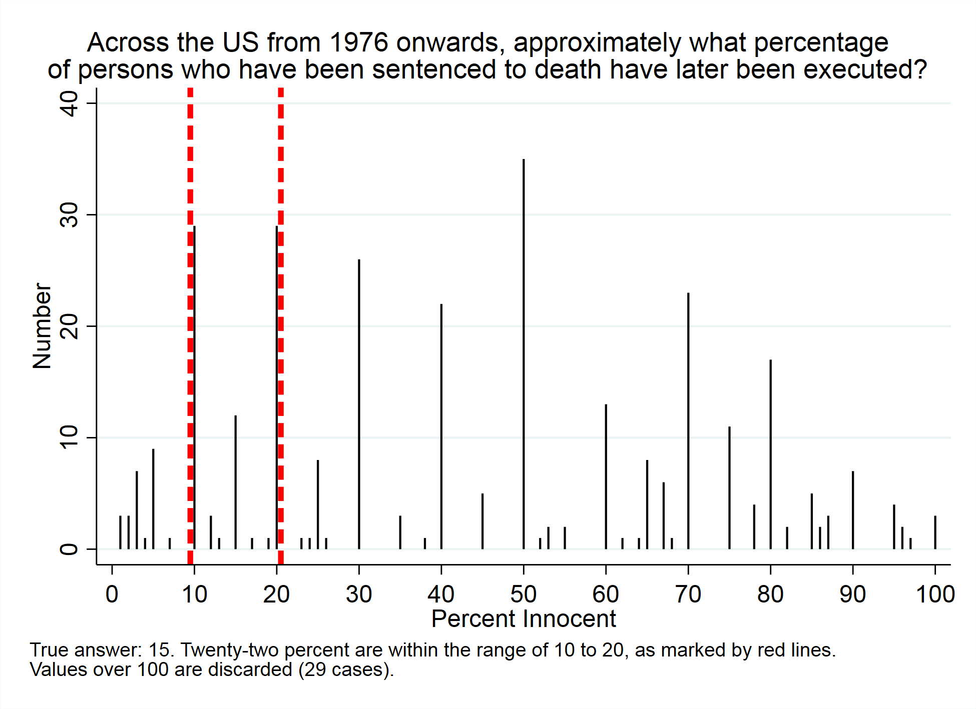

Slide 25
Which state has executed the most people since 1976?
Texas: 54%
Any other answer: 46%

Slide 26
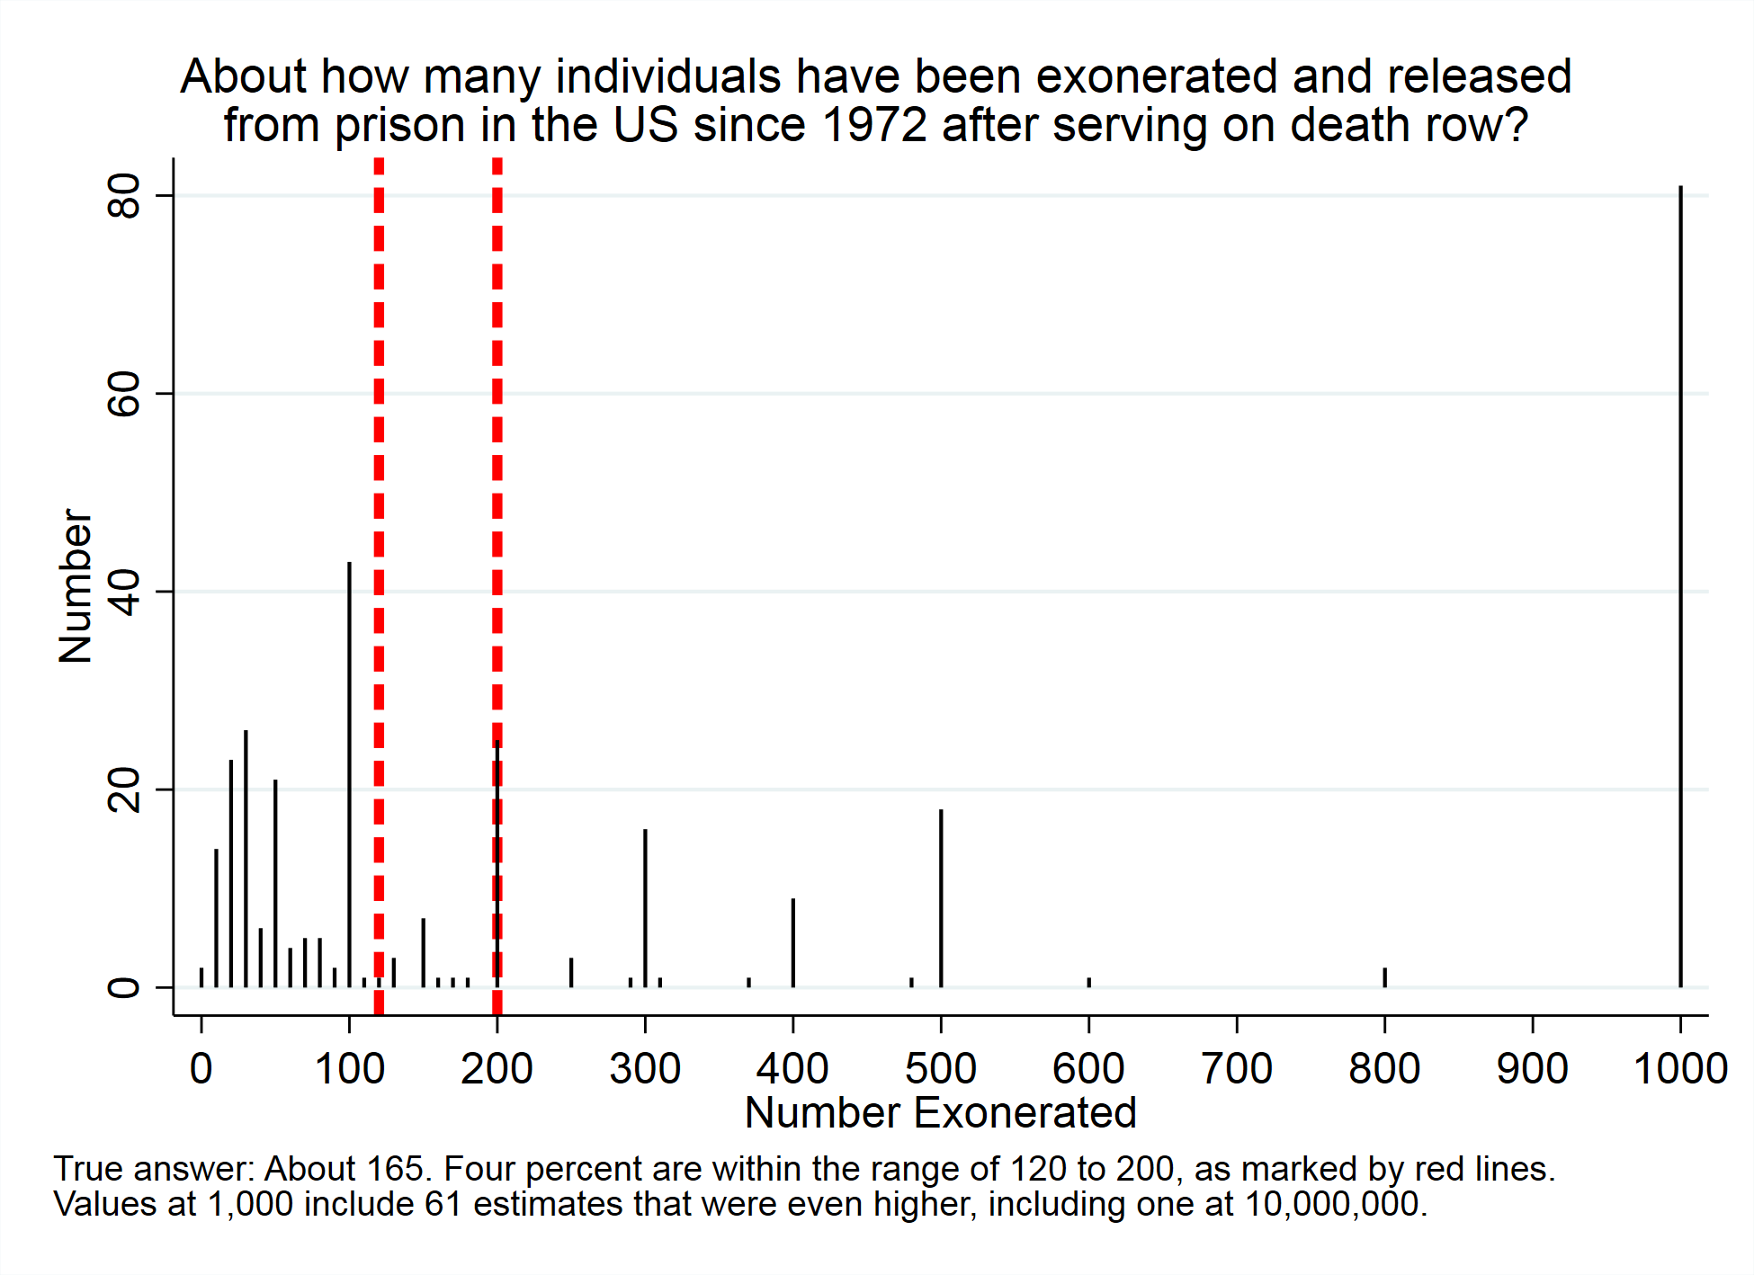

Slide 27
Which city has the most _____ since 1972?
 | Homicides | Executions | Death Sentences
Los Angeles | 20* | 14 | 35*
Chicago | 73 | 21 | 27
St. Louis | 7 | 65* | 39
(*: correct)

Slide 28
One county in the US has more executions than any state other than its own. Name that county or its major city.
Houston, Harris County, or any version: 7%
Other common answers: St. Louis, Los Angeles, Dallas, Chicago

Slide 29
Circle the states that currently have the death penalty
State | Yes | No
Oregon (yes) | 36* | 64
Ohio (yes) | 81* | 19
Michigan (no) | 67 | 33*
Vermont (no) | 30 | 70*
New Jersey (no) | 55 | 45*

Slide 30
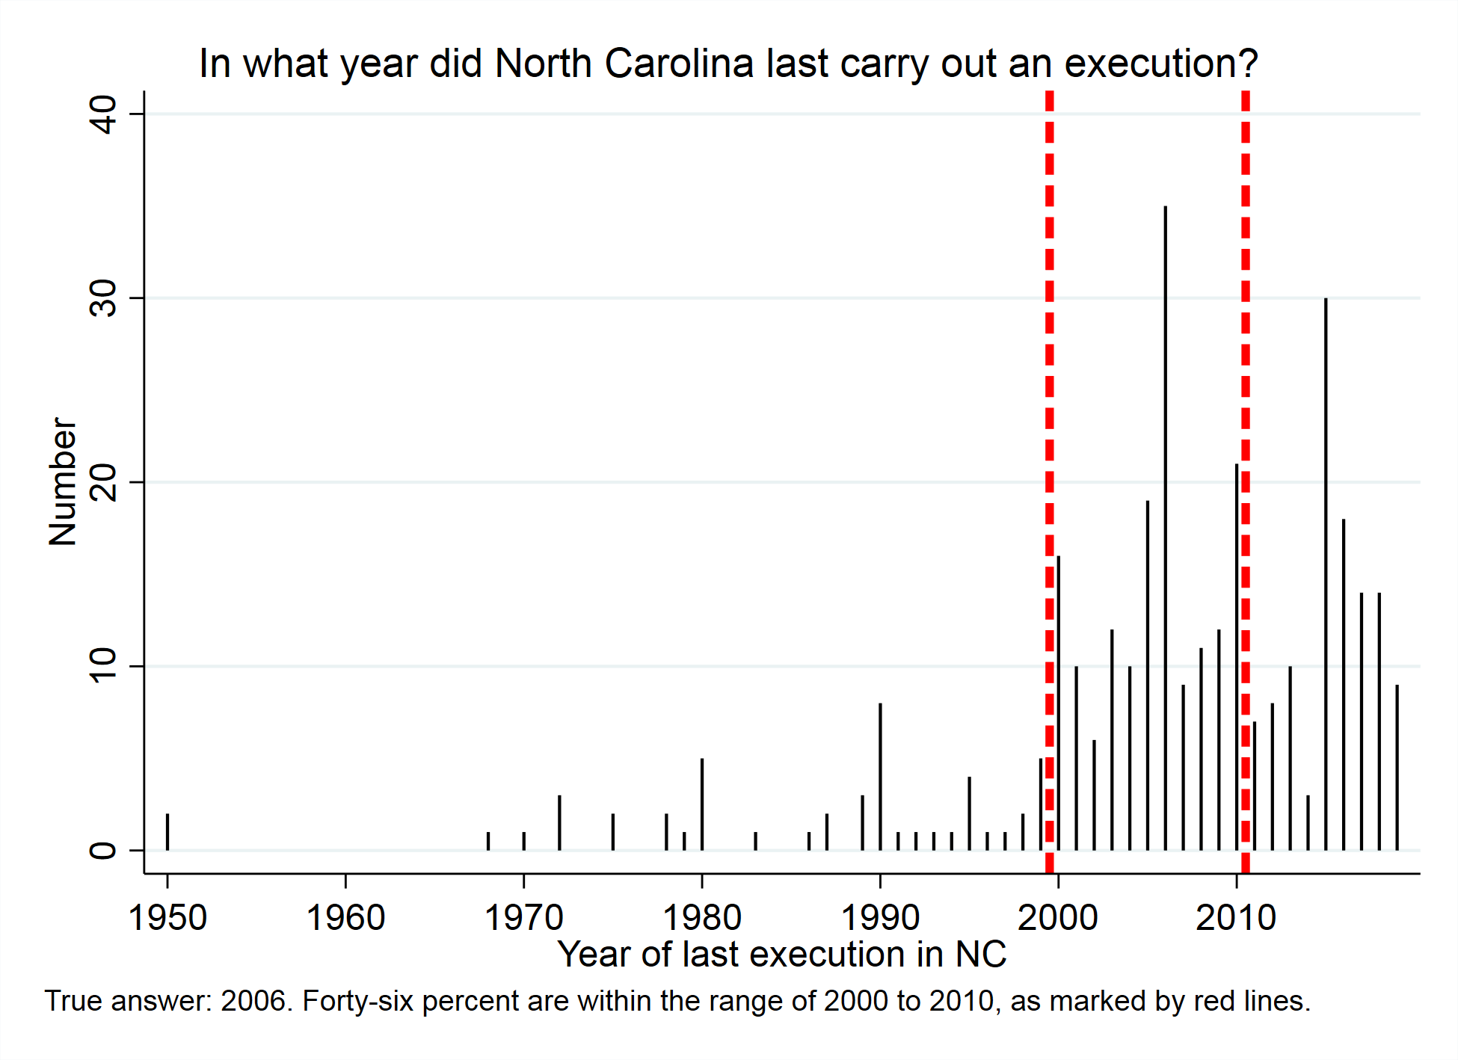

Slide 31
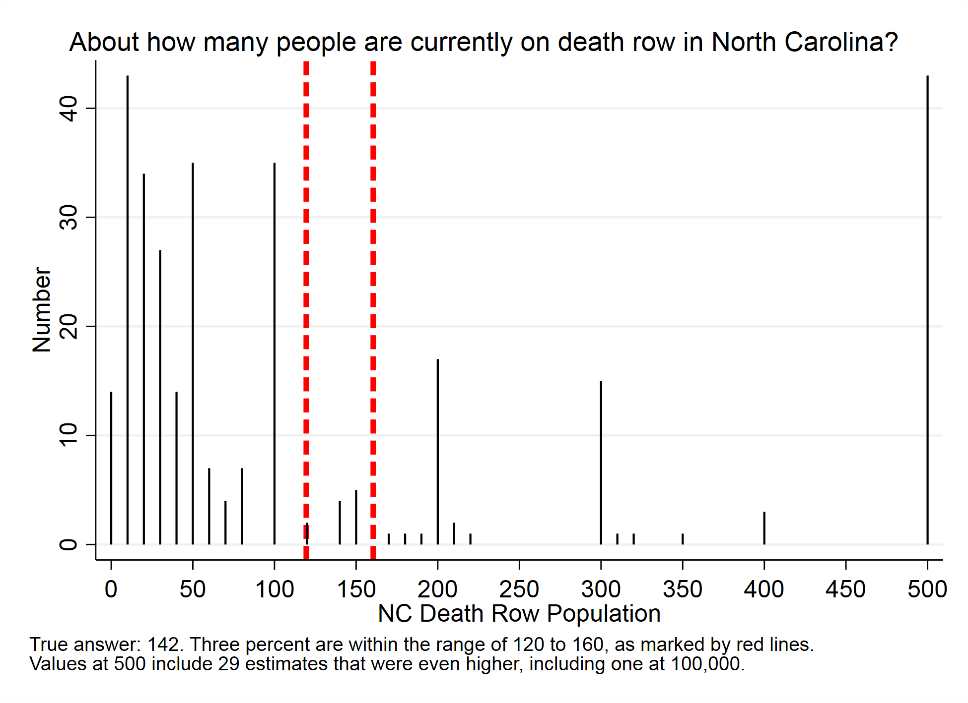

Slide 32
Which NC County has imposed the most death sentences since 1972?
County | Percent | Actual Number
Durham | 28 | 9
Forsyth | 14 | 31
Mecklenberg | 25 | 30
Orange | 13 | 1
Robeson* | 20 | 34

Slide 33
Good thing we’re not keeping grades!
Question | Percent Correct |  | Question | Percent Correct
US Population | 27 |  | City of death sentences | 35
US Homicides | 6 |  | County of executions | 7
NC Population | 17 |  | Oregon has dp? | 36
NC Homicides | 7 |  | Ohio has dp? | 81
Cost of DP higher | 58 |  | Michigan has dp? | 33
Max # executions | 9 |  | Vermont has dp? | 70
Max # death sentences | 5 |  | NJ has dp? | 45
Death qualification | 25 |  | Most recent NC execution | 46
Execution rate given condemnation | 22 |  | NC DR population | 3
Highest executing state | 54 |  | Top NC county for dp? | 20
Number of exonerations | 4
City of homicides | 20
City of executions | 65 |  | Average | 30.2

