Slide 1
POLI 203, Ghost of an Innocent Man
This lecture is going to focus on the Willie Grimes case, covering the odd-numbered chapters from 1 to 17.
On Wednesday, I’ll focus on the even-numbered chapters, 2 to 18.
So today is about the case itself, and Wed will be about NC policy reforms that mirror the case and are covered in the even-numbered chapters of the book.
I’ll do the same next week for the second half of the book
March 30, 2020

Slide 2
Announcements and catch-up
First, I apologize for the rookie mistake in setting up the first Quiz. I set it up to have a time limit of 30 minutes, but many students in the class are registered with ARS for disabilities and some of those individuals are entitled to extra time for assessments. I didn’t think the quiz would take 30 minutes anyway, but rather than make two versions of the quiz, I decided to simply remove the time-limit. When I did that, Sakai would not allow me to apply the change to the current quiz, since it was already live. So I had to make a second quiz, seen on Sakai as Quiz 1a. You should have taken just one or the other, but for this case, we’ll just count your highest score if you took both of them. Sorry for the confusion.

Slide 3
Announcements (cont.)
McGautha. I’ll generate another lecture / review of those results during this week. It will likely be much shorter than normal, but look forward to seeing it this week. Thank you for filling out that assessment. I’ll have it before Wednesday.
Quiz 2 will be due next Friday, April 3, just before midnight. It focuses on materials from weeks 2 to 5 of the semester. It will be available on Wednesday.

Slide 4
The Willie Grimes case
BTW, you can see extensive files on the exoneration of Mr. Grimes at the website of the NC Innocence Inquiry Commission.
https://innocencecommission-nc.gov/cases/state-v-grimes/
You might find it interesting to review that material.
Also note all the other cases with extensive materials there:
https://innocencecommission-nc.gov/cases/
We’ll talk more about the Commission in coming lectures.

Slide 5
Some questions the first chapter raises
Which witness are granted credibility?
The victim / survivor, certainly, is given credibility.
Generally, we believe survivors.
They have no desire to convict the wrong person, certainly not wanting the true perpetrator to go unpunished, for sure!
On the other hand, it’s surprising how easy it is for mistakes to happen
When the police say, we have a suspect, could you please come to the station to make an identification, and you want to help solve the crime and punish the x&@! person who assaulted you, you may feel implicit pressure to pick the closest match. You may not even realize it.
In any case, survivors get credibility; after all, they were there.
But note, obviously from this case, they can be wrong.

Slide 6
Credibility of witnesses
Family members of the accused:
“You would lie for your brother / son, wouldn’t you?”
(At least this is an implicit concern for the DA, the judge, and jurors)
The accused him / herself:
They are at the defense table in the court room, and the crime was really bad.
If they are so innocent, why did the police arrest them, and why are they the one and only person being tried for this case?
(Note that jurors are not made aware if there are other suspects, and trials are most often of just one person at a time, generally. So the only question for the jurors is, shall we find this particular defendant guilty?)

Slide 7
The crime was really bad
There is great pressure to hold someone accountable
But the trial occurs in a situation where the jury is not aware of any other suspects.
So, it’s psychologically really hard to say: Yes, this was a terrible crime and we are so sorry and we want it to stop, but we don’t have confidence in our local police department and we think they messed up the investigation. This does occasionally happen, of course, but the pressure and the slippery slope is in the other direction.

Slide 8
The social environment of the crime:
The crime took place in a public housing project
Everyone involved was poor
There was also a racial element: white female victim / black male perpetrator
Small town with a small police department
Poverty matters:
No funds for a strong legal defense team
Social status means the DA can discredit witnesses more easily
Someone might testify for the reward money
Someone might be “under paper” – police can more easily motivate testimony

Slide 9
The racial dynamic
White female victim / black male offender
This is the classic combination for difficulty:
Cross-racial eyewitness identification is not as good.
The perpetrator was not known to the victim; not an acquaintance
Jury sympathy for the victim of the crime, and distrust of the accused, both are enhanced by race and gender.
Note that the true perpetrator, Albert Turner, was also a black male. So the victim was not making up the idea that she was attacked by a black male; indeed she was. But it was a different person. Albert Turner was the perpetrator.

Slide 10
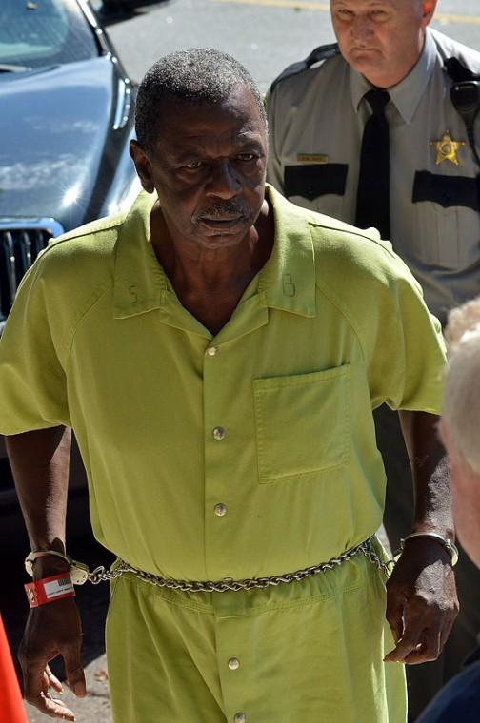
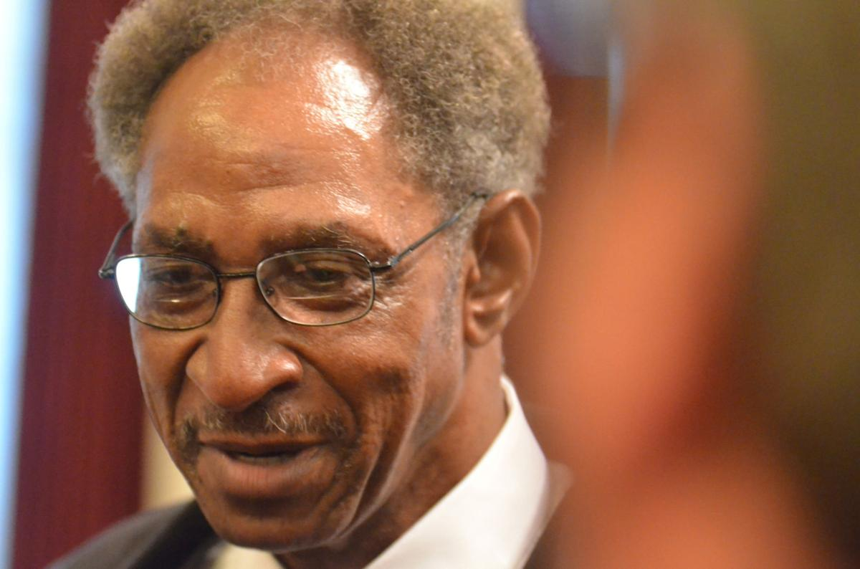
The true perpetrator (Turner) and the wrongfully convicted (Grimes)
Albert Turner
Willie Grimes

Slide 11
Forensics and hair
This was clearly a weak point in the investigation
However, when the DA stands in the courtroom and says that the evidence is “scientific” and “proves” or “links the suspect to the crime” and that the person testifying to this is a respected expert in his/her field, that gains a lot of credibility. It’s hard to debunk an SBI forensics expert.
(In retrospect, like eyewitness IDs, many of these “scientific” studies have been shown to be wrong. But they have a high degree of credibility in they eyes of the jury…)

Slide 12
A pretty incomplete / shoddy police investigation
They never gathered key pieces of evidence; the did not collect the fingerprints from the victim or other innocent people / non-suspects who were at the crime scene, etc.
Not totally uncommon for a small town police department (no offense to small town police departments!)
Totally sufficient to get a conviction, however.
In fact, the conviction could be made easier, paradoxically, if the investigation is relatively cursory: It points to a potential offender, and that’s good enough. More evidence might only serve to complicate matters…

Slide 13
The jury would never believe this story…
The perpetrator wasn’t wearing a shirt
Willie Grimes has a huge scar on his chest from an accident at work
The perpetrator was holding a knife in his right hand
Willie Grimes is missing the tips of two fingers, from another accident
The perpetrator has a mole on his face
So does Willie Grimes
(Willie was the only one with a mole in the photo line-up when identified.)
Why would the jury convict? Well, they did, so there must be a reason. Sympathy for the victim? Feeling that the only thing they can do is find someone guilty. Recall, they were not presented with Albert Turner, only Willie Grimes.

Slide 14
Crime-stoppers and the issue of financial motivation for testimony
Offering a reward for helpful testimony to put a criminal behind bars is common practice.
Would you perjure yourself for $500? $5,000? $25,000? A few million (to get Osama bin Laden, for example)?
We have a long tradition of offering such rewards; just see any western cowboy movie!
But:
Really desperate poor people could be motivated…
People who like attention could use the opportunity to get some
People with vendettas against old boy-friends, local enemies, or rivals…

Slide 15
But wait, isn’t this professor just too cynical?
Good police practice should not allow this. Police investigators should be cynical, worldly, and suspicious. And the are.
But put yourself in the position of trying to solve a brutal rape of an innocent elderly lady living in your community. You’d certainly want to close the case.
And you have a likely suspect. And you have people eager to testify against him. And you have a photo line-up identification from the survivor of the crime. And you have no other suspect to look at.
Willie Grimes was toast.

Slide 16
After the conviction
Shock, disbelief; there was no evidence to put him there!
Life sentence
(Note, if this crime had been post-1993, that would have been LWOP, but at the time, he would be eligible for parole after some long period of time)
Processing and assignment to prison
All inmates are sent to Central Prison in Raleigh on conviction to be “processed”
Review of education, skills, background, health and psychological tests
Figure out which prison across the state to send them to; send them off.
He gets maximum security because of the severity of the crime and the length of the sentence. He then has to earn through good behavior a reduction in grade to medium-security and wants to get minimum security (honor grade) eventually. But that will be hard with a long sentence.

Slide 17
“Inmate denies guilt”
Continued psychological assessments lead to problems for Mr. Grimes, as he never acknowledges his guilt.
This is taken as a sign of either a sign of no empathy for the victim, or of a lack of responsibility for his own actions.
The paradox of being in prison for a crime you did not do.
Better to be guilty. At least you can express remorse, as is expected.

Slide 18
Legal appeals: Time delays
Several interesting things to wrap your head around
First, how long they take
Lawyers and judges work on a really slow schedule
(This is not because they’re not working, but the system is handling thousands of cases, so there is a queue for everything. So a judge is working on one case, has a hearing about another, and sets the date for the next hearing, say 18 months out in the future. Then if an attorney has a hardship, it’s no big deal to give a 90 day extension. Time. Moves. Slowly. In. Prison.)

Slide 19
Legal appeals (cont.): Presumption of Guilt
Presumption of innocence becomes a presumption of guilt, once you have been convicted.
This means that the appeals courts are not looking at the evidence in the same way as in the trial court.
They are much more lenient toward the state.
(Note: if the state had not won, the inmate would not be appealing, and the state may not appeal a verdict of not guilty. So by definition, appeals courts only deal with people claiming an error in their trial which found them guilty.)

Slide 20
Legal appeals (cont.): Don’t second-guess the jury
Let’s say there is contradictory evidence presented in trial
This did happen in his case, as it usually does
Victim of the crime says: Willie Grimes did it.
Relatives of the defendant say: No he did not.
State says: He has a mole. Defense says: Yes, but also a scar and missing fingers, never mentioned by the victim, who would have noticed that.
It’s the jury’s job to decide who is right.
Appeals Court judges typically give a lot of weight to whatever judgments were made at the trial court
The appeals court only sees a transcript; the jurors and judge were there in the courtroom for the testimony.
So if the jury says that the victim’s testimony is more credible than the other witnesses, the appeals court is not likely to say this is not true.
So, if the jury believes false testimony, there is little to do.

Slide 21
You have to find: new evidence, or a procedural error
The fact that the jury reached an inaccurate conclusion is not grounds for appeal.
(Hmm, let’s make sure we get our heads around that, from the perspective of Willie Grimes. His Prison Legal Services attorneys, as well as his original attorney say: We believe you are innocent. There is nothing we can do.)

Slide 22
Forensics: Hair sample analysis
We know now that this is “junk science”. See the National Academy of Science report on forensic science, from 2009:
“As an example, in a FBI publication on the correlation of microscopic and mitochondrial DNA hair comparisons, the authors found that even competent hair examiners can make significant errors.35 In this study, the authors found that in 11 percent of the cases in which the hair examiners declared two hairs to be “similar,” subsequent DNA testing revealed that the hairs did not match.”
35. M. Houck and B. Budowle. 2002. Correlation of microscopic and mitochondrial DNA hair comparisons. Journal of Forensic Sciences 47(5):964-967.
Strengthening Forensic Science in the United States: A Path Forward http://www.nap.edu/catalog/12589.html

Slide 23
More from the National Academy Report:
P. 160-161. An FBI study found that, of 80 hair comparisons finding two hairs to be “associated”, 9 percent were in fact not from the same person. So 91% accuracy.
P. 160: “No scientifically accepted statistics exist about the frequency with which particular characteristics of hair are distributed in the population. There appear to be no uniform standards on the number of features on which hairs must agree before an examiner may declare a “match.” In one study of validity and accuracy of the technique, the authors required exact agreement on seven “major” characteristics and at least two agreements among six “secondary” characteristics. The categorization of hair features depends heavily on examiner proficiency and practical experience.”

Slide 24
But that was 2009; Grimes was convicted in 1988.
The DA presented an expert from the NC State Bureau of Investigation who said there was a “match”.
The defense says: No, that’s impossible, you must have made a mistake.
The DA says: Members of the jury, you can decide whom to believe.
Easy-peasy.

Slide 25
Some aspects of life in prison: Medical
Medical care
Poor in general
Lots of depression, so lots of drugs for that.
Xanax zombies. Lots of people walking around drugged up
This makes people less violent, less likely to erupt in anger.
Easy to see the temptation to over-prescribe. Everybody “wins”
But there are obvious downsides to this for your health…

Slide 26
Life in prison: Moving
He was moved around a lot. One never knows when it’s going to happen.
Chris Turner, one of our speakers who was not able to come, was in the *federal* system, and there you can be moved all around the country…
Inmate wants:
Lower custody level
Camp or prison closer to family and friends so they can visit
Camp or prison with less violence, more programs, etc.
State wants:
No trouble, no corruption, no close friendships, no loss of power
Also, punish the person, not coddle them. So they do not necessarily do what the inmate wants.

Slide 27
Life in prison: Prison attorneys
You heard from our speakers, many inmates become pretty accomplished lawyers.
But here you see the other side. They can also be amateurish, or incompetent.
Once you file an appeal on a given issue, and it is denied, you can no longer file an appeal on that issue again.
So, if you do a bad job, and work without a (good) attorney on an appeal, you could lose the opportunity ever to raise that issue again…
Legal concept: once the issue is adjudicated, you can’t waste our time by asking us to adjudicate it again.
(It would require new evidence, not available at the earlier time.)

Slide 28
Life in prison: Losing touch with friends and family
Willie lost touch with his girlfriend, and found out later she passed away.
But his family knew he was innocent and others continued to believe so.
He was relatively fortunate that way, compared to others.
Many people just fade away when a person is incarcerated…

Slide 29
Life in prison: Jobs and slave wages
13th Amendment:
“Neither slavery nor involuntary servitude, except as a punishment for crime whereof the party shall have been duly convicted, shall exist within the United States, or any place subject to their jurisdiction.”
Sounds good, until you pay attention to the “except” part…
Central Prison: You must work, and if you do not, you go into “segregation.” Segregation is Corrections-speak for solitary confinement, 23 hours in a cell, movement only with chains and restraints.

Slide 30
Life in Prison: Jobs (cont)
40, 70, 100 cents pay, per DAY.
Recent trip to Central Prison. Minimum security prisoners from another camp are living at Central Prison, death row, as they do a construction project, building a geriatric center in the hospital. They do all the construction work, plumbing, electrical, sheetrock, painting, demolition, etc.
These are the elite of the prison system, and they make “good money”.
Their pay: $3 per day.

Slide 31
That’s it for today
Wednesday, we’ll look at the even-numbered chapters in the first half of the book, focused on what was happening among a group of policy advocates, judges, and others seeking to find a system to deal with claims of innocence.
Also, results from your McGautha exercise.
Remember, a quiz on Wed due on Friday.
Have a great rest of the week.

