Slide 1
POLI 203, Ghost of an Innocent Man
This lecture focus on the even-numbered chapters, 20 to the end.
So: Policy reforms leading to the creation of the Innocence Inquiry Commission, and its initial workings..
April 8, 2020

Slide 2
Announcements and catch-up
Feedback on quizzes 1 and 3 (coming in later slides)
FYI, I had this note from a contact, concerning Lyle May: Lyle was interviewed by a producer for Dr. Sanjay Gupta's podcast yesterday. He asked me to let you know in case you might be interested. Lyle was told that the episode about COVID-19 in prisons would be broadcast sometime this week. The podcast is here: https://www.cnn.com/audio/podcasts/corona-virus
Read this letter from Henderson Hill and others asking the Governor to release people from prison because of Covid-19: https://www.scribd.com/document/454859721/Roy-Cooper-Letter-April-3

Slide 3
From a senior thesis (Sydney Johnson), this semester: NC prisoners are getting older…
1980: Average age, 33
2020: Average age, 41

Slide 4
Number of inmates over 50, 60, and 70
Today there are over 8,000 inmates in the system aged over 50 years old, and about 2,000 who are over 60.
Not because older people are committing crime.
Rather, LWOP is keeping people in prison literally until they die. Just as intended, but probably more costly and less valuable in terms of public safety than people thought.

Slide 5
Quiz 1
232 responses; 84 percent got the correct answer for each of 9 of the questions, but only 63 percent got Q5 right:
5. Which of these is one of the four prongs of Justice Brennan’s test for cruel and unusual punishment?
  a) Causes pain
  b) Applied in a racially biased manner
  c) Per opinion polling, is not accepted by a majority of Americans
  d) No more effective than a less severe punishment
Look it up; this is in the Furman decision. What were his reasons?

Slide 6
Quiz 3
361 responses
Again, generally the vast majority of you got most of the questions right, but there were 4 questions this time with more errors:
Q1: just 44 percent got it right
Q2: just 50 percent
Q7: just 73 percent
Q3, just 78 percent

Slide 7
Quiz 3, question 1 (44 percent correct)
1. (1 points) Which of the following qualify as aggravating circumstances in capital cases in one or more states? i) The crime was perpetrated on educational property ; ii) “Heinousness”; iii) “Pecuniary gain”; iv) “Risk to many”
  a. ii and iii
  b. ii, iii, and iv
  c. ii
  d. i, ii, iii, and iv
All of the above is correct. Re-read the chapter on state laws, aggravators. 2, 3, and 4 are very common; #1 is rare but does exist.

Slide 8
Quiz 3, question 2, just 50 percent correct:
2. Under this statute, an individual who was not the triggerman but was party to the crime can receive a death sentence.
  a. Lying in wait
  b. Felony murder
  c. Future dangerousness
  d. Guilty accomplice
You may have been looking for the phrase “law of parties” but this is also known as “felony murder”: committing a felony during which a murder occurs.

Slide 9
Quiz 3, question 7, just 73 percent correct:
7. Which of the following is the most common contributing factor to wrongful convictions in death penalty cases?
  a. Official misconduct
  b. Mistaken witness identification
  c. False confession
  d. Ineffective legal defense
Go to the National Registry of Exonerations, or look through the class notes. Official misconduct is shockingly common.

Slide 10
Quiz 3, question 3, just 78 percent correct:
3. Empirical studies such as those done by Baldus generally find that this predicts the odds that a perpetrator of capital-eligible homicide will receive a death sentence.
  a. Legally relevant factors
  b. Legally irrelevant factors
  c. Neither legally relevant nor legally irrelevant factors
  d. Both legally relevant and legally irrelevant factors
Legally relevant factors are such things as whether particular aggravators were present, how many victims, whether there was torture, etc.
Legally irrelevant things are such characteristics as geography, race, gender.
Every single such study has found both to occur.

Slide 11
No, I don’t think those were trick questions.
Mean score on Quiz 1: 8.99
Mean score on Quiz 2: 10
Mean score on Quiz 3: 7.67
So, you are doing fine. But please expect more of the same, and review your notes from the book, lecture, and speakers.

Slide 12
Policy reforms leading to the Innocence Inquiry Commission (IIC)
Continued work of the informal working group convened by Justice Lake and pushed by Chris Mumma…
Frictions within the group, particularly from Colin Willoughby, the DA in Wake County.
In general, since the idea is to review convictions and “second-guess juries”, the DA community has little to win here, so are hesitant.
Trust in the system: will that be enhanced by overturning convictions, or by keeping potentially innocent people in jail? People disagree on this. Justice Lake does not waver on it, however, and it goes forward.

Slide 13
Passage of the bill in the General Assembly
Chris Mumma drafts the legislation.
Sponsors in the House and Senate.
Quick passage in House.
  Some politics before it is passed in the Senate:
    Wait until Justice Lake is forced to retire at age 72 before passage, just so he won’t get credit.
    Hassle Chris Mumma a bit, since she had run for State Senate in Durham (as a Republican, therefore in retrospect with little chance of being elected)
  But it finally passes and becomes law in 2006
Commission starts operation in 2007, with a 4 year sunset clause.

Slide 14
Let’s look at the Commission charge and rules
“By statute, the North Carolina Innocence Inquiry Commission:
Cannot review procedural errors, sentencing issues, or any other claims not associated with actual innocence.
Cannot represent claimants.
Requires that claimants waive all privileges, including, but not limited to, self-incrimination, attorney/client, spousal, doctor-patient, etc.
Turns over additional evidence of a crime(s), other’s involvement, and new crimes to law enforcement.”
(https://innocencecommission-nc.gov/commissioners-2/)

Slide 15
More on the IIC Charge
Only Class A-E felonies
Only claims of “complete factual innocence” for a crime as well as “any related and/or lesser offense”
So, it can’t be wasting its time on drug possession, only serious felonies (A-E)
Also, you can’t say: I was just a bit player in the crime. You can’t have had anything to do with it.

Slide 16
So the IIC is not a fishing expedition
It’s the result of a lot of compromise, not a defense attorney wish-list.
Many people with serious claims, particularly being over-charged or over-punished for minor crimes, have no place here.
Further, it still requires “credible and verifiable evidence of innocence” that “the jury did not hear” or which was “not available prior to a plea.” (So, for lots of people, that’s just not possible.)

Slide 17
The first few years
Kendra Montgomery Blinn is hired as the first Exec. Director.
(She was to be our speaker in class to talk about this, and also in the April 1 evening session to discuss the Chapel Hill triple homicide case. She is now an Assistant District Attorney in Durham, and was the lead prosecutor of Craig Hicks, who murdered the three students and who is now serving a sentence of LWOP.)
First few cases lead to denial of claims.
Greg Taylor case comes up in 2009-2010. He is exonerated in 2010.
Wake County DA: Colin Willoughby. Not a fan of Greg, to this day.

Slide 18
Greg Taylor
Spoke in the class lecture series in 2014
Left his car in the mud during a drug-induced weekend in Raleigh.
Went back to pick it up the next morning, and there was a police investigation of a homicide the previous night. He was convicted of it.
The crime was a knife-murder with lots of blood.
His car had “blood splatter” on the bumper…
But later SBI notes uncovered by the IIC revealed that the first test said blood but the follow-up test revealed it was actually a smushed mosquito or something like that, not human blood, and certainly not incriminating evidence linking him to the crime.
Read the file at the IIC website: https://innocencecommission-nc.gov/cases/

Slide 19
Some prominent cases
Please review the cases on the Commission website.
2009: Greg Taylor, the first exoneration case.
2010: The General Assembly removes the sunset clause in the enabling legislation, making the IIC permanent. Note that if it had not been for the Taylor case, one could have made an argument to eliminate the commission since in 4 years it would not have had an exoneration.
2012: Willie Grimes
2014: Henry McCollum and Leon Brown
Lots of cases listed, most successful.

Slide 20
The stats, from the commission website
Over 2700 claims received
Almost all of these have been closed: 2688 of 2758, so just 70 cases have been accepted. 70 out of 2758: 2.5 percent.
15 hearings
12 individuals have been exonerated.

Slide 21
Is 12 exonerations a large number?
Let’s say there are 30,000 people in NC prisons.
People often say that maybe 4 percent are innocent, regarding serious crimes such as murder.
That would be 1,200.
Even if you are innocent, this is no panacea.
However, it’s a pretty good thing if you are Willie Grimes, Greg Taylor, or Henry McCollum!

Slide 22
North Carolina as an innovator
No other state in the nation had such an agency.
None does, still today: The IIC is unique in the United States.
It’s also the only “inquisitory” body I know of within the US criminal justice world. That is, its staff does the investigation, present the evidence, and its 3 judge panel rules on innocence. There is no adversarial process. No prosecutor, no defense. No “us v. them” dynamic to it. Very European, actually. And based on a UK model.
This is an innovation but also a concern for many, as it goes against the philosophy of the rest of the entire US criminal justice system.

Slide 23
Why did NC innovate here?
I don’t think there is any reason other than what is described in your book: Chris Mumma and others
A determined individual with skills, drive, and connections.
She put together a diverse coalition of actors from throughout the system and pushed it through.
It’s not like there was a state-wide social movement or some other conditions that made this obvious before her involvement.

Slide 24
NC not particularly more prone to convict the innocent, but it had gotten a lot of attention.
Exonerations have come from all around the country. We’re not the epicenter here.
However, there was a lot of media attention to various cases here.
During our discussion of the Racial Justice Act, we also discussed this. There was a racial element to many of the exonerations: black individuals were being exonerated. Greg Taylor is white, but McCollum, Brown, Grimes, and many others were black. Also Ron Cotton, Joseph Sledge (from the Last Lawyer book some of you read), Darryl Hunt (prominent case from Winston Salem); Ed Chapman (another case from Hickory). So innocence got linked up with racial politics here more than in most states, and it led to a number of reforms.

Slide 25
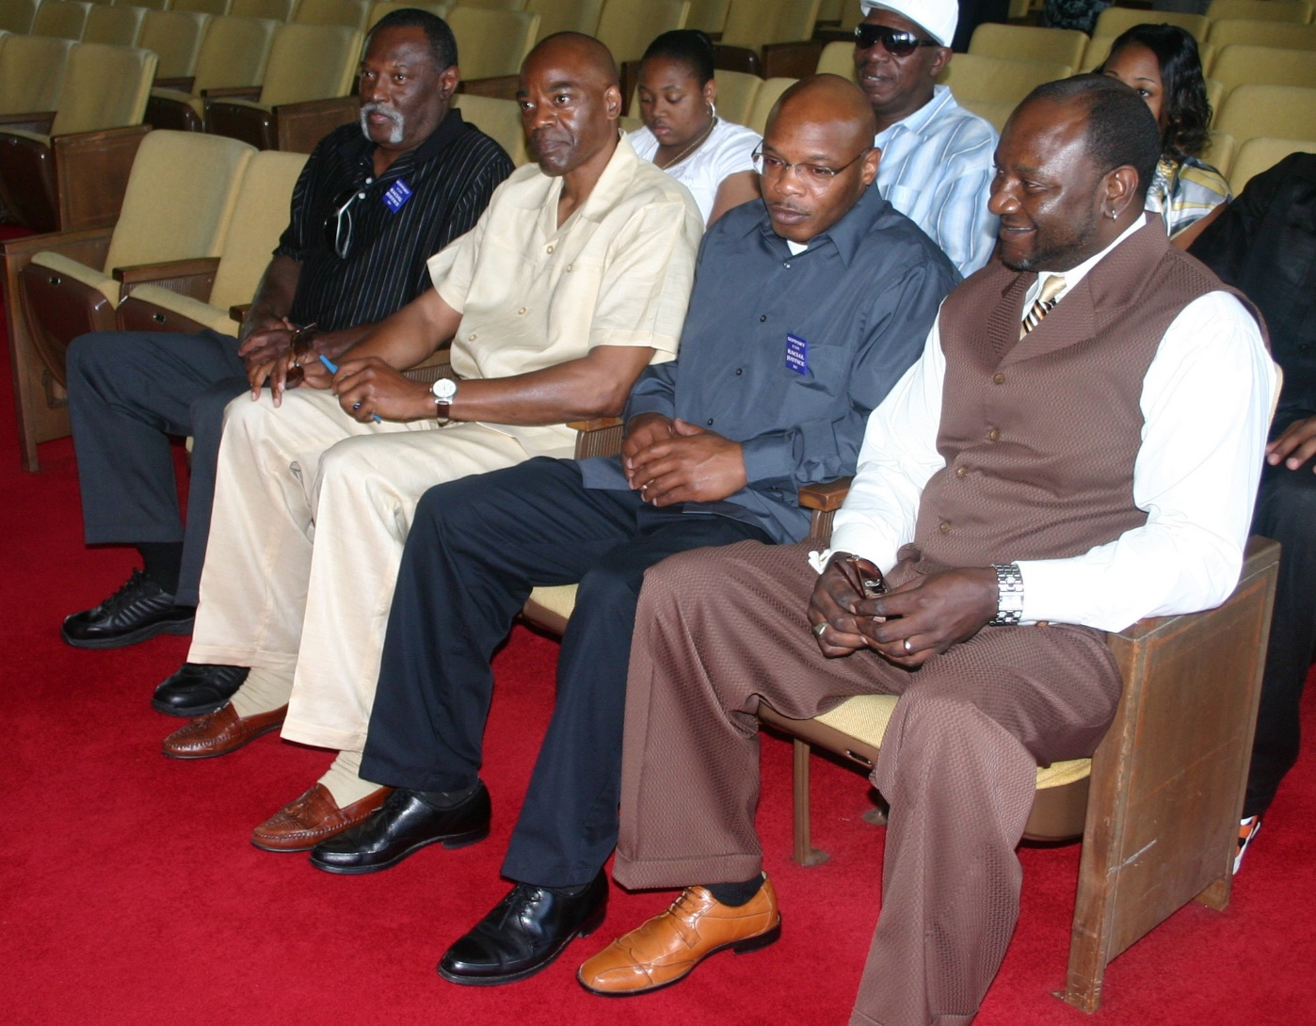
Recall this slide from my lecture about the RJA: Lobbying the General Assembly in 2009: Bo Jones, Jonathan Hoffman, Ed Chapman, Darryl Hunt

Slide 26
Next week, other innovations
It is true that the ground here in NC was fertile for criminal justice innovations in the early 2000s, when the movement to create the IIC started.
Indigent Defense reform (2000)
Eyewitness ID reform (how to do a line-up, mandating “best practices”)
DA discretion to seek or not the death penalty (2001)
Strengthening Brady-type evidence-sharing
(And of course the Racial Justice Act (2009))
So, for many reasons, NC has been an innovator in these criminal justice reforms designed to reduce the odds of convicting the innocent. There is still a lot to so.

Slide 27
Last reminders
Remember to do your quizzes.
See the revised format of the final exam and memo about that at the top of the class web page.
Come to my office hours and talk to me! https://unc.zoom.us/j/391002438
Send me questions and I’ll address those in my extra lectures or in the lectures on April 20 and 22.
Good luck to you and your families; I hope you are all staying healthy.

