Slide 1
Deadly Justice, Ch 10 Methods of Execution
Feb 16, 2022

Slide 2
Some links and announcements on the class website
A story by a journalist who is a former student in this class:
https://www.cbs19.tv/article/news/politics/wrongfully-convicted-texan-spends-13-years-in-prison-for-murder/501-7bc1dd6a-c05b-4f00-a6e0-5f1cfc0a4224
Vincent Simmons goes free after 44 years:
https://www.cbsnews.com/video/vincent-simmons-is-free-after-44-years-in-prison/
The “War of the Currents” between Westinghouse and Tesla on the one hand and Thomas Edison on the other
https://www.youtube.com/watch?v=oj-bDe84C0A

Slide 3
First, a quick diversion
My educational record. I only ever went to 3 schools!
K-8, Thomas A. Edison Elementary
9-12, Cass Technical High School (Go, Technicians!)
BA, MA, PhD, University of Michigan (Go Blue!)
At the end of this lecture you’ll see, I want to start a petition to get the Detroit public schools to change the name of my alma-mater! I never knew much about Edison other than that he invented the lightbulb, the phonograph, and a bunch of other things. But, he also promoted the electric chair, ick. That’s a long story and we’ll get into it today…

Slide 4
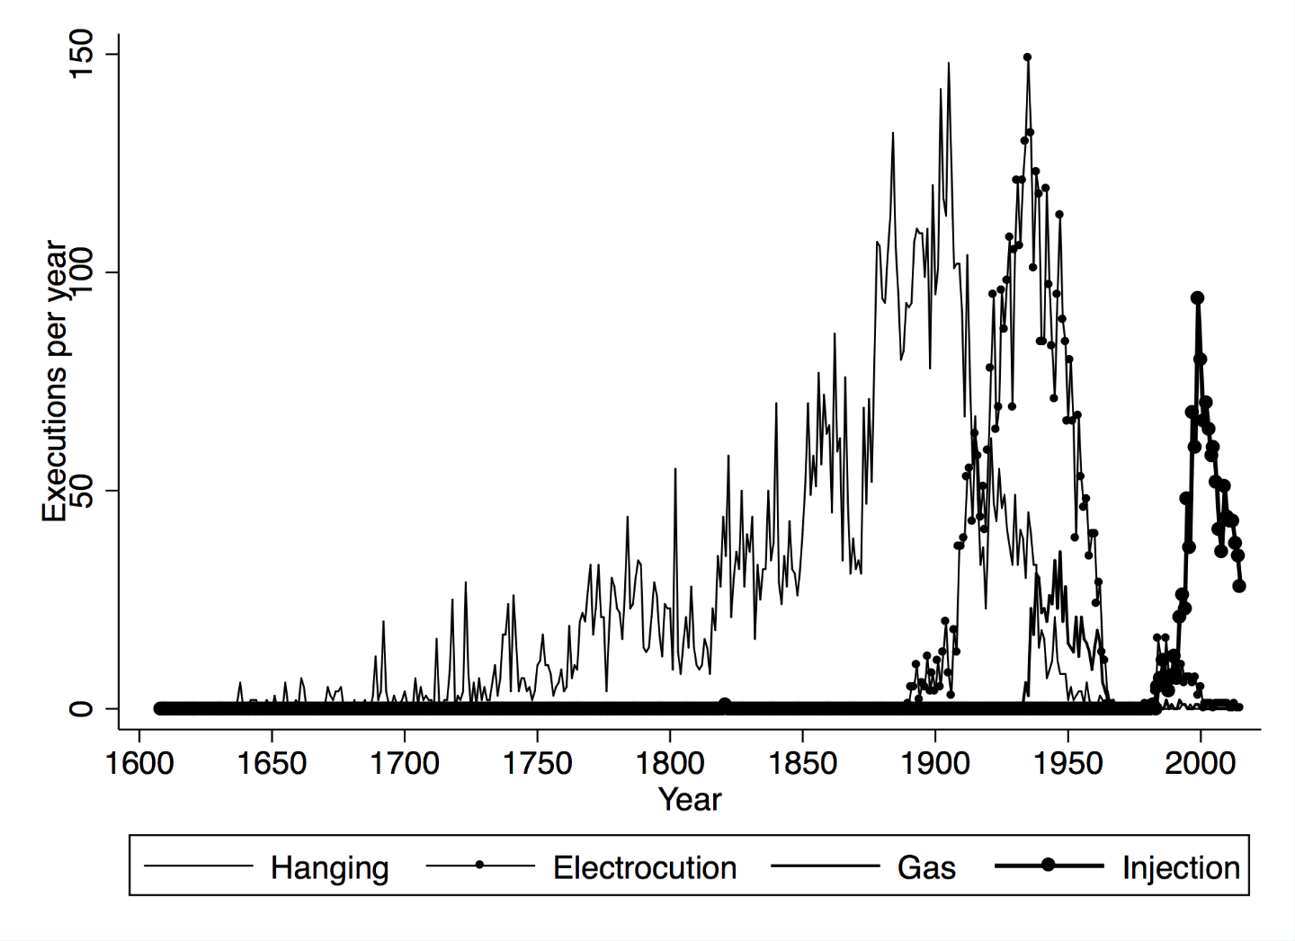
Methods: Hanging was most common once

Slide 5
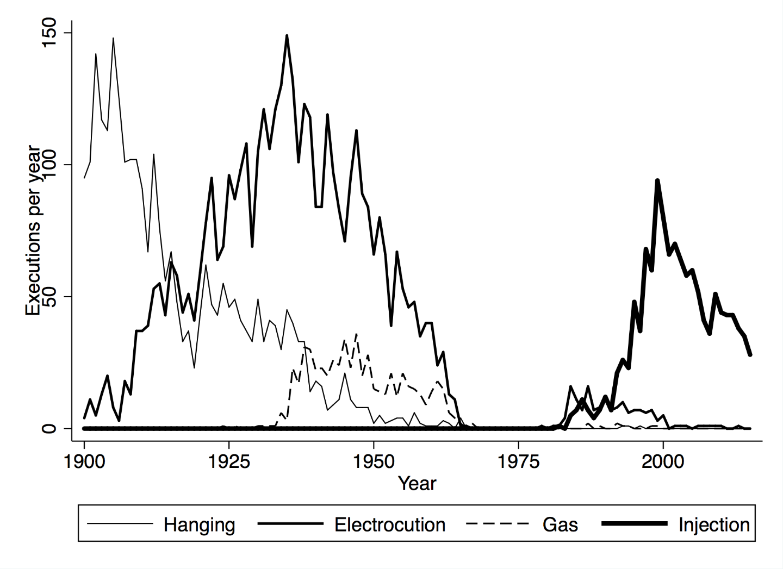
Modern methods: Hanging, then Electric Chair, Gas Chamber, then Lethal Injection

Slide 6
Lethal injections
Oklahoma medical examiner, let’s improve on the electric chair
3 drug cocktail
Sedative
Paralytic agent (stop all muscle movement, such as twitching, grimacing)
Stop the heart
Some key questions
If #1 fails, but #2 works, how would we know if #3 caused undue suffering?
What is the point of #2 anyway? Certainly not for the inmate’s benefit.
The Medicalization paradox

Slide 7
Recent controversies
No US based pharmaceuticals manufacture the drugs.
EU pressure on EU-based companies not to export them for this purpose.
Difficulties in finding the drugs, illegal processes of importing them.
Efforts to change the cocktail, develop new systems, nitrogen gas, other drug combinations, etc. How can you tell if they might cause suffering, as you can’t test them. Allegations of human experimentation and the risk of painful death.
Lawyers and judges making medical determinations.
Paradoxes: Many would be totally fine with painful death, but the US constitution does not allow that, maybe.

Slide 8
Post-mortem study of amount of anesthetic in the blood (Figure 10.4, from The Lancet)

Slide 9
Back to the firing squad?
We have never gone backwards.
Each generation has declared finding a higher level of civilization compared to previous ones: electrocution, gas chamber, lethal injection.
None has proven immune to botched application
(No one has much practice, after all)
For the Court: Isolated mishaps must be distinguished from systematic torture
Lethal injection:
No doctors, so can a prison guard do it?
No drug imports, so can states get them from just anywhere?
Very hard to regulate a medical procedure if no doctors involved…

Slide 10
North Carolina’s experience
State medical board says any doctor who participates in a lethal injection will lose their license to practice medicine.
State law requires a doctor’s participation.
Law changed in 2012, the “Restoring Proper Justice Act” not only did away with the protections in the 2009 Racial Justice Act, but it also eliminated the requirement for a doctor to participate. Under the new law, anyone with EMT training can do so.
So it’s clear that political leaders do not feel that protecting the condemned from the possibility of painful death is something that they care about. On the contrary!

Slide 11
Westinghouse and Edison
No standard, AC or DC, huge commercial competition
Edison losing the “battle of the currents”
He promotes Westinghouse’s system as the ideal way to kill people.
Hopes this will discredit the rival and associate his system with danger.
Guarantees to lawmakers that it will “kill in the 10 thousandth part of a second”
Who is to argue, and they adopt it.
First electrocution in 1890, terrible botch.

Slide 12
U.S. Technology in 1880
European countries were world leaders
Houses heated and lit with fires – dangerous
Edison perfected the light bulb in 1879
However, no electricity distribution system

Slide 13
Edison’s technical downfall
Could transmit DC only about a mile, so he
must build many power stations near his customers.
With AC, Tesla could place one power station 100 miles from many customers.

Slide 14
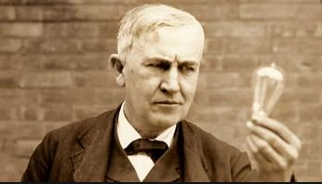
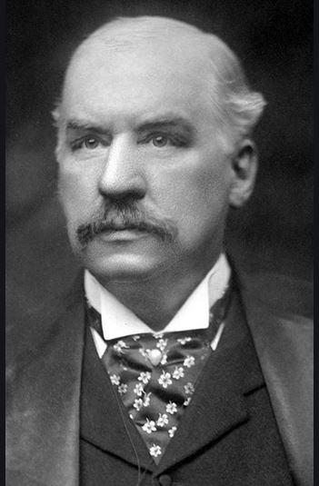
Players in this drama, team DC
Thomas Edison
famous American inventor
JP Morgan, Wall Street industrialist who funds Edison

Slide 15
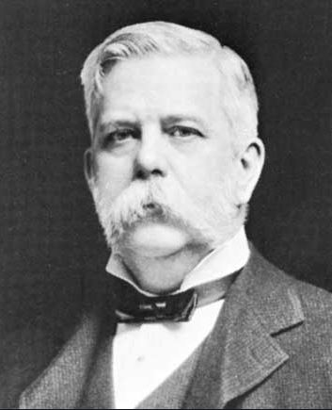
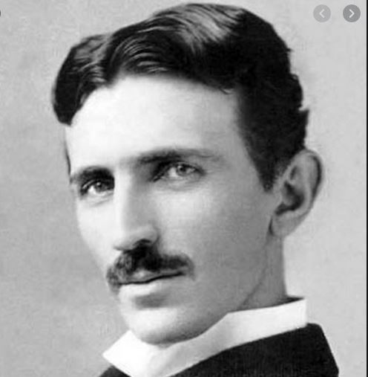
Players, team AC
Nikola Tesla
Serbian engineer
George Westinghouse
Success from train air brake, funds Tesla

Slide 16
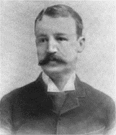
Edison had the inferior product
And it cannot be fixed, so:
Attack the competition
Promote AC as the “electricity of death
Hires engineer Hubert P. Brown
Presents media shows in which Brown electrocutes animals with AC.
Cats, dogs, sheep, horses, then… an elephant!

Slide 17
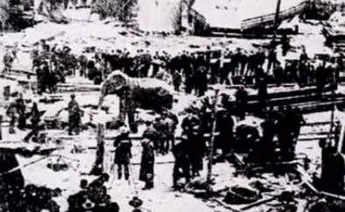
Topsy, retired circus elephant
Jan 4, 1903, in Coney Island, NY
Killed with AC in front of invited media

Slide 18
New York state commission, 1886
Searched for new method of execution, more humane than hanging
Chair: Elbridge Gerry, a New York City attorney and prominent citizen. Gerry’s grandfather had been the first Governor of Massachusets and the 5th US Vice President from 1813 to 1814.
Edison Electric built the first chair, and they designed an AC chair, hoping to link the system to Westinghouse’s technology.

Slide 19
The Gerry Commission
Reading their report is even more depressing than taking this class!
They went through all the historical practices known to human history.
Finally they settled on using the magnificent new technology of electric power, to generate something unlike anything previously ever experienced.
Edison personally guaranteed that it would kill instantly, painlessly.
New York state went on to use the chair more than 600 times before 1965.

Slide 20
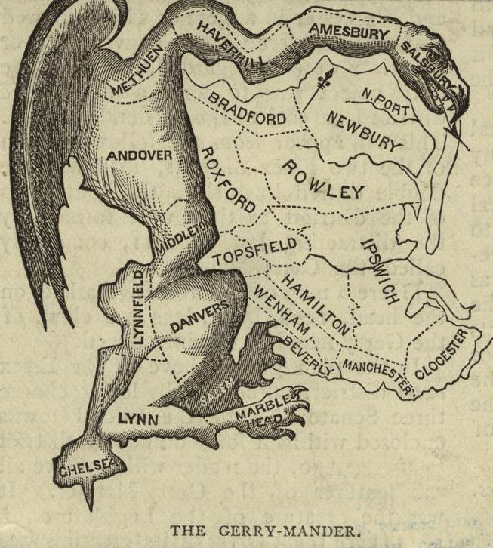
Contributions of the Gerry family to US history
Elbridge Gerry (elder): The original 1821 Gerrymander. Later VP of the US.
Elbridge Gerry (younger): Chaired the State of New York commission to replace hanging with a more civilized method of execution. The choice: Electrocution

Slide 21
First electric chair execution
William Kemmler, Aug 6, 1890
AC passed through him for 17 sec
Declared dead
Witnesses said he was still breathing
Current turned back on, ran for 8 minutes
Westinghouse famous quote:
They would have done better with an axe!

Slide 22
Let’s watch a few minutes of a film
Google youtube Tesla Master of Lightning
It should take you here:
https://www.youtube.com/watch?v=oj-bDe84C0A
Go to the 18 minute mark and watch for 5 minutes.

