Slide 1
Review for final and last feedback
Plan for day
Quick review about Andrea Harrison and Katie Monroe
Some other court cases I remembered you should now, as an educated person…
Questions you have sent me
Review of quiz responses from first day of class and this week
(improvement on some things, but surprisingly little learning on others)
(I’m not going to go over all of these today as it will take too long. But you should study the results and learn from them. Basically, the results are pretty bad.)
Answer any questions about the exam
Last comments about the course and the material
April 27, 2022

Slide 2
Andrea and Katie
Andrea did not mention a few things that perhaps are just too hard
Her mom was portrayed in the media in a very insulting and bad light, a sort of victim blaming that is not altogether uncommon
Her dad was treated as a potential suspect in the crime
When the exoneration occurred the police took the dad’s saliva again to test
The police never reopened the case, so there will be no justice.
Katie’s mom Beverly
Long-term romantic partner (still living separately) commits suicide
Detective decides to make it a murder, gets her to make statements that eventually lead to her conviction
Detective had other cases where he had done similar things. He was eventually forced into retirement. That was the entire punishment…
So much did not look the part that the bailiff never took her into custody…
No justice there. Also no crime in the first place…

Slide 3
Remember these court cases as well
Brady v. Maryland
Batson v. Kentucky
Miranda v. Arizona

Slide 4
Questions
Geographic epicenters of homicides, death sentences, and executions, and what that means.
First, they are not the same:
Homicide rates are highest in the Mississippi river area from NOLA to St Louis, and in the I-95 corridor from Richmond to NYC.
Death sentences very high in LA, AZ, FL, TX, also Philadelphia and Chicago (in the past)
Executions high in Houston, rest of Texas, OK, VA
No rhyme or reason to it
Momentum factor
DA discretion

Slide 5
Conditional probability of execution, given a death sentence
Table 7.1, Deadly Justice, shows these most likely outcomes, after a death sentence:
Overturned (sentenced reduced to LWOP, Life, or lower) (about 65%)
Sit on death row (about 35%)
Be executed (about 25% of the total, about 16% of “finalized” cases [not counting those still on death row, since we don’t know what will happen])
Die of natural causes or suicide while on death row (6%)
What do we learn from that? It’s 3-4 times more likely that you’ll have your sentence overturned than that you’ll be executed.

Slide 6
Direct appeals and all that
The US SC mandated “direct appeals” after a death sentence. These are automatic. You don’t have to allege an error in your trial. By right, you are allowed to have these direct appeals:
Through the highest court in the state. (So generally through an appeals court and then to the state SC.)
Direct federal appeal. This goes to the federal circuit court.
Many cases are overturned on these “direct appeals.”
After the direct appeals are complete, you could be scheduled for a death warrant, but not before.
After the direct appeals, you can still make “habeas corpus” appeals in the federal system, if you allege a violation of your US constitutional rights, and appeals “for cause” through the state court system. These are generally referred to as post-conviction appeals. In NC, they are called “MARs” – Motion for Appropriate Relief.

Slide 7
Timeline of public opinion
Generally corresponds with punitiveness more broadly, not specific to the death penalty.
Goes up throughout the 1970s and 1980s until mid-1990s; sharply down since then.
Correlates almost perfectly with the number of death sentences imposed over time, and generally with the “tough on crime” period of the 1990s.
Is it ok if you were sentenced to death in 1995 but most likely would not have been if the crime had been in 2015?
(See following slides from Feb 28 lecture)

Slide 8
Let’s look at that index again, 1953 to present Three periods: 1. Before 1965 2. To 1996 3. After 1996

Slide 9
Public opinion almost perfectly predicts the annual number of death sentences

Slide 10
Death Penalty and general punitiveness
Peter Enns, Incarceration Nation, used the same method to measure public support for harsher v. less harsh criminal justice policies. It correlates very closely with death penalty opinion.
So there is something general about the 1980s and 1990s and crime. It has changed since then.

Slide 11
Review of your quiz results
Note: About 360 responses on the first day of class, but only about 170 on Monday.
Some learning is apparent, so that is good.
Not really as much as I would have hoped for however.
Factual questions dealing with large numbers seem to be a particular area of lack of learning.
Just because a number has ,000 at the end does not mean you should just zone out. Numbers matter. Pay attention to their order of magnitude, and compare them to things you are familiar with. 5% is really different than 5 chances in 1,000,000. A five-percent thing (.05 odds) will happen to you pretty regularly whereas the one with odds of .000005 is something you can safely ignore.
This general lack of paying attention to numbers and odds may be why people play the lottery, I’m not sure.
Make a habit of being more literate with respect to numbers; it will help!

Slide 12
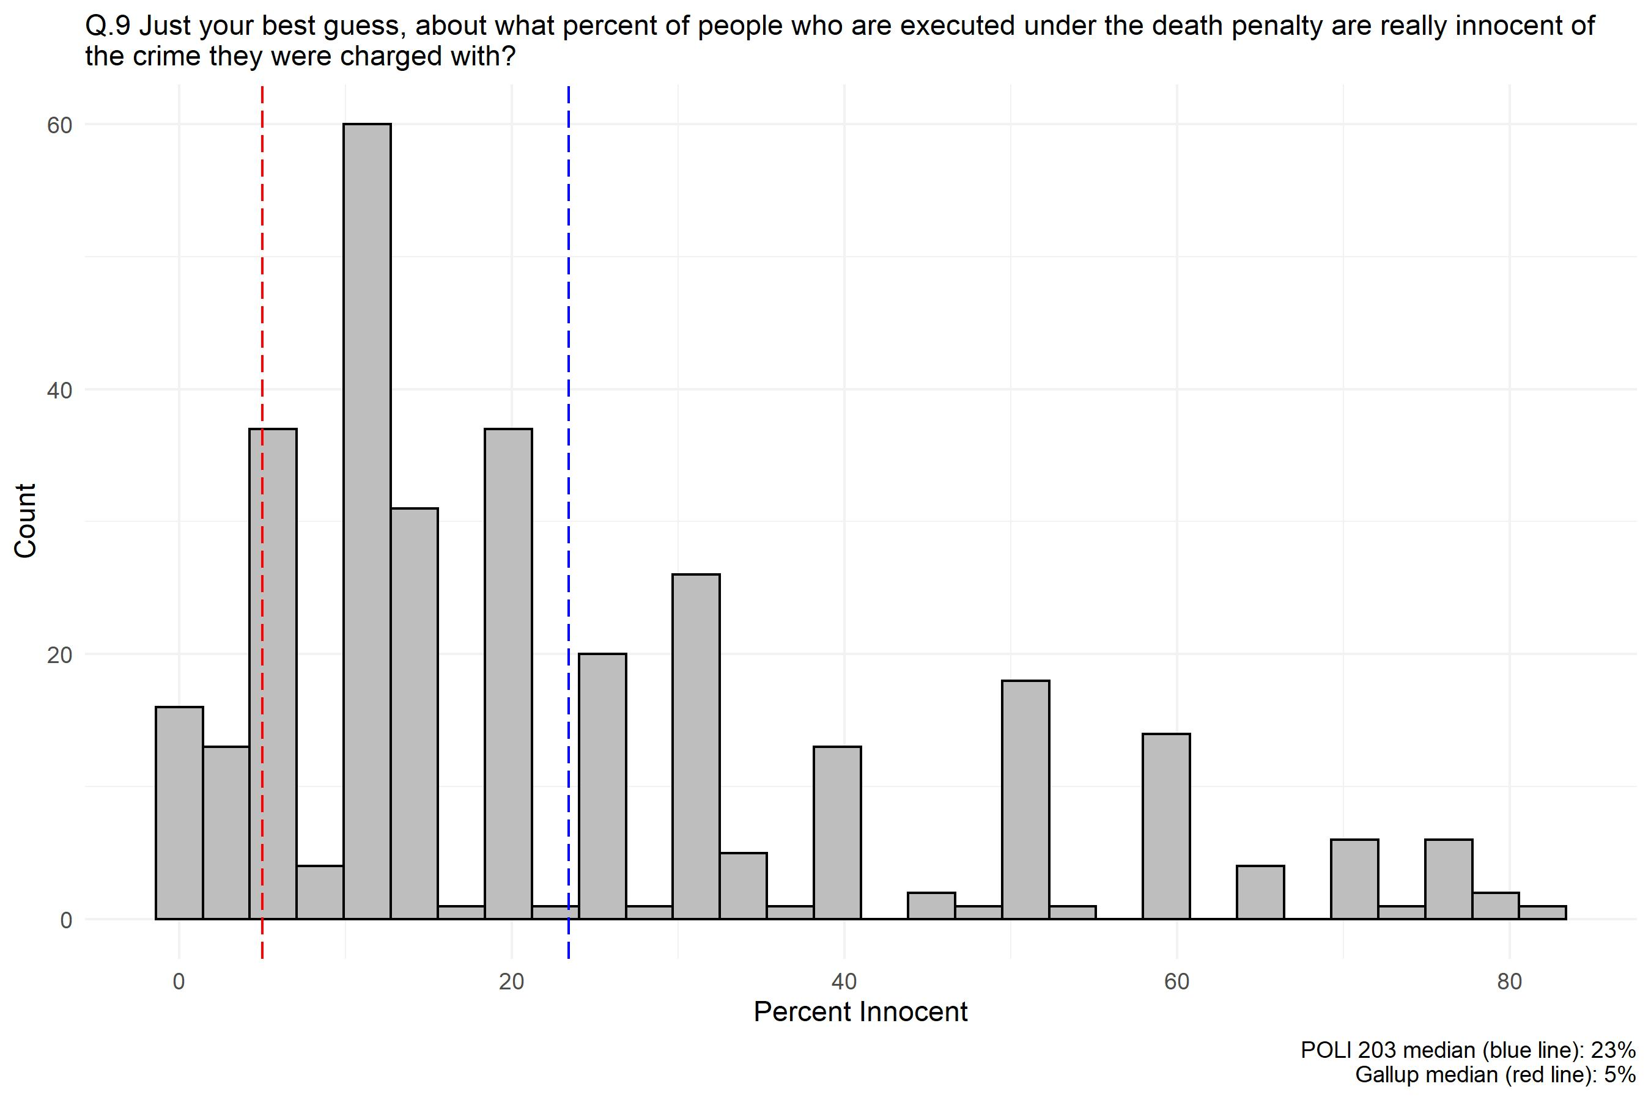
ROUND 1

Slide 13
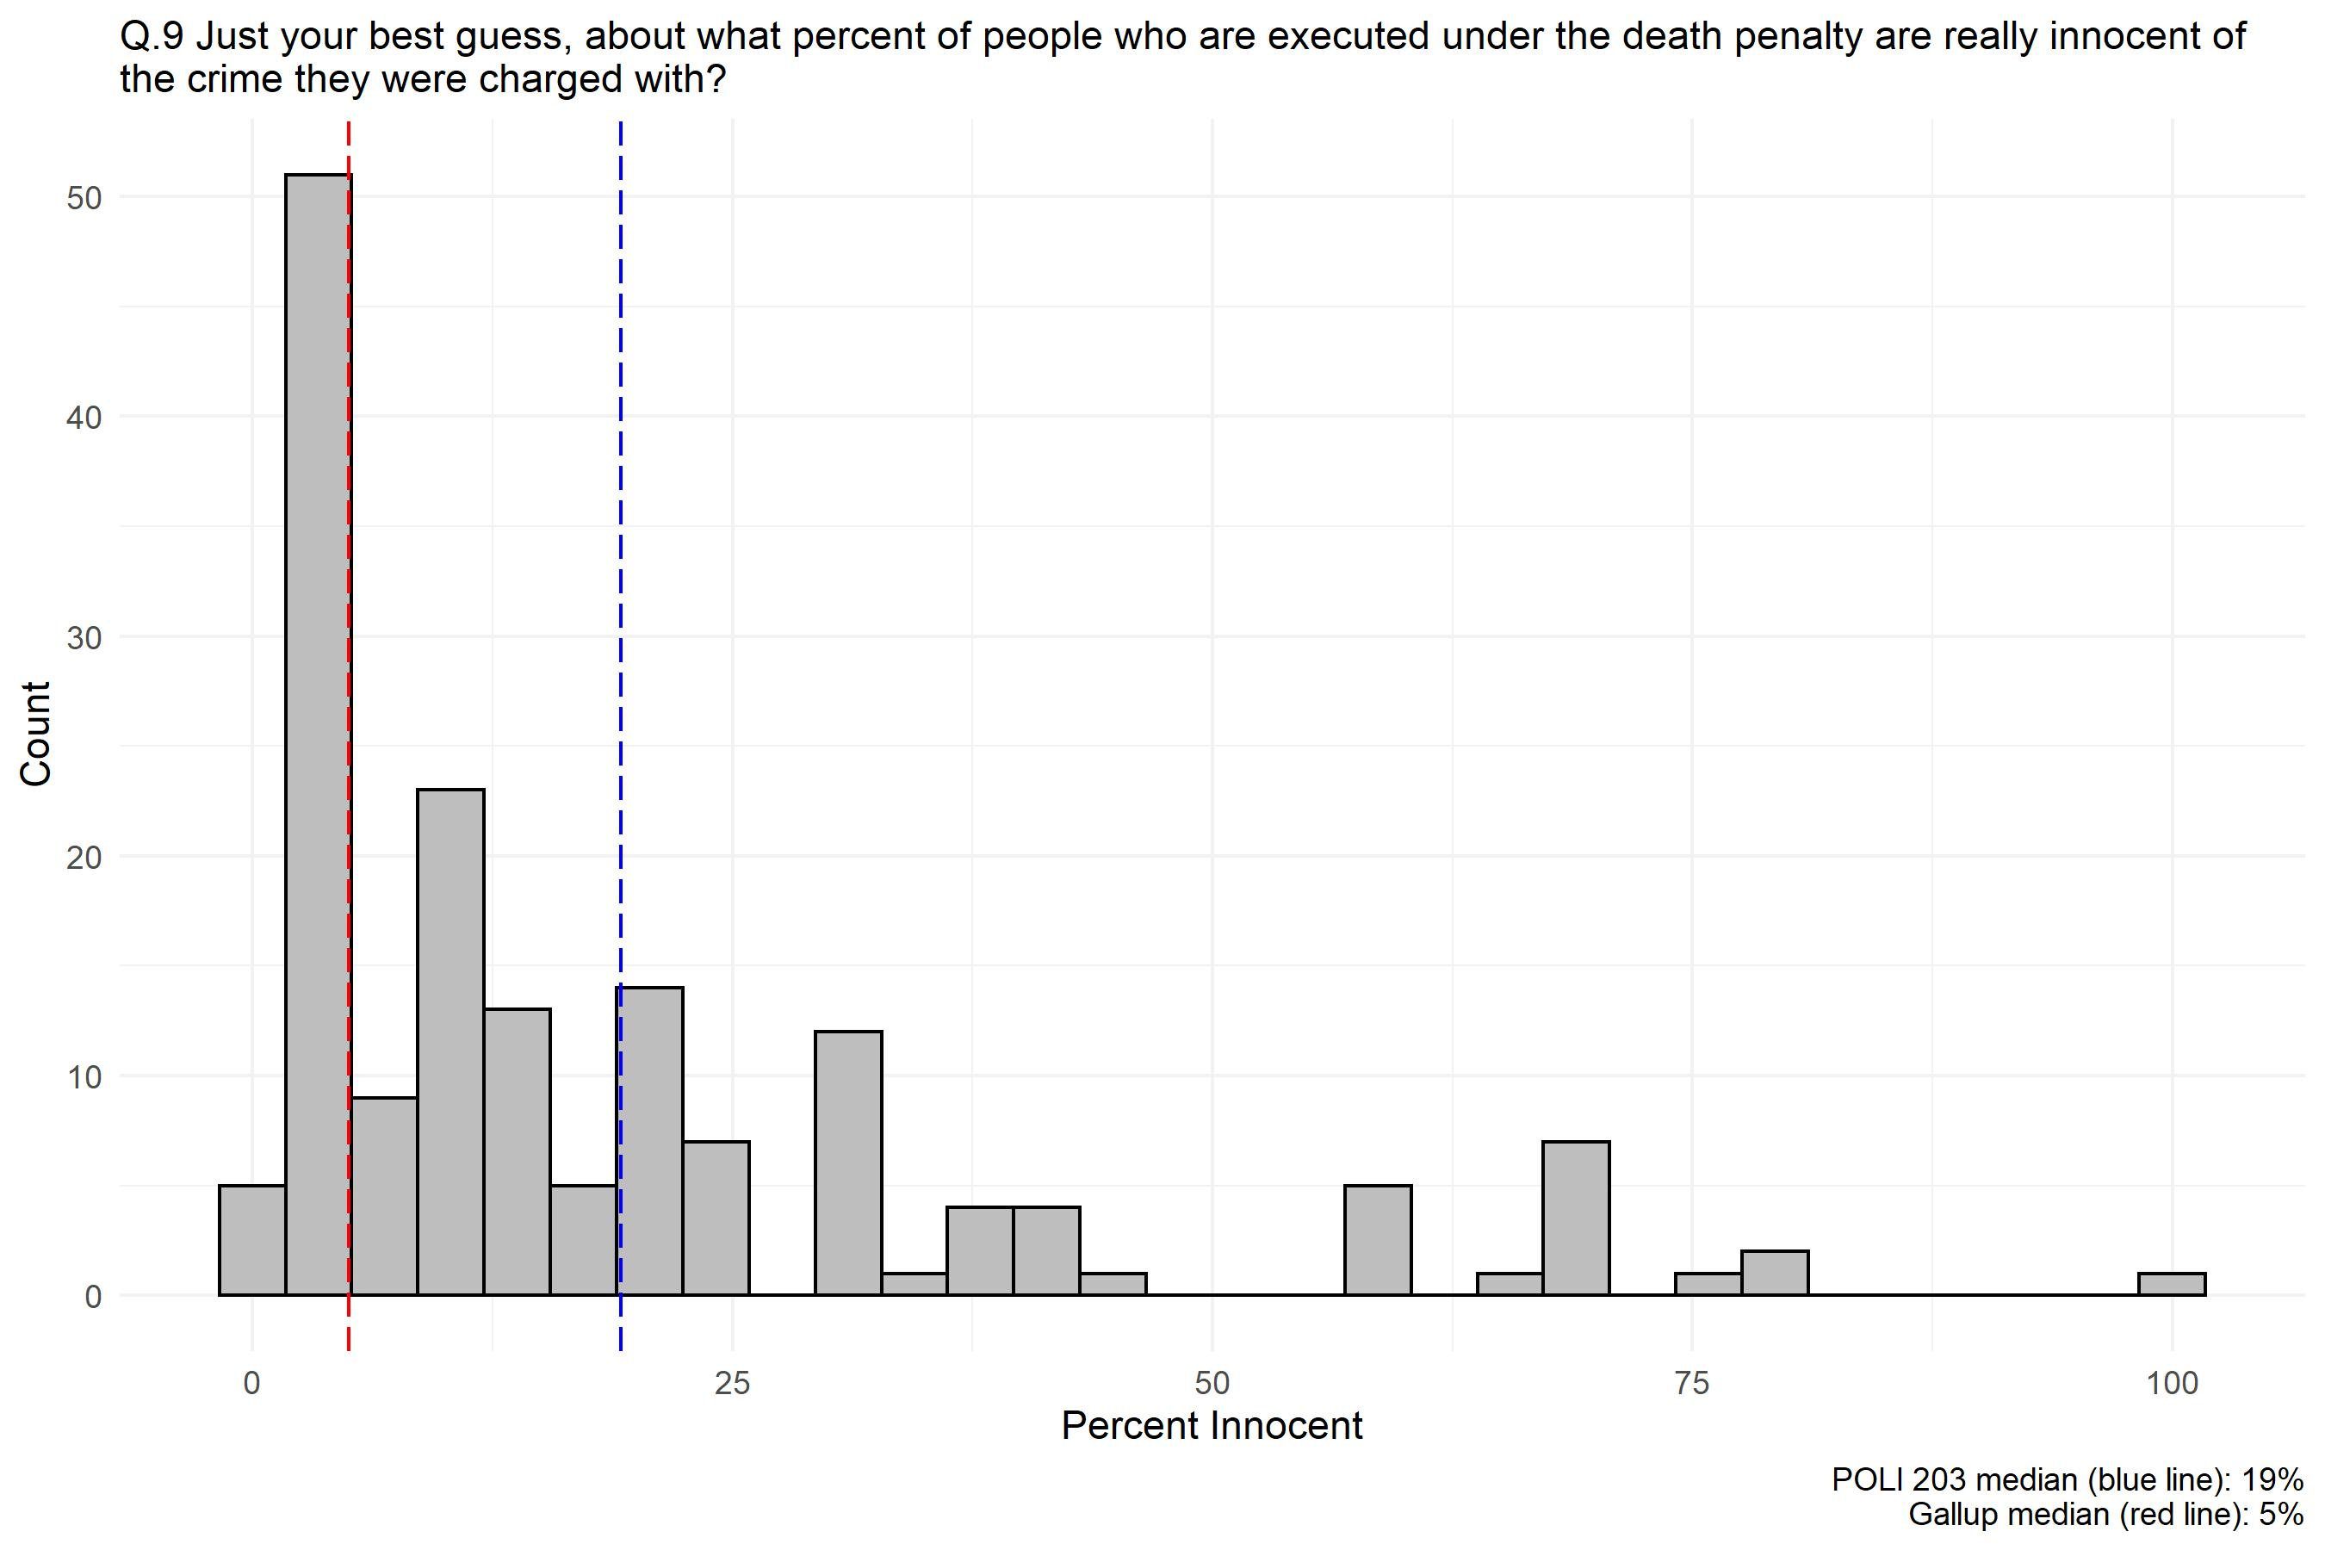
ROUND 2
Just because this is a class on innocence and mistakes does not make most people innocent!

Slide 14
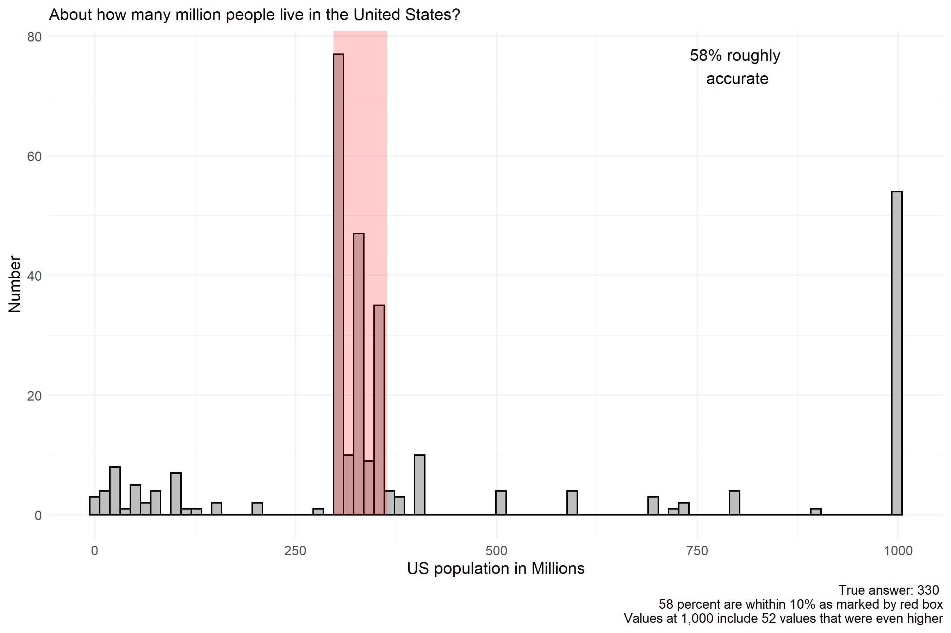
ROUND 1

Slide 15
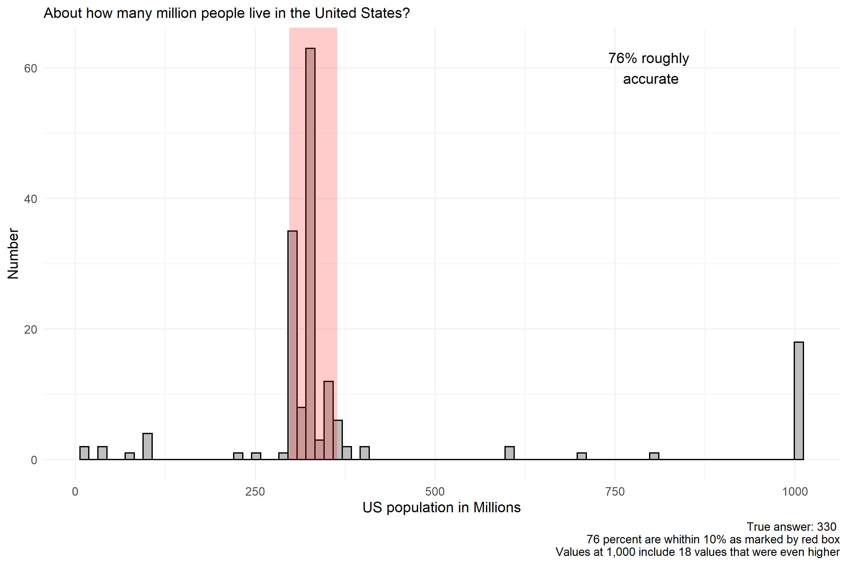
ROUND 2

Slide 16
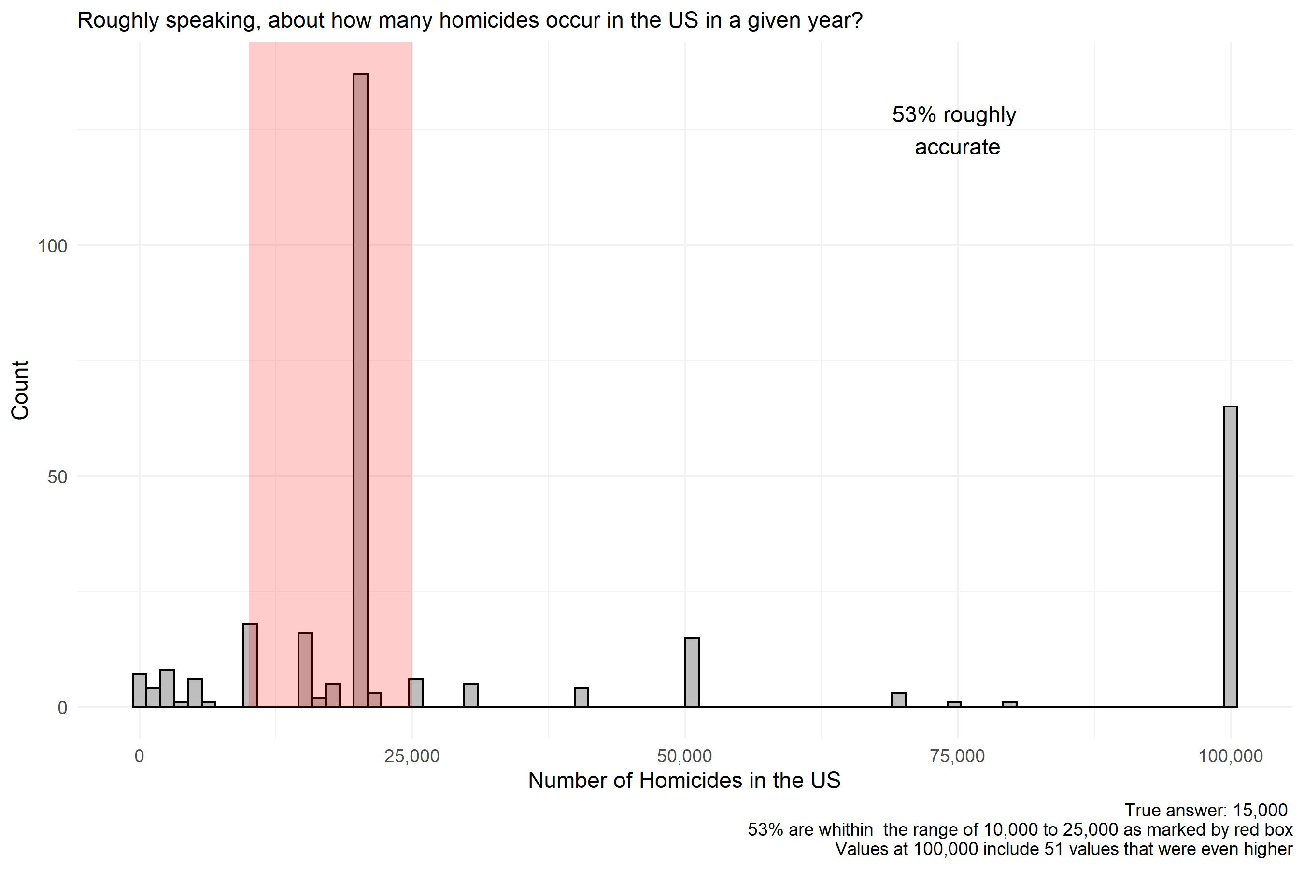
ROUND 1

Slide 17
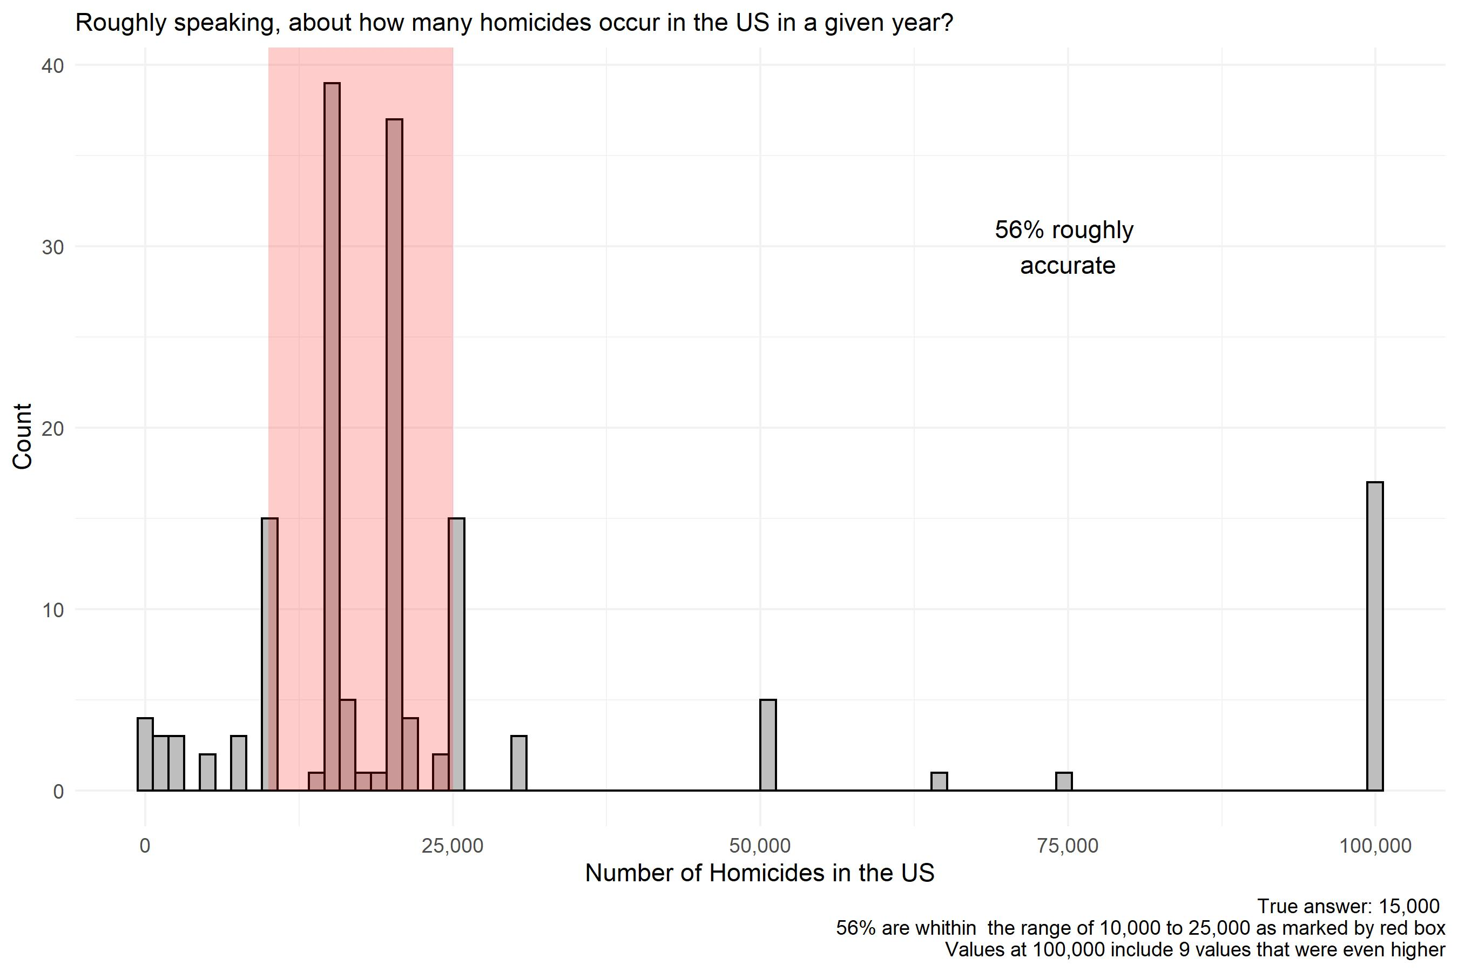
ROUND 2

Slide 18
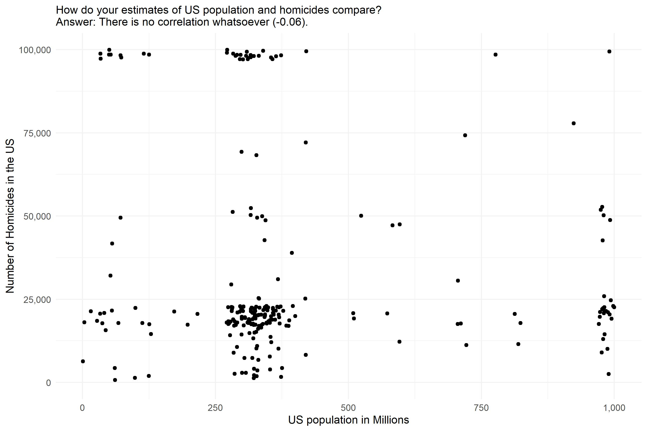
ROUND 1

Slide 19
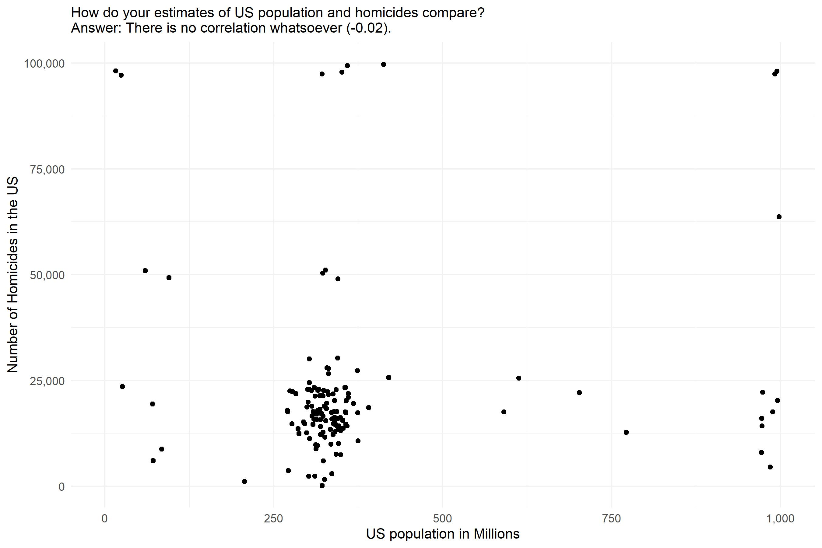
ROUND 2

Slide 20
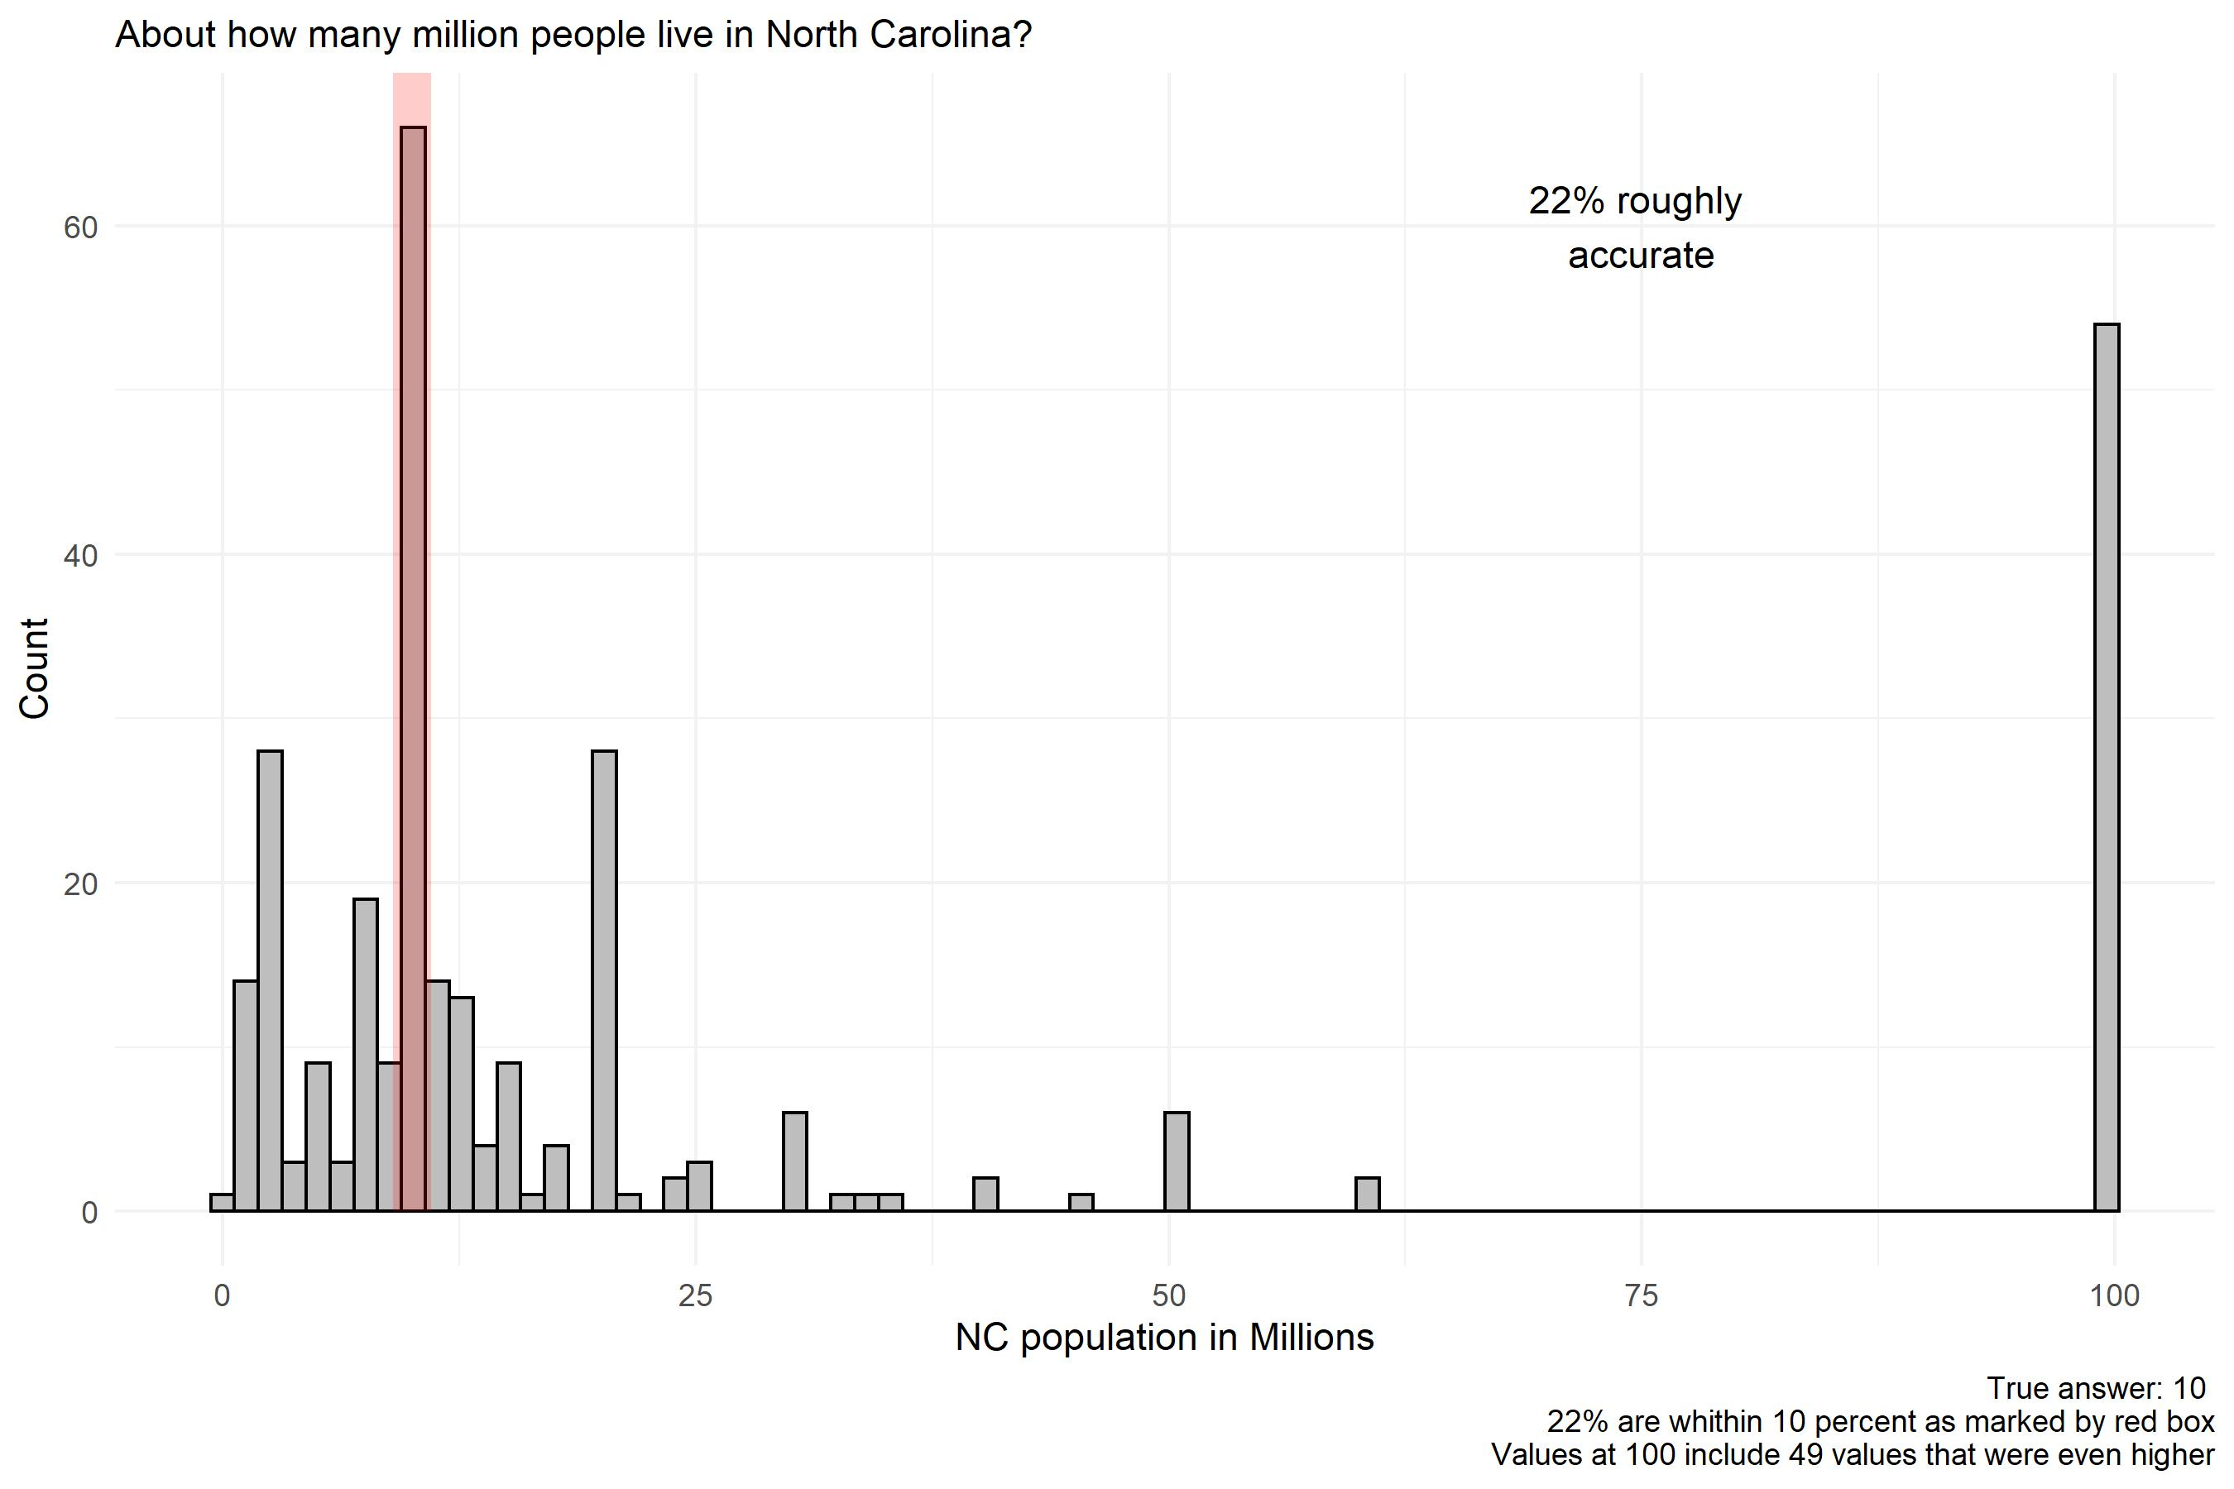
ROUND 1

Slide 21
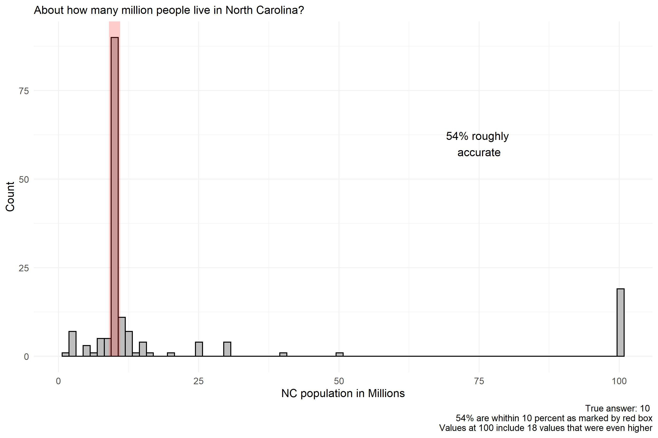
ROUND 2

Slide 22
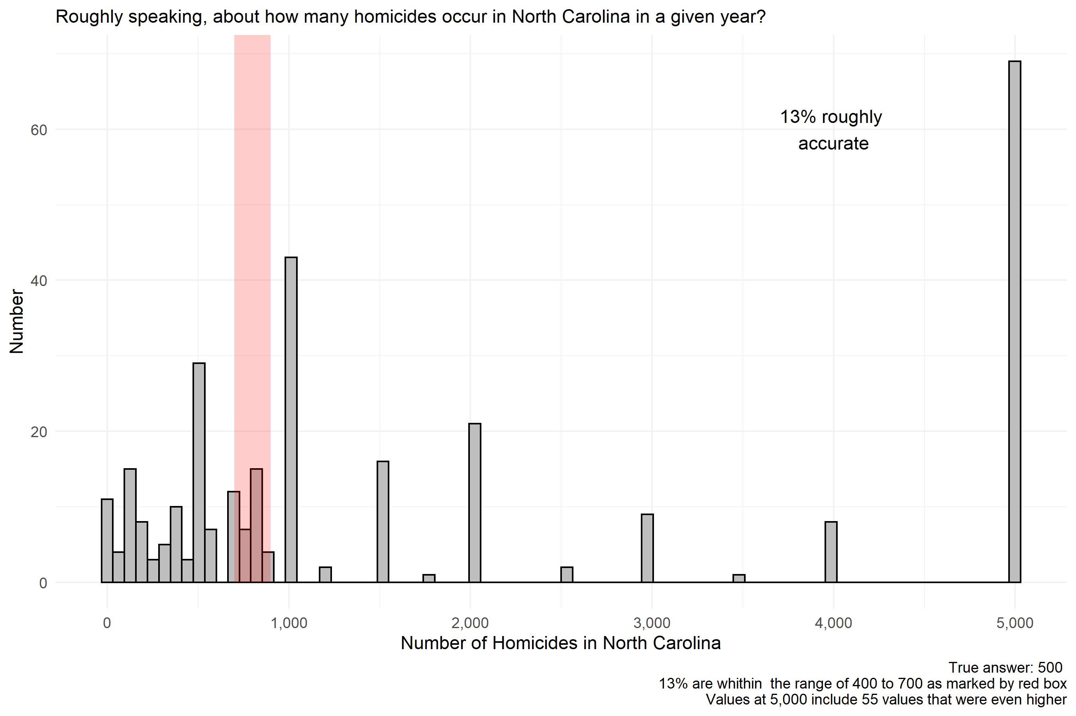
ROUND 1

Slide 23
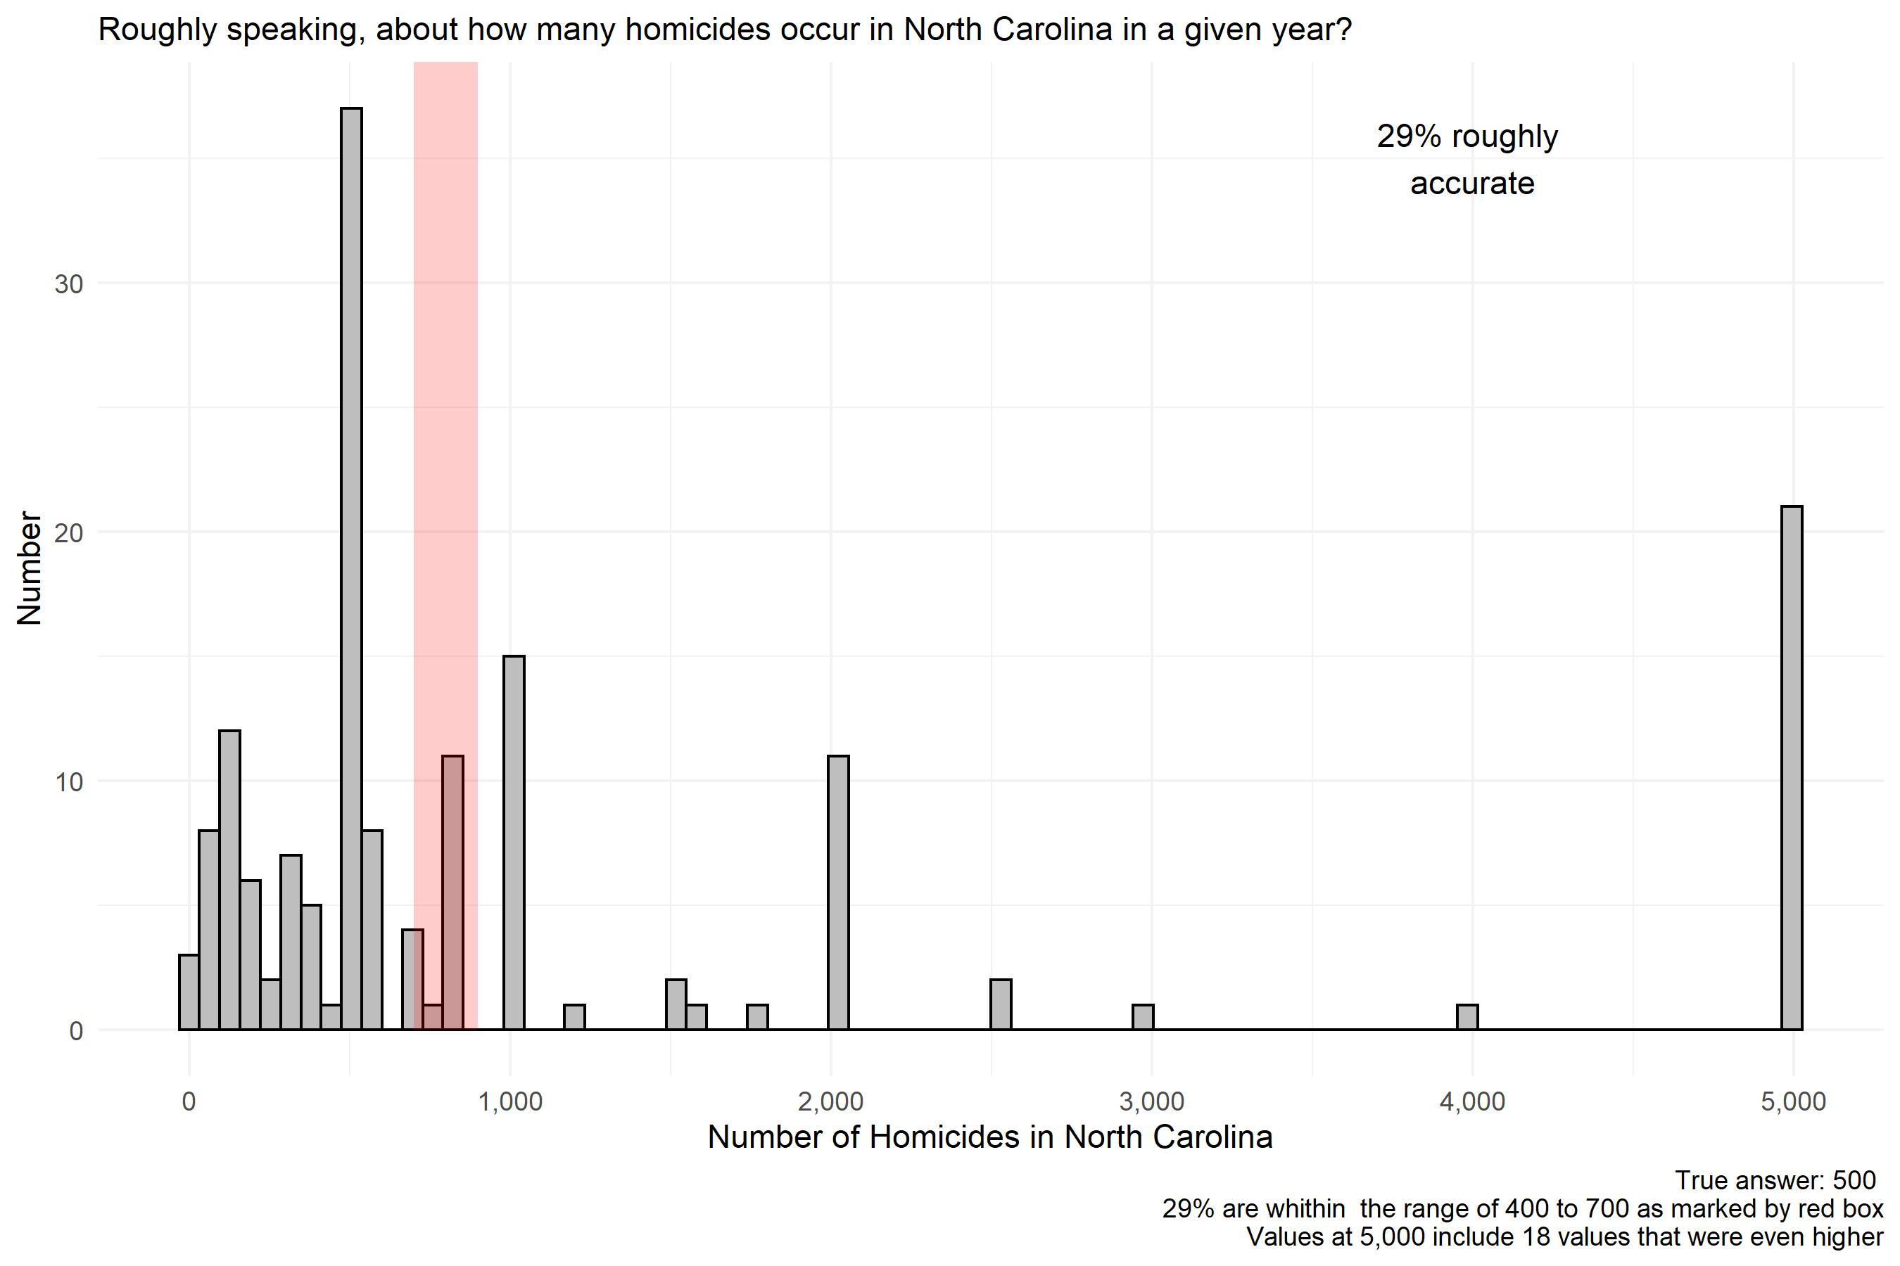
ROUND 2

Slide 24
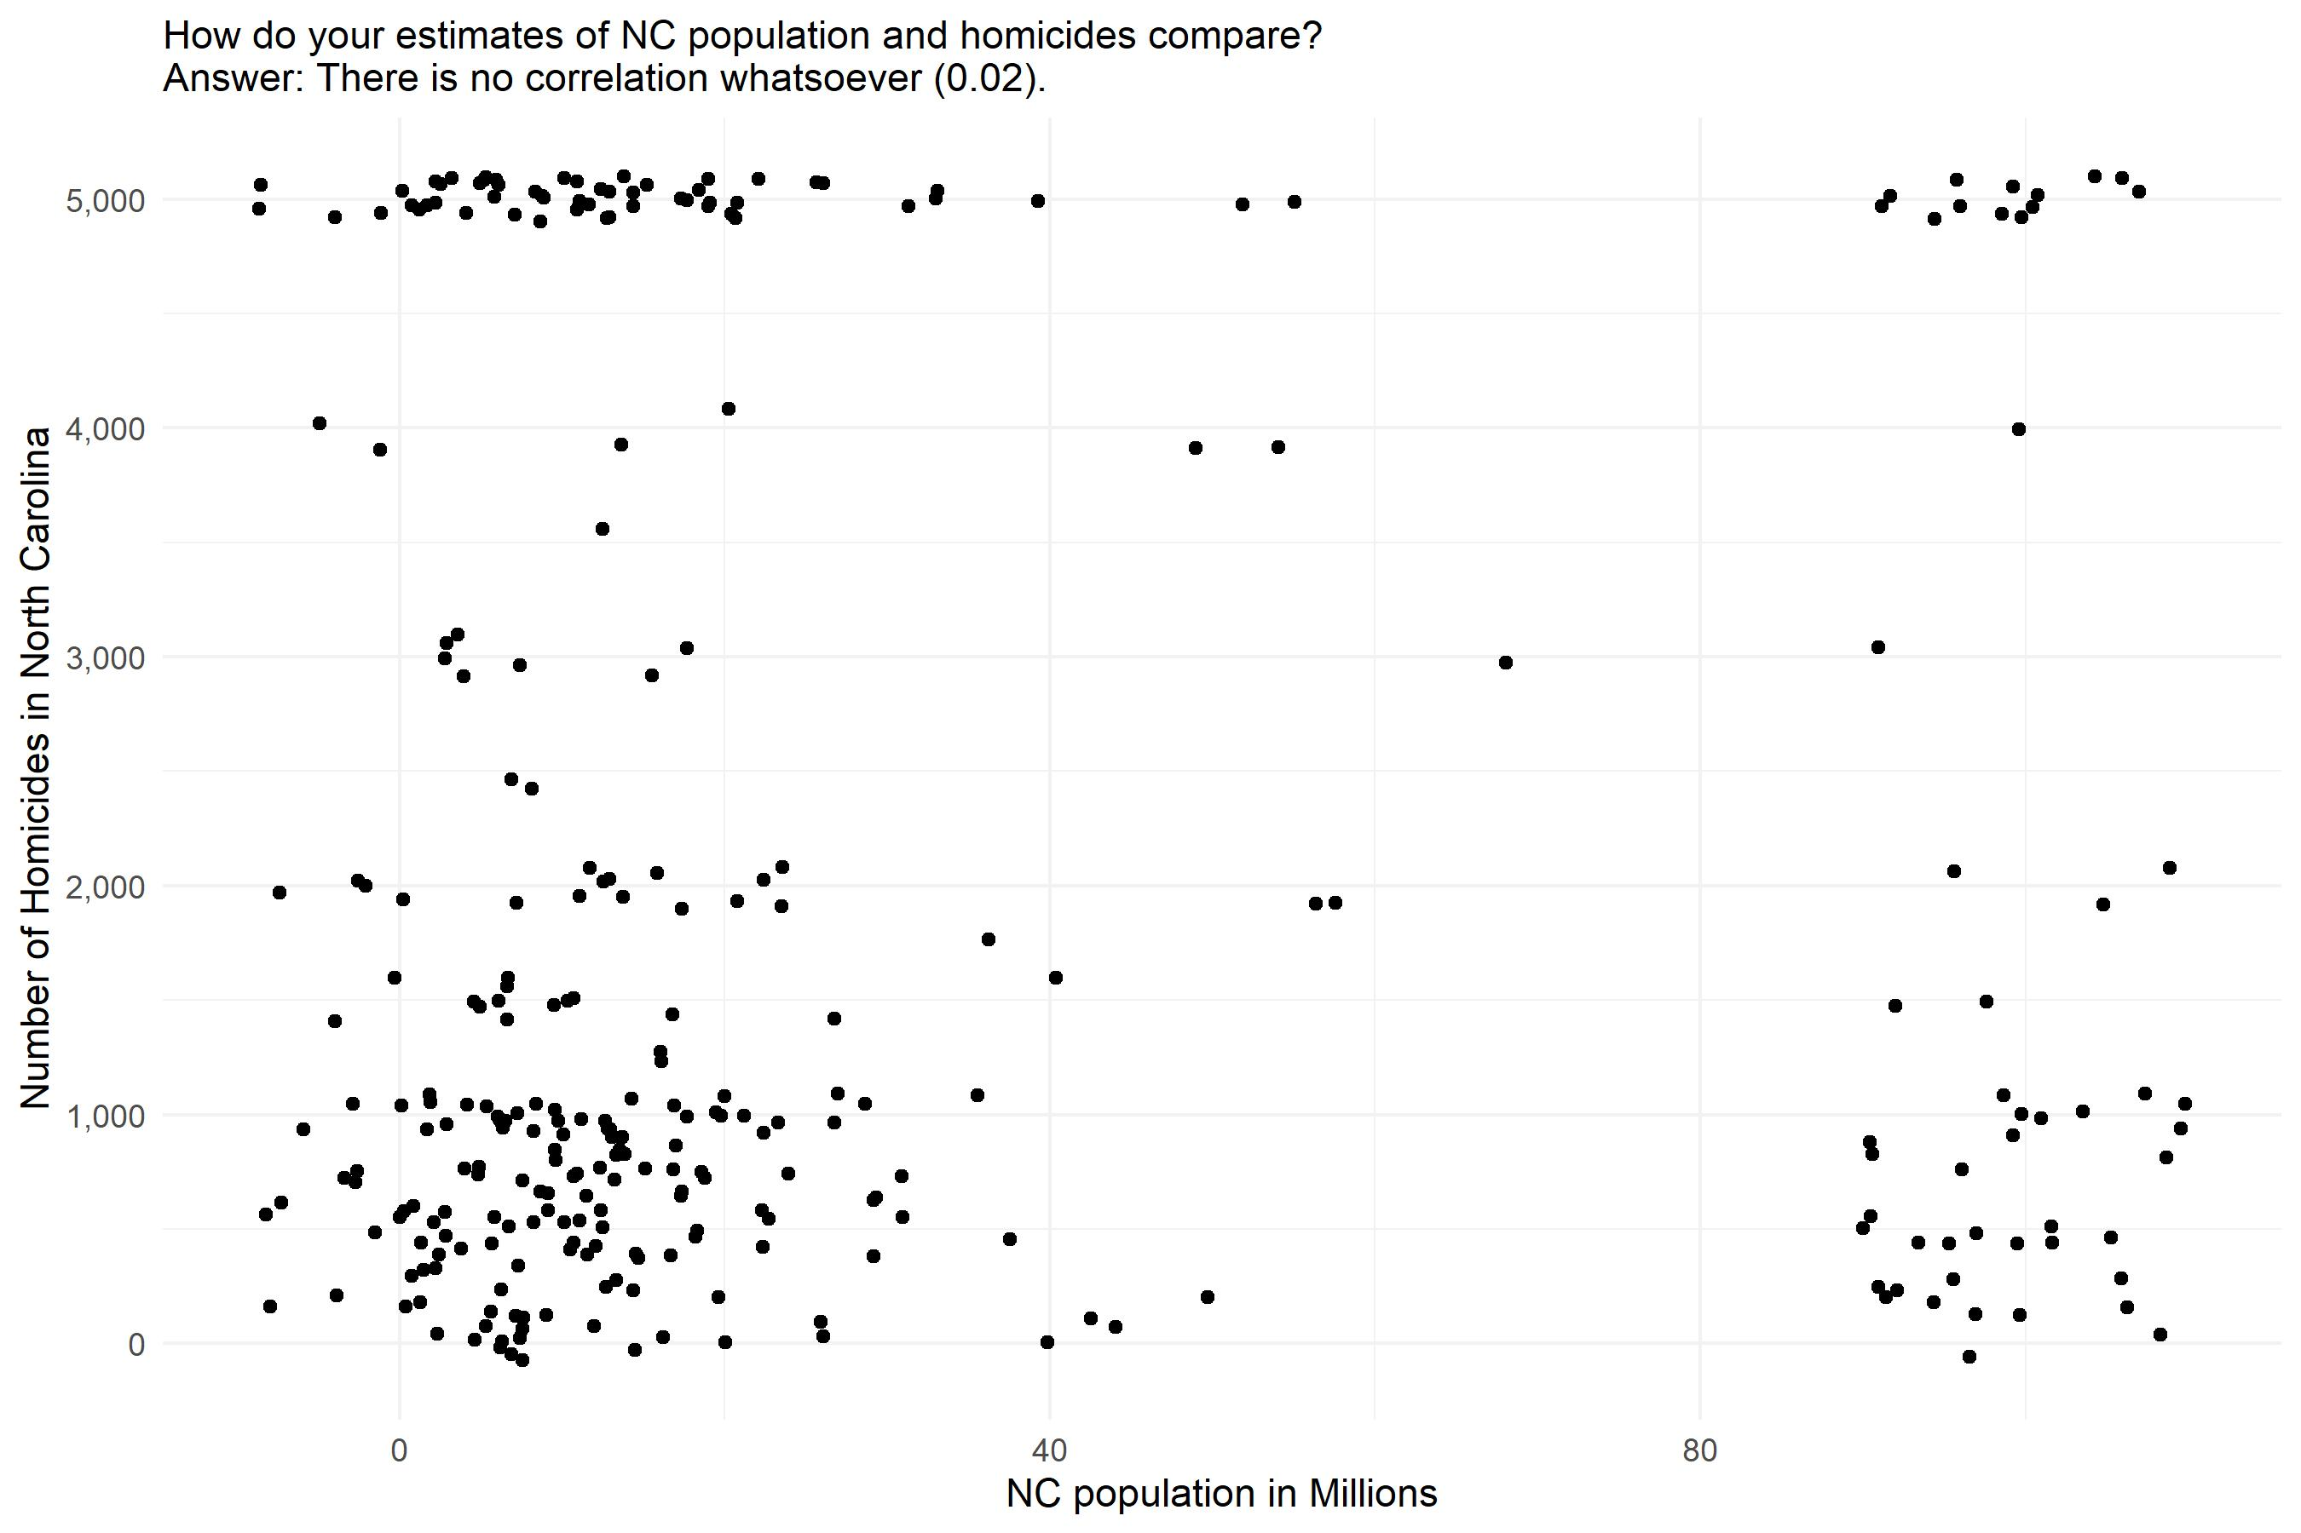
ROUND 1

Slide 25
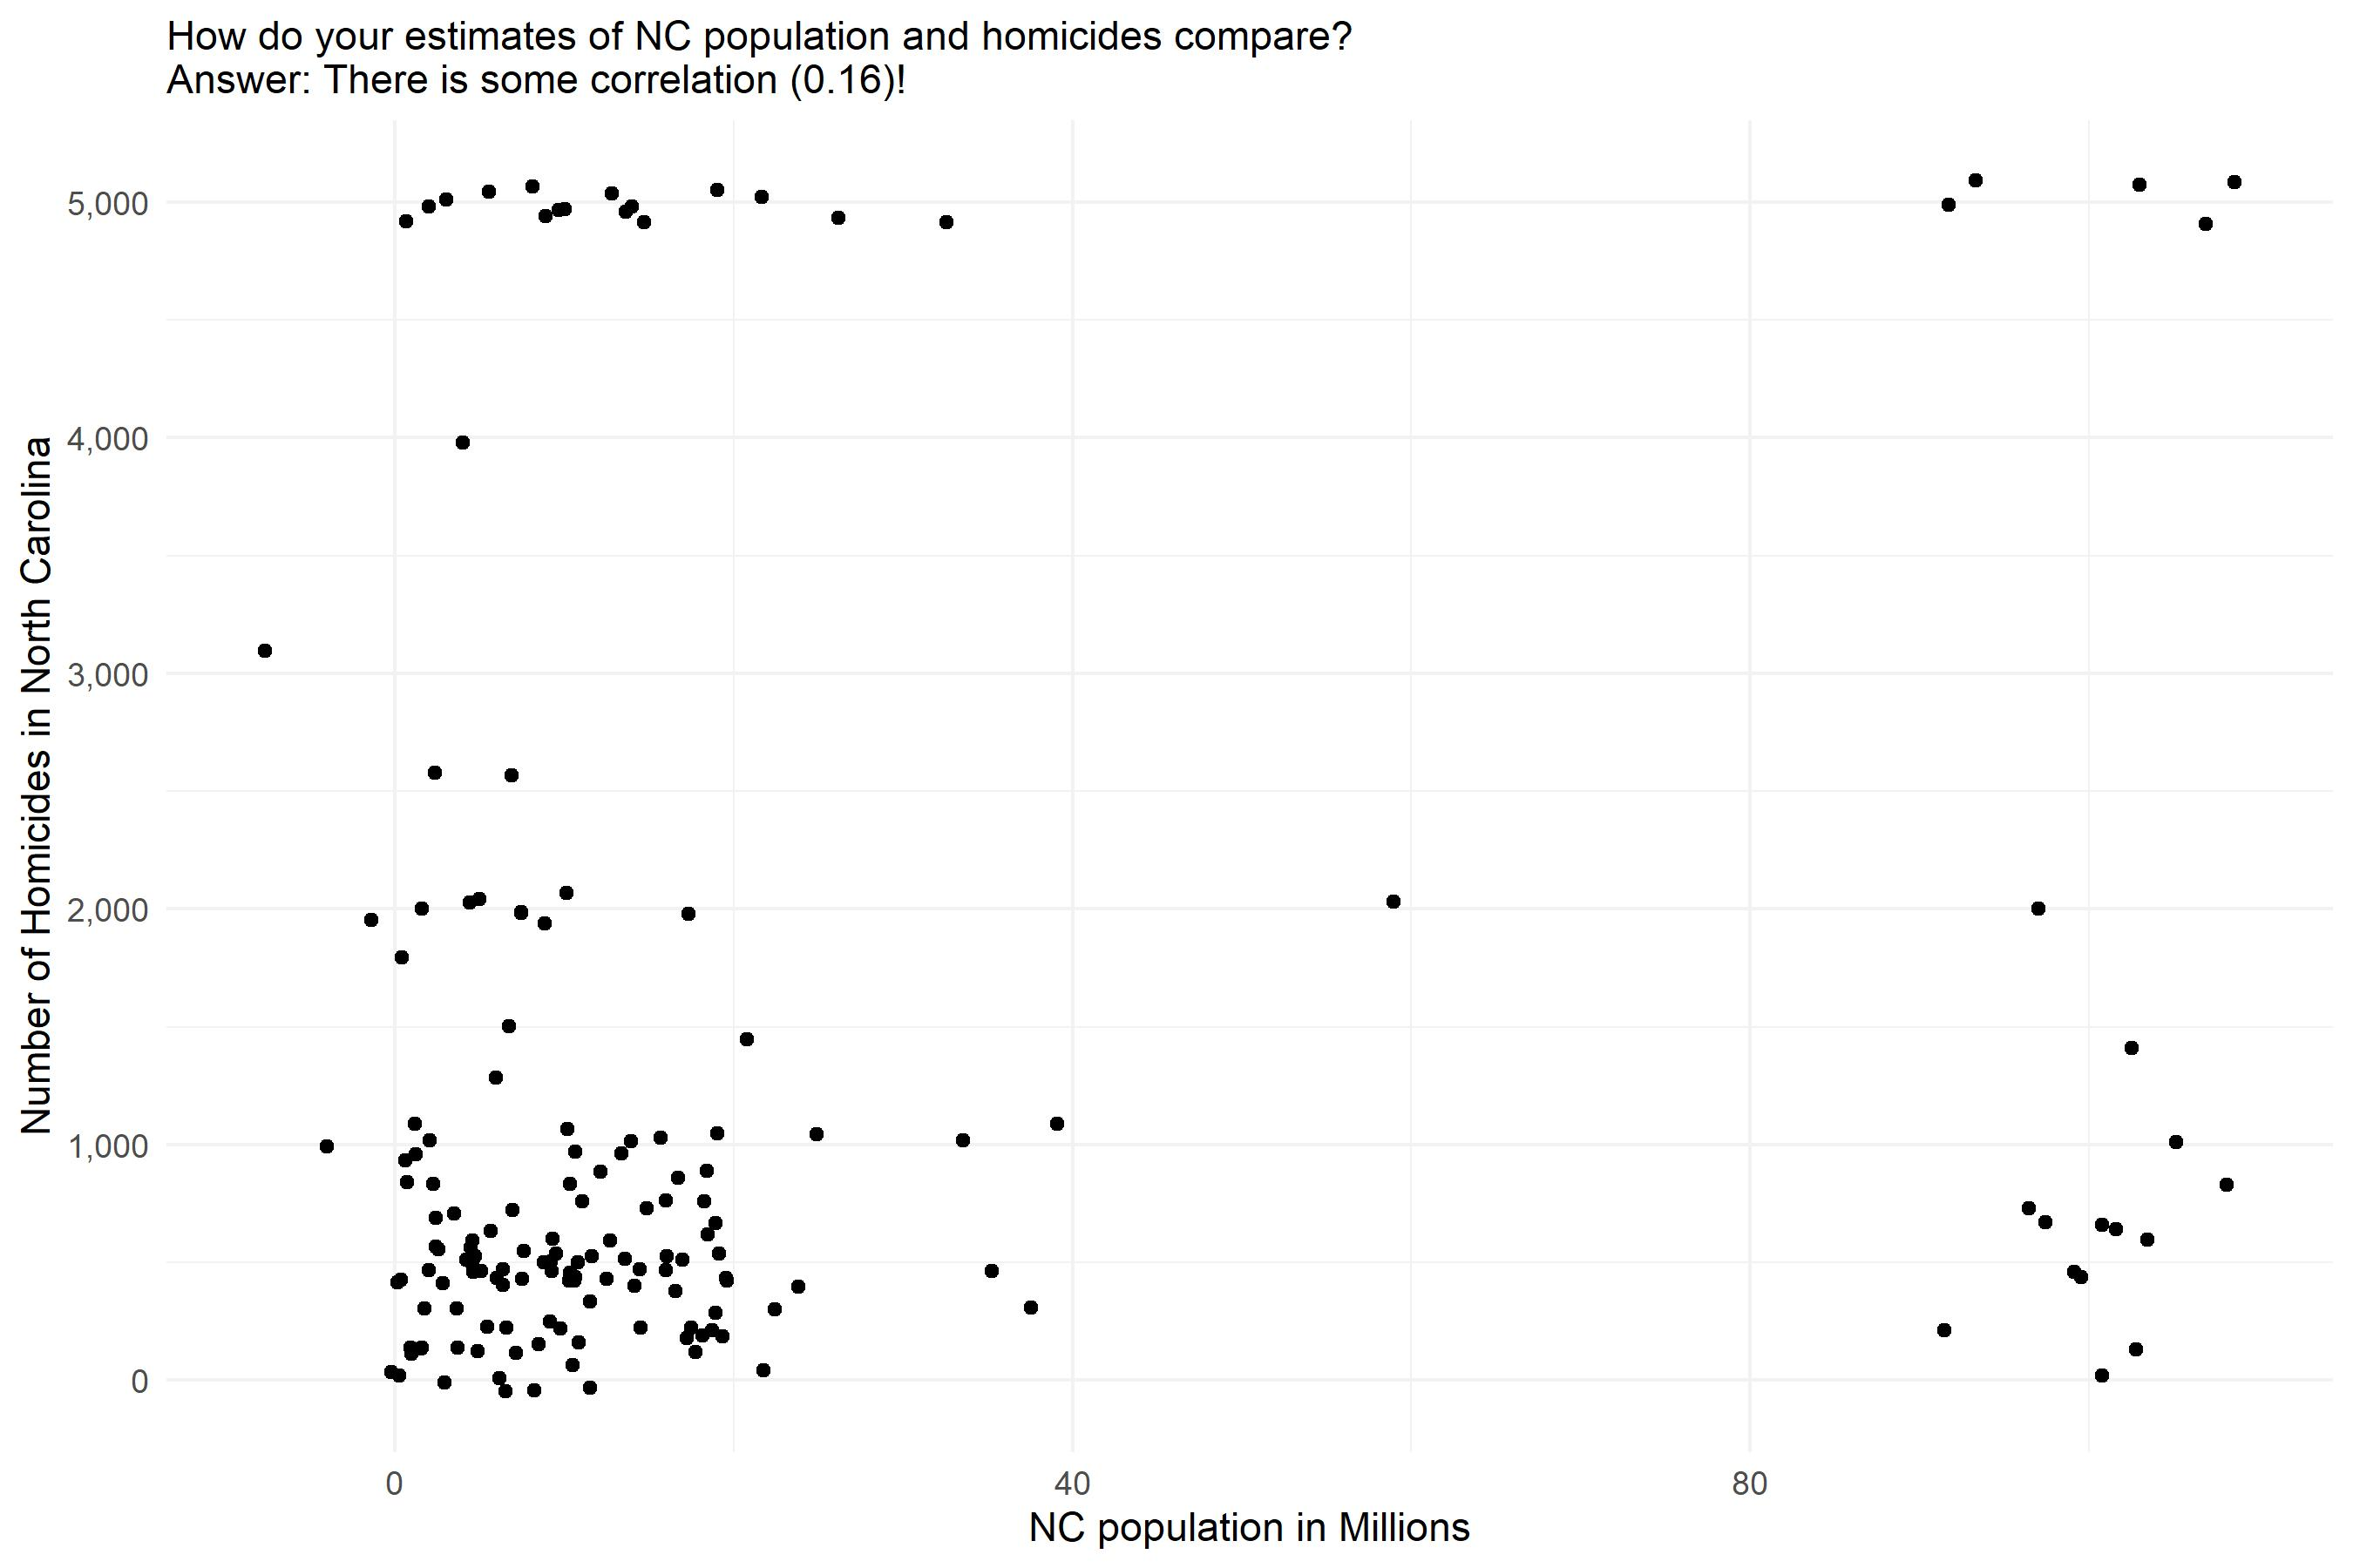
ROUND 2

Slide 26
Maximum homicide rates:
Roughly speaking, what was the maximum number of homicides in the US in any single year from 1972 to present?
In North Carolina?
These results were so crazy I did not graph them.
Round 1 US: 200,000,000 max estimate (1 cases)
Round 2 US: 200,000,000 max estimate (7 cases)
Round 1 NC: 100,000,000 max estimate (2 cases)
Round 2 NC: 100,000,000 max estimate (7 cases)
Note: that’s the entire population for the US, and 10 x the pop. for NC!

Slide 27
True or false: It costs more to maintain the death penalty than to have Life without Parole as the most severe punishment?
Round 1
True: 66%
False: 34%
Round 2
True: 92%
False: 8%

Slide 28
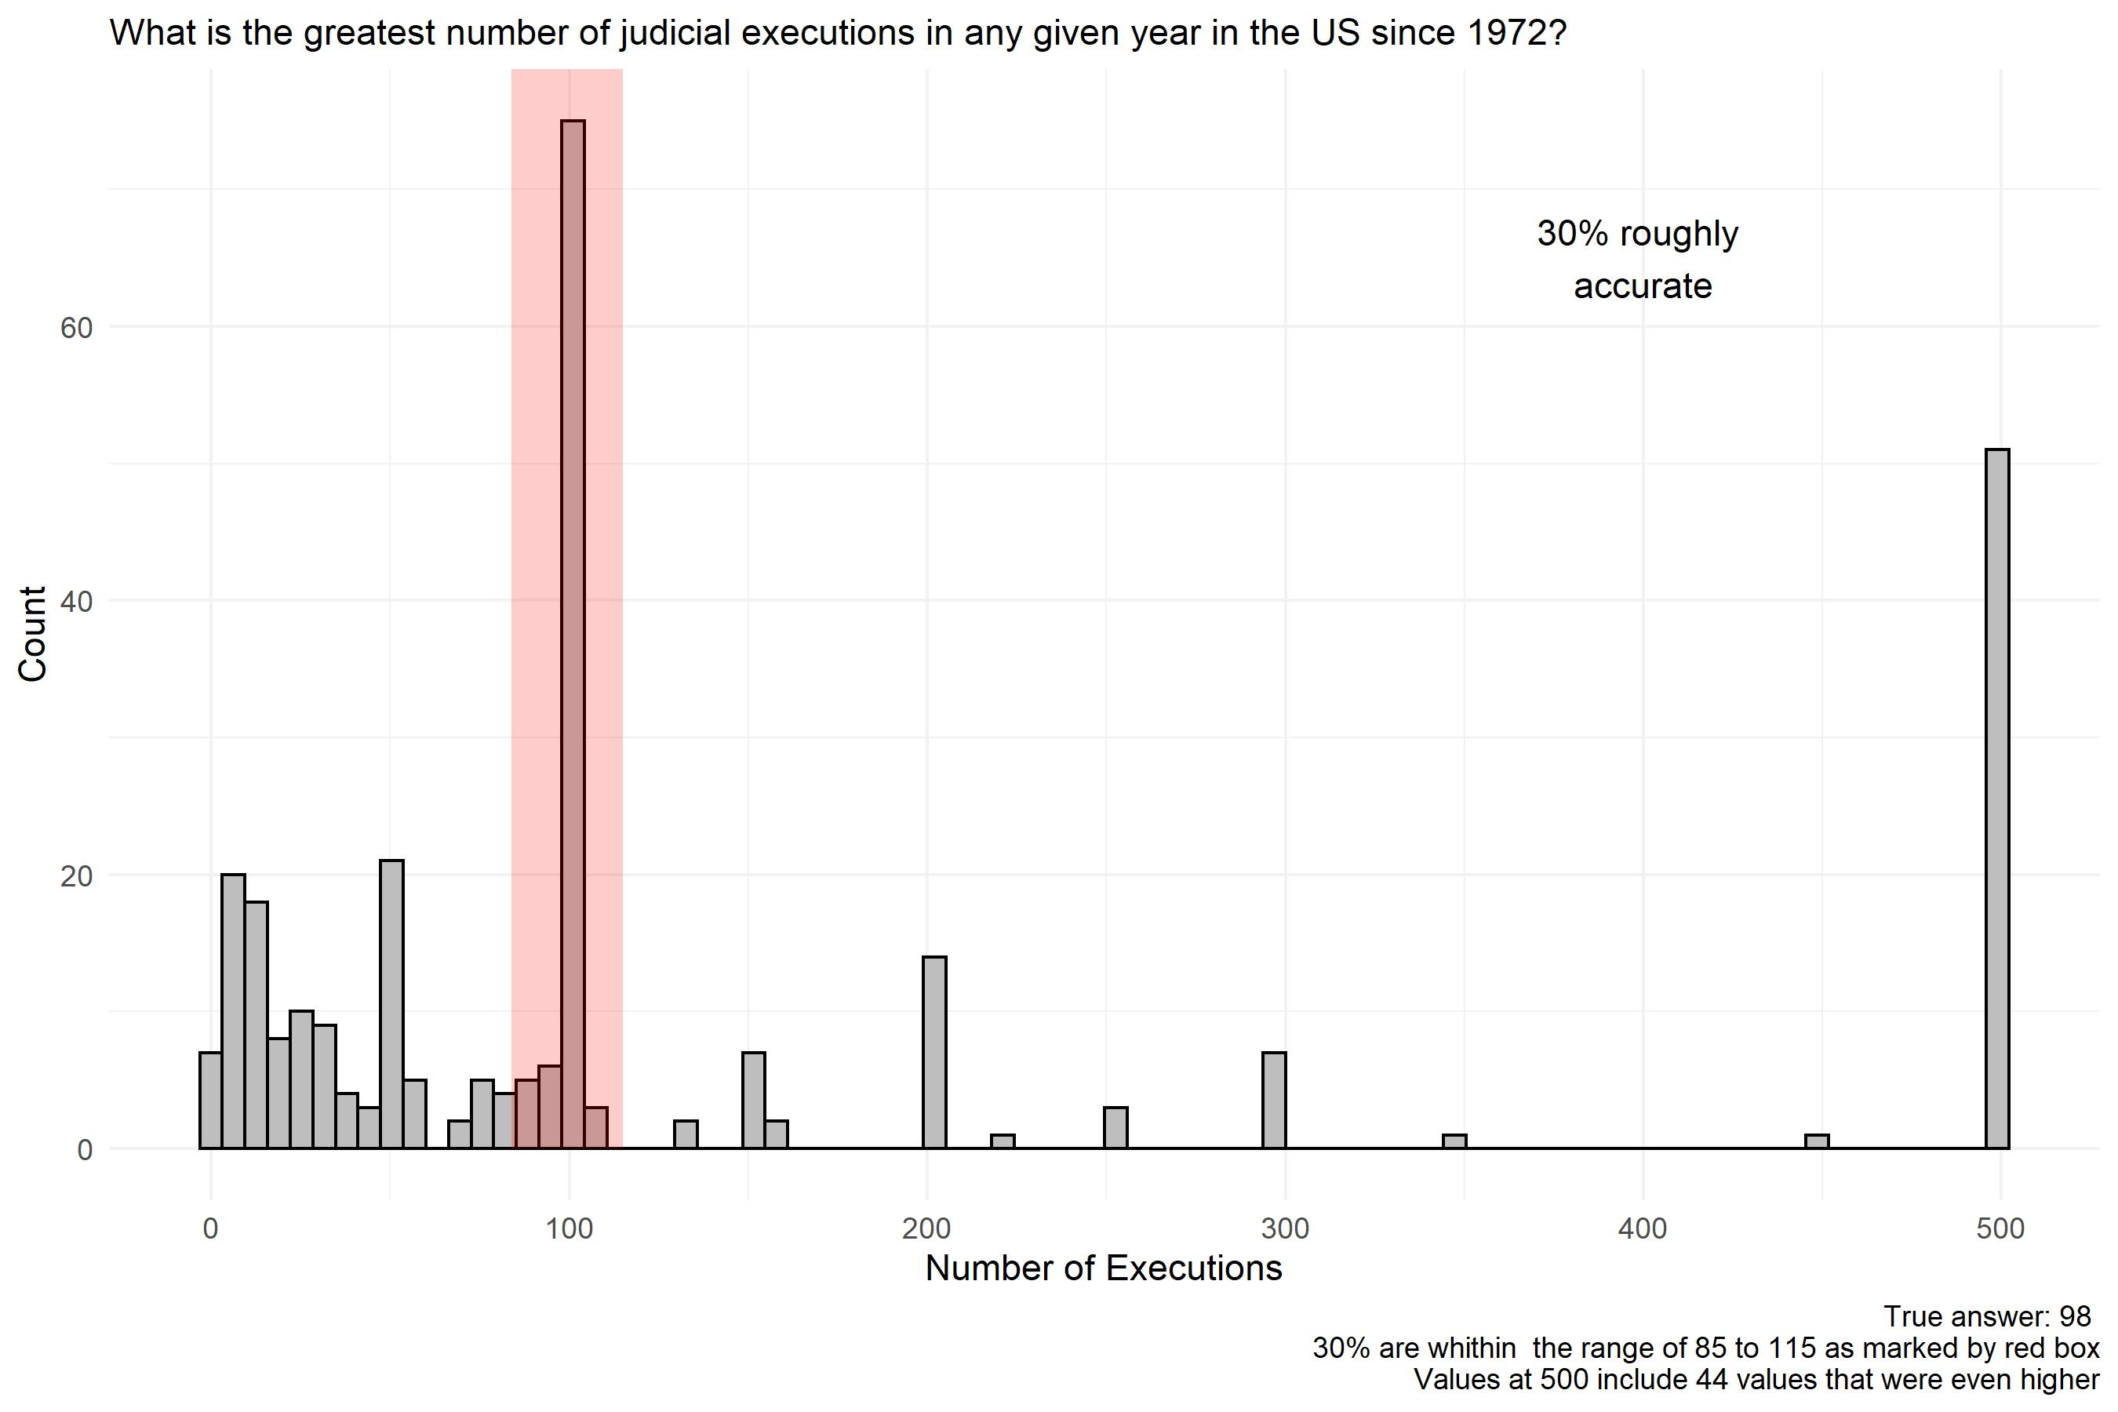
ROUND 1

Slide 29
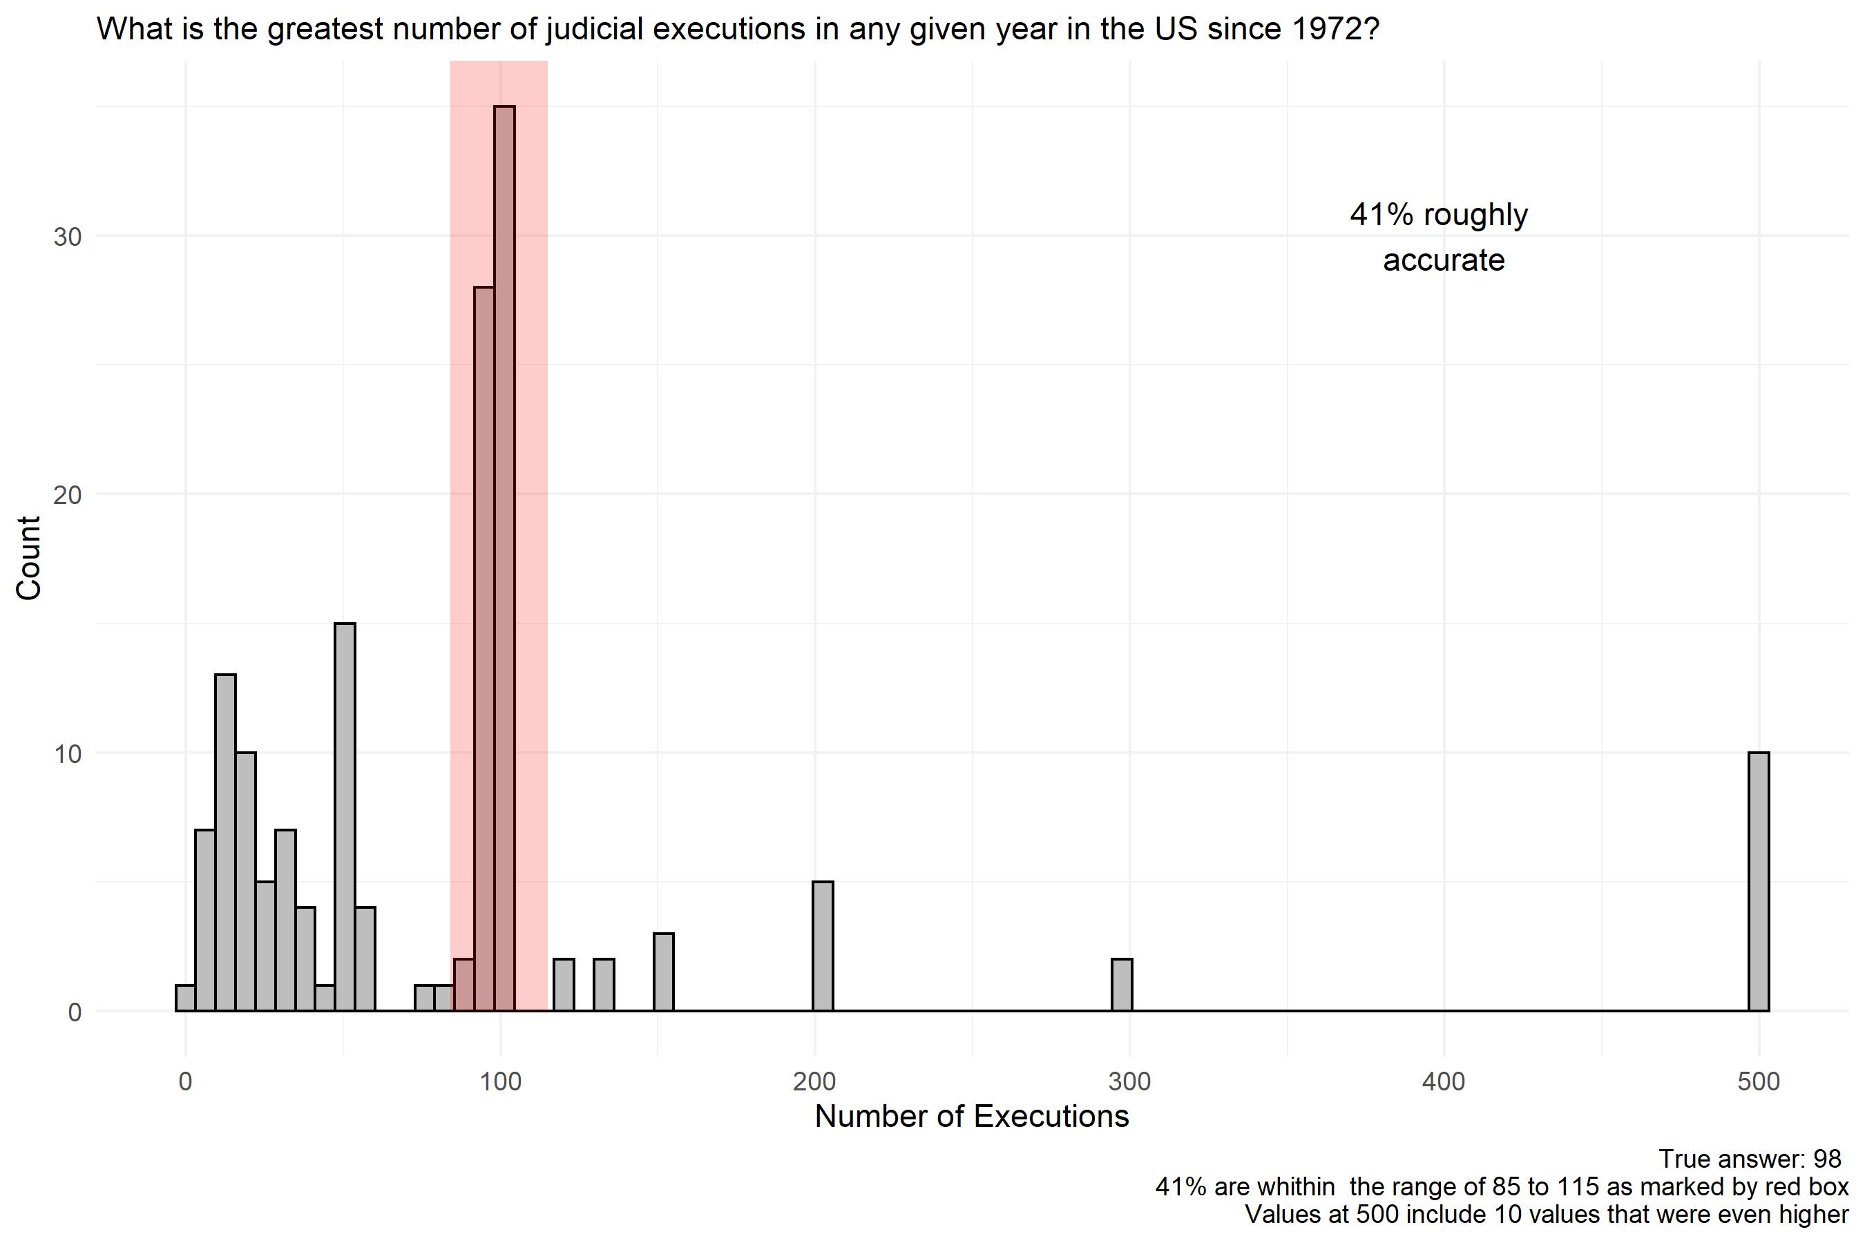
ROUND 2

Slide 30
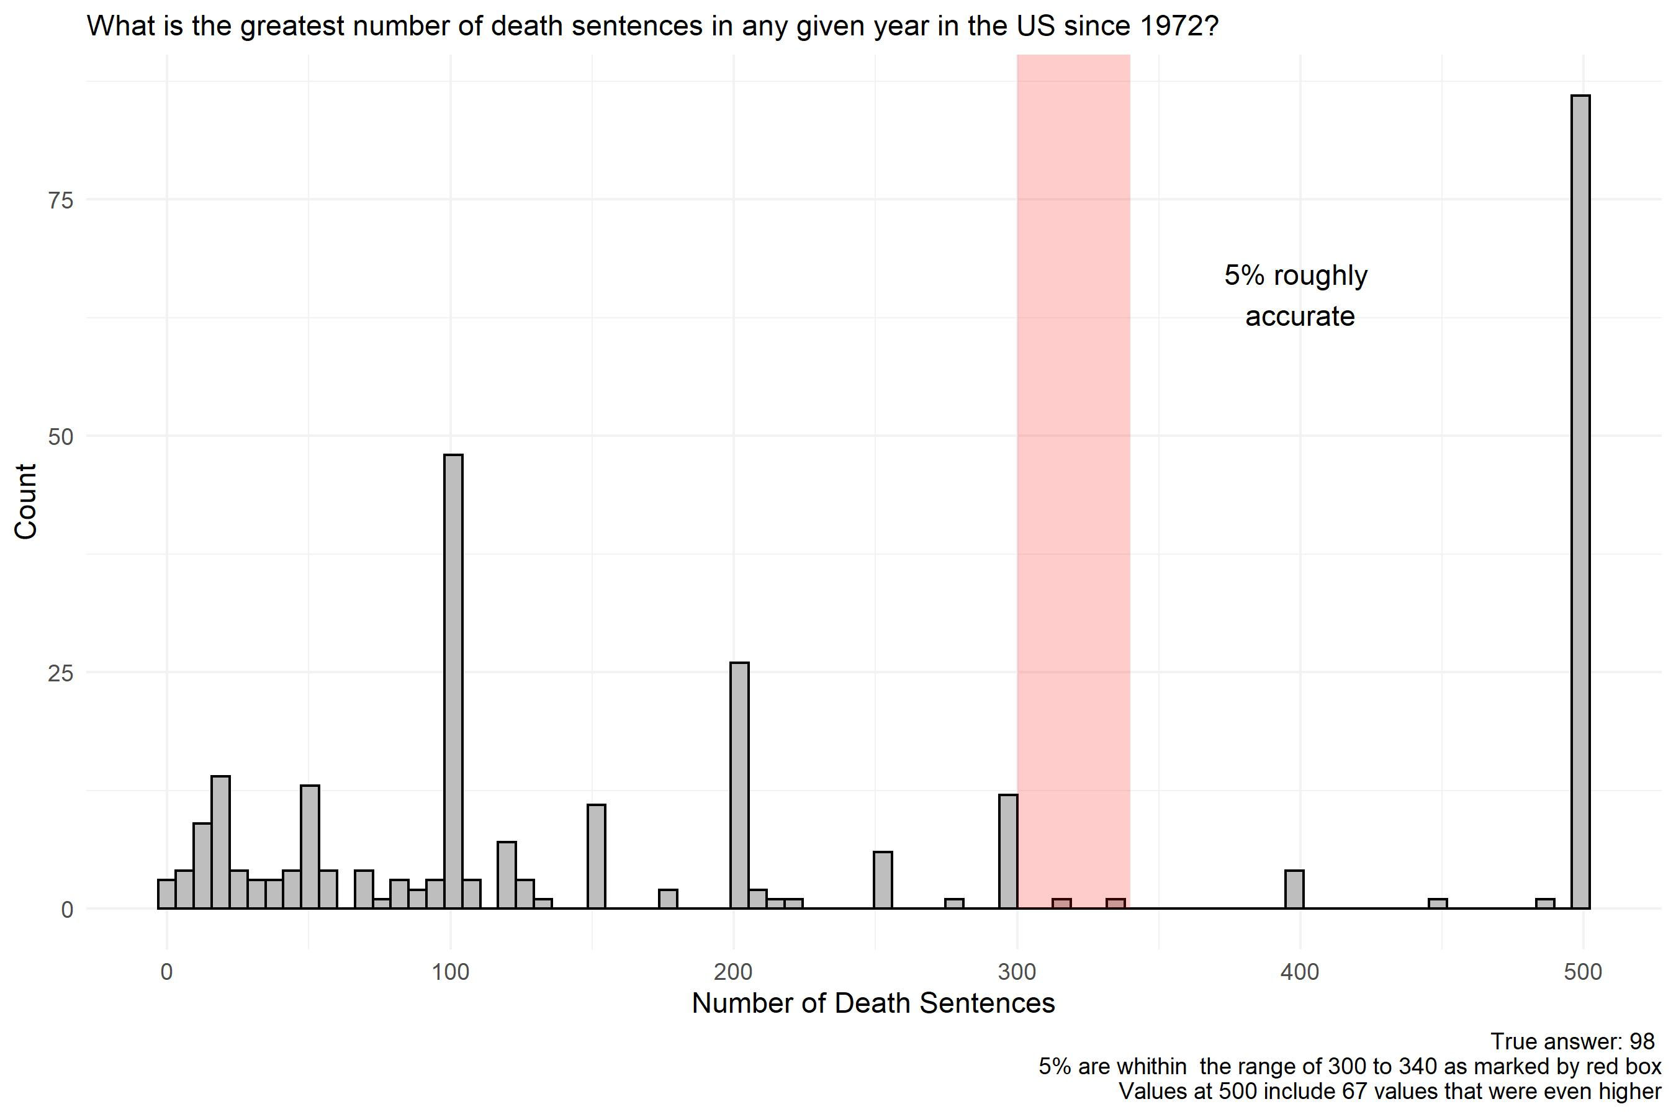
ROUND 1

Slide 31
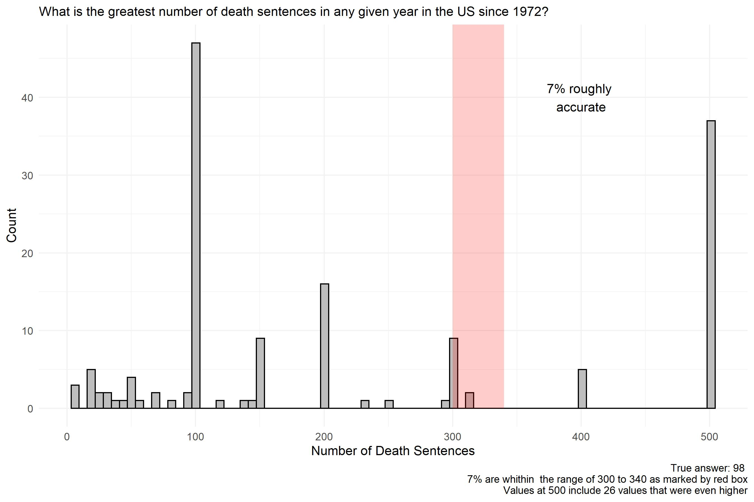
ROUND 2

Slide 32
True or false: No one in the US may serve on a jury in a capital case unless they believe in the death penalty.
Round 1:
True: 23%
False: 77%
Round 2:
True: 92%
False: 8%

Slide 33
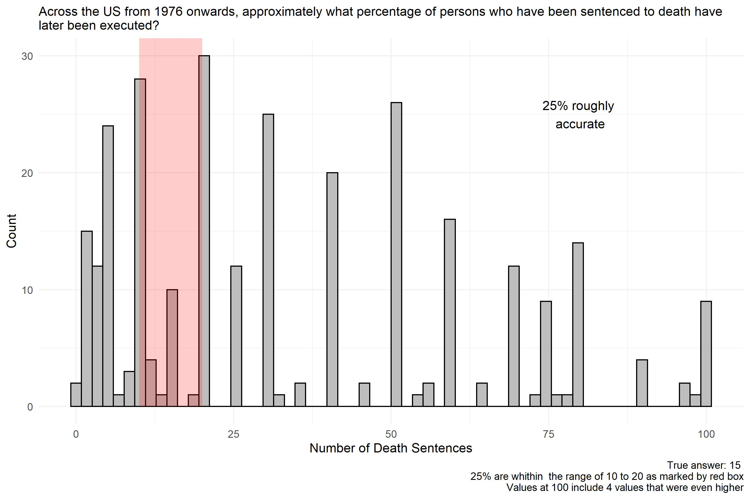
ROUND 1

Slide 34
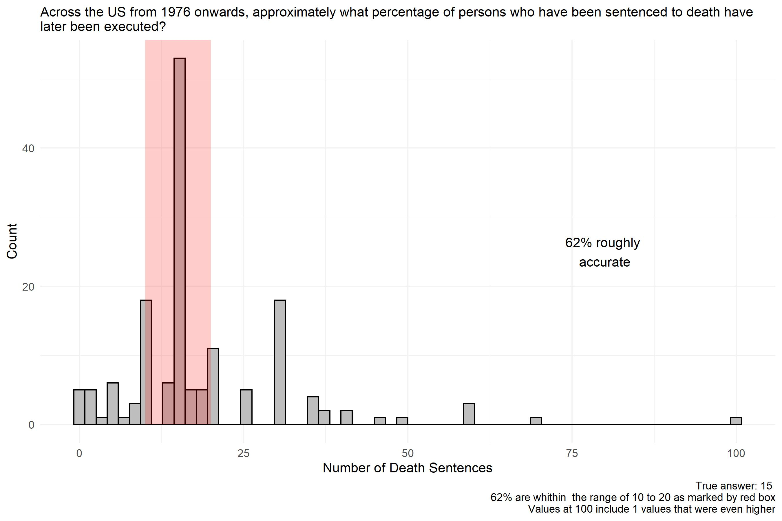
ROUND 2

Slide 35
Which state has executed the most people since 1976?
Round 1
Texas: 66%
Any other answer: 34%
Round 2
Texas: 86%
Any other answer: 13%

Slide 36
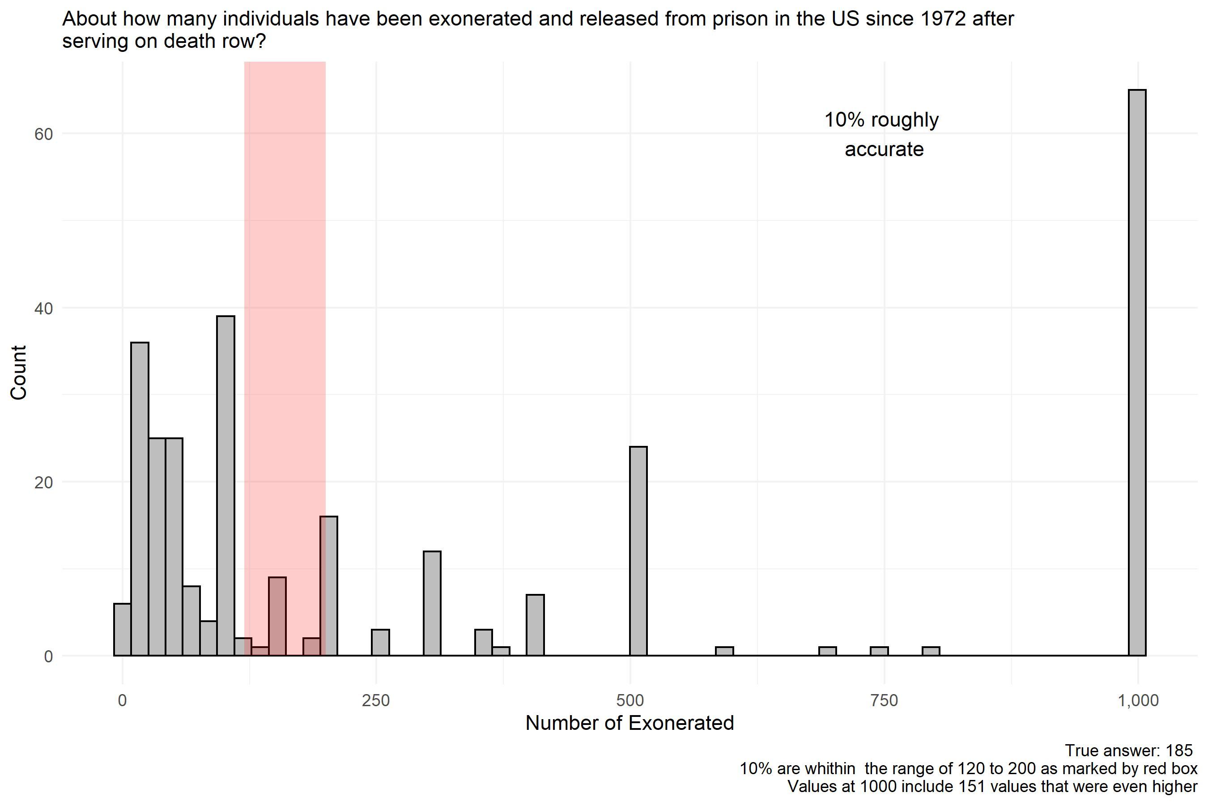
ROUND 1

Slide 37
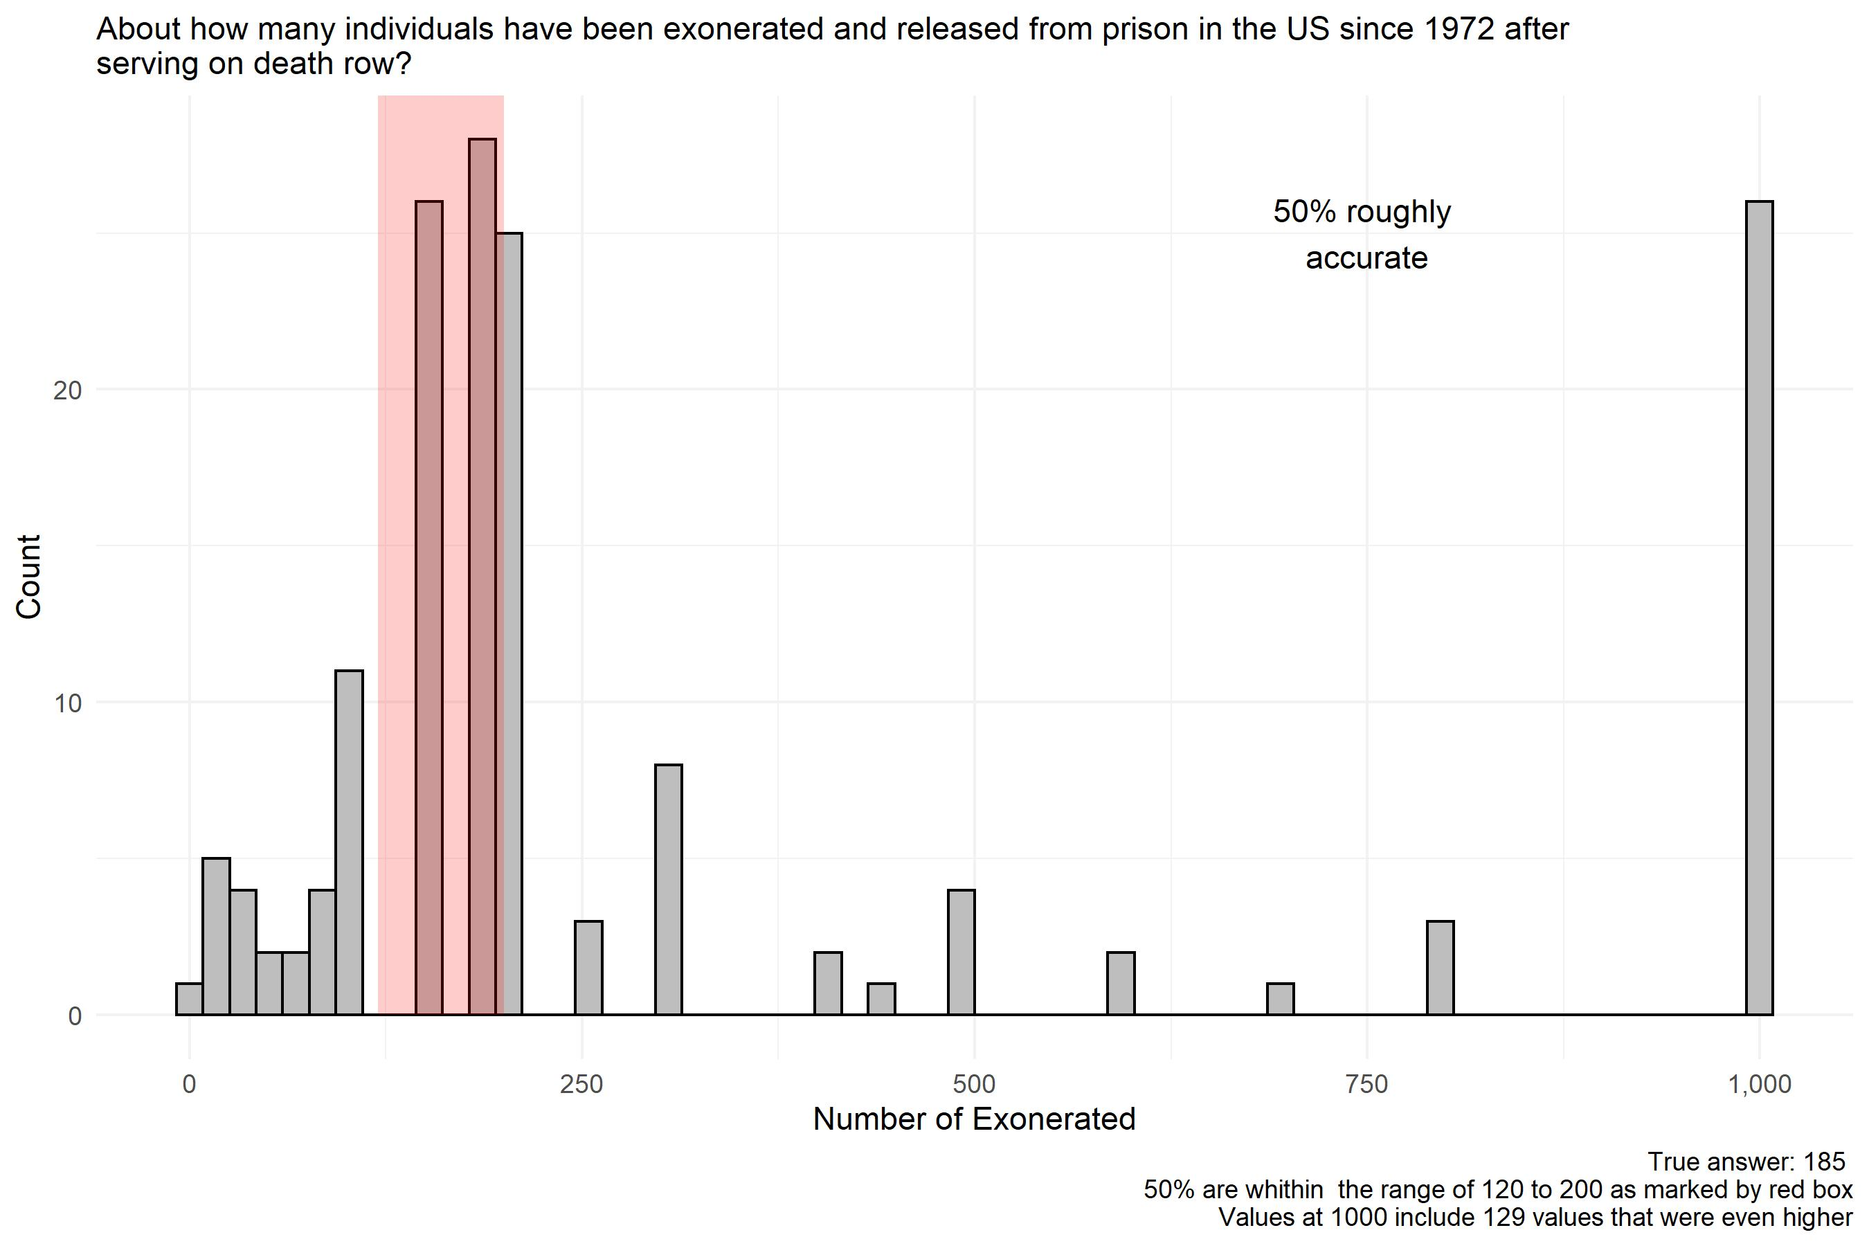
ROUND 2

Slide 38
Which city has the most _____ since 1972?
 | Homicides |  | Executions |  | Death Sentences
 | R1 | R2 | R1 | R2 | R1 | R2
Los Angeles | 20%* | 55% | 15% | 17% | 23%* | 60%
Chicago | 66% | 28% | 30% | 14% | 45% | 18%
St. Louis | 14% | 17% | 55%* | 68% | 32% | 22%
(*: correct)

Slide 39
One county in the US has more executions than any state other than its own. Name that county or its major city.
Houston, Harris County, or any version:
Round 1: 6%
Round2: 46%
Other common answers: St. Louis, Montgomery, Detroit, Los Angeles, Dallas, Chicago

Slide 40
Circle the states that currently have the death penalty
State | Yes |  | No
 | R1 | R2 | R1 | R2
Oregon (yes) | 26%* | 45% | 74% | 55%
Ohio (yes) | 75%* | 81% | 25% | 19%
Michigan (no) | 31% | 33% | 69%* | 67%
Vermont (no) | 20% | 15% | 80%* | 85%
New Jersey (no) | 49% | 28% | 51%* | 72%

Slide 41
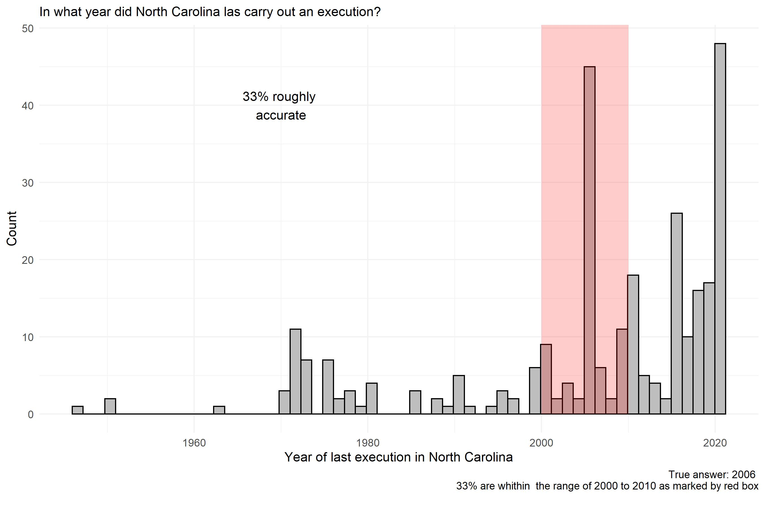
ROUND 1

Slide 42
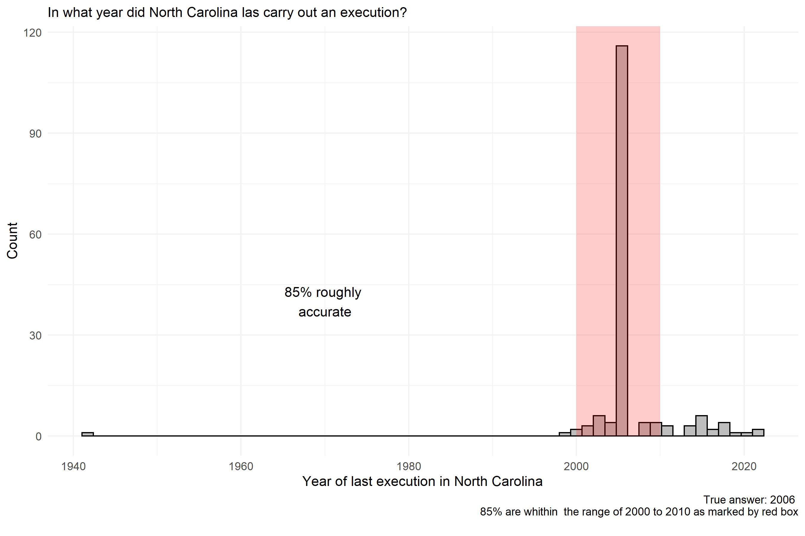
ROUND 2

Slide 43
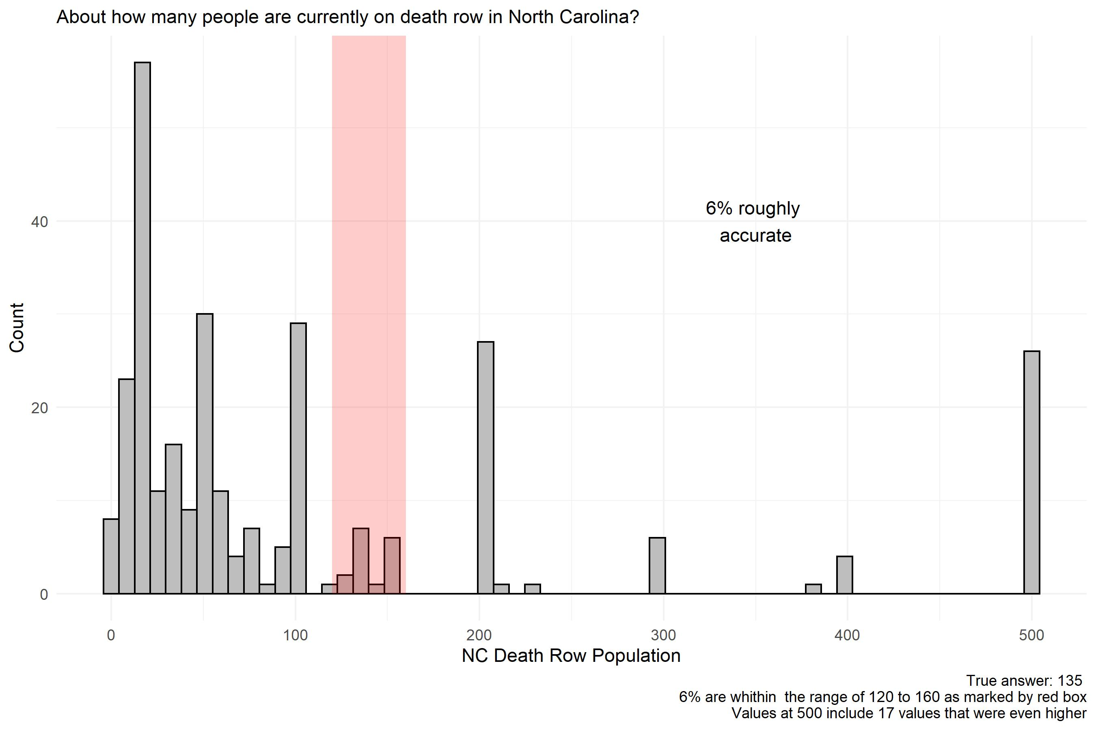
ROUND 1

Slide 44
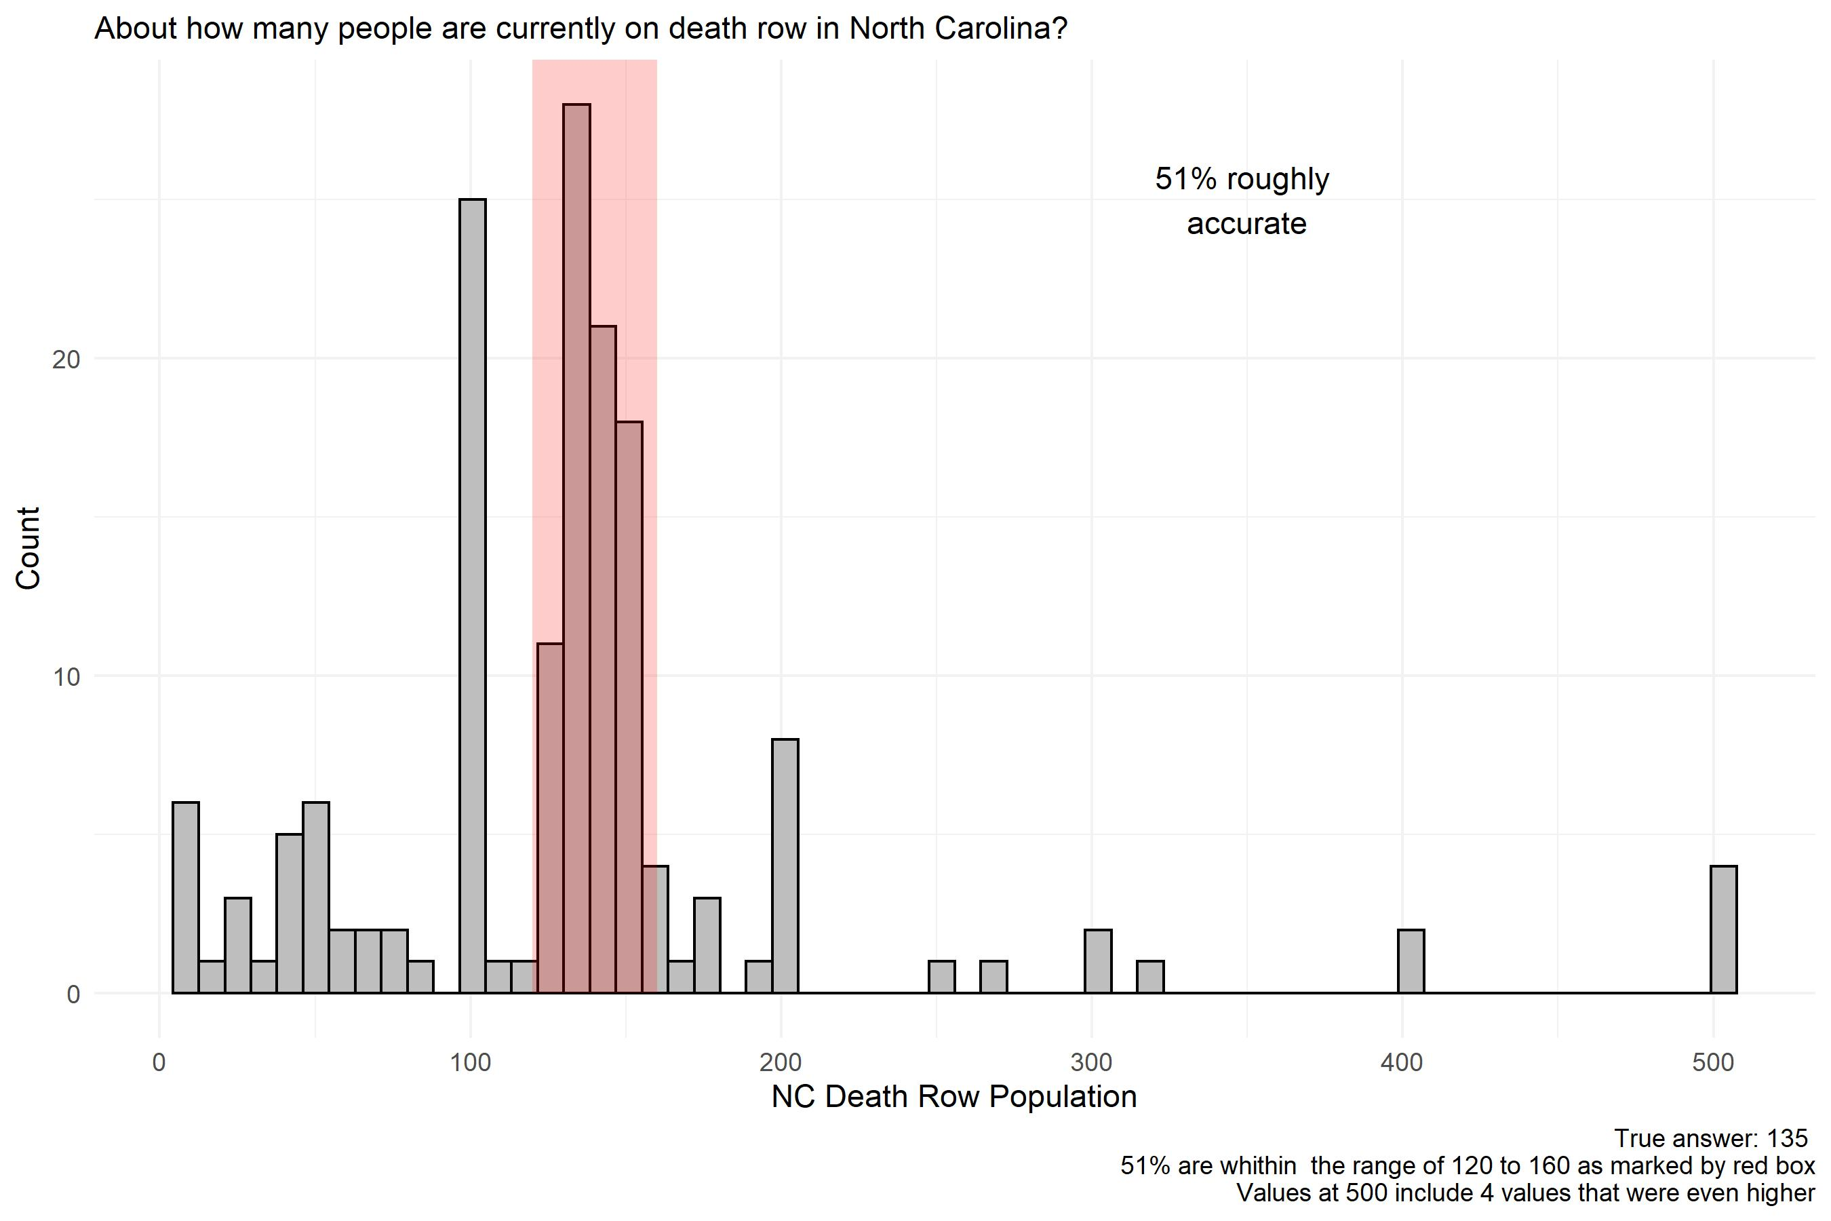
ROUND 2

Slide 45
Which NC County has imposed the most death sentences since 1972?
County | Percent |  | Actual Number
 | R1 | R2
Durham | 9% | 2% | 9
Forsyth | 12% | 12% | 31
Mecklenberg | 20% | 12% | 30
Orange | 1% | 4% | 1
Robeson* | 58% | 70% | 34

Slide 46
Good thing we’re not keeping grades!
Question | Percent Correct |  |  | Question | Percent Correct
 | Round 1 | Round 2 |  |  | Round 1 | Round 2
US Population | 58% | 76% |  | City of death sentences | 23% | 60%
US Homicides | 53% | 56% |  | County of executions | 6% | 46%
NC Population | 22% | 54% |  | Oregon has dp? | 26% | 45%
NC Homicides | 13% | 29% |  | Ohio has dp? | 75% | 81%
Cost of DP higher | 66% | 92% |  | Michigan has dp? | 69% | 67%
Max # executions | 30% | 41% |  | Vermont has dp? | 80% | 85%
Max # death sentences | 5% | 7% |  | NJ has dp? | 51% | 72%
Death qualification | 23% | 92% |  | Most recent NC execution | 33% | 85%
Execution rate given condemnation | 25% | 62% |  | NC DR population | 6% | 51%
Highest executing state | 66% | 86% |  | Top NC county for dp? | 58% | 70%
Number of exonerations | 10% | 50%
City of homicides | 20% | 55%
City of executions | 55% | 68% |  | Average | 37.5 | 62.0

Slide 47
But we will be keeping grades on the final exam.
To study for the final:
Review this quiz. I guarantee that will be helpful.
Keep in mind the difference between a number and a rate or a percentage. Los Angeles has more homicides because 10,000,000 people live there. If I asked about the rate, the answer might not be the same.
Review your previous quizzes.
Don’t stress too much: final exam = 20 percent of the grade.

Slide 48
Logistics of the final
In class, through Sakai. Identical format to the quizzes.
Closed book. No internet browsing.
You must be in class unless you are doing it through ARS or have made other arrangements with me for some special reason such as three exams on the same day.
Alternative exam, different questions, Tuesday May 3, 355 Ham.
Only for those with a valid reason, in advance.
If you simply don’t come to the final as scheduled on Monday at noon, in Ham 100, and have not made previous arrangements to take the alternative exam because of an approved reason, you will get a zero.
Students registered with ARS can take the exam through ARS at the regular time. Please do that with ARS, not in Ham 100.

Slide 49
Some last comments
Thank you for showing interest in this class
I hope you have learned a lot.
If nothing else, I hope you have learned to assess things as they actually work, not as one might hope they work, or as one could wishfully think they do work, or assume they work.
Wishful thinking is not good public policy
Due-diligence: understand the facts of what you are arguing about so that your opinion is based on reality, not wishful thinking.
That statement seems to have increased relevance in today’s polarized political environment, but it’s always been good advice!

Slide 50
Career ideas
First, if you took this class just because it was interesting, or fit into your schedule, and have no plans to let it affect you in the future, that’s totally fine.
But if you do:
Defense attorney is not the only option. It’s a good option. But so are these:
Prosecutor. You don’t have to be a bad and dishonest one. You could be a good one. You’d definitely have way more power.
Investigator, social worker, mitigation specialist, psychologist, forensic science
Many other professions work around these cases and they have a mix of people skills (investigators) and technical skills. Not all are lawyers.

Slide 51
What was this class about, anyway?
Don’t forget that at the core of everything we have discussed was a homicide.
We’ve had almost a million homicides since 1972…
Let that sink in. That’s the problem, violence, killing, loved ones violently killed.
Our country has an epidemic of it. Other countries have mush less violence.
You read Right Here, Right Now. You saw the childhood situations.
Another good career option is to work with children in almost any capacity to give them what hopefully all of you have: a sense of dignity, value, and purpose.
There are also many careers relating to healing and recovery after loss, focused on crime victims and survivors, not only offenders.
Do you want to work after a crime has happened, “fixing” it, or doing things that might reduce crime, poverty, poor educational options, and other social pathologies in the first place? This opens up a lot of options.

Slide 52
What my mom told me (with expansions of my own):
It’s not your responsibility to fix the entire world. If you set that as your goal, you’ll clearly fail, and it will be frustrating.
But you can choose your career path to be one that heals rather than harms.
Doing good should not just be a charitable activity on the weekends; it should be part of your full time job.
Find a career path that gives you meaning, and also does more good than bad, that helps rather than harms.
There are many careers that allow you to do this. I have one, as a college professor. But it obviously depends on how you use it!

