Slide 1

Deadly Justice, Ch 16
Declining Use
March 26, 2025

Slide 2
Declining Use
Numbers in sharp decline since peak in mid-1990s
Death sentences, executions, states abolishing, number of states no longer using, number of counties sentencing is lower and lower
What are / could be the constitutional issues associated with that?
  Evolving standards of decency: we don’t do this any more…
  Equal protection of the law: it can’t be just the county that determines your punishment…

Slide 3
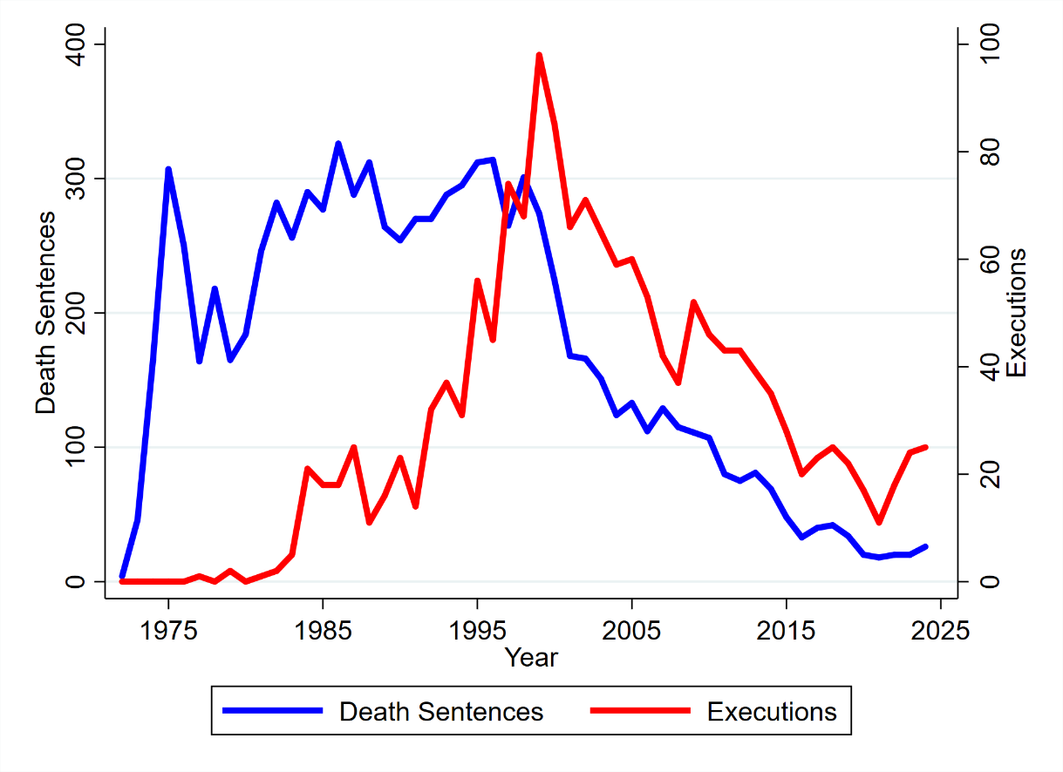
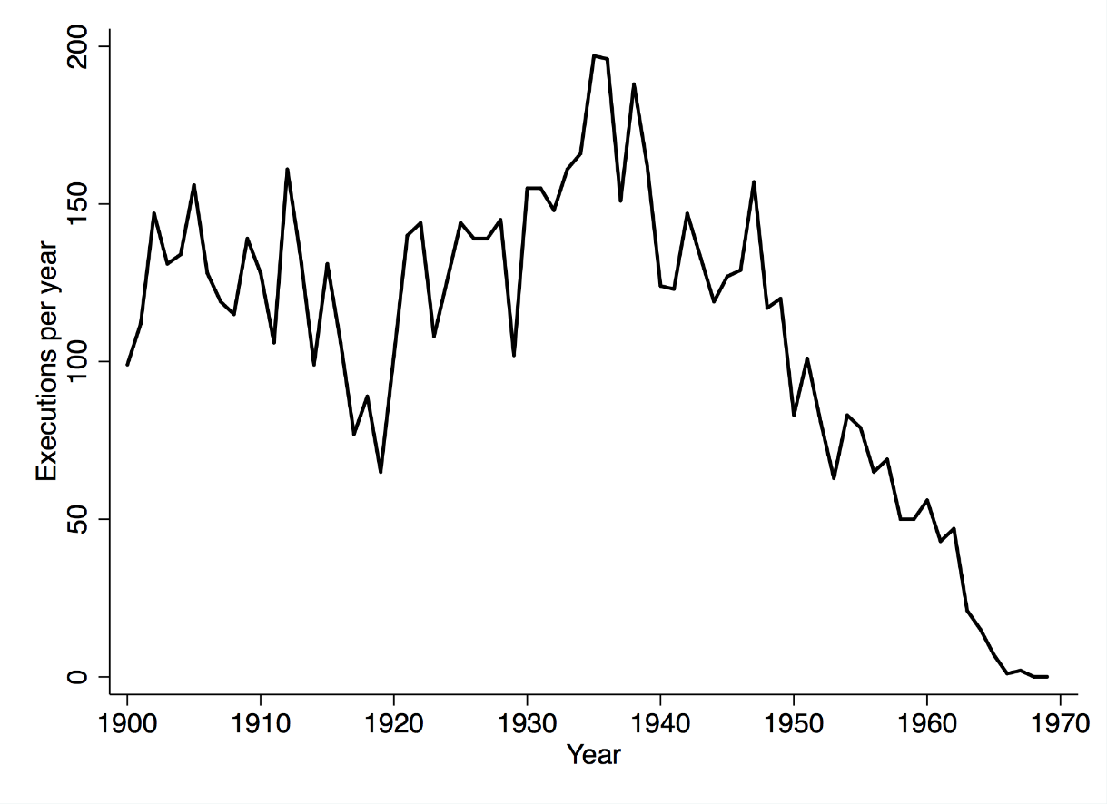
Is the death penalty dying?
Depends on when you look: increased from 1977 to 1998, decline since then
It completely disappeared from 1935 to 1966… (but it came back again!)

Slide 4
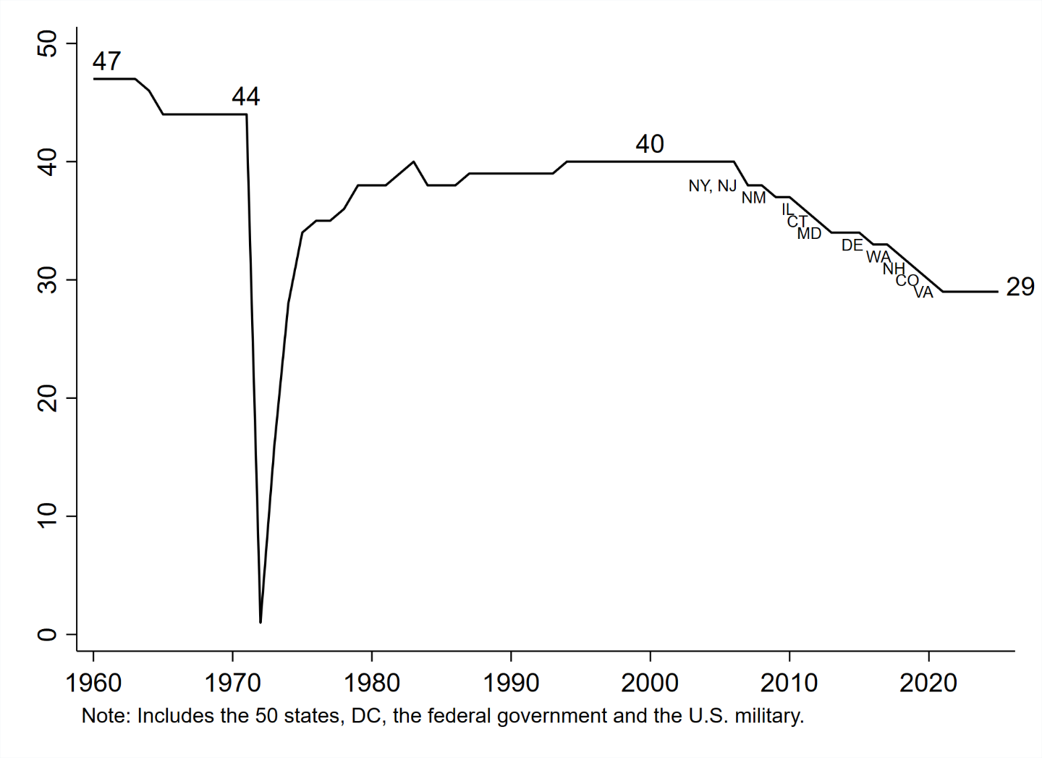
When it came back, it was fast. But some states have recently abolished.
Kansas was the last to add, 1994
Since 2006, 11 abolitions…

Slide 5
Recent abolitions:
Legal Abolitions (year)
Governor-imposed Moratoria (year)
New Jersey 2007
New York 2007
New Mexico 2009
Illinois 2011
Connecticut 2012
Maryland 2013
Delaware 2016
Washington* 2018
New Hampshire 2019
Colorado 2020
Virginia 2021
*Washington: Ruled unconstitutional, 2018; legislatively abolished, 2023
Oregon* 2011
Pennsylvania 2015
California 2019
(Note: these apply to executions, not death sentences)
(Also note: no recent re-establishments; some action in FL, LA, other states to expand use, however, in the past few years)
*Oregon: 2019 law restricts law to very small group of offenders; 2021, court rules this applies retroactively; 2022, Governor commutes 17 existing sentences, so no one remains on death row.

Slide 6
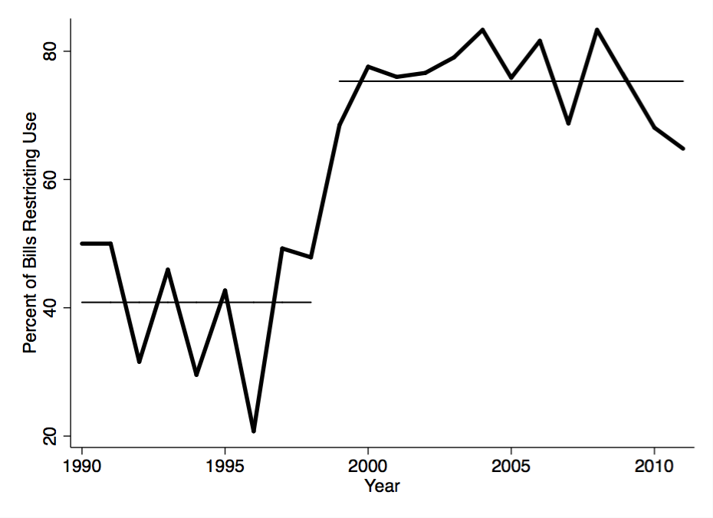
State legislative bills went from expanding to restricting use of the death penalty, in late 1990s (Term paper idea: Update this graph for me!)

Slide 7
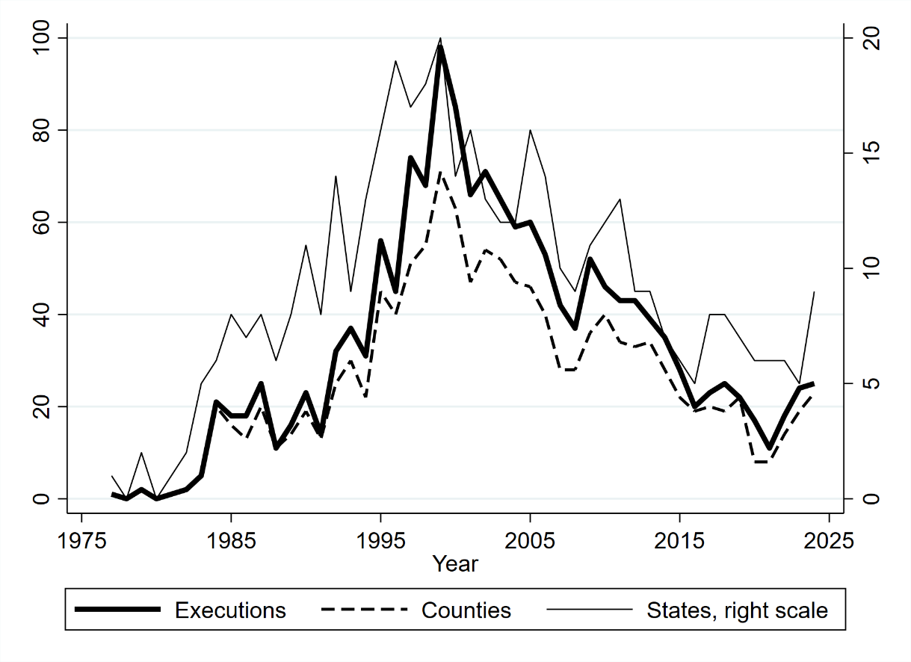
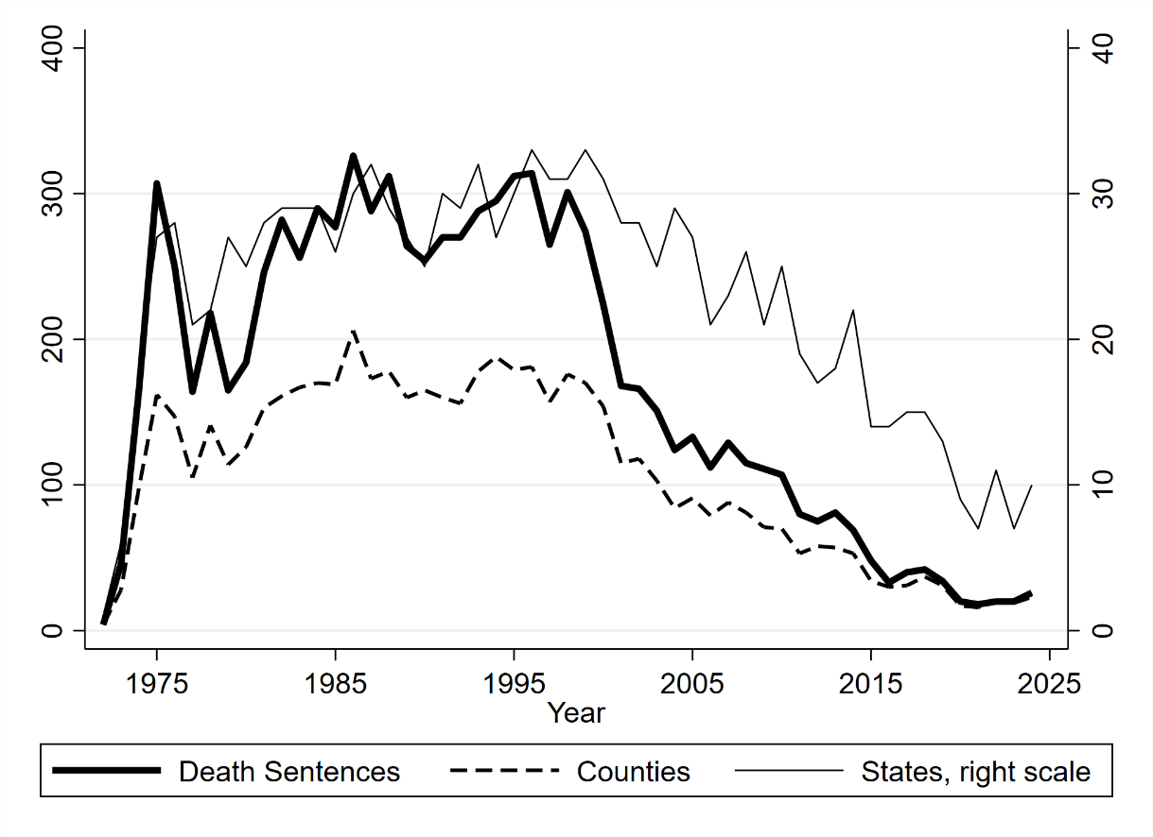
Trends went up, up, up, then down, down, down
Executions
Death Sentences

Slide 8
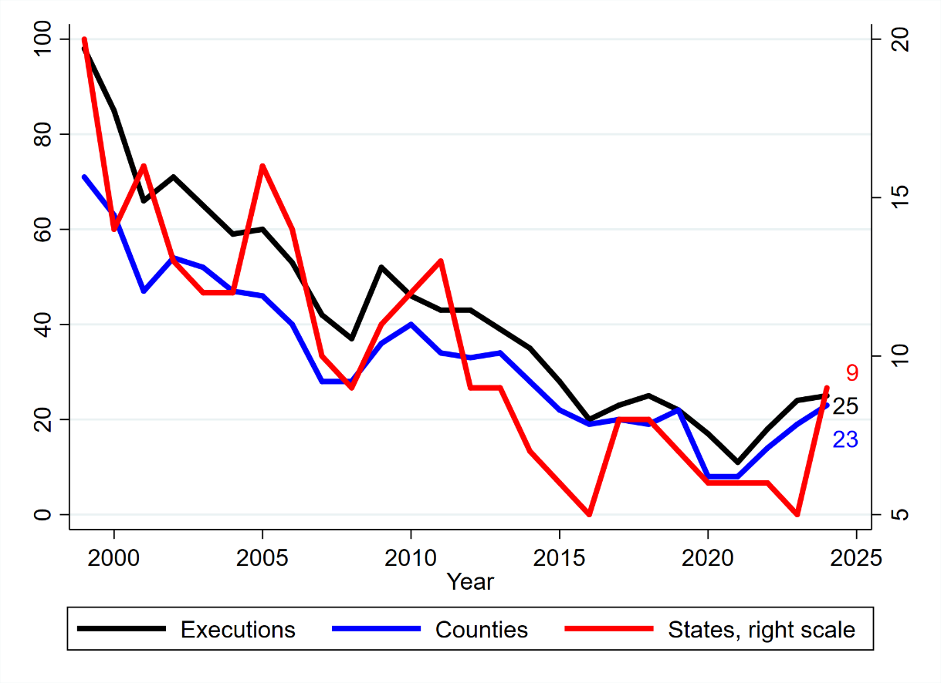
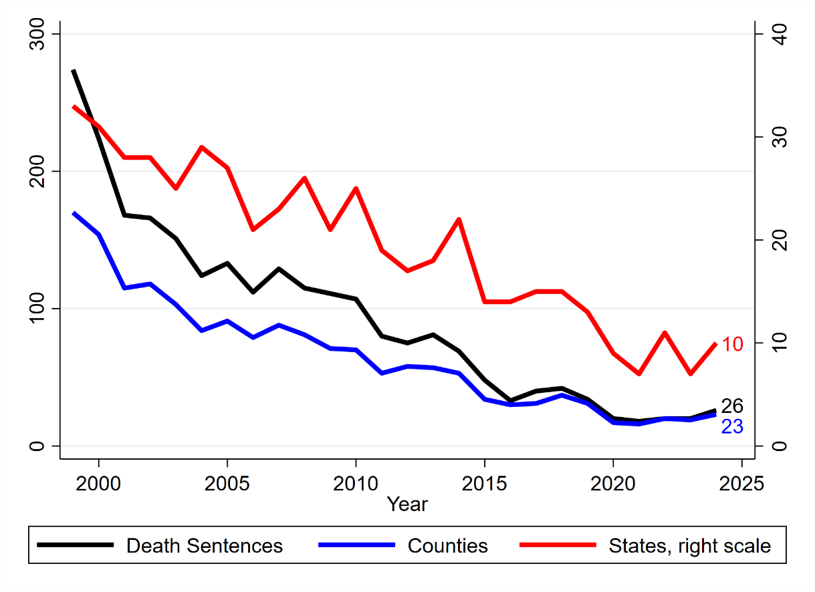
Every indicator in deep decline, on the order of 60-80 percent declines from mid-1990s
Executions
Death Sentences

Slide 9
“Evolving Standards of Decency”
Weems v. United States (1910): “Eighth amendment is not fastened to an absolute but may acquire meaning as public opinion becomes enlightened by a humane justice”
Trop v. Dulles (1958): Eighth amendment draws “its meaning from the evolving standards of decency that mark the progress of a maturing society”
Atkins v. Virginia (2002): DP not available for intellectually disabled.
Roper v. Simmons (2005): DP not available for juveniles
How were those considered? Let’s look at Atkins and Roper…

Slide 10
Atkins v. Simmons (2002): No death penalty for those with intellectual disabilities (IQ < 70)
But consider the relatively recent decisions in the other direction…
Penry v. Lynaugh (1989): ok to execute those with disabilities
So what happened between 1989 and 2002?
That was a pretty quick change. The Court noted several things:
  State legislatures changed laws on the topic, generally in the direction of restriction
  Scientific understanding changed
  General level of use declined
The Court just changed the interpretation, 13 years later…

Slide 11
Roper v. Simmons (2005): No DP for juveniles
But go to DPIC and search in the execution database, click on juvenile: we’ve done it 22 times, including 13 times in the period of 1998 through 2003: https://deathpenaltyinfo.org/views-executions
Thompson v. Oklahoma (1988): no one under 16
Stanford v. Kentucky (1989): ok to execute 16, 17 year olds
So again, in 1989 it’s ok, then in 2005 it’s not: a big change in 16 years

Slide 12
So, what happened so quickly? In 1989, these things were AFFIRMED; in 2002 and 2005, they were REJECTED
Re-read pp. 323-324 of the book…
Lots of different indicia were cited by the Court:
  how many states allow it (trend, rather than number);
  how often it has been done (e.g., actual use, no matter what the law);
  The direction of legislative actions
  Direction / development of social science research on juveniles
  International trends, decisions from other countries…
  many other factors cited, including the Court’s “own judgment”
Very strong reactions / rejections from the Originalists
  Scalia, Rehnquist, Thomas, O’Connor: no consensus, in fact a majority of states allowing DP also allow it for juveniles, so no legislative / elected officials have rejected it.
Evolving standards a very interesting issue, very contentious

Slide 13
Would the original constitution have allowed execution of a 7 year old?
Justices Stevens and Ginsberg, concurring in Roper v. Simmons:
  https://supreme.justia.com/cases/federal/us/543/551/concurrence.html
“Perhaps even more important than our specific holding today is our reaffirmation of the basic principle that informs the Court’s interpretation of the Eighth Amendment. If the meaning of that Amendment had been frozen when it was originally drafted, it would impose no impediment to the execution of 7-year-old children today. See Stanford v. Kentucky, 492 U. S. 361, 368 (1989) (describing the common law at the time of the Amendment’s adoption).”

Slide 14
Very strong reactions from the others…
Justice O’Connor agrees with this prohibition, but dissents anyway, based on the idea that SOME 17-year olds may deserve death:
  https://supreme.justia.com/cases/federal/us/543/551/dissent.html
Wow was Justice Scalia unhappy with all this. And several other justices joined his dissent. He did not like:
  How the “consensus” was calculated
  The use of “own judgment”
  The use of “international norms”
  Many other elements of the decision: “this is no way to run a legal system”
  https://supreme.justia.com/cases/federal/us/543/551/dissent2.html

Slide 15
So what can we say about “evolving standards”?
It’s clear that we no longer do many things that we once did, particularly hundreds of years ago. So this is an important part of the constitution.
It’s also clear that conservative Justices object to the very concept of “evolution” – they believe in and focus on the “original meaning” of the constitution, at the time it was written.
A wide variety of indicators are used to judge whether societal standards are changing, but some justices regard these as irrelevant.
The constitution does prohibit “cruel and unusual” punishments: So therefore some assessment of whether a punishment is “unusual” versus relatively common is part of the constitution.
But, no guidance on how unusual is too unusual…
Dominance of “originalists” on US SC today means few would want to re-litigate these issues now. So no cases are coming to the Court…

Slide 16
The “Roper Extension” argument
Current movement to push for an extension of the age limit of Roper, 18, to 21.
Evolving standards of decency
Evolving standards of neuro-science…
Sorry fellas but this entire argument is that the male brain is not fully developed until a later age, beyond 21. Nothing personal!

Slide 17
Background on Randy Guzek
Committed a double homicide four weeks past his 18th birthday.
  DOB: 5/29/1969
  DOC: 6/29/1987
  DODS: 3/18/1988
Death sentence overturned twice, resentenced again and again.
Was on death row in Oregon since 1988, commuted with others in 2022
He is now manager of the Memorial Healing Garden at Oregon State Penitentiary. https://memorialhealinggarden.org/

Slide 18
Background on “worst of the worst”
From Steele, quoting Hart:
the general requirement of mens rea is an element in criminal responsibility designed to secure that those who offend without carelessness, unwittingly, or in conditions in which they lacked the bodily or mental capacity to conform to the law, should be excused (Hart 2012, p. 178).

Slide 19
Obviously this is a slippery slope and is therefore highly contested in legal circles
No one contests whether there should be some kind of lack of applicability for crimes committed by certain people:
  A 4 year old causes a death, they will not be charged with homicide
  A 6 year old…
  A 12 year old…
  A 16 year old?
Where to draw the line: Age / Drunk – high / Emotional disturbance…

Slide 20
Evolving Standards and the Roper Extension
Direction of state legislative activity
  The courts interpret as a “national consensus” if the direction of movement over recent years is uniformly in the same direction.
  No clear standards about how many states have to adopt, highly contested.
  Still, of all the states that make changes to a given policy are moving in the same direction, this implies a shifting consensus and has constitutional importance.
Actual use
  Are prosecutors, judges, and juries seeking and imposing death sentences for this class of people?
  If not, or if trends are lower and lower over time, then this is an indicator too.

Slide 21
Karen Steele: The Legal Arguments
The need for proportionate punishment
  This should exclude the most vulnerable
Evolving Standards
  These show a consistent pattern
  Since Roper, a new pattern:
    Continued decline in use
    Emerging scientific consensus
    Consistent trends in legislative action as well as in use
  No possible way to draw a Bright Line at one’s 18th birthday

Slide 22
Social trends: Meggitt’s article
He goes through all the current laws and practices that limit things to 21 v. 18.
Note, some of these things are only in some states, not others:
  You can drive a car, but not get a commercial driver’s license.
  You can be an Army private, but not an officer.
  You can’t rent a car at Hertz or Avis.
  You have to wear a motorcycle helmet, even if 21+ do not.
  Many professions require age 21: midwives, polygraph examiners, house mover.
  Possession and use of firearms, etc.

Slide 23
Article II of the US Constitution
No Person except a natural born Citizen, or a Citizen of the United States, at the time of the Adoption of this Constitution, shall be eligible to the Office of President; neither shall any Person be eligible to that Office who shall not have attained to the Age of thirty five Years, and been fourteen Years a Resident within the United States.
Article 1, Section 2: You have to be 25 years old to be a US Rep.
Article 1, Section 3: US Senators must be 30 years old.

Slide 24
Interesting outcomes: Total failure (Guzek)
The judge rejected these arguments.
After all, he’s a district judge following precedent.
Other lawyers are bringing similar cases elsewhere, throughout the country.
About 20 percent of all DR inmates are in the “Late Adolescent Class”
Possible outcomes:
  US Supreme Court eventually hears a case and rules (unlikely)
  State legislatures prohibit it
  It just becomes another argument to use the DP less
  It becomes part of an argument for legislative abolition in a given state
These are long-term legal strategies that take a lot of time and work.

Slide 25
Race and the Roper Extension
“adultification” of minority children, more so than whites
White teenagers treated as children, black and brown boys as men.
Haney, Craig, Frank R. Baumgartner, and Karen A. Steele. 2022. Roper and Race: The Nature and Effects of Death Penalty Exclusions for Juveniles and the “Late Adolescent Class”. Journal of Pediatric Neuropsychology 8: 168-177. DOI 10.1007/s40817-022-00134-0

Slide 26
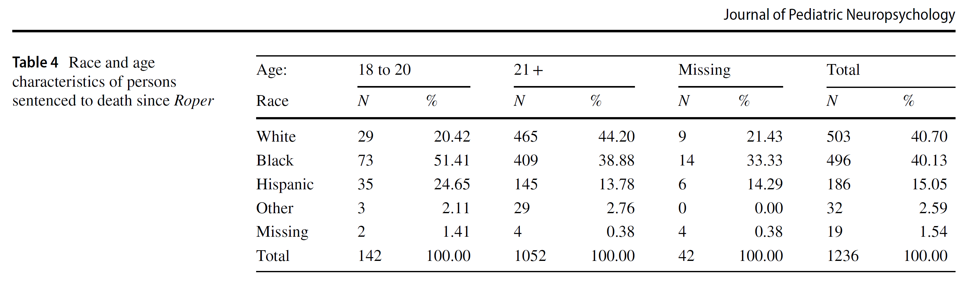
Since Roper, whites under-represented in the “Late Adolescent Class” compared to 21 years +: 44% of those older than 21, only 20% of those 18-20…

