Slide 1

McGautha v. California (1971)
https://supreme.justia.com/cases/federal/us/402/183/case.html):
Petitioner in No. 203 was convicted of first-degree murder in California, and was sentenced to death. The penalty was left to the jury's absolute discretion, and punishment was determined in a separate proceeding following the trial on the issue of guilt. Petitioner in No. 204 was convicted of first-degree murder, and was sentenced to death in Ohio, where the jury, which also had absolute penalty discretion, determined guilt and penalty after a single trial and in a single verdict. Certiorari was granted to consider whether petitioners' rights were infringed by permitting the death penalty without standards to govern its imposition, and in No. 204, to consider the constitutionality of a single guilt and punishment proceeding.
Held:
1. In light of history, experience, and the limitations of human knowledge in establishing definitive standards, it is impossible to say that leaving to the untrammeled discretion of the jury the power to pronounce life or death in capital cases violates any provision of the Constitution.

Slide 2
Some quotes from Justice Harlan’s majority opinion…
To identify before the fact those characteristics of criminal homicides and their perpetrators which call for the death penalty, and to express these characteristics in language which can be fairly understood and applied by the sentencing authority, appear to be tasks which are beyond present human ability.

Slide 3
Justice Harlan continues…
Thus, the British Home Office, which, before the recent abolition of capital punishment in that country, had the responsibility for selecting the cases from England and Wales which should receive the benefit of the Royal Prerogative of Mercy, observed:
"The difficulty of defining by any statutory provision the types of murder which ought or ought not to be punished by death may be illustrated by reference to the many diverse considerations to which the Home Secretary has regard in deciding whether to recommend clemency. No simple formula can take account of the innumerable degrees of culpability, and no formula which fails to do so can claim to be just or satisfy public opinion."

Slide 4
He continues: no finite list of mitigators possible.
States are entitled to assume that jurors confronted with the truly awesome responsibility of decreeing death for a fellow human will act with due regard for the consequences of their decision and will consider a variety of factors, many of which will have been suggested by the evidence or by the arguments of defense counsel. For a court to attempt to catalog the appropriate factors in this elusive area could inhibit, rather than expand, the scope of consideration, for no list of circumstances would ever be really complete. The infinite variety of cases and facets to each case would make general standards either meaningless "boiler-plate" or a statement of the obvious that no jury would need.

Slide 5
The McGautha quiz
Prof. Carol Steiker, Harvard Law School does this in her law classes.
Ten hypothetical scenarios / vignettes.
Please rank from most heinous to least heinous.
If there were consensus and clarity, then a random sample of people would consistently rank the cases in a reliable and consistent manner, agreeing on which cases are “bad” and which are “less bad.”
If, however, people do not agree on what is “bad” then how can the death penalty be reserved for the “worst” offenders?

Slide 6
Reminder of the quiz:
Foster mother neglect: A middle-aged woman with no substantial criminal record completely neglects a 3-year-old child who is placed with her for foster care, for which the foster mother receives a stipend sufficient to care for the child. The foster mother spends the stipend on her opioid addiction rather than the child, and the child slowly starves to death over a period of months.
Alcoholic armed robber: A 30-year-old alcoholic with a substantial record of theft offenses commits an armed robbery of a liquor store. When the store clerk reaches for the alarm button, the defendant shoots him once in the chest, killing him.
Abused wife: A woman who has been repeatedly physically abused by her husband (that is, badly beaten up, but not to the point of being in danger of death) hires a hit man, who kills her husband. The defendant to be sentenced is the wife.
Sex offender rape in desert: A repeat sex offender—a 25-year-old of low intelligence (though not intellectually disabled) who was himself sexually abused as a child—kidnaps a college-age woman, drives her into the desert, and then rapes her, beats her, and leaves her there. She dies of exposure to the elements when she can’t find her way out of the desert before nightfall.
Suicide bomber accomplice: A suicide bomber detonates a bomb in a public place, killing 5 and injuring 12. Although the bomber himself is killed in the attack, the members of the radicalized religious “cell” who helped to plan the attack and make the bomb are arrested. They are two men in their late 20s and one 19-year-old, who has no prior record of adult or juvenile offenses. The defendant to be sentenced is the 19-year-old.
Father killer: A middle-aged man with no criminal record kills his elderly father who is in a permanent vegetative state in order to inherit his father’s estate.
Intentional killing of fetus: A man beats up his pregnant ex-girlfriend with the express intent of killing her unborn child by another man, with whom she is 8-months pregnant. The mother lives, but the fetus dies. Note: this prosecution takes place in a state that designates the intentional killing of a fetus without the mother’s consent as first-degree murder.
Young car thief kills police officer: An 18-year-old car thief is driving a stolen car when he is stopped by the police. When the officer approaches the driver-side window, the defendant shoots him. The defendant has a juvenile record of theft, assault, and weapons possession.
Drug addict arson: A drug addict burns down the triple-decker home that he inherited from his parents for the fire insurance. Four members of the family that rented the apartment on the third floor die in the fire. The defendant knew that the rental unit was occupied, but it’s not clear whether he knew that the renters were home at the time of the arson.
Prison race riot: A large-scale fight breaks out between warring racial gangs in prison, during which a white supremacist gang member kills a Hispanic gang member. The defendant was serving time for armed robbery at the time of the riot.

Slide 7
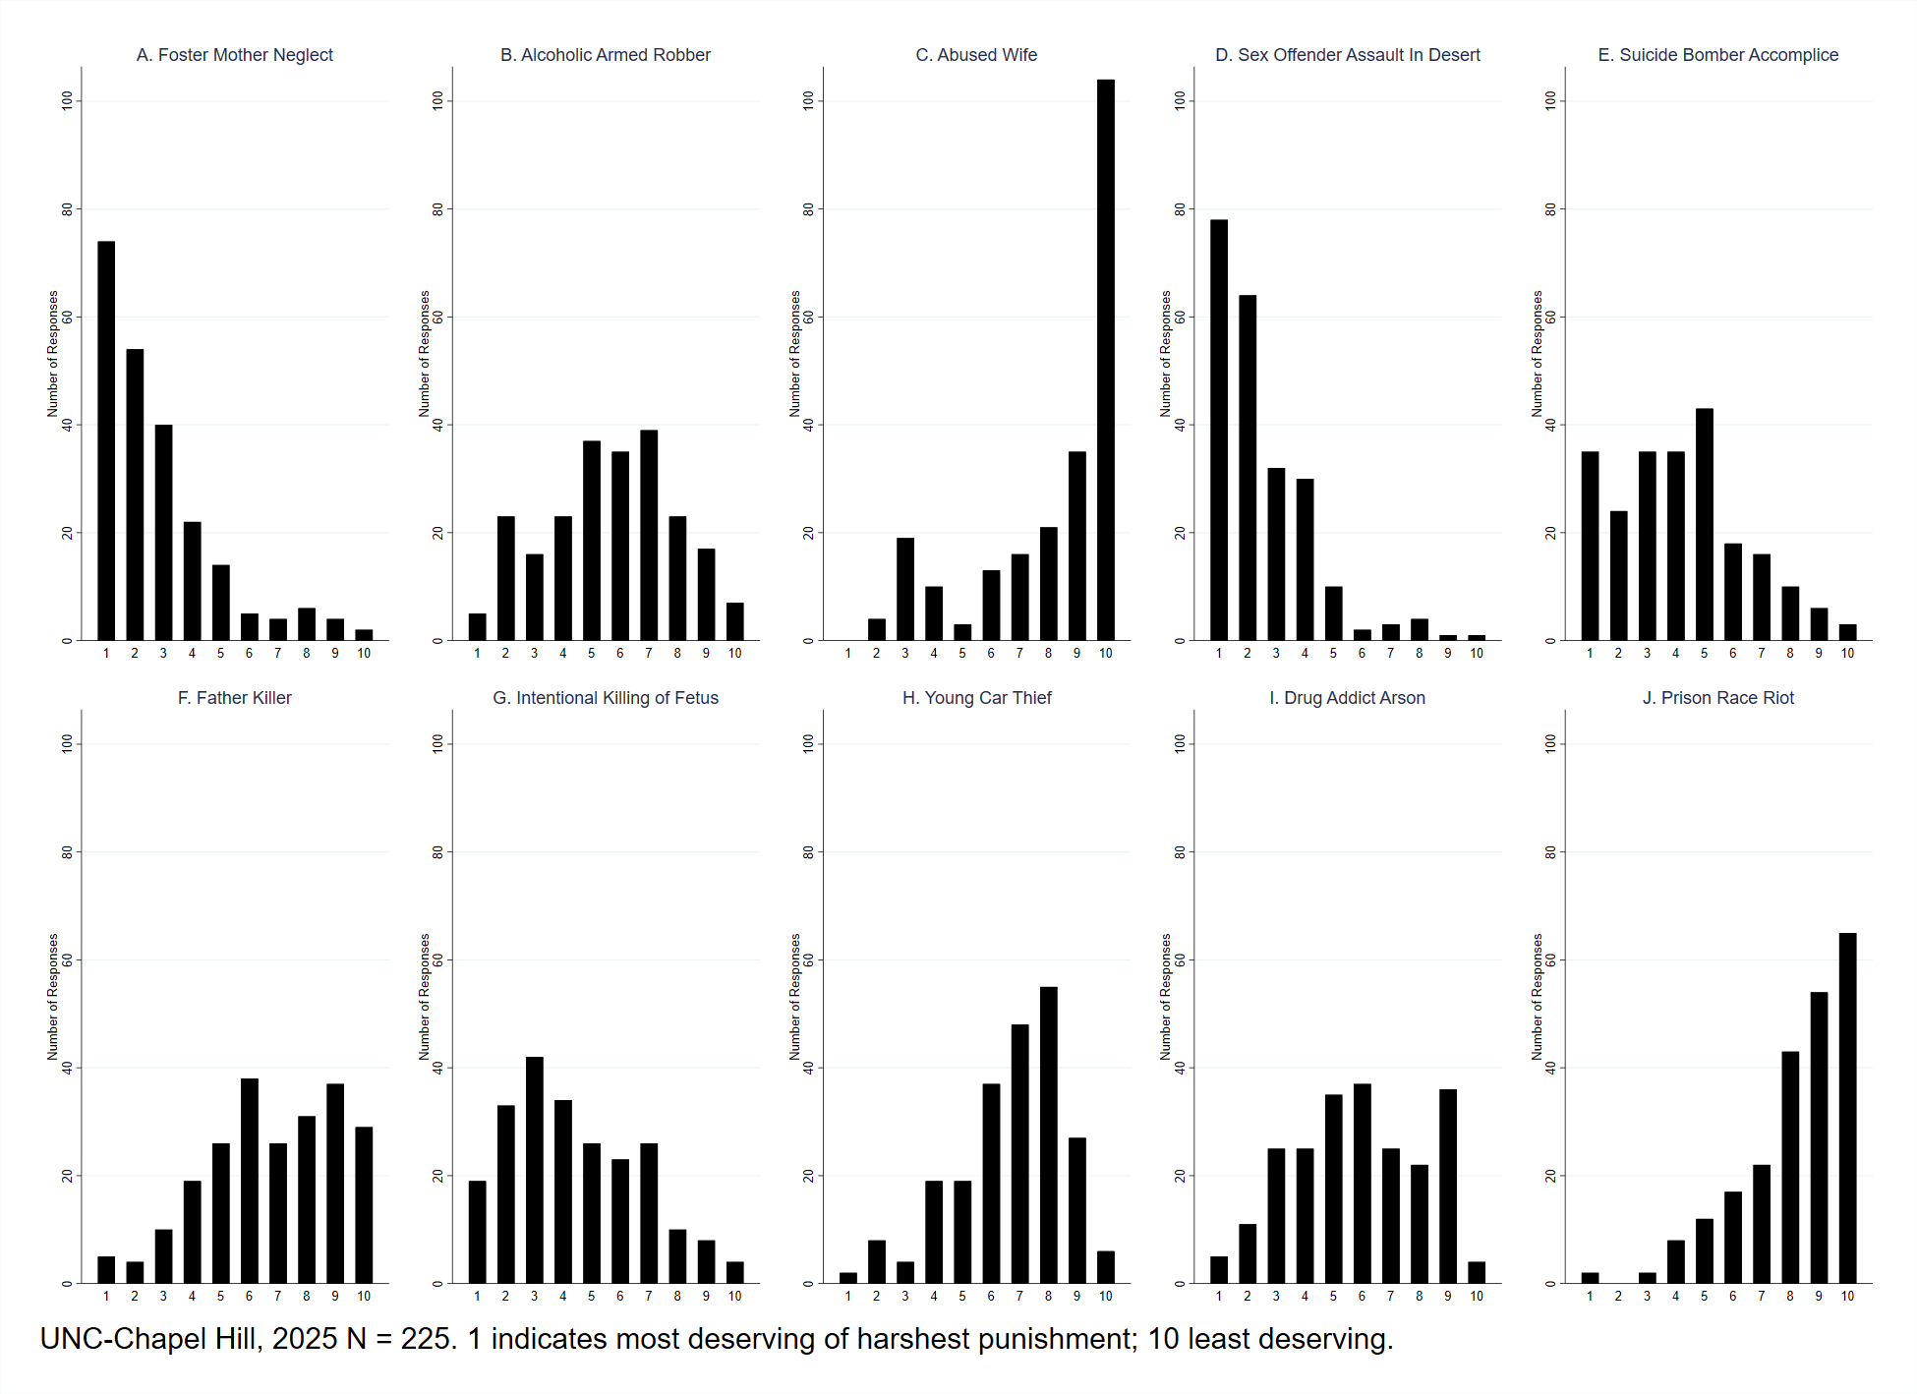
Your results

Slide 8
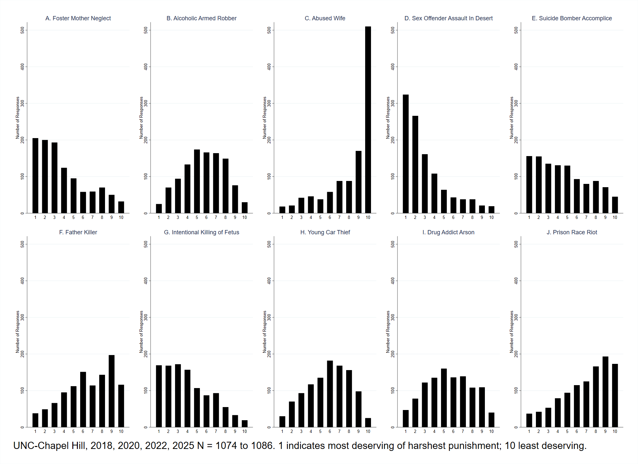
Results from 1,000 students, 2018, 2020, 2022, 2025: Same thing

Slide 9
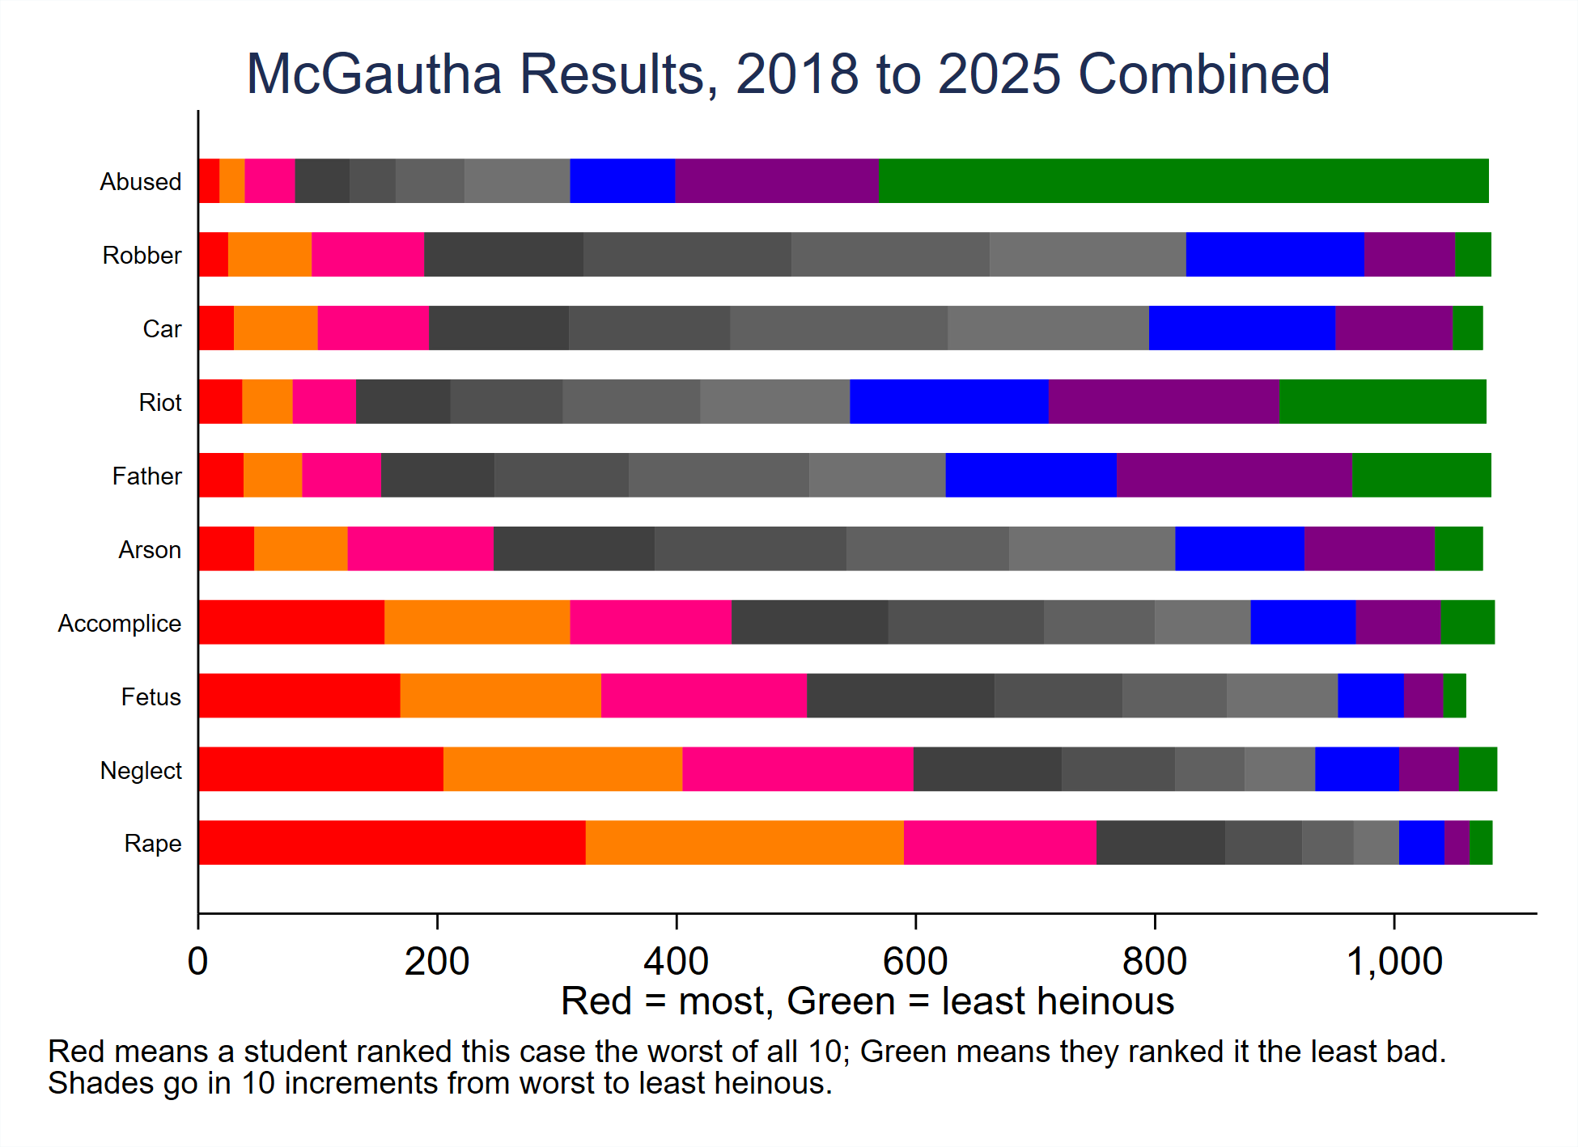

Slide 10
We should think about what this means…
If a random selection of 12 individuals will decide on death…
Should we expect them to come to a reliable and consistent set of results, case after case?
Definitely not.
So, in McGautha, the Court said we have to leave it to the discretion of the jury because it’s too complicated.
But you could make the opposite argument. Maybe it’s too complicated to leave to the discretion of the jury…

