Slide 1

Deadly Justice, Ch 17
Pass the Gregg test, or fail the Furman test?
Given all the evidence we have considered, does the “modern” death penalty system in place since 1976 achieve the goals of the Justices in Gregg v. Georgia (1976), or does it still have the flaws that the Justices rejected in Furman v. Georgia (1972)?
March 31, 2025

Slide 2
One bit of news: A death sentence was handed down last week in Pasquotank County
https://www.dailyadvance.com/news/local/monk-gets-death-penalty-for-role-in-pci-murders/article_380a18d5-61cb-4e4f-820a-849afb54a4e8.html
4 individuals broke out of prison in 2017, killing 4 staff members and injuring others. This is the 3rd person to stand trial, and the 3rd to get death. There is one more trial still to come.
Jonathan Monk was sentenced after only 2 hours of deliberation.

Slide 3
Compare use of mitigators and the state response:
PTSD from service in the military, lots of evidence about him coming back from Afghanistan “changed” and “troubled.” Original crime that put him in prison was a “bizarre” attempted murder; brother testified, etc.
“The prosecutor also argued Monk can’t blame his involvement in the prison murders on his overseas deployments while serving in the U.S. Army. Monk was separated from the Army after two alcohol-related incidents.
“You can’t hide behind the flag,” she said.
Pellini reminded jurors of Dr. Wilson’s testimony that Monk had embellished his mental problems on an evaluation test after arriving at Granville Correctional Institute following the murders at PCI. She argued Monk was “gaming the system” in order to receive mercy.”

Slide 4
Second mitigating factor: follower, not leader
Mikel Brady (already sentenced to death) was the ring-leader; Monk just a follower…
Prosecutor response: “I will certainly concede Brady is the devil, Pellini said. “But even the devil needs help.”
It does sometimes seem easier to be a prosecutor than to be a defense attorney, and the statistics would bear that out…
No guidelines about how to weigh mitigators and aggravators…

Slide 5
Passing the Gregg test
“Narrow targeting”
“Substantial proportion”
Proportionality review: it should only apply to the worst of the worst.
Free from bias: Race, gender, class, type of attorney, etc.
Free from caprice: it should not be weirdly random, for example based on geography (e.g., not a “randomly selected” handful of offenders, like being “struck by lightning”)
These were all problems noted in Furman, and were supposed to have been fixed by the complicated new system imposed over the years starting with Gregg…

Slide 6
“Wonton and freakish”, like “being struck by lightning” (among convicted murderers)
One justice’s opinion focuses on the capricious and arbitrary nature of the punishment
Many of those given the death penalty are NOT guilty of the most heinous crimes.
Concern about impact of race here, but no clear finding that race drives it.
No procedural safeguards to guarantee fairness
Extreme rarity of the punishment: who gets selected, it is like being struck by lightning
Note: One solution to this freakishness would be to make the death penalty mandatory. North Carolina did this, in fact, in response to the ruling.

Slide 7
Plea bargains and motivated testimony
Many of those guilty of “bad” crimes take a plea.
Often, this is in exchange for testifying against a codefendant.
Makes sense and is integral to the US system of criminal law.
However, does this help or hurt in the effort to reserve the death penalty for the “worst”.
Or do we want to say that those who cooperate with the authorities are thereby reducing their own culpability?
If you and a buddy did a crime that went bad, would you testify against the other, maybe falsely, in order to safe your life?

Slide 8
Deterrence
Is it acceptable to punish on person more severely just to “make an example”?
  Does that mean that we are treating a human life as an object, merely a means to an end?
  Is it constitutionally acceptable to treat a person as an object, or is that inhumane?
Given the low rate of usage of capital punishment, is there any deterrent value, anyway?
Note the difference in the Deterrence argument now that more contradictory and inconclusive studies have been done, compared to the situation in 1976, when it was more widely accepted.
Note the rise of LWOP, so the difference between the alternative punishments is no longer so clear. Which is worse?

Slide 9
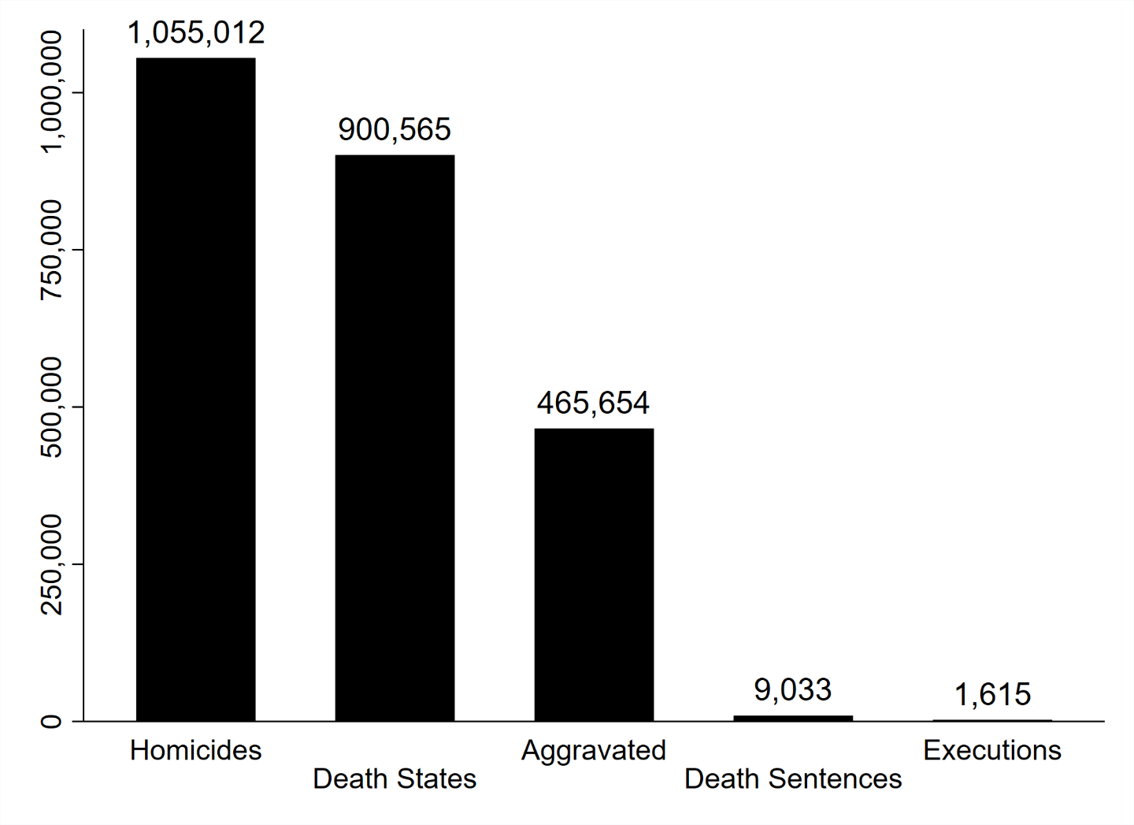
Death Sentences: A low number compared to homicides. Executions: Even Lower

Slide 10
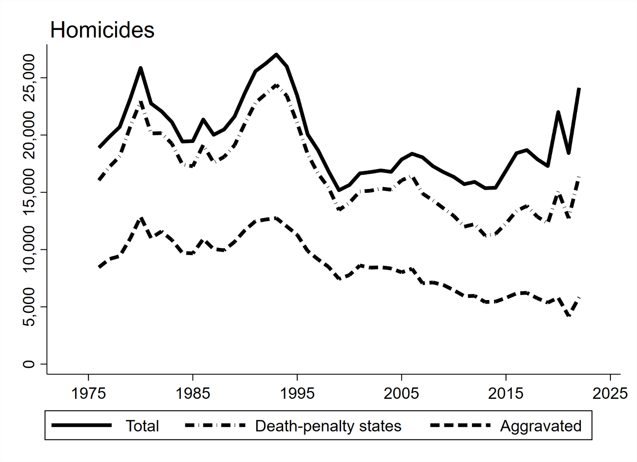
How many homicides, and how many are in death penalty states?

Slide 11
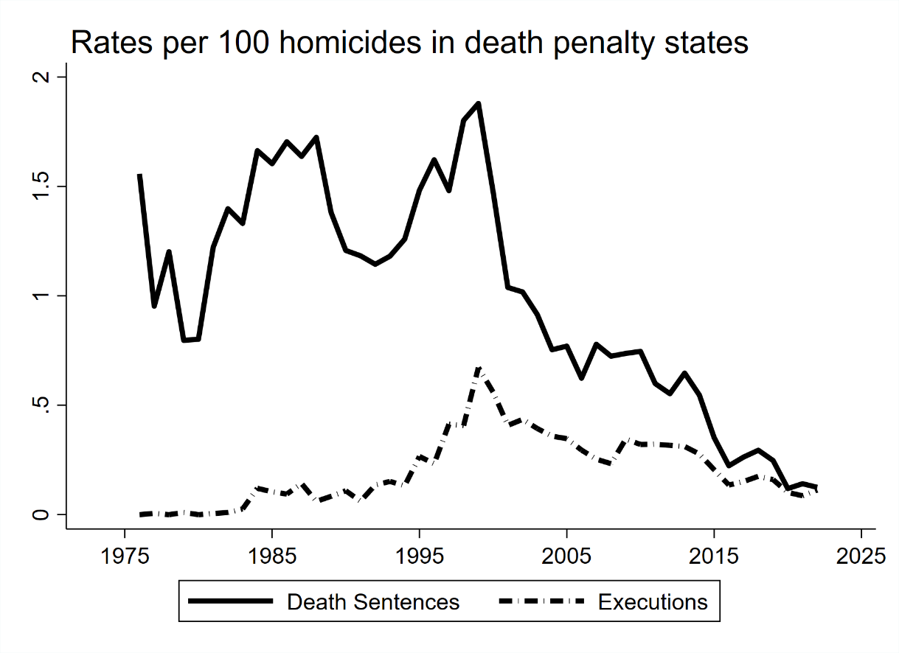
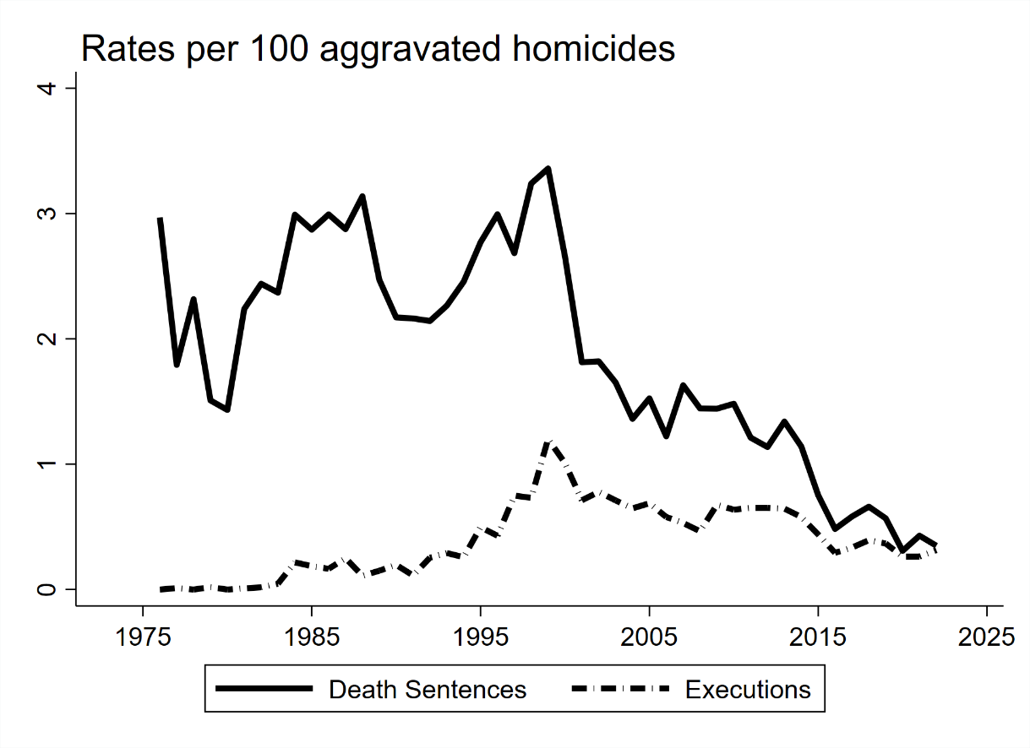
Is it still like being “struck by lightening”? Yes.
Rates per 100 homicides, death states only
Rates per 100 aggravated homicides, death states only

Slide 12
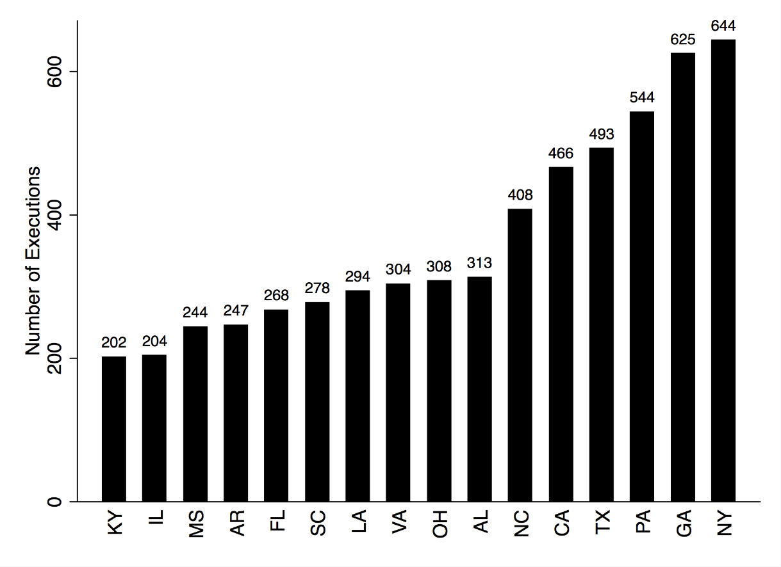
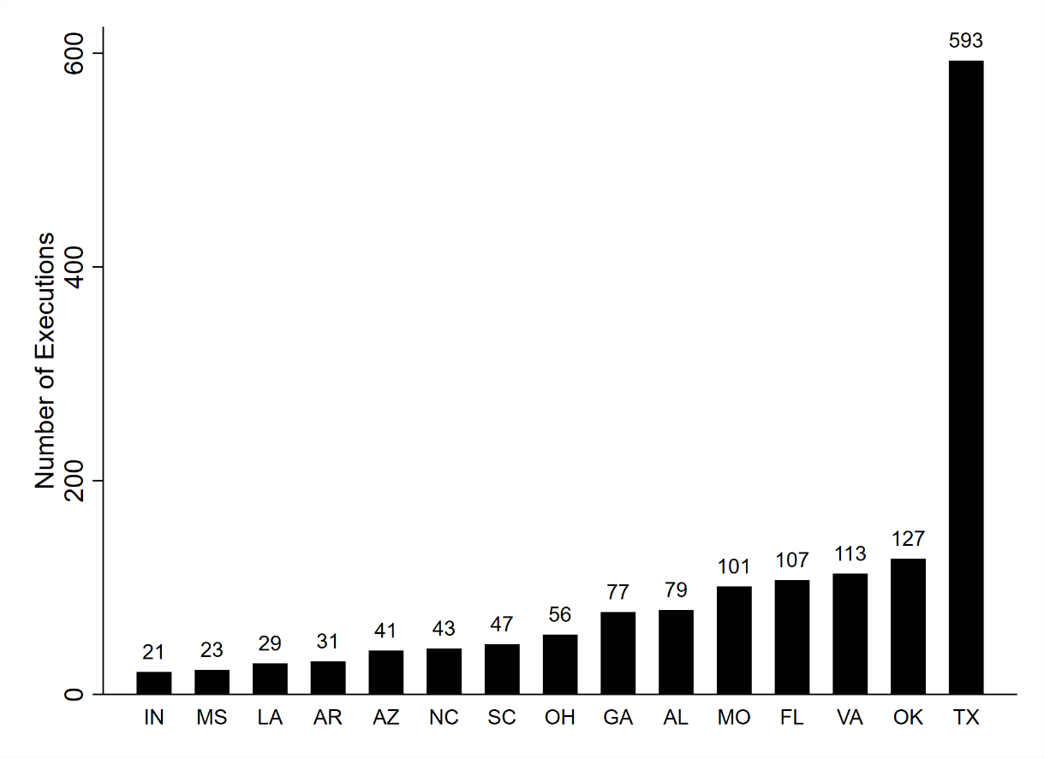
Geographic Concentration: Even greater now.
Before Furman
After Gregg

Slide 13
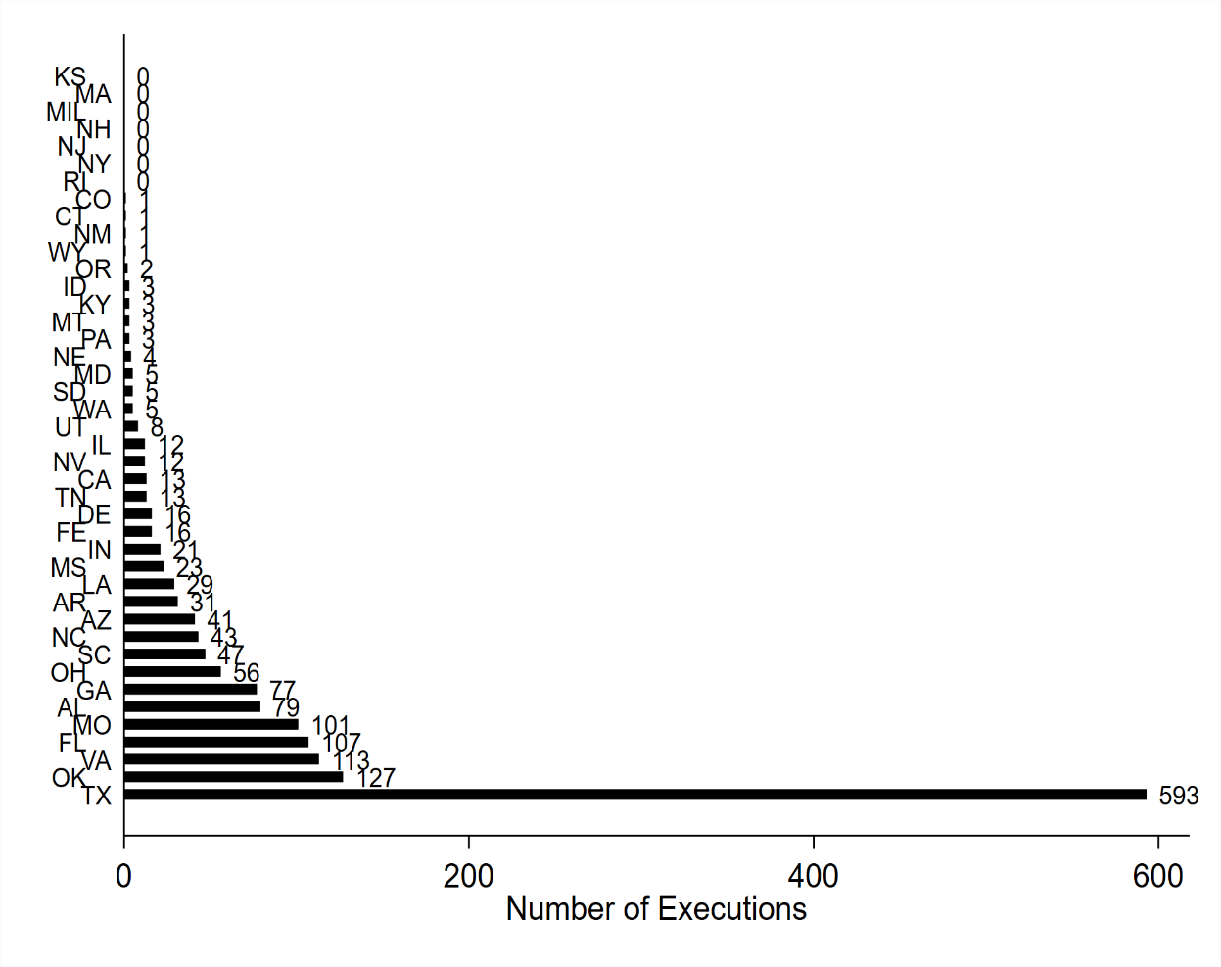
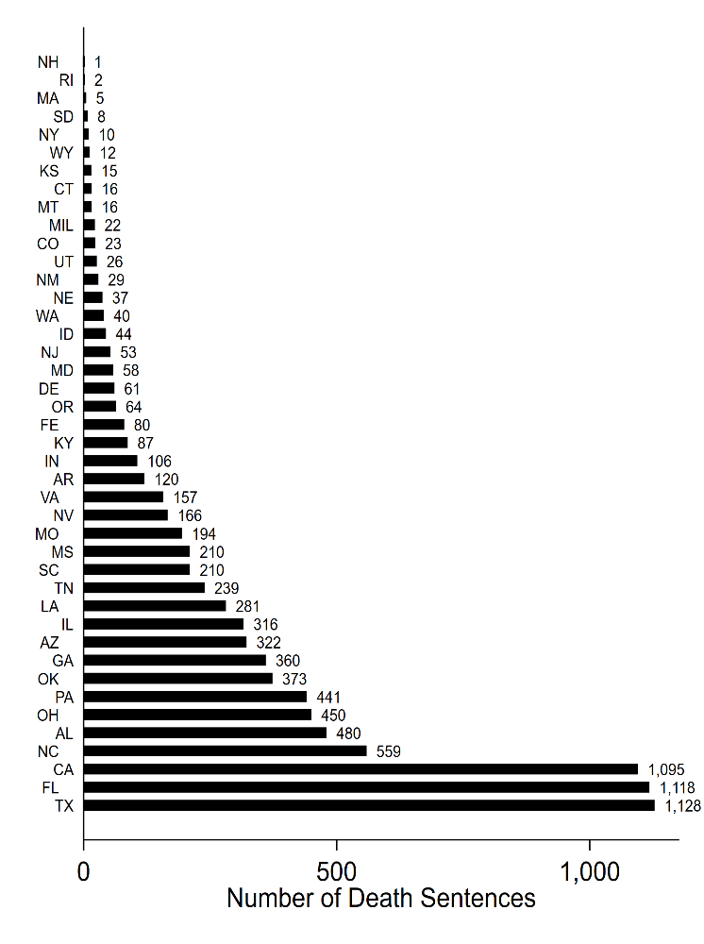
Geographic Concentration: Executions more concentrated than sentences. Both highly concentrated, however.
Executions by state (Death states only)
Death Sentences by state

Slide 14
Other statistical elements clear from the chapters previously discussed
I won’t review the evidence about cost, racial bias, deterrence, and so on here.
Clearly, the system fails the Furman test on these and other matters…

Slide 15
A litany of old problems still here:
Low rate of use invites “caprice and arbitrariness”
Geographical concentration: even worse
“extra-legal” disparities: Race, gender, etc. For sure.
“Narrow targeting” and “substantial proportion”: Nope.
Deterrence: at issue in Gregg, but a settled matter now. No evidence.
  Further, note that the justices in Furman suggested that even if there was a deterrent value, killing a person in order to dissuade another from homicide is not fair to the person killed: “does not comport with human dignity.”
Evolving standards: “cruel AND unusual” – so use matters.

Slide 16
Massive evidence of racial bias, but mostly by race and gender of the victim. Cross-racial crimes massively punished.
This data not available at time of Furman, but it was suspected.

Slide 17
New problems not discussed in Furman
Innocence: over 190 found to be innocence
Reversals: over 70 percent reversed
Stays: typical, sometimes many times, or at the last minute
Delays: typically now over 20 years from sentence to execution, often longer
  All these can be considered elements of torture)
Unwillingness of governors to commute death sentences
  (This was previously more common, very rare in the modern period; see next slide)
Cost
  (Changes the political calculus, if not the moral / legal issues)

Slide 18
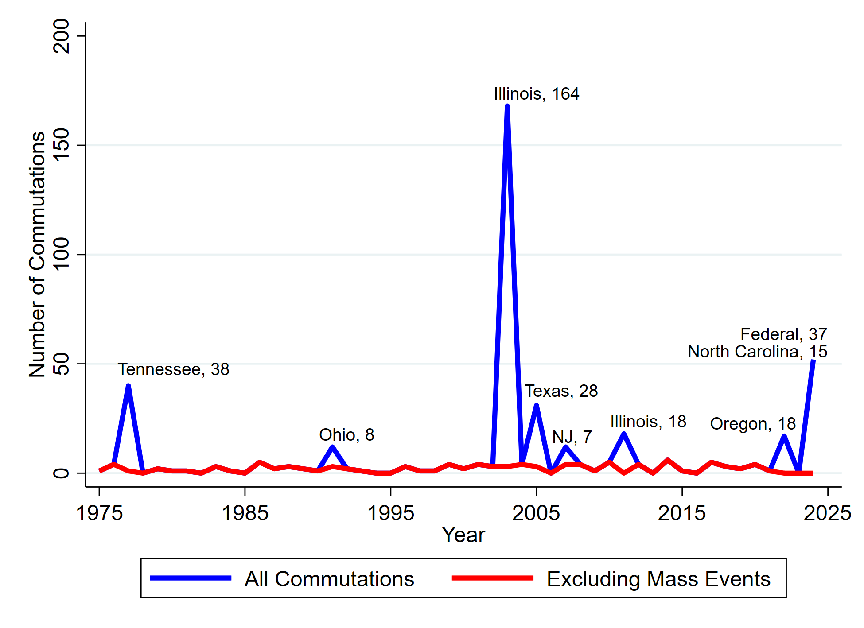
Governors almost never commute death sentences: 437 total, but most of these associated with mass decisions, not individual mercy.

Slide 19
No solution to the McGautha problem
The Court has long been comfortable with McGautha
Are you?
Bring 12 jurors into a room
Note that they are not comparing. They are looking only at one case.

Slide 20
No solution to the death-qualification problem
Jury of your peers?
What if you are:
  Catholic? Jewish? Buddist? Of another faith that does not abide the death penalty?
  Black? Lots of black Americans oppose the system, based on practical politics moreso than based on religion
  Not trusting of the police?
Your trial of guilt will exclude people who could not sentence a person to death. (Also those who would do so every time…)

Slide 21
So, what can we say?
Definitely fails the Furman test
  Based on the original concerns, it has not dramatically improved
  Additional problems that were not there are now present
But the Furman decision was just a hodge-podge
  Only two justices came out with a moral statement that it is wrong to kill
Clearly a majority supports the death penalty in the abstract
  Question is how badly administered can it be to be unacceptable
This will likely be a political decision, not a judicial one
  Voters, not judges, may decide.

