Slide 1

Racial Justice Act, passage, revisions, repeal, etc.
California version as well.
April 16, 2025

Slide 2

So a turn to the legislature
If the US SC will not use statistical evidence, pass a law specifically to allow this
From lawyering to lobbying…

Slide 3
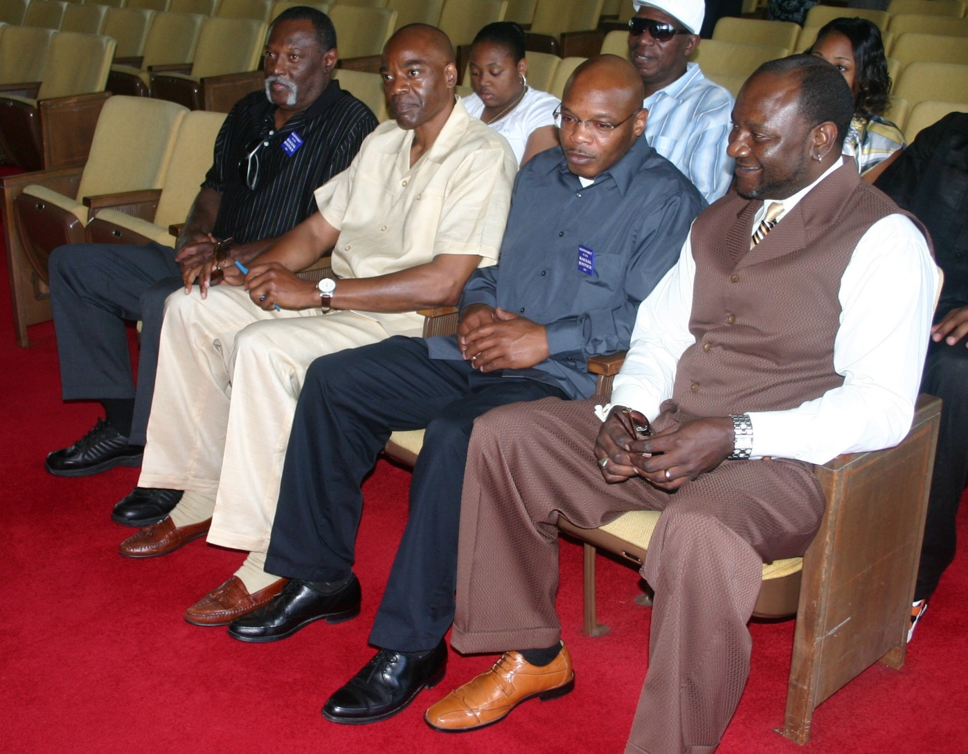
Lobbying the General Assembly in 2009: Bo Jones, Jonathan Hoffman, Ed Chapman, Darryl Hunt

Slide 4
March 2009
Floyd McKissick Jr (D-Durham)
  (Note: his dad was the first Black student at UNC Law)
Legislative Black Caucus pushes hard

Slide 5
Outside actors
NAACP, Rev. Barber, much more aggressive, public tone of pressure than previous president of NAACP
Death penalty reform advocates
  Had already had lots of successes restricting use, many reforms since 2000 / 2001: eyewitness ID reform, discretion not to seek death, creation of Innocence Inquiry Commission, and so on…
Democratic caucus has a closed session, people come out unanimously in favor.
  Black caucus within the democratic party: Don’t think representation does not matter; it does.

Slide 6
Timing is everything
NC as a leader in reforms from 2000 through 2009, eyewitness ID, many other reforms
Exonerations: lots of them here in NC
Lobbying by exonerees, including Bo Jones, Darryl Hunt, Jonathan Hoffman, Ed Chapman

Slide 7
2009 RJA
Read the law, it is only 3 pages long…
Show racial disparity in:
Decision to seek or impose death:
  In the county, prosecutorial district, judicial division, or state
  At the time that death was sought or imposed

Slide 8
Relevant evidence to demonstrate disparities
Statistical or other evidence including but not limited to:
  Sworn testimony of attorneys… or other members of the criminal justice system

Slide 9
Any of three findings
Inmate’s race
Victim’s race
Peremptory challenges in jury selection

Slide 10
States seek death, juries impose it
Thinking back to Deadly Justice, chapter 4 on racial bias, you will see separate analyses of:
  DA’s decision to seek a death sentence (e.g., “charging”)
  Juries’ decisions to impose death (“sentencing”)
Should we constrain the actions of jurors? Kentucky said no. Is the jury a state actor? Interesting philosophical / legal question.

Slide 11
OK, what is clear and what is not clear about the NC RJA?
Clear:
  Inmate
  Victim
  Jury selection
  Statistical evidence can be used

Slide 12
Unclear, needs to be litigated…
What if I show bias in the county, but the state rebuts that there is no bias in the district or state?
What if I show bias in a certain time frame? Which time frame is appropriate? Can’t just be the day of my trial, obviously.
What if the state counter-argues that it was 10 years ago, and therefore not relevant, or in a different county / judicial district?

Slide 13
What is enough disparity?
40% for whites v. 41% for blacks? Is that enough?
Judge has to rule on this, unclear
  Judge Weeks: BOTH statistically significant at .05 level (1 in 20 chance of occurring by random chance), AND a 20 percent difference in value. This was taken from employment law.
  (His ruling shows that for jury strikes, the actual probability level was more like 1 in 10,000,000,000,000,000,000,000,000,000,000.)

Slide 14
10,000,000,000,000,000,000,000,000,000,000.
ten commas?
1: thousand
2: million
3: billion
4: trillion
5: quadrillion
6: quintillion
7: sextillion
8: octillion
9: nonillion
10: decillion
So the odds were 1 in 10 decillion, not very likely.

Slide 15
How to rebut?
Statistical evidence, clearly
But also “sworn testimony” of people involved in the system
  I did not intend to discriminate
  We have programs in place to eliminate discrimination
Unclear how such evidence would / should be weighed by a judge or the NC SC

Slide 16
How did this ever pass???
O’Brien and Grosso article
  Lots of mobilization
  Evolution of the argument following McCleskey
  Dissatisfaction with the Batson ruling, or lack of enforcement
  Large black caucus in the Democratic Party; party-line vote.
Post-passage controversies
  That party-line vote was a recipe for repeal as soon as the majority changed.

Slide 17
What happened after it passed
First surprise: almost everyone on death row appealed
  Something like 145 of 150 inmates appealed
  White on white cases as well as others. (Does that make sense? It does to me; a disparity is a disparity and life and death should not hinge on it. But anyway the cases all hinge on jury selection, not race effects for inmates and victims.)
Second, it becomes a political football (no surprise). However, the focus on Hugh Holliman is a surprise. He was defeated for reelection.
Third, the CDPL and others mount a massive fund effort to get a study done in 12 months: thousands of murders analyzed, a Baldus study. But the focus is on jury strikes. Evidence is overwhelming.

Slide 18
In 2011, the Republican Party takes over both chambers, for the first time in recent history.

Slide 19
Hugh Holliman entered politics because of his daughter’s murder by Ricky Sanderson
http://www.wral.com/news/local/story/123265/
http://www.wral.com/news/local/story/123357/
Ricky Sanderson was executed in 1998. Holliman and Sanderson visited in prison, and prayed together. Holliman was present when Sanderson was gassed.

Slide 20
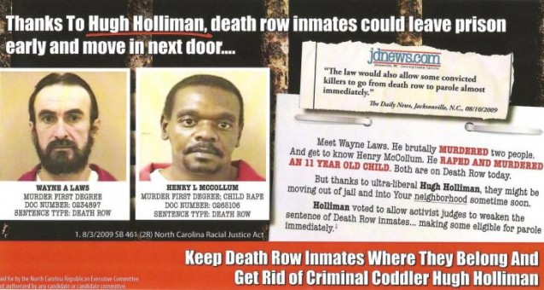
Hugh Holliman the target of these ads, defeated in 2012

Slide 21
So many ironies
Hugh Holliman as the target
Henry McCollum as the threatening inmate (he was exonerated in 2014 after 30 years)
Suggestion that people would go free (much less “move into your neighborhood”)
But race, crime, capital punishment are potent scare dynamics in elections. Holliman was defeated.

Slide 22
Legal Strategy
Focus on the jury venire members not allowed to exercise their constitutional right and responsibility to be on a jury
Avoid the race-of-victim litigation
Avoid the race-of-inmate question
No one can argue that black citizens should not have an equal right to be on a jury. Since that was in the law, it was “low-hanging fruit” because it’s pretty standard practice to eliminate most blacks from capital juries…

Slide 23
4 cases make it to trial
First case: approved on the basis of jury selection (Marcus Robinson)
Next 3 cases combined, one involved the killer of a police officer. Also successful on the basis of jury selection
2015: cases overturned on the basis that the judge should have allowed more time for the prosecutors to submit their evidence.
2018: NC SC agrees to hear the appeals of the 4 inmates who had been returned to death row. The case is pending.

Slide 24
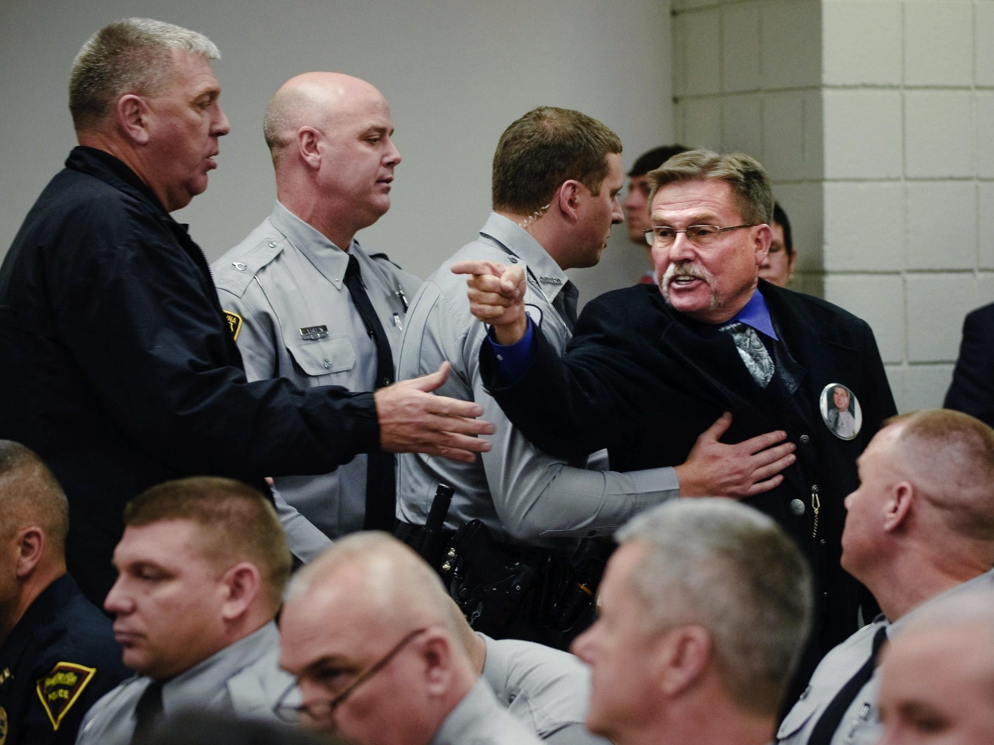
One of the RJA cases involved the killing of an NC state trooper. Many troopers were in the courtroom when Judge Weeks ruled in favor of the inmate.

Slide 25
Where we stand
4 cases were heard, then the law was repealed
Can you take away a right, once granted? In other words, do the 142 inmates who filed in 2009 have the right to have their cases heard, even though the law is no longer in effect?
The four cases that were heard, and which were successful, are to have new hearings. But the law is no longer in effect… They are currently back on death row.
The NC SC heard arguments on the four cases, in August 2019
If they find in favor of the 4, what about the 142 others who sought relief, under a law which has since been rescinded? What a mess!

Slide 26
Restoring Proper Justice Act (2013; repeal immediately in 2011, back to requirement of demonstrating discriminatory intent.
Kick-start the execution machinery
Look at the law on the web site and consider
Is this “cheap talk”? That is, are there so many legal hurdles to making this happen that it simply allows politicians to take a stand without actually worrying about making it happen?
Or, even if it is not going to happen, is there a large constituency for bringing back executions?
The symbolic value of the death penalty…

Slide 27
Only 3 states have an RJA
Kentucky’s is really in name only. It was gutted during the legislative process.
NC’s was operable only from 2009 to 2011 when it was appealed. But 140 people on death row filed and it’s unclear whether they will get relief.
California’s 2020 law is actually much more expansive.

Slide 28
Pen. Code § 745 (a) https://law.justia.com/codes/california/2020/code-pen/part-2/title-2/section-745/
The state shall not seek or obtain a criminal conviction or seek, obtain, or impose a sentence on the basis of race, ethnicity, or national origin.
A violation is established if the defendant proves, by a preponderance of the evidence, any of the following:

Slide 29
§ 745 (a)(1) out of court bias
The judge, an attorney in the case, a law enforcement officer involved in the case, an expert witness, or juror exhibited bias or animus towards the defendant because of the defendant’s race, ethnicity, or national origin.

Slide 30
§ 745 (a)(2) in court bias
During the defendant’s trial, in court and during the proceedings, the judge, an attorney in the case, a law enforcement officer involved in the case, an expert witness, or juror, used racially discriminatory language about the defendant’s R/E/NO,
Or otherwise exhibited bias or animus towards the defendant because of the defendant’s R/E/NO, whether or not purposeful.
This paragraph does not apply if the person speaking is describing language used by another that is relevant to the case or if the person speaking is giving a racially neutral and unbiased physical description of the suspect.

Slide 31
Differences between (a)(1) and (a)(2)
§ 745 (a)(1)
§ 745 (a)(2)
Applies to racial bias exhibited outside the courtroom
The bias or animus must be directed towards the defendant
Applies to racial bias exhibited inside the courtroom during trial
The bias or animus may be directed towards the defendant
But also racially discriminatory language about def’s R/E/NO group, even if not towards def.

Slide 32
“Racially discriminatory language” defined:
language that, to an objective observer, explicitly or implicitly appeals to racial bias,
including, but not limited to, racially charged or racially coded language,
language that compares the defendant to an animal, or language that references the defendant’s physical appearance, culture, ethnicity, or national origin.
Evidence that particular words or images are used exclusively or disproportionately in cases where the defendant is of a specific R/E/NO is relevant to determining whether language is discriminatory.

Slide 33
§ 745 (a)(3) charge or conviction
The defendant was charged or convicted of a more serious offense than defendants of other R/E/NOs who commit similar offenses and are similarly situated,
And the evidence establishes that the prosecution more frequently sought or obtained convictions for more serious offenses against people who share the defendant’s R/E/NO in the county where the convictions were sought or obtained.

Slide 34
§ 745 (a)(4)(A) – sentence & defendant race/ethnicity
A longer or more severe sentence was imposed on the defendant than was imposed on other similarly situated individuals convicted of the same offense,
and longer or more severe sentences were more frequently imposed for that offense on people that share the defendant’s race, ethnicity, or national origin than on defendants of other races, ethnicities, or national origins in the county where the sentence was imposed.

Slide 35
§ 745 (a)(4)(B) – sentence & victim race/ethnicity
A longer or more severe sentence was imposed on the defendant than was imposed on other similarly situated individuals convicted of the same offense, and longer or more severe sentences were more frequently imposed for the same offense on defendants in cases with victims of one race, ethnicity, or national origin than in cases with victims of other races, ethnicities, or national origins, in the county where the sentence was imposed.

Slide 36
“More frequently” sought, obtained or imposed defined as:
Statistical evidence or aggregate data demonstrate a significant difference in seeking or obtaining convictions or in imposing sentences
comparing individuals who have committed similar offenses and are similarly situated,
and the prosecution cannot establish race-neutral reasons for the disparity.

Slide 37
PC § 745 (d) motion for disclosure of relevant evidence
A defendant may file a motion requesting disclosure of all evidence relevant to a potential violation in the possession or control of the state.
The motion shall describe the type of records or information the defendant seeks.
Upon a showing of good cause, def. gets the info.

Slide 38
Pen. Code § 745 (e) - Remedy
… the court shall impose a remedy specific to the violation found from the following list:
Before trial:
  Mistrial
  New jury
  Drop certain charges
After conviction:
  Reduce imposed punishment to one no higher than those imposed on people of other R/E/NO.

Slide 39
Where we stand, in California
No cases have been finally adjudicated.
State must provide data if a judge so orders.
  (Do they have it? How far back does it go?)
Are the people “similarly situated”?
  State will argue no, there are differences.
  Burden of proof is hypothetically on the state to demonstrate this.
Recall the failure of proportionality review in Death Penalty cases.
  State can go through each case and argue that the facts are special…
Not a slam dunk, not clear how it will be interpreted.
No doubt, however, about the intent of the legislature.

