Slide 1
Litigating Racism in the Death Penalty under State Laws and Constitutions
Cassy Stubbs
ACLU Capital Punishment Project

Slide 2
McCleskey v. Kemp (1987)

Slide 3
McCleskey v. Kemp (1987)
Majority (Powell):
Disparities in sentencing are an “inevitable part of our criminal justice system.”
Dissent
Brennan, “fear of too much justice” (Brennan, Marshall & Stevens)
Reaction:
Dred Scott of our time
Justice Powell, to his biographer, John Jeffries.
Justice Scalia “It is my view . . .that the unconscious operation of irrigational sympathies and antipathies, including racial, upon jury decisions and hence prosecutorial decisions is real . . . I cannot honestly say all I need is more proof.”
Notes:
The new study found that 22 out of 972 defendants convicted of killing a white victim in Baldus’ study were ultimately executed, but only two out of 1,503 defendants convicted of killing a Black victim were put to death.
“Thus, the overall execution rate is a staggering 17 times greater for defendants convicted of killing a white victim,” write the authors of the new study, professor Scott Phillips and law professor Justin Marceau of the University of Denver.

Slide 4
Tony Amsterdam on litigating race after McCleskey v. Kemp (2007)

Slide 5
STATE CONSTITUTIONS

Slide 6
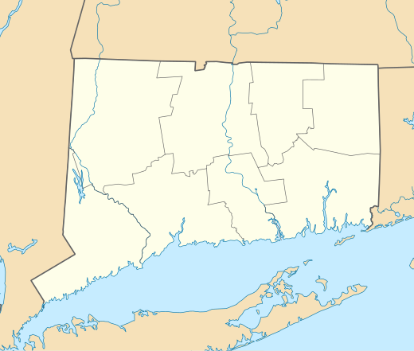
Connecticut (2015)
State v. Santiago, 381 Conn. 1 (2015):
“ the application of the death penalty fails to comport with our abiding freedom from cruel and unusual punishment”
“the racial, ethnic, and socio-economic biases that likely are inherent in any discretionary death penalty system.”
This Photo by Unknown Author is licensed under CC BY-SA

Slide 7
In the background . . .
State v. Cobb, 663 A.2d 948, 962, 234 Conn. 735, 762–63 (Conn.1995)
Defendants are entitled to develop evidentiary claims of racial bias in state habeas: “Furthermore, the nature of the defendant's claim of systemic racial bias, and the seriousness and finality of the death penalty, counsel against raising any undue procedural barriers to review of such a claim.”
In re Racial Disparities litigation

Slide 8
State v. Gregory Washington (2018)
Lose, lose, lose, win!
Earlier cases:
State Cross (2006) – three justices (Masden, Owens, Johnson)
The death penalty is unconstitutionally applied, like lightening
Davis (Wiggins, Fainhurst, Stephens)
Growing number of cases about racial bias, in addition to Saintcalle:
State v. Monday (2011, reversing, “black people don’t testify against black folk” and “poleese” when questioning Black witness)
In re Gentry (2014) (“where did you learn your ethics? In Harlem?”)
Broad coalition (prosecutor Dan Satterberg’s public opposition to death penalty; strong repeal campaign on the ground)
.

Slide 9
Broad Amici: judges, churches, former U.S attorney, civil rights groups

Slide 10
Jeffery Robinson answers Washington State Supreme Court Justice Madsen

Slide 11
If the death penalty is racist, arbitrary and serves no valid penological purpose, does it violate the Kansas Constitution?

Slide 12
Legal Framework
Constitutional Challenge Claim
Violations under Kansas Constitution:
Section 1 Right to Life and Liberty
Section 2 Right to Equal Protection
Sections 5 Right to Trial by Jury
Section 9 Freedom from Cruel or Unusual Punishment
Section 10 Right to Public Trial by Impartial Jury
Violations under the federal Constitution:
8th Amendment Freedom from Cruel and Unusual Punishment
14th Amendment Rights to Due Process and Equal Protection

Slide 13
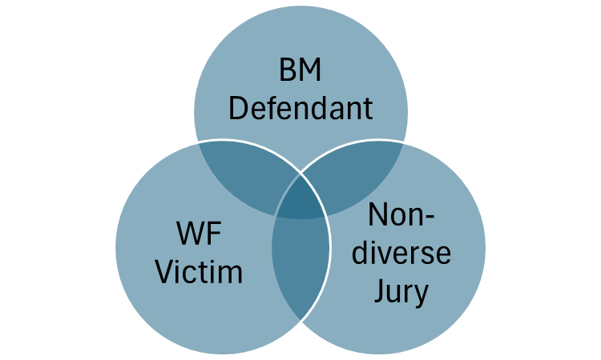
Racial Discrimination & the Kansas Death Penalty
Constitutional Challenge Claim
Race of Jurors
Race of Defendants Charged
Race of Defendants Sentenced
Race of Victims
Combination of Race of Defendant and Victim

Slide 14
The Death Penalty is Infected With Racial Discrimination
Dr. Jeffrey Fagan (T.604-657; Exs., 24, 25)

Slide 15
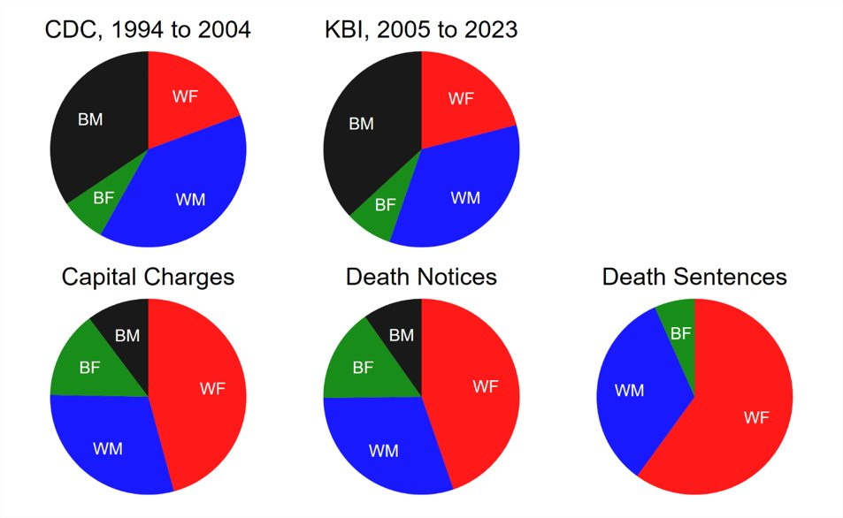
The Death Penalty is Infected With Racial Discrimination
Dr. Frank Baumgartner (542-603; Exs. 23, 32) – Statewide Data

Slide 16
The Death Penalty is Infected With Racial Discrimination
Dr. Frank Baumgartner (542-603; Exs. 23, 32) – Statewide Data

Slide 17
The Death Penalty is Infected With Racial Discrimination
Dr. Brent Never, 658-697; Exs. 26, 28
Wyandotte County

Slide 18
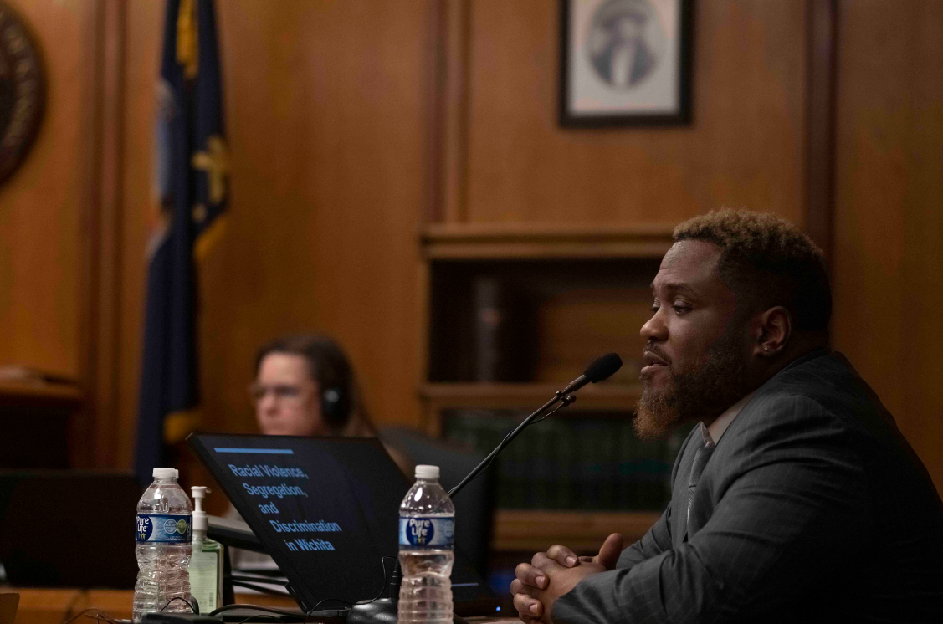

Slide 19
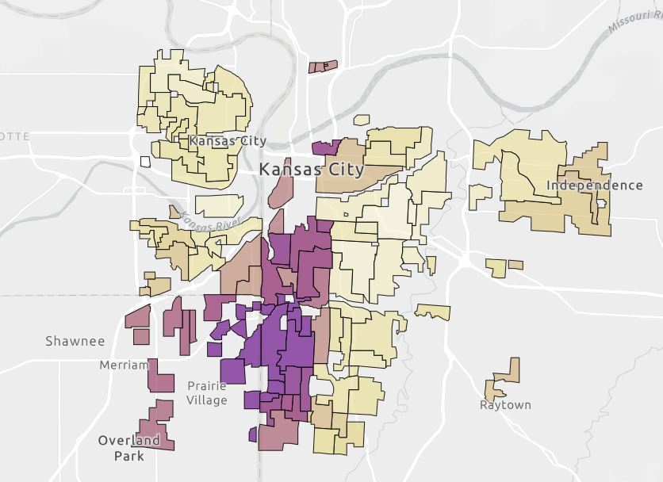
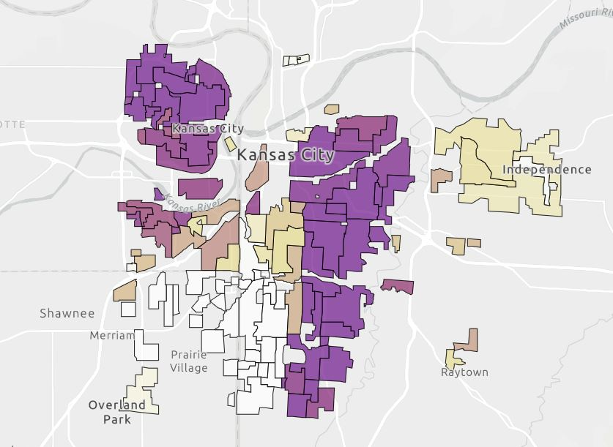
The Impact of Housing Segregation and Redlining
Kansas City Distributions of Home Value and Race, Ex. 3, Slide 12

Slide 20
Non-Death Qualification Exclusion of Black Kansans from Juries: An Analysis of 133 Kansas Batson Appellate Decisions 1987-2024
Professor Elisabeth Semel (T.339-425; Exs. 13-17)
Who Was Removed
__________________________________
*1/3 cases with no POC on jury*
Reasons for Removal
Demeanor and/or appearance: 37.6%
Potential bias against law enforcement or the criminal legal system: 33.8%
Neighborhood or location: 12%
Under or unemployment: 15.8%

Slide 21
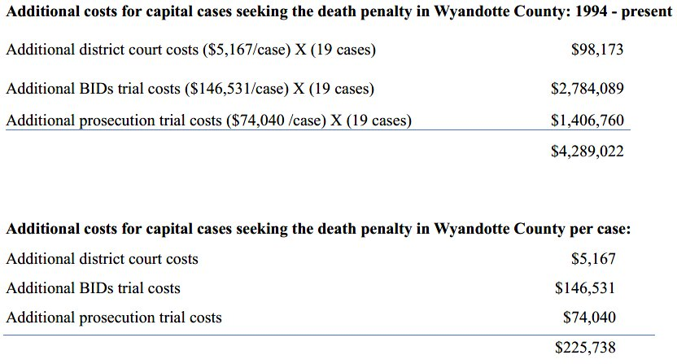
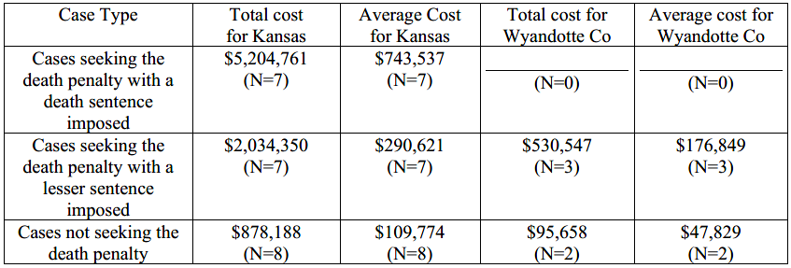
The Cost of the Kansas Death Penalty
Dr. Brittany Street (T.483-540 , Exs.19, 31)

Slide 22
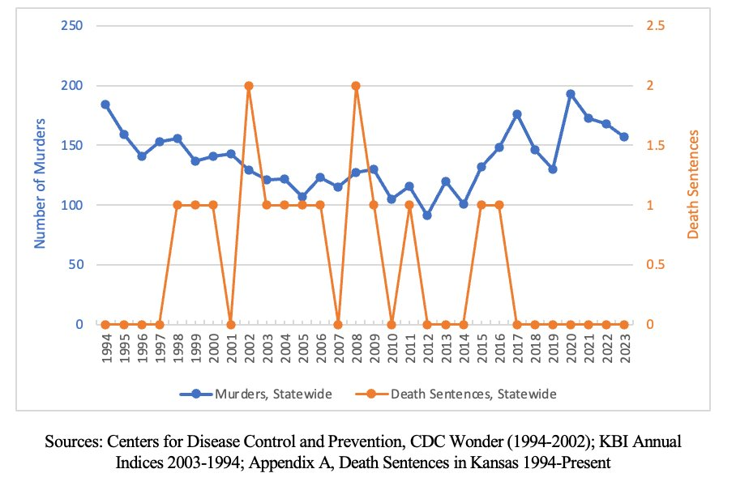
The Kansas Death Penalty Does Not Deter Crime
Dr. Jeffrey Fagan (604-657; Exs, 24, 25)
Constitutional Murders and Death Sentences, Kansas, 1994-2021 ​

Slide 23
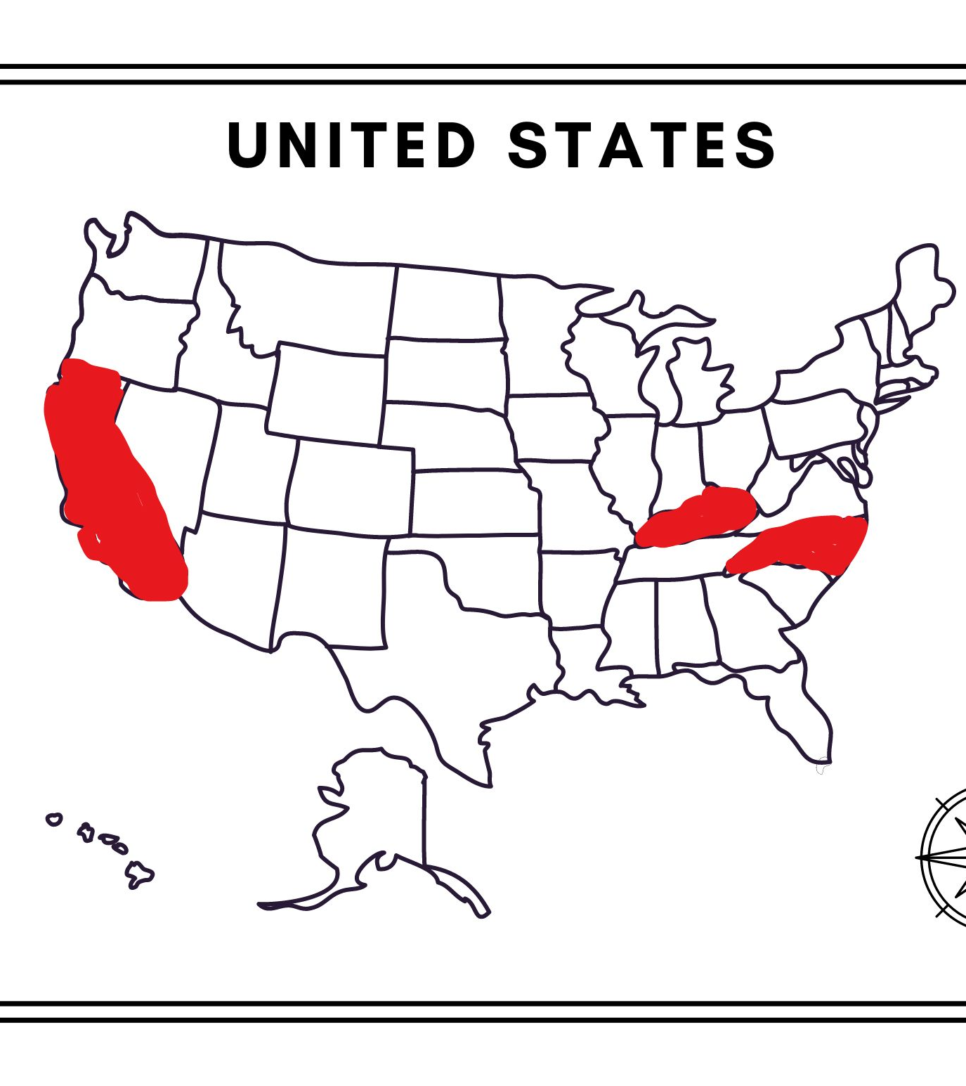
STATE STATUTES

Slide 24
North Carolina: Hasson Bacote

Slide 25
North Carolina Racial Justice Act
NC Exonerees, from Left: Levon Bo Jones, Jonathan Hoffman, Glen Chapman, and Darryl Hunt

Slide 26
2009 Racial Justice Act
No person shall be subject to or given a sentence of death or shall be executed pursuant to any judgment that was sought or obtained on the basis of race.
Defendant must show:
race was a significant factor
in decisions to exercise peremptory strikes
in the county, the prosecutorial district, the judicial division, or the State
at the time the death sentences was sought or imposed

Slide 27
Statute or Legal Frame Drives Research Questions
Was race correlated with prosecutor strike decisions in Cumberland County or North Carolina in between 1990 and 2010?
And if yes, when other likely explanations for strike decisions are taken into account, do the disparities remain?

Slide 28
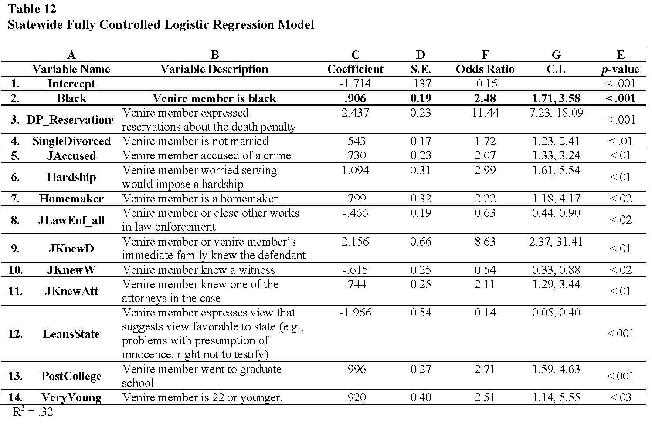
p =0.00000253017601926498
Or, approximately 1 in 250,000
PROBABILITY of Odds Ratio for Black: p = 0.000001346893972448002
(Less than 1 in 100,000 or 1.34 in 1,000,000)
PROBABILITY of Odds Ratio for Black: p = 0.000001346893972448002
(Less than 1 in 100,000 or 1.34 in 1,000,000

Slide 29
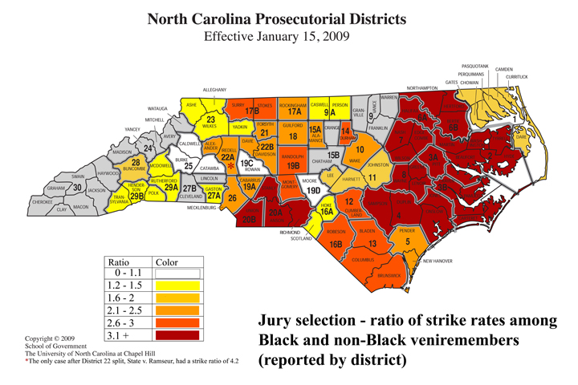

Slide 30
Strike Rates for Death-Sentenced Cases Tried by Bacote Prosecutor Gregory Butler

Slide 31
Convergence of findings through multiple methods of analysis
History of Discrimination/
Anecdotal
Observational Studies
(MSU, Mary Rose, David Baldus, others)
Experimental Studies
(Sommers and Norton, Norbert Kerr, Abramowitz and Douglas)
Black jurors are struck disproportionately in criminal cases.

Slide 32
NORTH CAROLINA DISTRICT ATTORNEY STATEWIDE TRAINING 1995

Slide 33
Prosecution “Cheat Sheet”

Slide 34
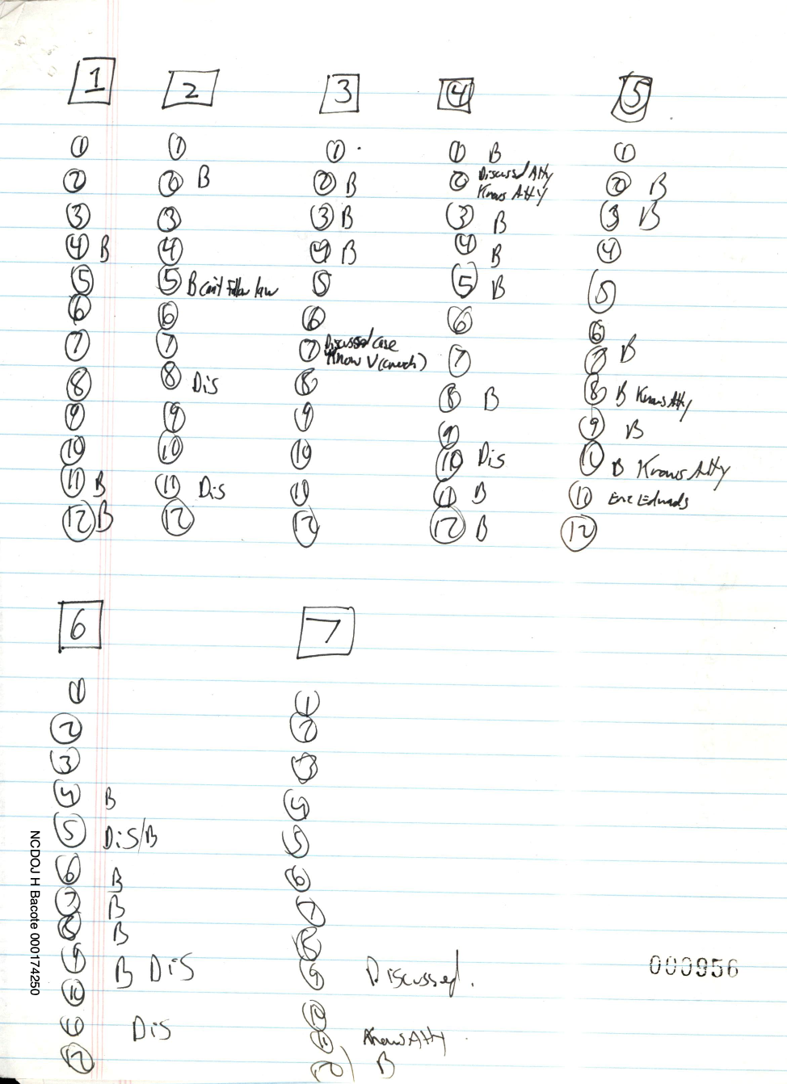
Prosecutor notes demonstrate racial bias
Johnston County: State v. Holmes

Slide 35
Prosecutor notes demonstrate racial bias
“Good . . . . bring her own rope” “She had child by BM – sympathetic to plight”
DE300
Notes:
DE300 – Cumberland

Slide 36
Prosecutor notes demonstrate racial bias
“Good address – affluent people who have blacks living behind them”
DE150
DE151
DE259
Notes:
DE150 –Iredell
DE151 – Iredell
DE259 – Cumberland

Slide 37
All-White Juries
(35 Trials)
Al-Bayyinah, J. (1999)
Augustine, Q.
Blakeney, R.
Brown, P. (1998)
Burke, R.
Call, E. (1996)
Call, E. (1999)
Cole, W.
Davis, P.
East, K.
Fletcher, A. (1999)
Goss, C.
Jaynes, J. (1999)
Laws, W.
LeGrande, G.
Moseley, C. (1992)
Moseley, C. (1993)
Polke, A.
Prevatte, T. (1999)
Raines, W.
Ramseur, A.
Richardson, M.
Rose, C.
Rouse, K.
Sidden, T.
Strickland, D.
Tucker, R.
Warren, L.
Wilkerson, G.
Williams, James
Buckner, S.
Trull, G.
Hooks
Larry, C.
Holmes, M.

Slide 38
Juries With Only 1 Person of Color
(40 Trials)
Hyatt, T.
Morgan, J.
Al-Bayyinah, J. (2003)
Anderson, B.
Campbell, J.
Campbell, T.
Chambers/Barnes
Cummings, D.
Daughtry, J.
Davis, E.
Davis, J.
DeCastro, E.
Elliott, J.
Frogge, D. (1995)
Garcell, R.
Geddie, M.
Golphin, T.
Gregory, W. (1994)
Gregory, W. (1996)
Harden, A.
Haseldon, J.
Jaynes, J. (1992)
Jones, M.
Mann, L.
Miller, C.
Murrell, J.
Neal, K.
Reeves, M.
Watts, J.
Williams, J.
Williams, M.
Woods, D.
Wooten, V.
Burr, J.
Parker, C.
White, M.
Bowie, N./Bowie, W.
Morganherring, W.
Badgett, J.
Atkins, R.

Slide 39
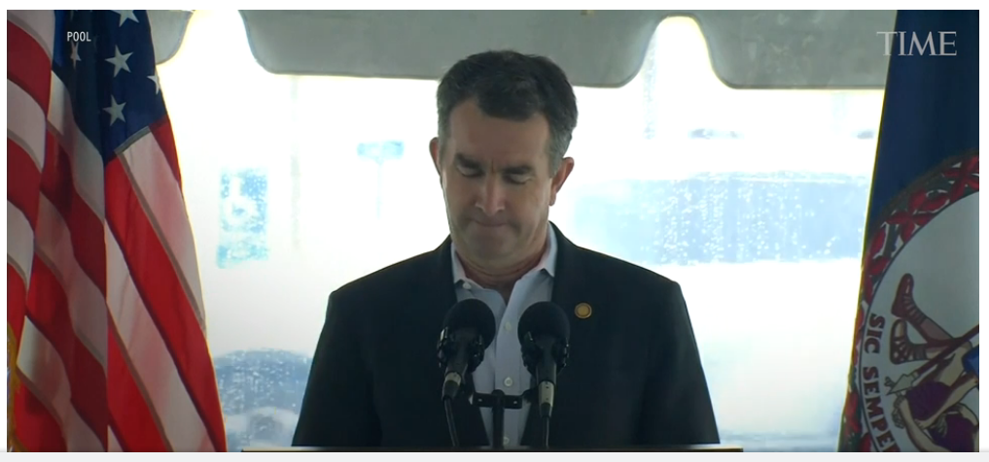
Virginia Repeal
Notes:
Virginia has executed more than 1,300 people since its founding as a colony in the 1600s. It executed 113 of those people in the years since the U.S. Supreme Court reinstated capital punishment in 1976, according to the Death Penalty Information Center (DPIC). Only Texas has executed more people in the last 45 years. Prior to the Civil War, Virginia law delinated capital punishment by race: White people could only be executed for first-degree murder, but enslaved Black people could be executed for non-homicide offenses, according to DPIC. This segregated system continued into the 20th century. Between 1900 and 1969, more than 70 Black men were executed for rape, attempted rape, or robbery in Virginia; no white men were executed for these crimes during this time, according to DPIC. During the same time period, 185 Black and 46 white people were executed for murder.
In 1908, Virginia replaced execution by public hanging with the electric chair, but extrajudicial lynchings of Black residents continued. Between 1877 and 1950, there were 84 documented lynchings of Black people in Virginia, according to the Equal Justice Initiative

