Slide 1
POLI 203 Results of Anonymous Survey and factual questionnaire
This set of slides compares your collective results on the first day of class and at the end of the semester.
N for first day survey: 322
N for April 26, 2025: 198
Note: This was completely anonymous. It’s just to see what has changed, collectively. Particularly on the knowledge questions.

Slide 2
Q1. Are you in favor of the death penalty for a person convicted of murder?
 | Pre | Post
Favor | 18% | 4%
Oppose | 82% | 96%
Total | 100% (321) | 100% 198

Slide 3
Q2. If you could choose between the following two approaches, which do you think is the better penalty for murder?
 | Pre | Post
the death penalty | 8% | 5%
life imprisonment, with absolutely no possibility of parole | 92% | 95%
Total | 100% (322) | 100% (198)

Slide 4
Q3. Regardless of whether or not you think it should be legal, for each one, please tell me whether you personally believe that in general it is morally acceptable or morally wrong. How about the death penalty?
 | Pre | Post
Morally acceptable | 30% | 18%
Morally wrong | 70% | 82%
Total | 99% (322) | 100% (198)

Slide 5
Q4. In your opinion, is the death penalty imposed -
 | Pre | Post
Too Often | 68% | 76%
About the right amount | 27% | 13%
Not often enough | 5% | 11%
Total | 100% (321) | 100% (198)

Slide 6
Q5. Generally speaking, do you believe the death penalty is applied fairly or unfairly in this country today?
 | Pre | Post
Fairly | 13% | 1%
Unfairly | 87% | 99%
Total | 100% (322) | 100% (198)

Slide 7
Q6. Apart from your opinion about the death penalty, what form of punishment do you consider to be the most humane?
 | Pre | Post
Firing squad | 9% | 45%
Hanging | 1% | 3%
Lethal injection | 84% | 41%
Electric chair | 2% | 4%
Gas chamber | 3% | 8%
Total | 99% (320) | 100% (197)

Slide 8
Q7. Do you feel that the death penalty acts as a deterrent to the commitment of murder, that it lowers the murder rate, or not?
 | Pre | Post
Yes, does | 14% | 2%
No, does not | 86% | 98%
Total | 100% (322) | 100% (198)

Slide 9
Q8. How often do you think that a person has been executed under the death penalty who was, in fact, innocent of the crime he or she was charged with -- do you think this has happened in the past five years, or not?
 | Pre | Post
Yes, has | 93% | 90%
No, has not | 7% | 10%
Total | 100% (322) | 100% (198)

Slide 10
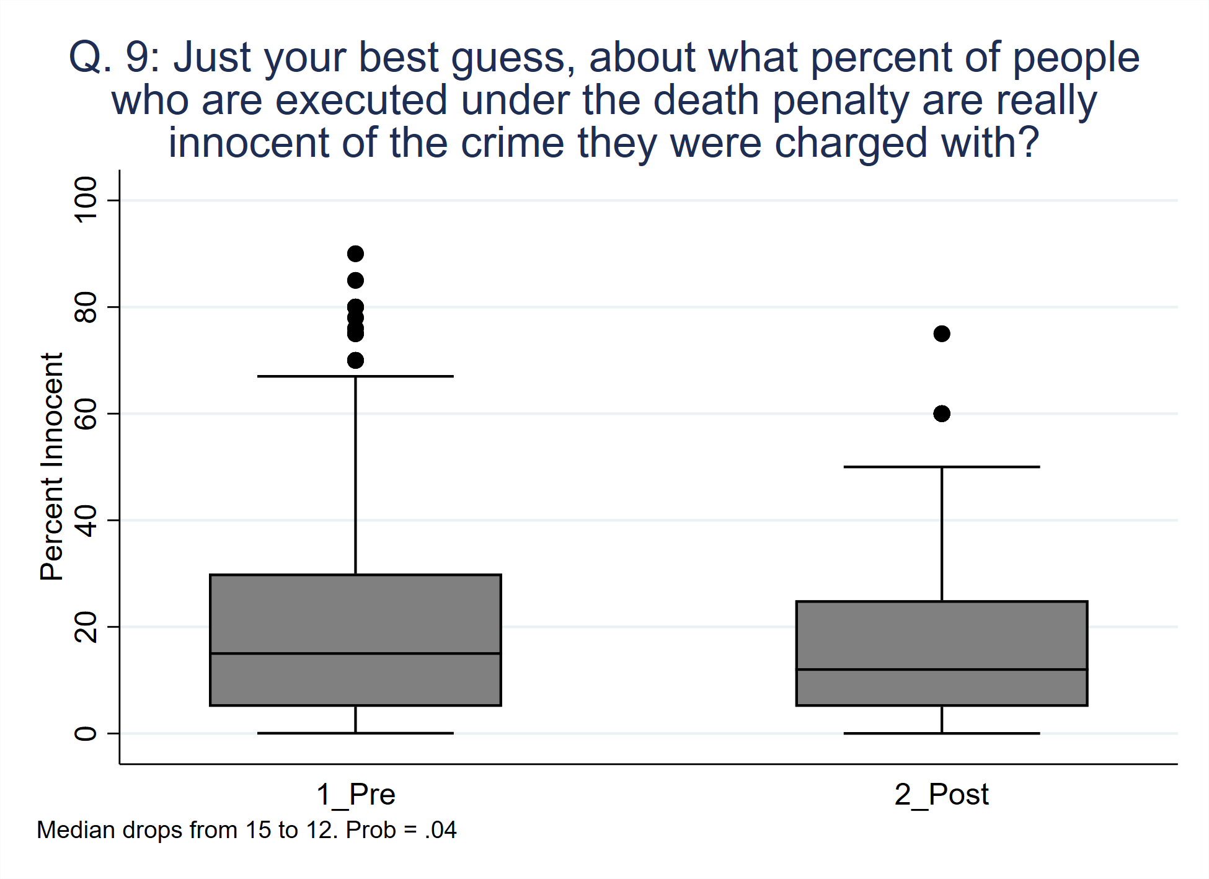

Slide 11
Q10. Which comes closer to your view?
 | Pre | Post
allow lethal injection | 38% | 15%
lethal injection should not be permitted | 62% | 85%
Total | 100% (321) | 100% (198)

Slide 12
Do you favor or oppose the death penalty for: (Percent opposed)
 | Pre | Post
Women | 78% | 86%
Mentally Ill | 88% | 96%
Mentally retarded | 94% | 99%
Juveniles | 96% | 99%

Slide 13
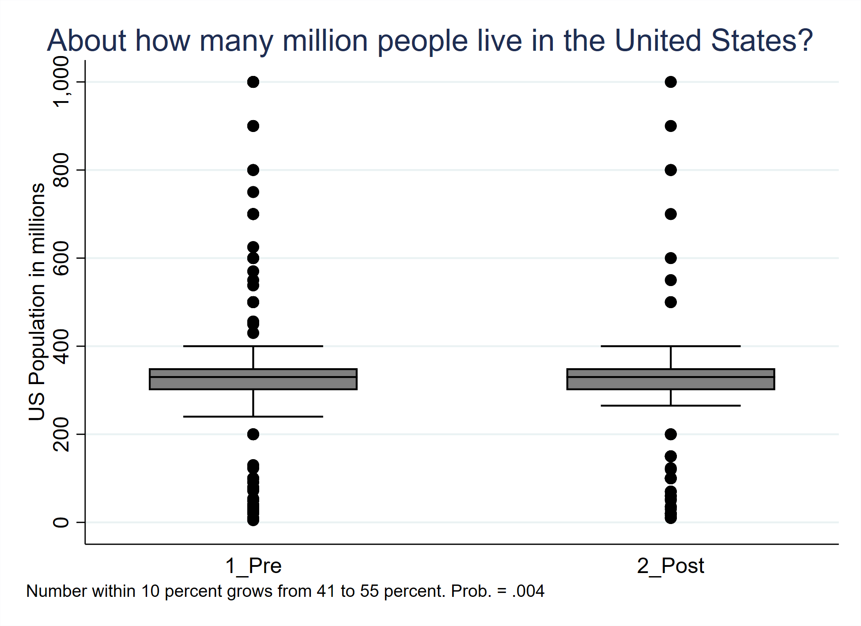

Slide 14
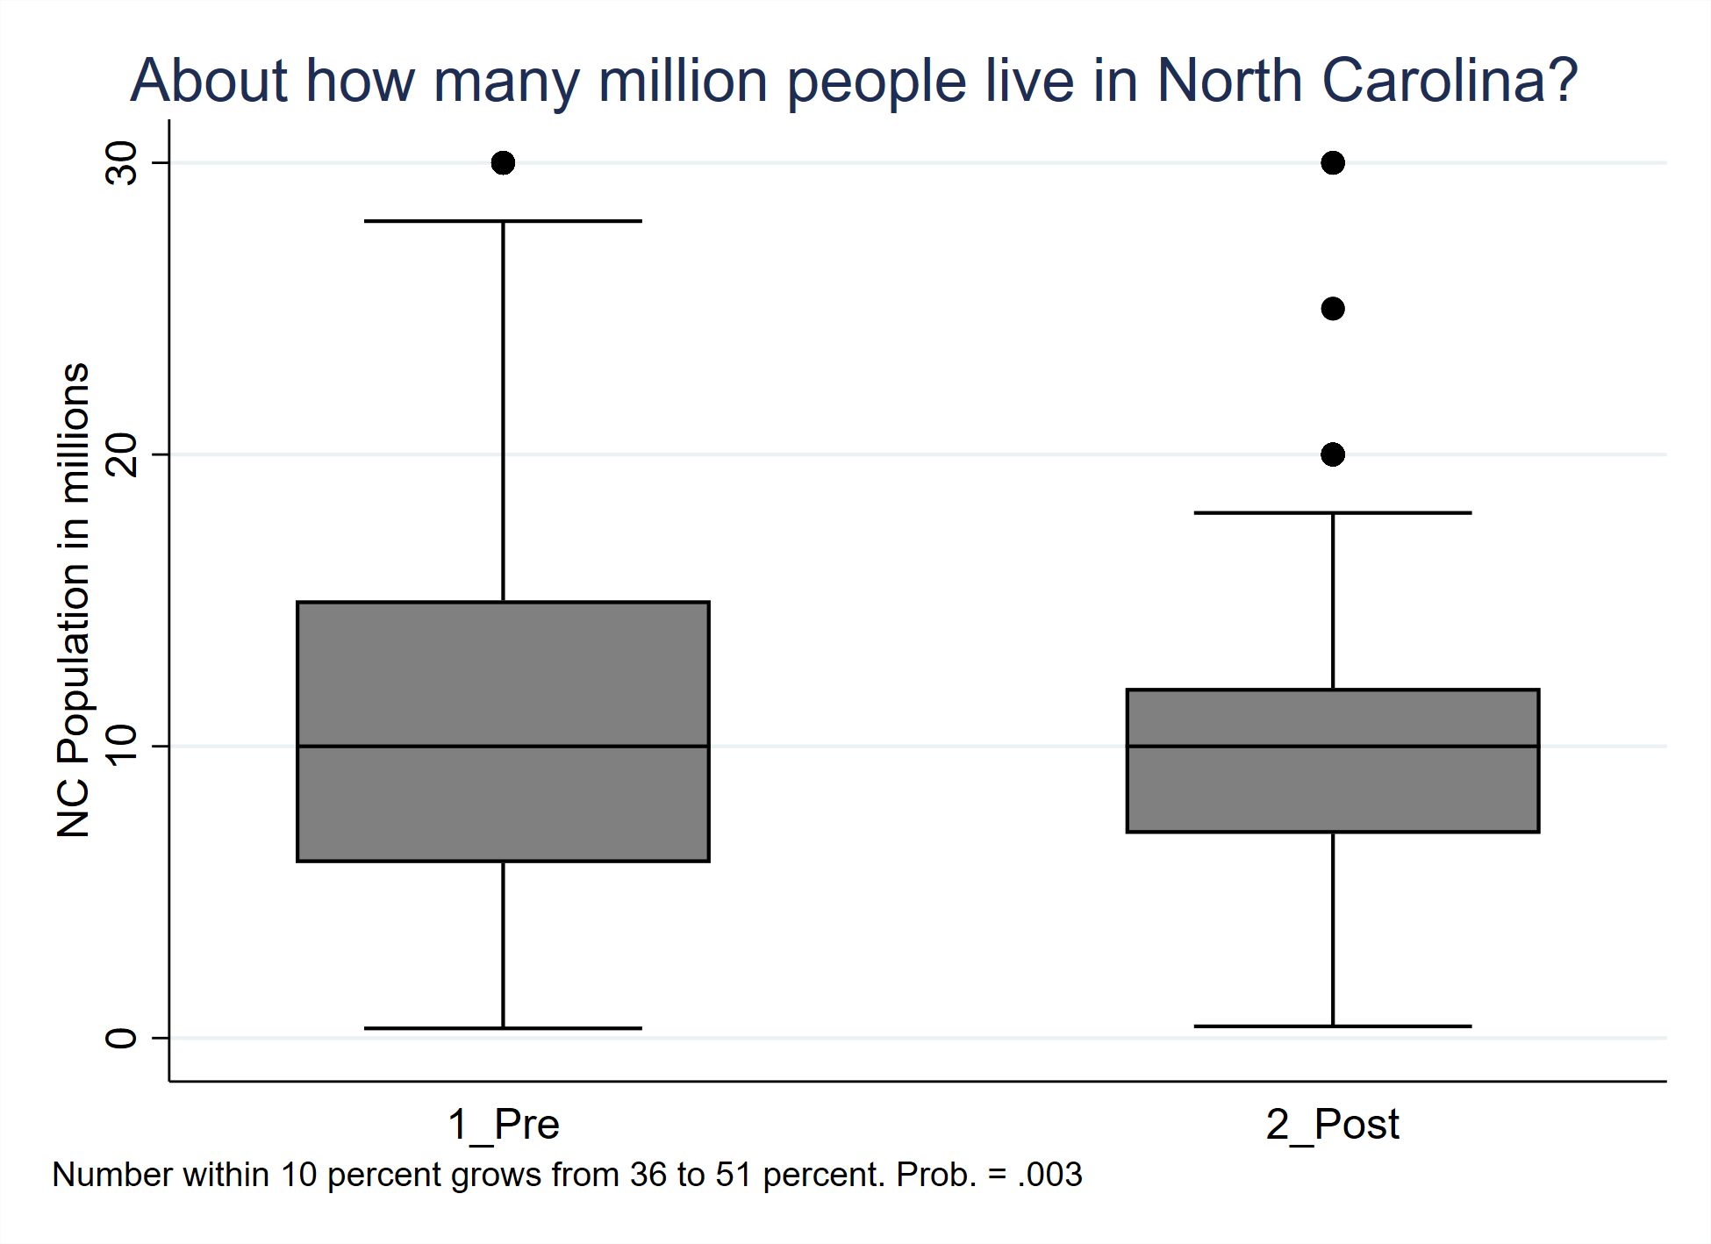

Slide 15
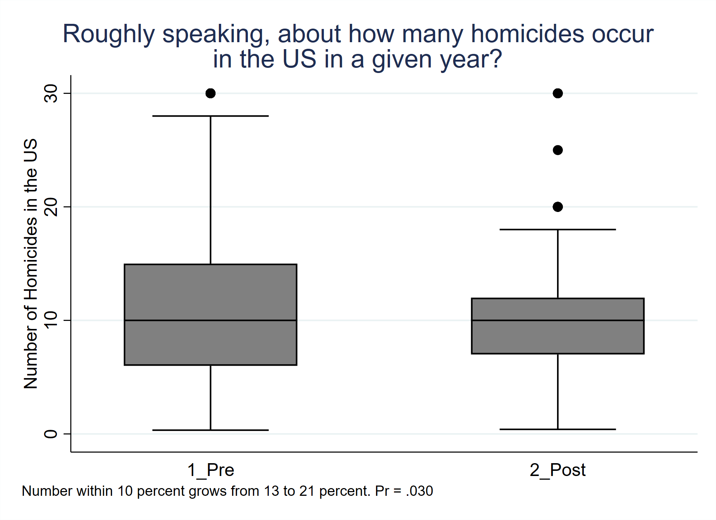

Slide 16
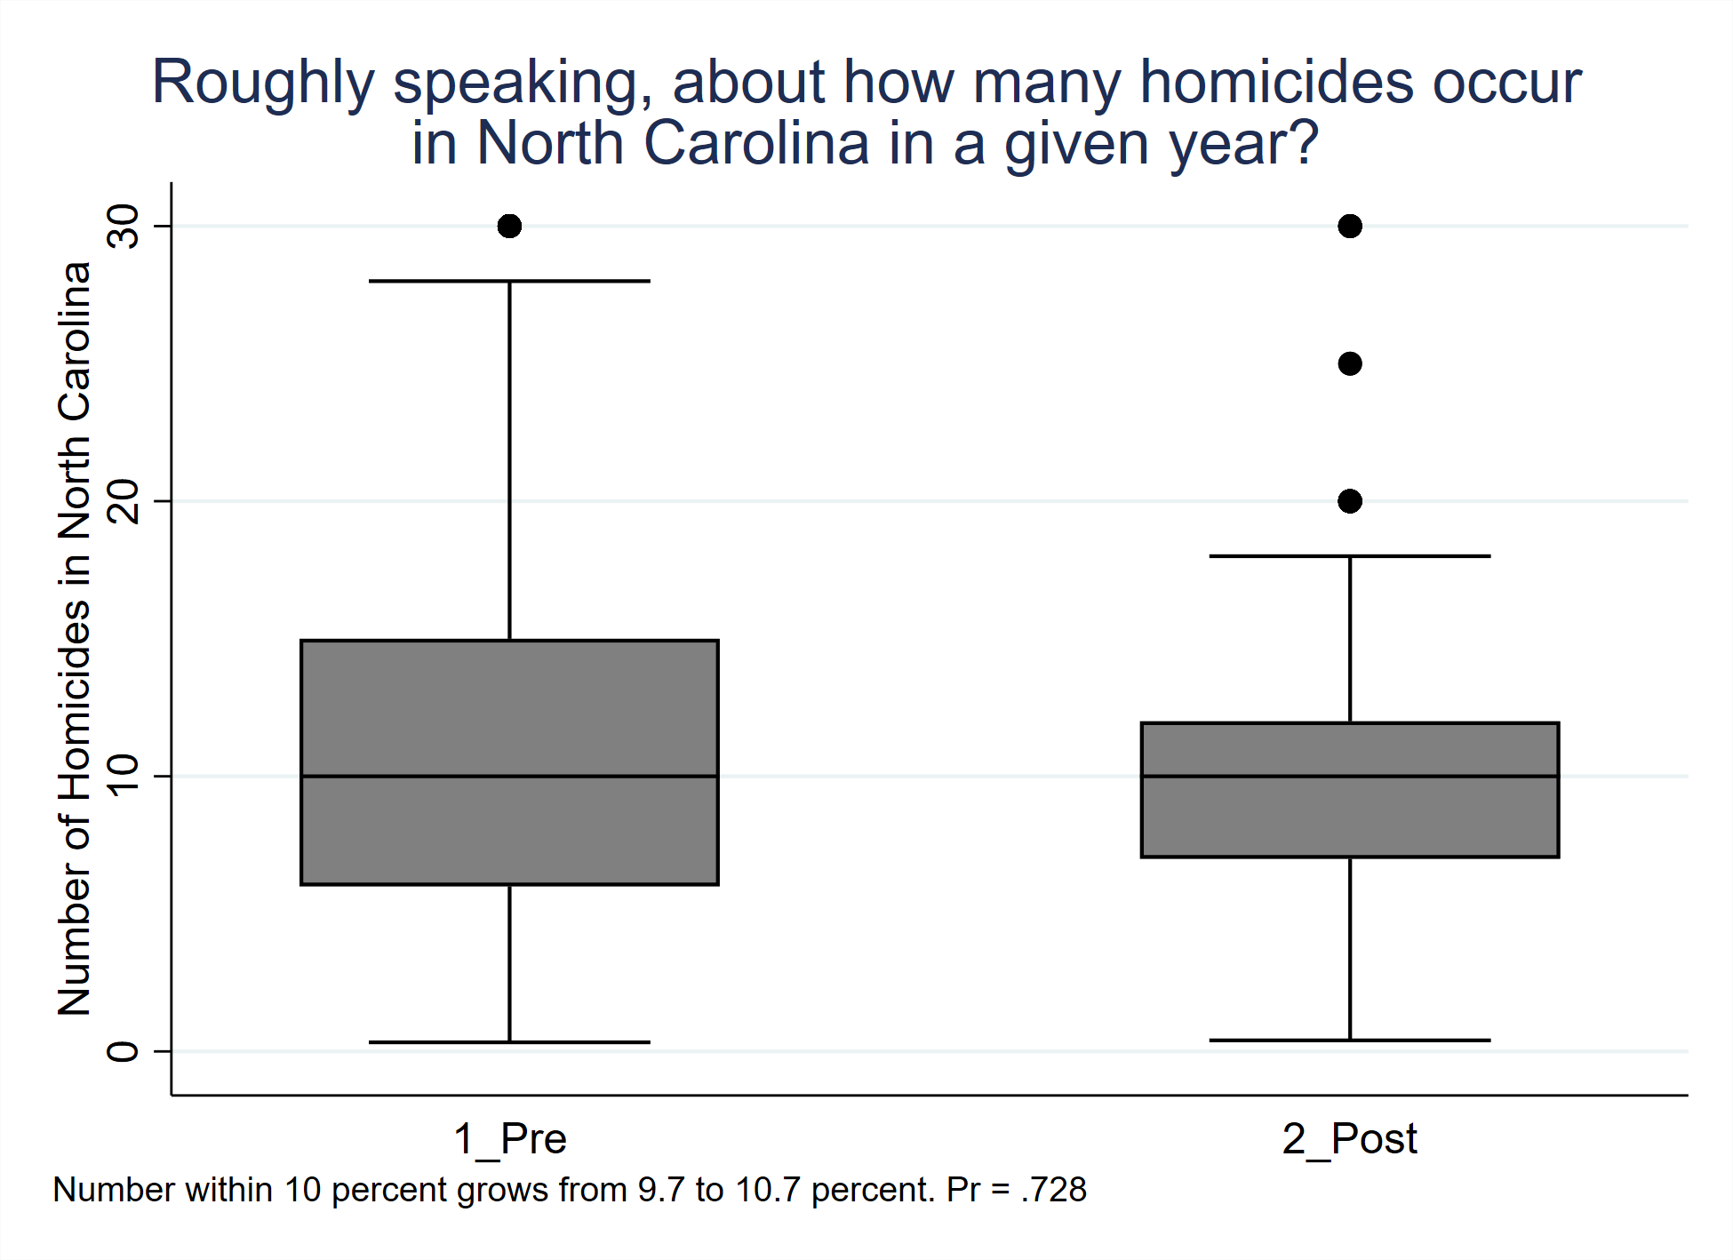

Slide 17
True or false: It costs more to maintain the death penalty than to have Life without Parole as the most severe punishment?
 | Pre | Post
Less Expensive | 38% | 7%
More Expensive | 62% | 93%
Total | 100% (316) | 100% (173)

Slide 18
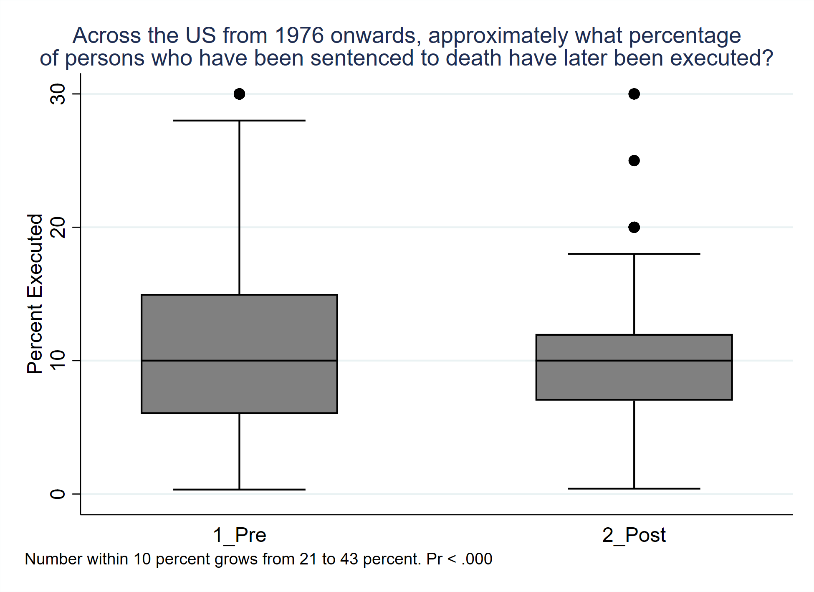

Slide 19
Which is the most likely outcome of a death sentence in the US since 1972?
 | Pre | Post
Suicide | 5% | 0%
Natural Death | 24% | 7%
Execution | 8% | 1%
Stay on DR | 49% | 26%
Reversal | 14% | 66%
Total | 100% (316) | 100% (170)

Slide 20
Which state has executed the most people since 1976?
 | Pre | Post
Texas | 54% | 90%
Any Other Guess | 46% | 10%
Total | 100% (310) | 100% (164)

Slide 21
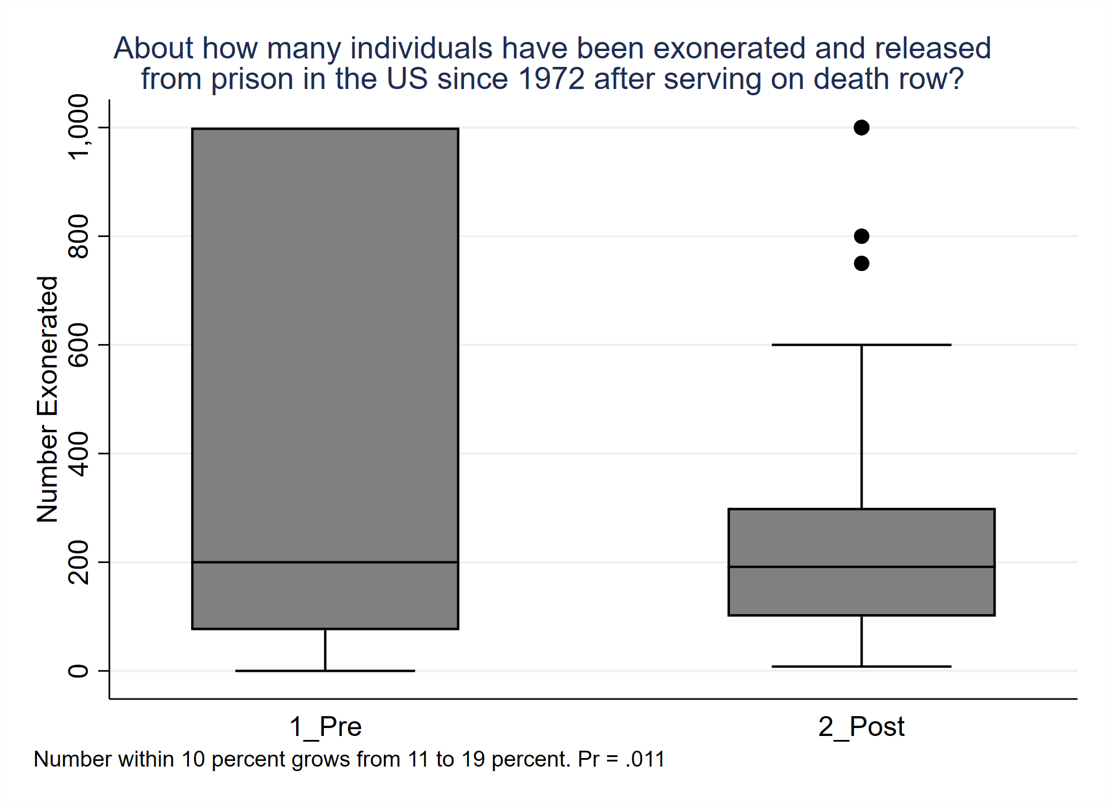

Slide 22
Which city has the most _____ since 1972? (Pre)
 | Homicides | Death Sentences | Executions
Los Angeles | 19%* | 18%* | 18%
Chicago | 59% | 26% | 25%
St. Louis | 22% | 57% | 57%*
(*: correct)

Slide 23
Which city has the most _____ since 1972? (Post)
 | Homicides | Death Sentences | Executions
Los Angeles | 50%* | 54%* | 18%
Chicago | 29% | 13% | 19%
St. Louis | 21% | 33% | 61%*
(*: correct)

Slide 24
One county in the US has more executions than any state other than its own. Name that county or its major city.
 | Pre | Post
Houston, Harris County, any variant on that. | 39% | 77%
Any Other Guess | 61% | 23%
Total | 100% (273) | 100% (154)

Slide 25
Three states have sentenced over 1,000 individuals to death since 1972. What are they?
 | Pre | Post
Any mention of Texas in top 3 | 61% | 73%
Any mention of California | 21% | 33%
Any mention of Florida | 16% | 15%
Total | N = 322 | N = 198

Slide 26
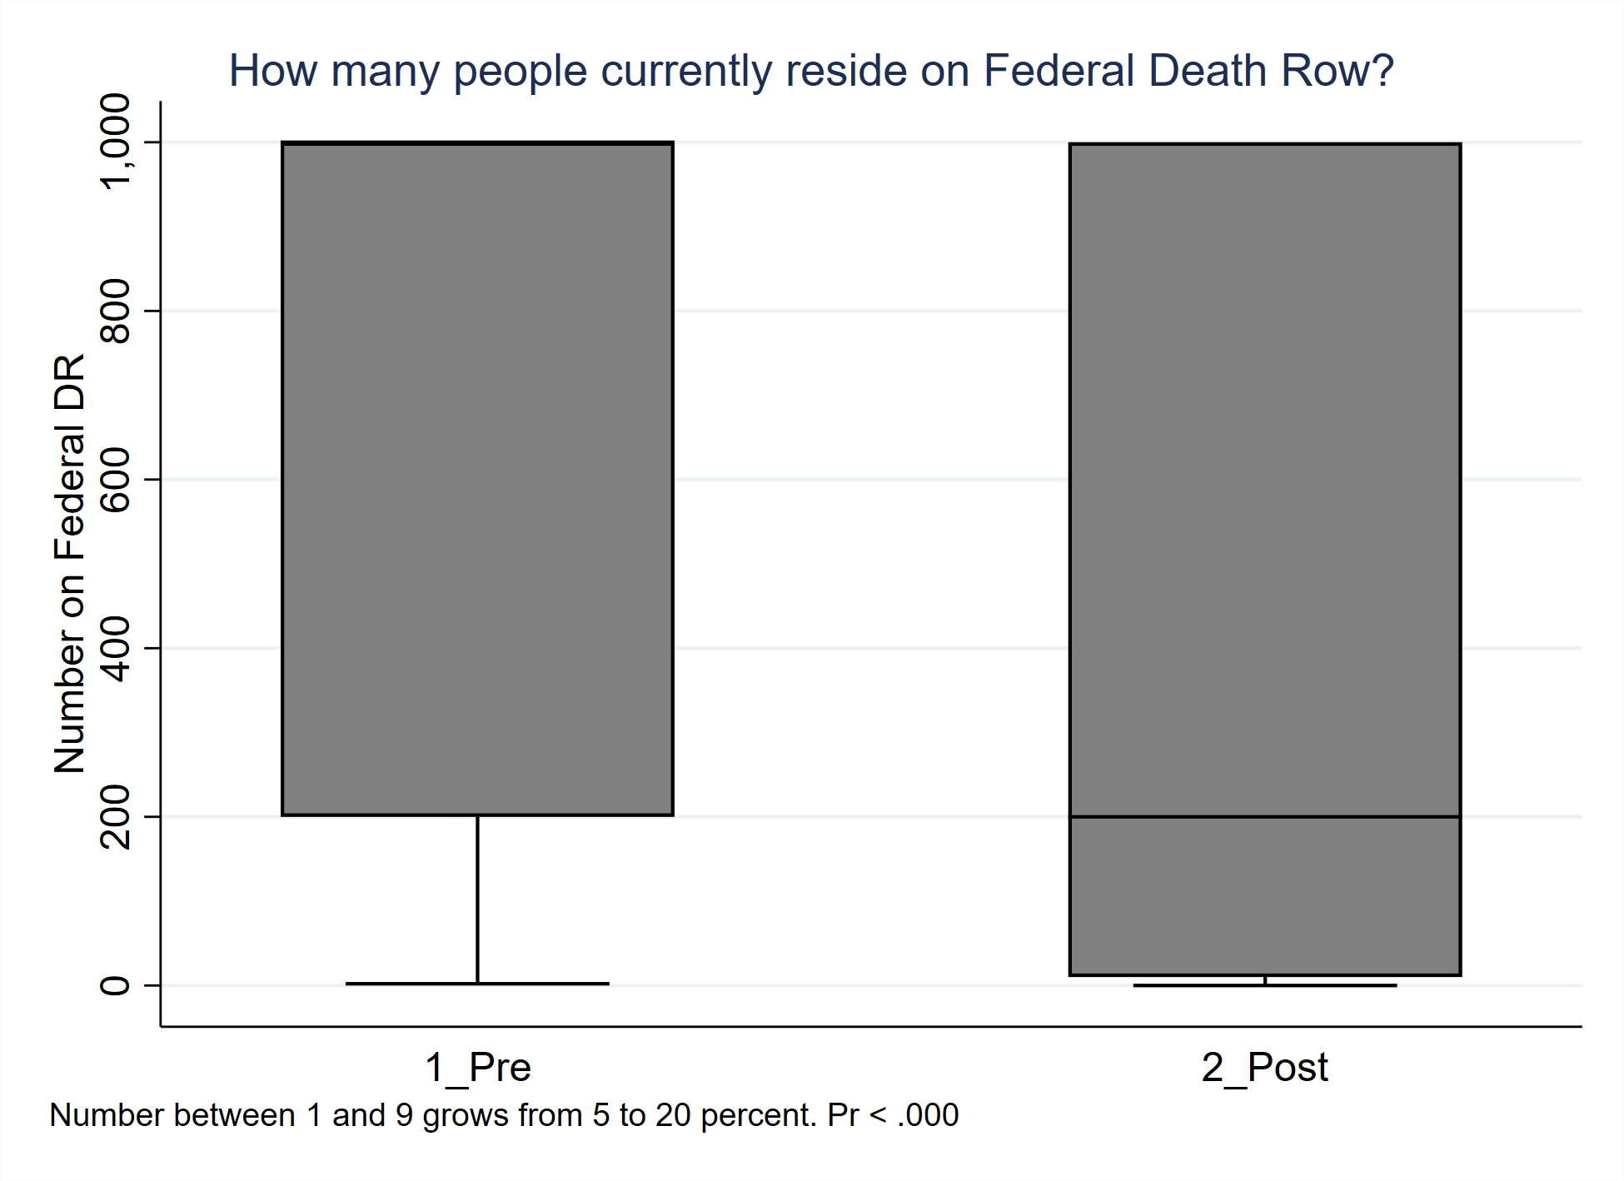

Slide 27
Circle the states that currently have the death penalty (Pre)
State | Yes | No
California (yes) | 30% | 70%
Ohio (yes) | 74% | 26%
Michigan (no) | 43% | 57%
Vermont (no) | 14% | 86%
South Carolina (yes) | 93% | 7%
Virginia (no) | 70% | 30%

Slide 28
Circle the states that currently have the death penalty (Post)
State | Yes | No
California (yes) | 73% | 27%
Ohio (yes) | 78% | 22%
Michigan (no) | 37% | 63%
Vermont (no) | 12% | 88%
South Carolina (yes) | 97% | 3%
Virginia (no) | 47% | 53%

Slide 29
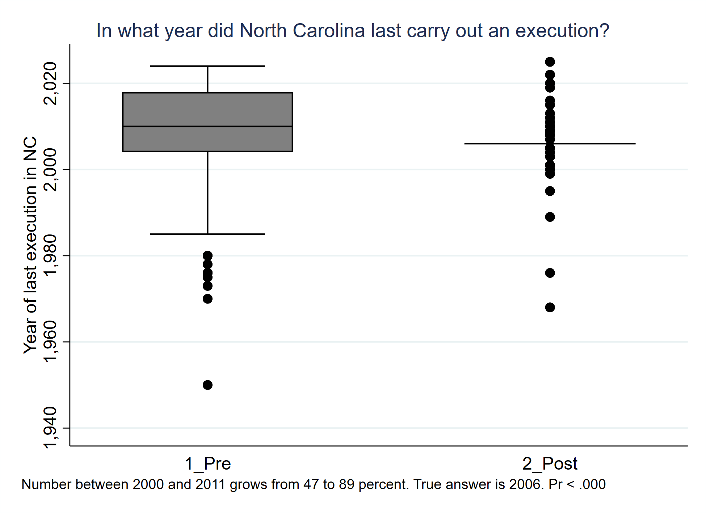

Slide 30
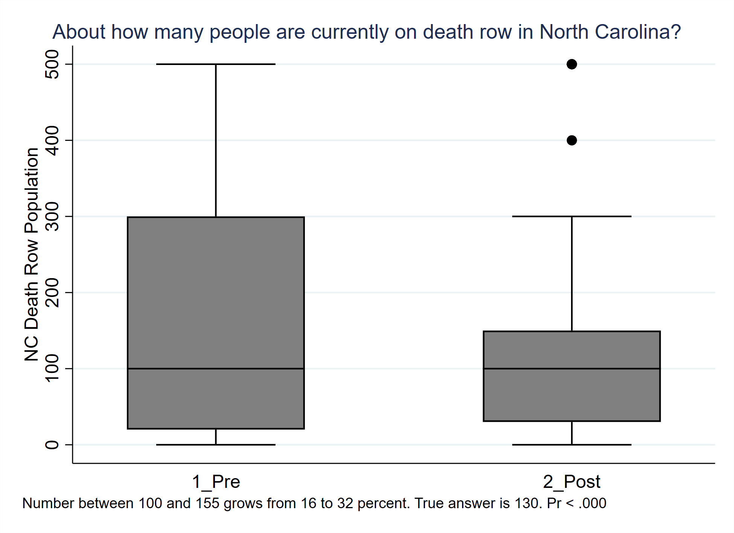

Slide 31
Which NC County has imposed the most death sentences since 1972?
County | Pre | Post | Actual Number
Durham | 5% | 4% | 9
Forsyth | 39% | 26% | 31
Mecklenberg | 10% | 10% | 30
Orange | 7% | 6% | 1
Robeson* | 39% | 54% | 35

Slide 32
Summary
There is some evidence of learning. Good!
Some reduction in the variance of the answers, so more of you are in the ball-park of correct.
Some general reputational effects still affecting you: California does not “seem like” a death state, but it is! Virginia abandoned the DP. Florida is a national leader, not just Disneyland. So it seems like when the facts go against the stereotype, you are confused. Facts are generally preferred to stereotypes…
You might think it’s not important to have an idea of numbers. But if you don’t know general ball-park numbers, you can be misled.
Protect yourself from conniving political leaders and hucksters by knowing some facts so you can resist manipulation…

