Slide 1
Review for final and last feedback
Plan for today:
We already reviewed the first-day survey
Logistics of Exam and any questions
Final comments and feedback
April 28, 2025

Slide 2
Logistics of the final
Wed April 30, 4-7pm in the regular classroom
In class, through Canvas. Identical format to the quizzes. 100 questions.
Quizzes should now be visible for browsing and studying. Access will be denied to the quizzes shortly before the final. But you should have it now.
Closed book. No internet browsing. No visible phones or other e-devices. Sign a class roster with your TA at the end of the exam before you leave.
If we see you on a web site or device including your phone, you’ll immediately get a grade of 0 for the exam.
You must be in class unless you are doing it through ARS or have made other arrangements with me for some special reason such as three exams on the same day.

Slide 3
To study for the final:
Review the quizzes. I guarantee that will be helpful.
Keep in mind the difference between a number and a rate or a percentage. Los Angeles has more homicides because 10,000,000 people live there. If I asked about the rate, the answer might not be the same.
Review the books, lectures, and speakers.
Don’t stress too much: final exam = 20 percent of the grade.

Slide 4
Content of the final
Similar to the quizzes.
I like it when people know facts and background so that their opinions are based on solid facts, not assumptions.
So, know the basic facts. It’s ok to be off by a fraction or small percentage; I’m not trying to trick you or catch you on a numeric technicality. But you should know facts and numbers, generally.
Court cases matter, so remember important citations.
Refresh your memory about which speaker was which.
Pay careful attention to the language of the question and choose the best answer, given that language.

Slide 5
Some last comments
Thank you for showing interest in this class
I hope you have learned a lot.
If nothing else, I hope you have learned to assess things as they actually work, not as one might hope they work, or as one could wishfully think they do work, or assume they work.
Wishful thinking is not good public policy
Due-diligence: understand the facts of what you are arguing about so that your opinion is based on reality, not wishful thinking.
That statement seems to have increased relevance in today’s polarized political environment, but it’s always been good advice!

Slide 6
Career ideas
First, if you took this class just because it was interesting, or fit into your schedule, and have no plans to let it affect you in the future, that’s totally fine.
But if you do:
Defense attorney is not the only option. It’s a good option. But so are these:
Prosecutor. You don’t have to be a bad and dishonest one. You could be a good one. You’d definitely have way more power.
Investigator, social worker, mitigation specialist, psychologist, forensic science
Many other professions work around these cases and they have a mix of people skills (investigators) and technical skills. Not all are lawyers.

Slide 7
What was this class about, anyway?
Don’t forget that at the core of everything we have discussed was a homicide.
We’ve had over a million homicides since 1972…
Let that sink in. That’s the problem, violence, killing, loved ones violently killed.
Our country has an epidemic of it. Other countries have much less violence.
You read Right Here, Right Now. You saw the childhood situations.
Another good career option is to work with children in almost any capacity to give them what hopefully all of you have: a sense of dignity, value, and purpose.
There are also many careers relating to healing and recovery after loss, focused on crime victims and survivors, not only offenders.
Do you want to work after a crime has happened, “fixing” it, or doing things that might reduce crime, poverty, poor educational options, and other social pathologies in the first place? This opens up a lot of options.

Slide 8
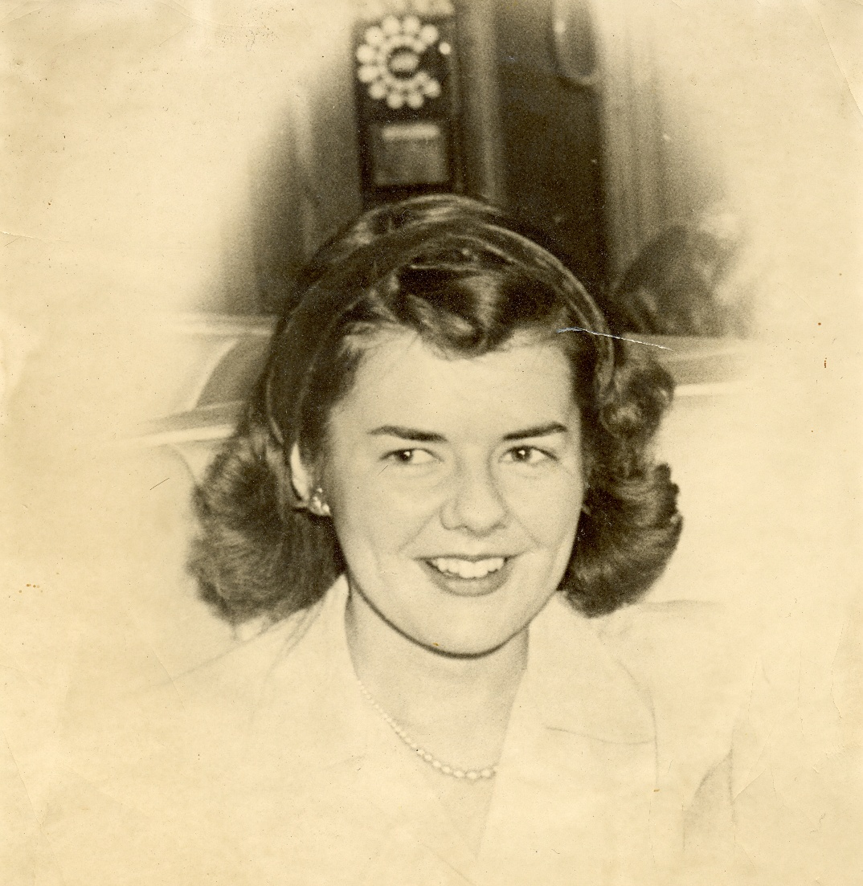
What my mom told me (with expansions of my own):
It’s not your responsibility to fix the entire world. If you set that as your goal, you’ll clearly fail, and it will be frustrating.
But you can choose your career path to be one that heals rather than harms.
Doing good should not just be a charitable activity on the weekends; it should be part of your full-time job.
Find a career path that gives you meaning, and also does more good than bad, that helps rather than harms.
There are many career paths that allow this.

Slide 9
See you Wednesday.
Good luck on the exam.
I’ll teach this class again next Spring; tell your friends.
Also, a research seminar for 20 students with this class as a pre-requisite, Spring 2026: POLI 490, Special Topics: Advanced Research on the Death Penalty.
Stay in touch, say hi when you see me on campus. Thanks for your interest in this class.

