Slide 1
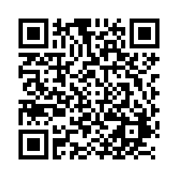

POLI 203, Special Guests, Marvin Anderson, March 24, 2025
Students: Scan this QR Code to record your attendance.
Alternatively, enter this URL: https://unc.az1.qualtrics.com/jfe/form/SV_9AekxDX16FiM6fY

