Slide 1
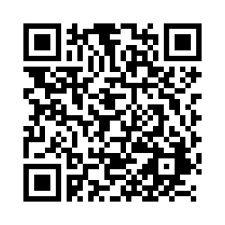
POLI 203, Special Guests, Leon Benson and Kolleen Bunch March 17, 2025
Students: Scan this QR Code to record your attendance.
Alternatively, enter this URL: https://unc.az1.qualtrics.com/jfe/form/SV_egqbM8Hk0zqrhMG

