Slide 1
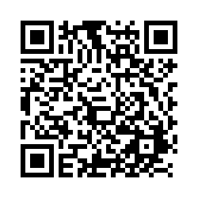

POLI 203, Special Guests, Isaac Knapper and Amy Banks March 31, 2025
Students: Scan this QR Code to record your attendance.
Alternatively, enter this URL: https://unc.az1.qualtrics.com/jfe/form/SV_6XVAesN0KqVnA3k

