Slide 1
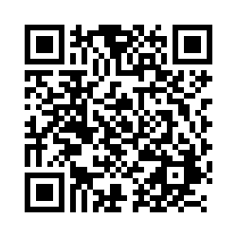
POLI 203, Special Guest Kristine Bunch September 27, 2025
Students: Scan this QR Code to record your attendance.
Alternatively, enter this URL: https://unc.az1.qualtrics.com/jfe/form/SV_3r95kk7cWQRgLga

