Slide 1
Rose and Baumgartner, “Framing the Poor”
October 16, 2019

Slide 2
Feedback on paper drafts
Good topics, very interesting, I look forward to them.
Grades: if they were not really high, then look for:
Stay on topic, don’t go off-topic, too much background
This may particularly be true if you are personally invested in your topic. For all the reading we have done about motivated reasoning, if you feel strongly about your topic, sometimes it can be hard to be neutral and balanced!
Grammar. Yes, I do care about that. Many of you have sentences that just get too confused, too long. Be simple.
Grammar. Look for passive voice and eliminate it. “There is” and “there are” are good signs the sentence could be written in a more direct manner.
Grammar. Pay attention to subject-verb agreement when the subject is something like “the police” (which is singular, of course.) Many of you do poorly on such things as “the majority [singular] of Americans [plural] feels [singular]…”

Slide 3
Before we start
Additional resources in the library
> Library > e-Research > A-Z Database List > News
Contains 73 databases, including many individual papers such as NYTimes, Charlotte Observer, the archive of the Associated Press, and so on, often back to the 1800s.
Also contains such things as “America’s News”, which has hundreds of papers included, though not as much historical coverage.
“newspapers.com” has many NC newspapers going back in time.
Note some of the papers are from overseas, some are African-American or Hispanic papers in the US, and so on. A good resource.

Slide 4
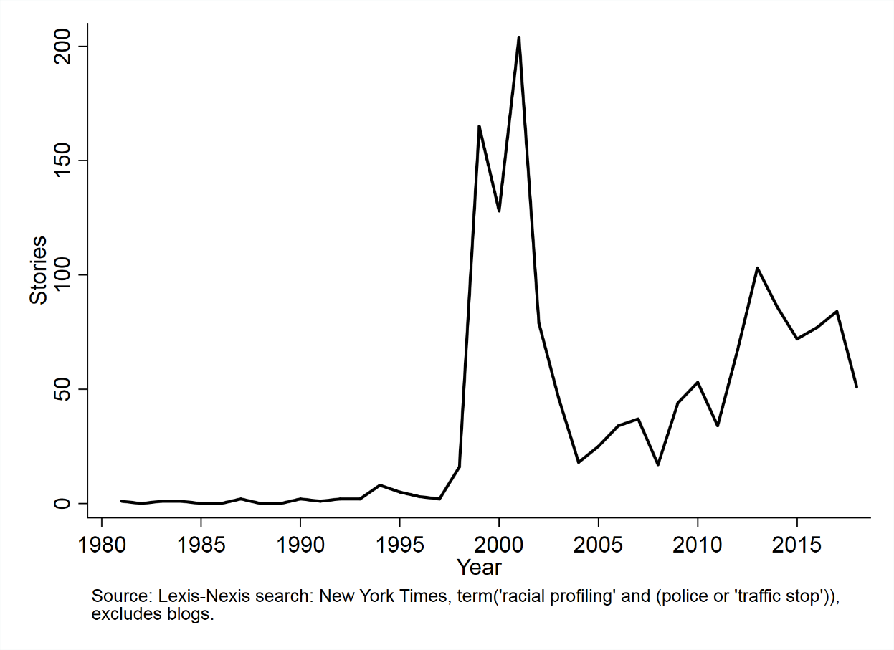
Before we start (cont.)
I can do this for you, or whatever search results you need graphed, or show you how to do it in office hours.
A. Save results in excel, 1,000 at a time.
B. make a new variable called “Year” (=year(c:2)) assuming the date is in cell c2
C. Save as a CSV, and a name that indicates the keyword.
D. Do this for as many keyword searches as you want. Use consistent names for the files. If there are more than 1,000 hits, do multiple files with names ending in 1, 2, 3, etc. DWB1.csv, DWB2.csv, etc. Maybe you have pro-choice and pro-life keywords, or maybe more than two frames in your issue. Do one search for the total number of stories on the topic, then separate ones for the specific frames you are tracking.
E. Email me those files, or come see me in office hours, and I can run them through my program to make graphs in Stata. If your files are formatted and named consistently, I can do it in about 5 minutes.
F. This is a good offer I’m making you. Take me up on it. However, do not do it at the last minute.

Slide 5
Framing the poor
Max Rose a senior thesis student
April 2011 completion of thesis
Sept 2011 submission
Feb 2012 revisions after reviews
June 2, 2012 conditional acceptance
June 16, 2012 revisions completed
Jan 2013 published

Slide 6
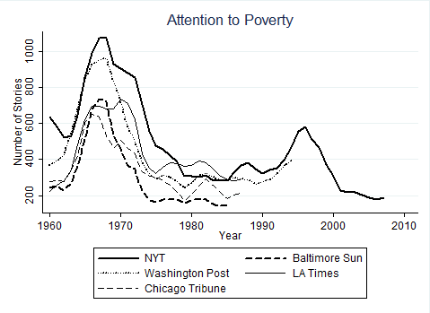
A surge and decline in attention

Slide 7
Keywords for poverty:
ENHAI(welfare OR poverty OR "low-income" OR "public housing" OR needy OR ghetto OR indigent OR impoverished) AND PDN(>1/1/2000) AND PDN(<12/31/2007) AND NOT ("endangering the welfare" OR Haiti OR Nazi OR Brazil OR China OR Africa OR India OR Iraq OR Europe OR Afghanistan OR animal) AND NOT AT(review)
Note: these changed (slightly) every decade

Slide 8
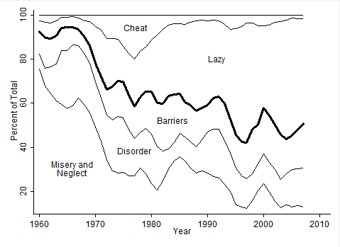
Increased attention to “lazy” over time…

Slide 9
Keywords for Frames:
Underclass | poverty-stricken OR "urban renewal" OR despair OR shelter OR bleak OR blight OR hunger OR ghetto OR "neediest cases" OR homeless OR slum
Social Disorder | anger OR police OR killing OR violence OR "civil right" OR crime OR gang OR riot OR demonstrator OR (strike W/3 rent OR welfare OR worker OR union) OR protest OR ("community action" AND NOT "community action agency")
Economic and Physical Barriers | (student W/1 aid OR needy OR loan OR disadvantaged) OR industrial OR wage OR economy OR "affordable housing" OR "unemployment rate" OR disabled OR "poor children" OR elderly OR aged
Laziness and Dysfunction | able-bodied OR dependency OR "work requirement" OR mother OR "welfare family" OR father OR "welfare hotel" OR (drug AND NOT Medicaid OR Medicare OR company OR prescription) OR abortion OR "child welfare" OR workfare OR "welfare to work"
Cheating | chiseler OR cheat OR fraud OR ineligible OR overpayment OR corruption OR audit

Slide 10
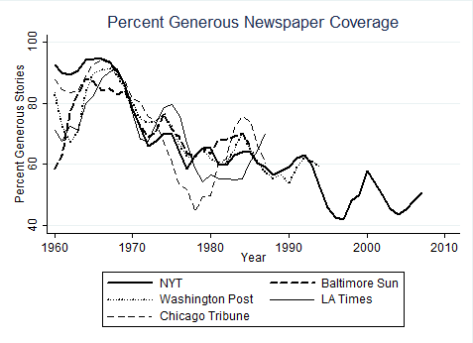
Many newspapers show the same results

Slide 11
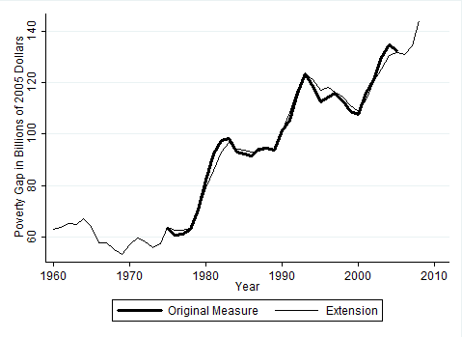
The Poverty Gap = (# of Poor) x (Depth of Poverty)

Slide 12
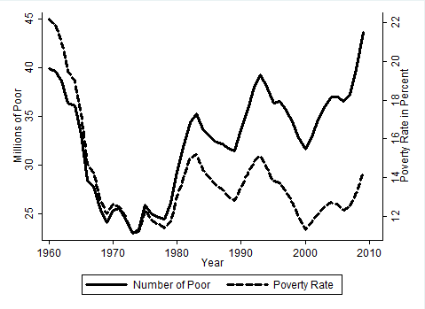
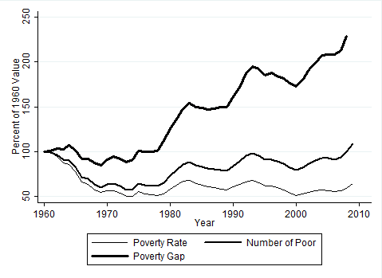
Three measures of poverty: number, rate, gap

Slide 13
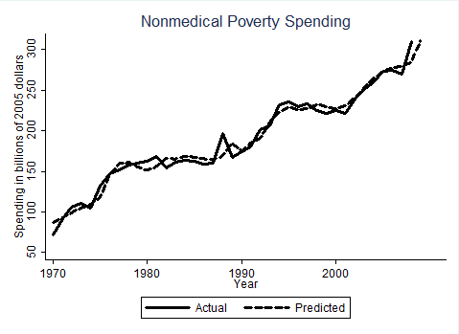
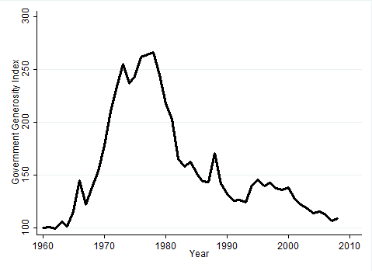
Spending goes up, but the demand changes, so the generosity is different: meet the gap, or no?

Slide 14
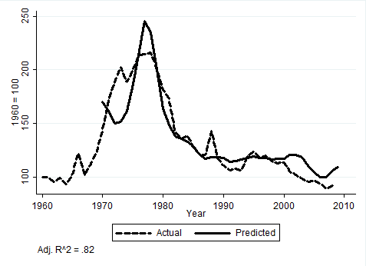
We can predict the generosity by the framing (lagged by… 10 years!)

Slide 15
So, framing drives government policy
For a paper:
Maybe just measure the frames, that’s plenty
But this article got published because we were able to show that it actually affected policy outcomes, though everyone (including us) was puzzled that the delay appears to be 10 years.

