Slide 1
Aaroe, Episodic and Thematic Frames February 11, 2019

Slide 2
Before going into today’s reading…
NPR coverage of the importance of anger, on the class website.
Let’s listen to this story and discuss.
What other social movements would this apply to?
Because of the nonviolent and non-confrontational nature of the MLK-era civil rights movement, we often think of successful social movements as following this model. However, there are many motivators.
Does anger as a motivator need to lead to angry demonstrations?
How do you use anger but not seem angry? Is that necessary?

Slide 3
What makes a frame “strong”?
Her argument: It depends on the “emotional state of the receiver”.
Thematic v. episodic frames
Thematic frames: Statistics, general patterns, collective evidence, background, context, etc.
Episodic frames: Illustrations, case studies, life stories, anecdotes, concrete events

Slide 4
Reasons for impact of episodic frames
Stronger emotional reactions
Direct these responses into support for a policy implied by the frame
Direct the emotional response at a particular character
That is, it creates a villain. Think back to Deborah Stone.
More influence on opinion if the emotional arousal is stronger
(Therefore, less so it the episodic frame elicits little emotion.)

Slide 5
A key difference in the two types of frames
Thematic: brings the viewer / reader’s mind to think of abstract causes, more diffuse, more external causes
Episodic: human interest details put a “face” on the problem and direct attention to specific people or characters, the objects of your emotional response.

Slide 6
The Study: “the 24-year rule” in Denmark
No foreigner may marry a Dane and live in Denmark until both bride and groom reach the age of 24…
Fewer than 2% of people younger than 24 in Denmark are married.
2002 law was an anti-immigrant move, or an assertion of the “Danish lifestyle” and the need to assimilate.
(Side point: is this a racist law?)

Slide 7
Two arguments for, two arguments against
Arguments for: changing immigrants’ outdated, involuntary marriage patterns.
Thematic: statistics show a clear change in marriage patterns, away from the country of origin and therefore toward marrying Danes or people already in Denmark
Episodic: desperate immigrant woman promised before birth to her cousin
Arguments against: injustice against innocent young people
Thematic: statistics that arranged marriages are not a big problem
Episodic: happy couple, one Dane one immigrant forced to live in Sweden because they would be arrested in Denmark if they came home.

Slide 8
Episodic frames much more powerful here
Innocent victims of the law
Villains: people enforcing arranged marriages, or Danish police authorities putting young couples in jail
Anger, disgust
Blameworthy agent of the bad policy

Slide 9
Experimental method
She needed to find frames that differed along the lines above, four different ones, but that were not inherently better or worse than each other along any other dimension.
Pretest: nine frame presented, “How strong would you say this argument is?”, use those results to select the experimental stimuli.
(Note: experiments are hard to do right!)

Slide 10
More on methods
“Do you think the 24-year rule should be abolished or preserved?”
How much of each of the following emotions to you feel?
Compassion, pity, anger, disgust
Each measured on a 7 point scale
Participants: high school students

Slide 11
More emotional response to the episodic frames, as one would expect
Emotion | Episodic Frame | Thematic Frame | Control Group
Compassion | .64 | .38 | .45
Pity | .63 | .36 | .43
Anger | .45 | .19 | .27
Disgust | .45 | .23 | .27

Slide 12
Results in Table 2 and 3
Direct results: both the episodic and thematic frames move the subjects on their opinion by about .25 or .26
But, there is no effect of emotion for the thematic frames and there is a strong one for the episodic frames
If the frame stimulates an emotional response, it is more persuasive.
Note that the same frame may or may not evoke such a response in different people…

Slide 13
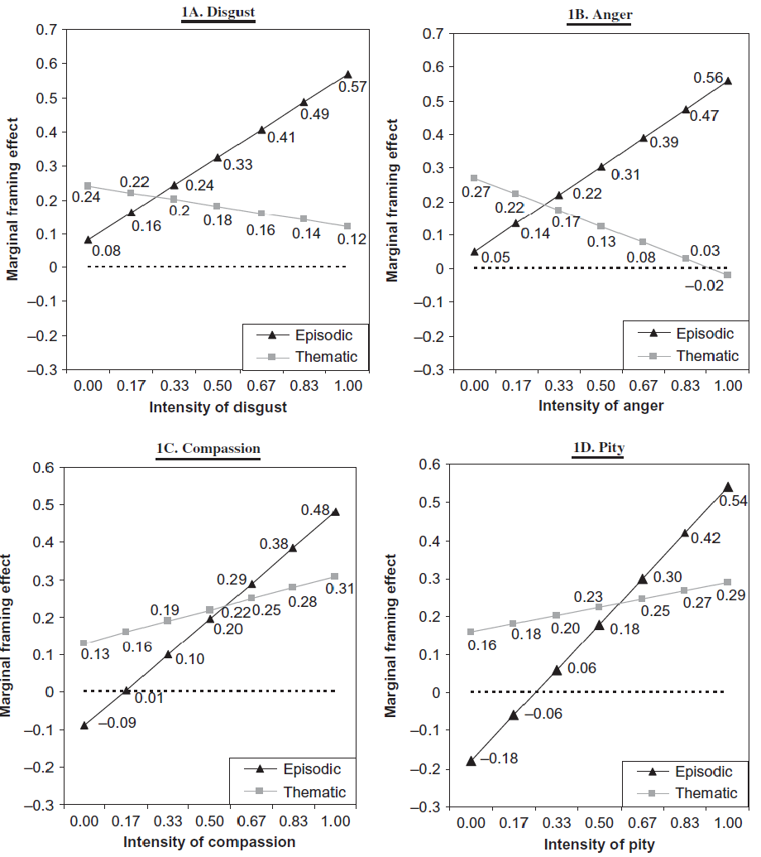
Figure 1. The stronger you feel the emotion, the bigger the change in level of support for the policy.

Slide 14
Let’s discuss that
Compare to Stone: purposeful actions with intended bad consequences make a villain…
Is the experiment well done?
Would it travel to different contexts?
How would you relate it / design it for the US context? What example?

Slide 15
A possible counter-example: Sexual Assault
What are the best frames for the #MeToo movement?
Huge national problem?
John Doe attacked me?
How do courts, the media, and others approach these issues when presented in the episodic and thematic frames?
What about John Doe? In the episodic frame, when it is personalized rather than kept abstract, somehow in this context the dynamic shifts…

Slide 16
Here’s a paper I did with a student in this class a few years ago:
There's been a big change in how the news media covers sexual assault. Washington Post, Monkey Cage, May 11, 2017. (Frank R. Baumgartner and Sarah McAdon)
Read and let’s talk about it

