Slide 1

Carpenter, Protection of Civilians as a Transnational Issue,
International Studies Quarterly, 2005
April 3, 2019

Slide 2
Protecting “women and children”
What about the men and boys?
Men get summarily executed
Boys get recruited to serve in the army
Boys and men, as civilians, have their rights violated or are killed
Women and girls also suffer, of course.
But it’s easier to sell and promote the idea of a norm protecting “vulnerable populations” if limited to “women and children”

Slide 3
“Laws of war” (p. 296)
“Civilians” must be spared
“Combatants” may be legitimately be killed
How to tell the difference? If they “participate directly in hostilities”
But this gets turned into a proxy:
  Women and children, perhaps the elderly, are “civilians”
  Men and boys are “combatants”
That’s both inaccurate and a moral failing…
  Innocent men and boys then can be killed as acts of war; not seen as a moral outrage.

Slide 4
Her argument, p. 297
“network actors have attempted to establish a ‘frame’ that ‘resonates’ with the moral language familiar to international donors, belligerents, and the media, and that is acceptable to political allies in the women’s network.”

Slide 5
Norms can be dysfunctional
The international community of human rights activists finds it easier to push this norm than one that is more accurate: protect civilians.
Note: a key element here is that it is acceptable to the “belligerents” – they want to be able to treat all men as combatants, so they can be killed.
  Human rights activists find ways to devote their moral outrage in those areas where the world’s largest armies will accept it.
  Recall Bachrach and Baratz (1962) argument about limiting the agenda only to those decisions that are comparatively inconsequential…

Slide 6
Protecting civilians in war zones, a new idea
More attention to this issue only in the 1990s
International humanitarian network promotes this idea
(Note: the network is an amorphous group of states, IO’s, and NGO’s.)
  UN Office for the Coordination of Humanitarian Affairs, UN OCHA, a key actor
Great to promote this new ideal, fantastic. But how was it framed?

Slide 7
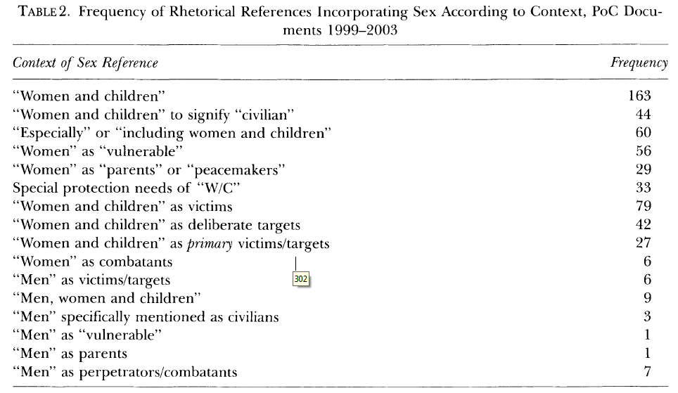
UN OCHR focuses on women and children…

Slide 8
Other evidence in the article reinforces the point…
References to how vulnerable mothers, babies, women, children are…
Women are mothers / peacemakers. Men are warmakers…
Occasional reference to the elderly (including men) and those with disabilities (including men)
Generally, however, a powerful “essentialism” that excludes men from a protected class.

Slide 9
A certain irony…
Traditionally, “human rights law and discourse privileged able-bodied adult men rather than women or children …, [but] precisely the opposite has historically been true with respect to the protection afforded by the civilian immunity norm” (p. 302)
That is, finally women are the privileged class here; men are the second class ones here...

Slide 10
Two questions then to discuss
First, why did this happen?
Let’s list the reasons for it, from her article and you can also add more
Take some time and think of 3 reasons, and I’ll compile on the board

Slide 11
Second, how could you shift the frame, if you disagree with it?
Perhaps you think this frame is fine; what are the reasons why it’s appropriate, let’s list them.
If it is inappropriate, what would be the arguments to protect those who are not directly involved in hostilities, no matter their gender?
Think of arguments / frames and I’ll compile on the board.

Slide 12
Why did I make you read all this Carpenter stuff?
Frames aren’t automatic.
Someone has to make them.
They need resources; these are not widely shared.
Agendas, even of well-meaning human rights oriented organizations, are crowded. If you try to reframe issue X, you cannot simultaneously reframe issue Y. But many issues may deserve attention / reframing.
Therefore, to understand framing, we also need to understand power.

