Slide 1

POLI 421
January 14, 2019
Tversky and Kahneman on Heuristics and Biases
Slovic on misperceptions of risk

Slide 2
What are the odds of an uncertain event?
Fully rational: How would you do it?
Actual people: How do we really do it?
Objective v. subjective assessments of probability.

Slide 3
Things people do wrong / characteristics of human cognition:
Representativeness: from my limited knowledge, or from a sample, can I extrapolate to a larger situation?
Availability: What is most easily brought to mind?
Anchoring: Points of reference

Slide 4
Representativeness
Insensitivity to prior probability / base rates
A person is shy. Are they more likely a librarian or a teacher?
What if there are 100 x more teachers than librarians?
Insensitivity to sample size / quality of estimates; small samples have high variance.
Misconceptions of chance: We don’t understand how to flip a coin; “gambler’s fallacy”
Illusion of validity: we have too much confidence when making choices based on very little information
Regression to the mean: people don’t even know what this means

Slide 5
Availability bias
Things close to our memory / easily available come to mind more easily and therefore we pay more attention to them.
(Note: lots of framing is about “priming” – making the person think about something first, which makes certain things more cognitively “available” or “near the surface” and therefore affects how they respond.)

Slide 6
Anchoring
We start with a point of reference, and then adjust (insufficiently) from there.
Points of reference have an out-sized impact on estimates.
(Remember this if you buy a car. The dealer will tell you how low the price is, compared to the “retail price”, which is made up and too high.)

Slide 7
Also by Kahneman and Tversky
“Prospect Theory”
Domain of gains: be risk-acceptant
Domain of losses: be risk-averse
That is, people will take more risks / behave differently when they might win something, but act the opposite when the risk is that they might lose something they already possess.
Apply this to the Obama health care debate. Is US health care the best in the world? Or do we have a scandal of too many uninsured? (Hint: the first frame puts us in the frame of mind that we have something to lose; the second, that we have little to lose and should take a risk to make a significant gain.)

Slide 8
Slovic: Perceived risk of various things
Why are we over-afraid of nuclear power?
Why are we under-afraid of smoking?

Slide 9
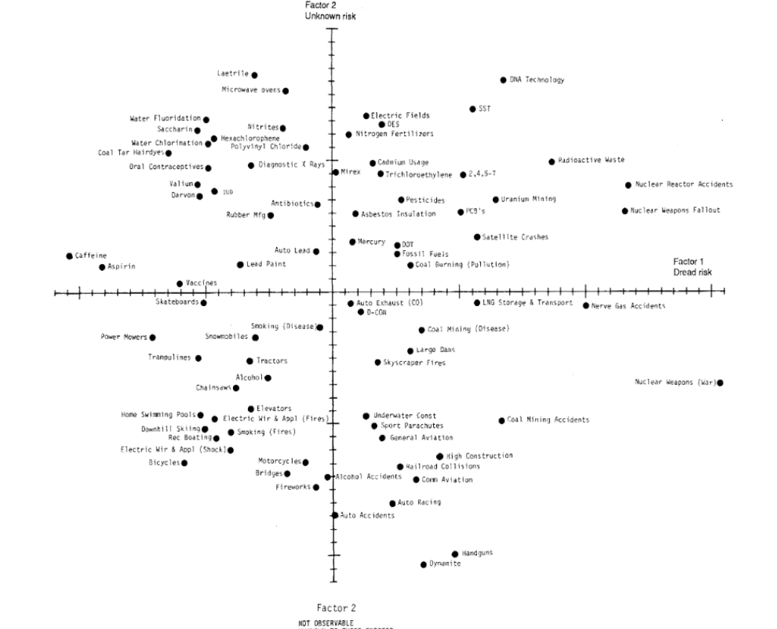
Familiar v. unfamiliar; dread v. mundane risks

Slide 10
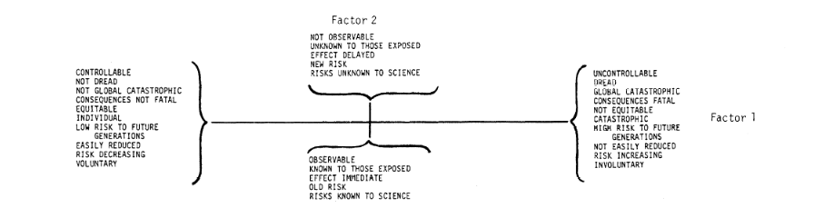
Controllable v. not; Observable v. not

Slide 11
Things that make us over-estimate risk
Unknown (invisible, delayed, unfamiliar)
Dread (scary!)
Uncontrollable (sit on an airplane someone else drives v. drive your car)
Inequitable (victims did not deserve it; v. they took a known risk)
Catastrophic v. individual consequence
Likely to affect future generations v. only oneself
Voluntary v. involuntary

Slide 12
Do we see this in politics?
What fears are manipulated?
Odds of violent crime?
Odds of someone on work release will commit a crime?
Stranger-attacks v. dangers from loved ones or family members
Think of more examples; how do people do this?
Why do they manipulate fear?

