Slide 1
Baumgartner, Framing, Spring 2023
Chong and Druckman, Framing Theory Overton Window
Jan 11, 2023

Slide 2
The overcrowding issue will be solved!
We are working on a plan to find another room and to expand the enrollment limit for this class.
We expect to have it solved … tomorrow! We should also have a new, bigger, room next week. Watch your emails.
Open enrollment is closed, so any new enrollments will be by permission and handled by Millie Tan of the Pol Sci Dept office; she’ll always need your name, PID, and if you also need to drop another class. She’ll get you enrolled quickly and it should all be fixed by next week. Her email: mtan56@email.unc.edu.
Please do not encourage other people to sign up. Enough is enough! But we can go to 45, including any TAM students.

Slide 3
A word about term paper projects…
Let’s start talking, in office hours or among yourselves, about your topics.
Recall the idea of historical cases (e.g., Equal Rights Amendment, Women’s Suffrage…) as well as more recent controversies. But it can be current: campus sexual assault; Confederate memorials, all those current things are fair game as well.
Foreign examples are fine as well; does not have to be from the US.
Nexis-Uni from the library web site, or New York Times historical, or other historical newspaper web sites available through the UNC library may be key resources.
Step 1. Find stories on your topic using keywords for the topic.
Step 2. Read a bunch of stories and pay attention to the arguments and actors.
Step 3. Develop keywords associated with the pro- and the anti-movement actors.
Step 4. Create a chronology using counts of such keywords.
Step 5. I can help you with the quantitative parts.
Step 6. You can also read through histories as well as these newspaper stories to develop your own chronology and history of the issue, and its opponents and proponents.
See the template as well as the instructions on the class web site.

Slide 4
Chong and Druckman: the vocabulary (p. 104)
The major premise of framing theory is that an issue can be viewed from a variety of perspectives and be construed as having implications for multiple values or considerations.
Framing refers to the process by which people develop a particular conceptualization of an issue or reorient their thinking about an issue.

Slide 5
Two really important concepts
Mediation
Things that generate framing effects
The idea must be “available” – in your memory.
The idea must be “accessible” – the more accessible, the more likely you are to use the idea. So…
Priming: make the idea accessible to someone by mentioning it just before you pop the question you are really interested in.
Moderation
Things that moderate or limit framing effects
Strong predispositions
Lots of knowledge
Credibility of the source, cultural resonance, competing frames from other sources…

Slide 6
Two simple examples of “priming” and “framing”
Given the importance of free speech, do you believe the KKK should be allowed to hold a rally in [your town]?
Given the risk of violence, do you believe the KKK should be allowed to hold a rally in [your town]?
Would you support spending more on welfare programs?
Would you support spending more on programs that aid the poor?
Framing effects: 85 to 45 percent support; 20 to 65 percent support…

Slide 7
How frames work (p. 110) (Mediation)
Do you have certain items in your short term memory?
Availability: can you remember it?
Accessibility: is it immediately available? Were you just thinking of it?
Unconscious mechanisms
Conscious thought: rational decision-making
These accessibility things don’t matter for conscious thought, but they can play a role similar to implicit bias.

Slide 8
Moderating effects
Strong prior beliefs: these make you resistant
Knowing a lot about the topic…
Caring a lot about the topic…
Not trusting the opposing messenger…
Being exposed to counter-arguments in the same time period…

Slide 9
Confusing concepts
Equivalency frames
20 % chance to gain a dollar, v. 80 % chance not to lose a dollar
97 % fat free, v. 3 % fat
95 % employment, v. 5 % unemployment
Priming
Make a certain idea accessible, then ask a question
IAD test: show a picture of a black face, and it makes the respondent quicker to see a gun, for example. This is priming; manipulating accessibility. It’s a form of framing.
Persuasion
Change the weights on the attributes, v. change the evaluation of them.
Really, does it matter? The decision changes either way. But the literature on framing and persuasion have emphasized different mechanisms.

Slide 10
Summary
File this article away for your term paper.
Use it, refer to it, like an encyclopedia article, or a dictionary.
It’s a good reference point for language, vocabulary, distinctions in use of terms, and in bibliographic starting points to dig more deeply into various issues.

Slide 11
The philosophical problem for the study of public opinion
Democracy is supposed (by some) to involve accurate reflection of public preferences by governments.
But if public preferences are so fickle as to be affected by simple framing effects, then how can there be democracy?
Question: what are the topics, for you personally, where it would make no difference whatsoever how the question was phrased, you’d never change your response? (E.g., strong attitudes)
What are areas where your attitudes are weak and you would perhaps be affected by how the question was phrased?

Slide 12
Many unanswered questions in the study of framing
We don’t actually know what makes a frame strong v. weak.
Existing studies identify “strong frames” by noting that they have a big impact.
But we don’t actually know many basics:
Why are some frames strong?
What is the value of excessive repetition of the same message? (e.g., can you buy influence by repeating the message, as in advertising?)
What about counter-frames by the other side?
Cultural resonance, patriotism, the use of group identity, and so forth.

Slide 13
The Math
Your attitude toward an object is the sum of your weighted evaluations of the different dimensions (attributes) of the object
Attitude = ∑ v_{(i)} * w_{(i)}
v = evaluation of the object on attribute (i)
w = the salience weight of that attribute (these sum to 1.00)
Buy a car? Pay attention to: cost, horse power, color, local dealership, brand name, and many other factors. But some count more than others.
Go to college? Date someone? Decide among candidates in an election? In any complicated decision, you intuitively go through a process of evaluating lots of things, and weighting some more than others.

Slide 14
Change your mind or change your focus?
It’s easier to change someone else’s decision by getting them to change the WEIGHTS they assign to the different attributes than to get them to change the values they place on those attributes.
Let’s say you’re a car salesperson with a reluctant buyer. You might try to get them to focus on the fact that the car is immediately available, and does not have to be ordered, when in conversation the buyer had paid no attention to that question at all. You are trying to up-weight the dimension of availability.
Framing: shift the weights; persuasion: shift the evaluations. Framing is easier, and they both lead to the same outcome!

Slide 15
This person buys Car # 1
Person 1 |  | Car 1 |  | Car2 |  | Car3
Attributes | Weight | Value | Score | Value | Score | Value | Score
MPG | 0.50 | 9 | 4.50 | 5 | 2.50 | 3 | 1.50
Price | 0.30 | 3 | 0.90 | 5 | 1.50 | 9 | 2.70
local dealer | 0.05 | 5 | 0.25 | 5 | 0.25 | 5 | 0.25
friends have one | - | 0 | - | 5 | - | 10 | -
stylish | 0.15 | 3 | 0.45 | 5 | 0.75 | 7 | 1.05
etc. |  |  | - |  | - |  | -
etc. |  |  | - |  | - |  | -
Total | 1.00 |  | 6.10 |  | 5.00 |  | 5.50

Slide 16
This person buys Car # 3. Same values, just different weights for the attributes…
Person 2 |  | Car 1 |  | Car2 |  | Car3
Attributes | Weight | Value | Score | Value | Score | Value | Score
MPG | 0.05 | 9 | 0.45 | 5 | 0.25 | 3 | 0.15
Price | - | 3 | - | 5 | - | 9 | -
local dealer | 0.25 | 5 | 1.25 | 5 | 1.25 | 5 | 1.25
friends have one | 0.50 | 0 | - | 5 | 2.50 | 10 | 5.00
stylish | 0.20 | 3 | 0.60 | 5 | 1.00 | 7 | 1.40
etc. |  |  | - |  | - |  | -
etc. |  |  | - |  | - |  | -
Total | 1.00 |  | 2.30 |  | 5.00 |  | 7.80

Slide 17
This person has not taste at all, weighs all the attributes equally; they buy Car #3.
No Taste |  | Car 1 |  | Car2 |  | Car3
Attributes | Weight | Value | Score | Value | Score | Value | Score
MPG | 0.20 | 9 | 1.80 | 5 | 1.00 | 3 | 0.60
Price | 0.20 | 3 | 0.60 | 5 | 1.00 | 9 | 1.80
local dealer | 0.20 | 5 | 1.00 | 5 | 1.00 | 5 | 1.00
friends have one | 0.20 | 0 | - | 5 | 1.00 | 10 | 2.00
stylish | 0.20 | 3 | 0.60 | 5 | 1.00 | 7 | 1.40
etc. |  |  | - |  | - |  | -
etc. |  |  | - |  | - |  | -
Total | 1.00 |  | 4.00 |  | 5.00 |  | 6.80

Slide 18
No one does this
The point of this is just to explain that rather than changing people’s understanding of whether the car has a higher or lower MPG, which is a fixed attribute, people argue about how much to care about (e.g., weigh) that particular attribute.
Because complex decisions have many attributes (dimensions), there is a lot of room for action here.
Note that there are no correct answers; in weighing diverse attributes, it really is a matter of taste.

Slide 19
If I give you a picture with an object in the middle, what associations come to mind? This is an opinion-object. Note: some associations lead to support, some to opposition to the object.
Nuclear Power
Carbon neutral
high-paid jobs
highly contaminated waste
secrecy, war, military

Slide 20
Pesticides
Green revolution
no more hunger
endangered species
chemical companies

Slide 21
Candidate X
Good stand on taxes
Good stand on foreign policy
wrong part of the country
Can't trust them

Slide 22
Some interesting elements about these associations
A given object may stimulate any number of associations in your mind
These associations may be completely different from each other: incommensurate trade-offs
That is, you might think: good on the issue of trade, but bad on the issue of integrity or personal morals
Trade-offs with incommensurate or non-comparable items.
Buying a car: you like the performance, but it’s the wrong color
No right or wrong way to do that

Slide 23
So, this really changes a lot over time
Does your opinion change if your focus changes?
Let’s say you are totally stable:
You don’t like liars
You support restricting immigration
You also have other policy preferences and associate a candidate with a wide mix of attributes.
At Time1 you support a given candidate
At Time2, after relative attention shifts to a different set of attributes, you no longer support that candidate
Did you change your mind? (You did change your behavior.)

Slide 24
We like dissent, but not dissenters
Everyone agrees (generally) with various freedom of speech statements.
But when “communists”, “flag burners”, “white nationalists”, “neo-Nazis” or other “radicals” are the object, opinion might differ.
Think back to the opinion-object idea. What’s at the center of the circle, and what psychological / cognitive connections do you have with it?
Dissent > American tradition > Freedom of speech > basic US values (maybe?)
Dissenters > people you disagree with > rabble-rousers > trouble-makers > violence > crime> danger (maybe?)

Slide 25
Do we want to fight against poverty, but simultaneously not like the poor?
The Poor
A
B
D
C
Poverty
A
B
D
C

Slide 26
The point about frames and decisions
By manipulating the salience of different attributes, opinions can change.
But note you did not really change your opinion on that attribute, rather you simply changed how important you think that attribute is compared to other attributes.
But your behavior or overall preference may well change…

Slide 27
The Overton Window

Slide 28
Overton’s basic idea (or pitch to philanthropists about why to support think tanks)
What was considered unthinkable some time ago may now be policy.
Marriage equality, smoking bans, etc.
But also earlier policy shifts: no borders in Europe, a single EU currency, free trade between the US and Mexico. All those were equally radical.
So, promoting an idea, giving it credibility, can have dramatic, but only long-term benefits
To get the big pay-offs in terms of public policy change, you need to take ideas that seem crazy today and make them mainstream.

Slide 29
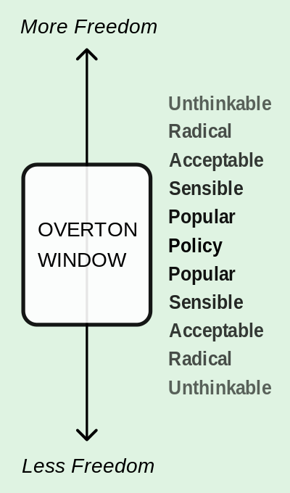
Overton was a libertarian, and they are all about framing things in terms of “personal freedom” as opposed to “government control.” (But the idea is general.)

Slide 30
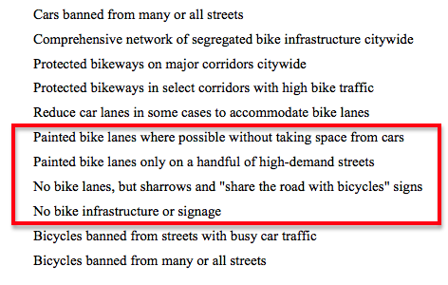
Some examples cribbed from a quick internet search (apologies to the authors).

Slide 31
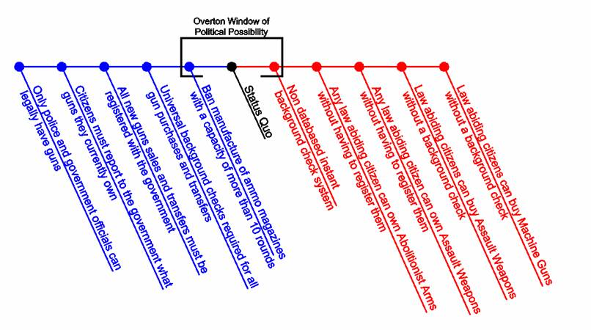

Slide 32
What’s the point, why do we care?
Framing is about changing people’s understandings of a policy.
It can involve radical change, not just marginal, incremental changes.
Overton did not explain how to do it. But the concept is useful because it reminds us that the consequences can be huge.

