Slide 1
Baumgartner, Framing, Spring 2023
Slovic, Paul. 1987. Perception of Risk. Science 236 (4799): 280–85.
Quattrone, George A., and Amos Tversky. 1988. Contrasting Rational and Psychological Analyses of Political Choice. American Political Science Review 82, 3: 719–736.
Monday Jan 23, 2023

Slide 2
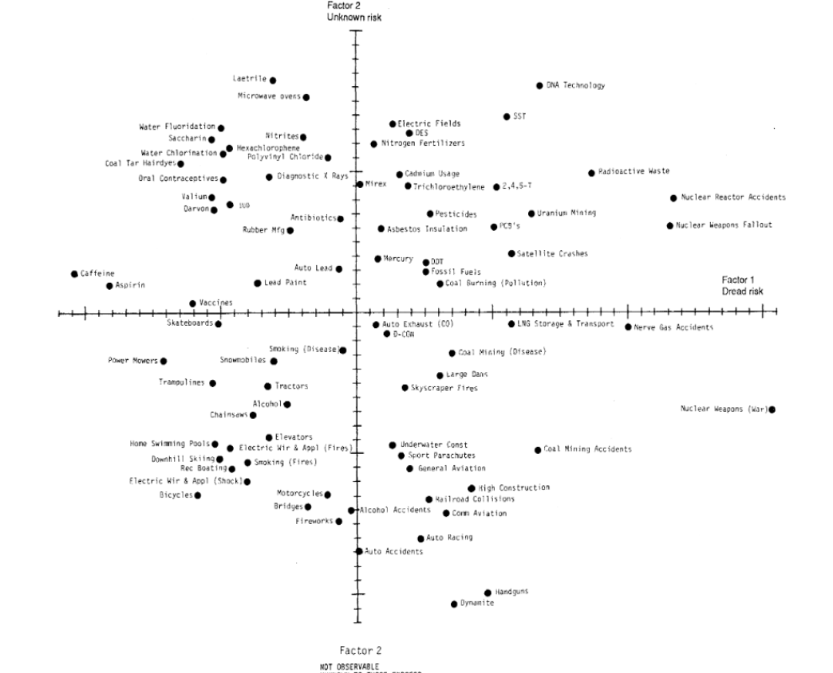
Familiar v. unfamiliar; dread v. mundane risks

Slide 3
Controllable v. not; Observable v. not

Slide 4
Things that make us over-estimate risk
Unknown (invisible, delayed, unfamiliar)
Dread (scary!)
Uncontrollable (sit on an airplane someone else flies v. drive your car)
Inequitable (victims did not deserve it; v. they took a known risk)
Catastrophic v. individual consequence
Likely to affect future generations v. only oneself
Voluntary v. involuntary

Slide 5
Do we see perceptions of risk being manipulated in politics? Does your mom do it, too?
What fears / risks are manipulated / amplified?
“You’ll catch pneumonia!”
Odds of violent crime.
Odds of someone on work release will commit a crime.
Stranger-attacks v. dangers from loved ones or family members.
Every airplane crash or near miss.

Slide 6
What risks are minimized?
Bad things are going to happen in war...
The Soviets couldn’t handle Afghanistan, but Americans will have no problem…
Cost estimates can be optimistic…
No one will do anything bad with all the data they collect about you…
Trust me…
Sometimes both: Our product is excellent, but here’s a 3 year warranty you can purchase to protect yourself…

Slide 7
Sometimes we have no choice
If your child had an incurable disease, you’d enroll them in a clinical trial…
Let’s expand that to a general idea:
How much do you care about the problem?
A lot: then take risks to at least do all you can do to solve it.
Not that much: then play it safe.
Think about that when you hear conservatives and liberals arguing about solving some social problem…

Slide 8
Rational v. Psychological Theories of Choice (Quattrone and Tversky)
Economics: Common to assume rationality in that people will by the same product at a lower price if they can, and we can understand a lot of outcomes from decisions by acting “as if” people are rational. They are not stupid, after all.
Psychology: This is crazy. People don’t calculate like that.
Political science and framing: When is it ok to assume something relatively close to rational, and when do we really need to understand psychology?

Slide 9
Things to keep in mind about how people actually think
How we approach risk
Depends on if we are thinking of gaining or losing something.
Fully rational: it would not matter. $100 = 0.5*$200, same expected value.
Gains: Take $100, or flip a coin for $0 or $200?
Losses: Lose $100, or flip a coin to keep your money or possibly lose $200?
Most will like certainty (be risk-averse) in the domain of gains, but take more risks in the domain of losses…

Slide 10
Note the confusing terminology
Depends on if we are thinking of gaining or losing something. Paradoxically, that is the domain of losses (hoping to gain), and the domain of gains (where you fear losing what you have).
Domain of gains: You already have something, but you might lose it.
Think of the wealthy with income tax proposals. They don’t want to lose what they have. Therefore they do not want to take risks.
Domain of losses: You don’t have something, but you’d like it.
Maybe you’ll take more of a risk to get it. Lottery tickets are mathematically losing propositions. But poor people are more likely to buy them.

Slide 11
Public policy always involves a status quo
Preserving the status quo is generally the low-risk choice.
Change generally involves some risk.
To encourage someone to support the status quo, just make them convinced that they are in the domain of gains.
To make someone support change, convince them that they are in the domain of losses.
Gains: do what you can to protect your gains. Losses: take a risk and see if maybe you can improve your situation…

Slide 12
Risk acceptance in the domain of loss Risk aversion in the domain of gains Losses loom larger than gains… Does that happen in public policy and framing?
How to proponents and opponents of new programs manipulate feelings of gain v. loss, and therefore people’s sense of risk-acceptance?
Consider:
Expansion of medical coverage / “Medicare for all” / other health care reforms
Climate change mitigation
How do the two sides manipulate feelings of risk?

Slide 13
Health Care Reform: urgent need to take a risk to resolve an urgent problem? Or be cautious with “risky schemes” because we have the “best health care system in the world”?
Opponents of expansion of medical coverage:
“We have the greatest medical system known to human civilization”
Proponents of change:
It’s a disgrace that xxx millions of Americans don’t have medical care
We manipulate people’s feelings of the need to take a risk for a greater gain, v. the need to “play it safe” to protect something.
Note the confusing language about “gains” and “losses”: we are more willing to take a risk if we feel we have something to gain. So down-grading what we have is a good strategy. If we love the status quo, then any change is a “risky scheme”.

Slide 14
How bad is the status quo?
Status quo is catastrophic:
Any change is worth the risk
Status quo is really working pretty well:
You prefer the certainty of what you know you are going to get compared to a chance to either get less or more
(You are in the domain of gains)
Note how often people argue not about how good their proposed plan is, but about the relative urgency of “doing something” and how terrible the status quo is. They are manipulating your risk-aversion.

Slide 15
Some vocabulary to keep straight…
“Expected utility theory” v. “prospect theory”
Economics v. psychology
“Reference points” or “anchors”, and “equivalence frames”
Unemployment rate of 7% ~= employment of 93%
This product is on sale, 20 percent below the “manufacturer’s suggested retail price.” “Compare at twice the price”. Normal price: much higher.
By making to anchor or consider a high reference point, the product seems cheaper.
What they are really doing is making you think about some number from a different perspective. It’s still the same number!

Slide 16
Losses are more hurtful than gains are helpful
Presenting things as possible losses generates more anxiety…
Wed: “Bad is stronger than good” in many areas of thinking

