Slide 1
Title of Talk Here Name 1, Name 2, Name 3, etc. UNC-Chapel Hill, Political Science 490 Research Seminar in Racial Disparities in Criminal Justice November 21, 2022

Slide 2
Background on the topic
Explain the topic
Point one
Point 2
Explain the data or the approach you are using
Point one
Point 2
Explain the theory or hypotheses you are testing
Point one
Point 2

Slide 3
Plan for this talk
What parts of the larger project are going to be in this talk?
What else are you doing in the paper that is not here?
What is the outline / structure of what we are going to see?
Topic 1
Topic 2
Etc.
(This section just tells the reader what is coming)
Then the slides come in the order just described, so no surprises

Slide 4
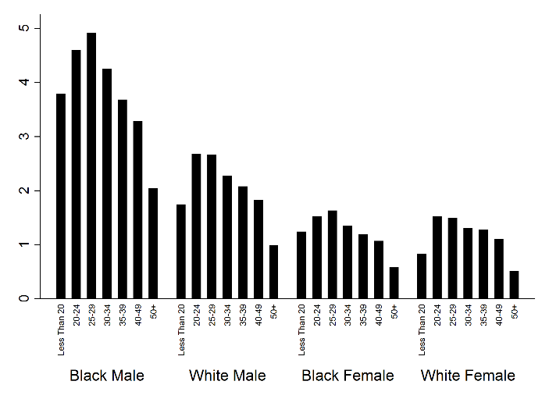
Example of a single graph on a page

Slide 5
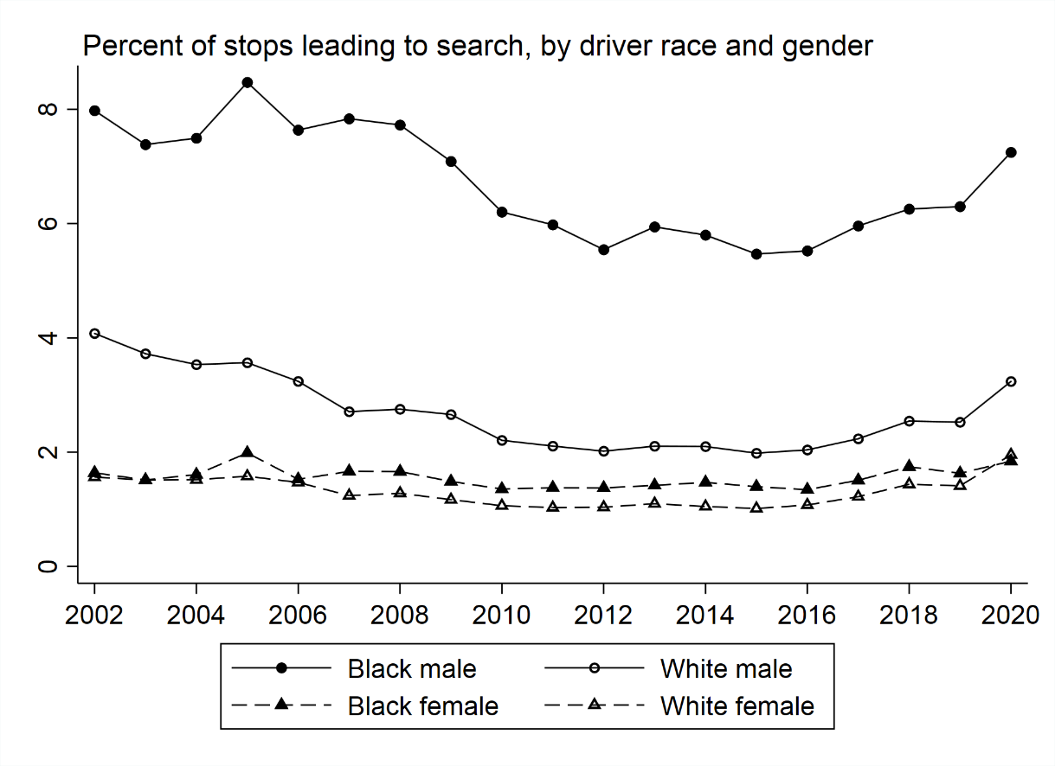
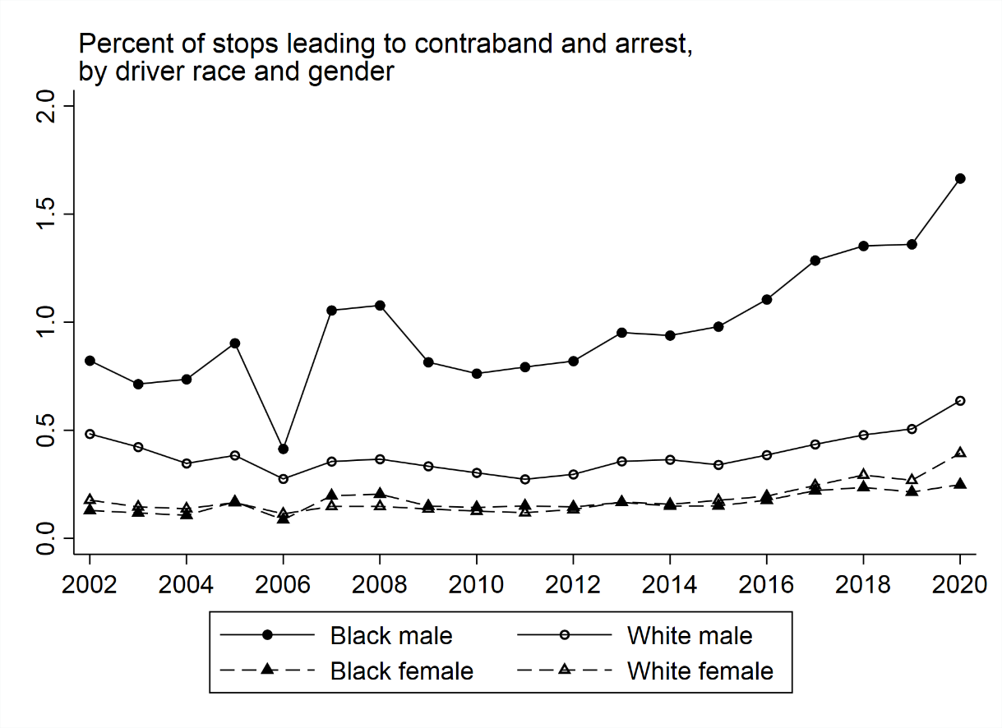
Example of two graphs with 2 titles
Black males searched way more
Very few of these traffic stops lead to arrest following the discovery of contraband.

Slide 6
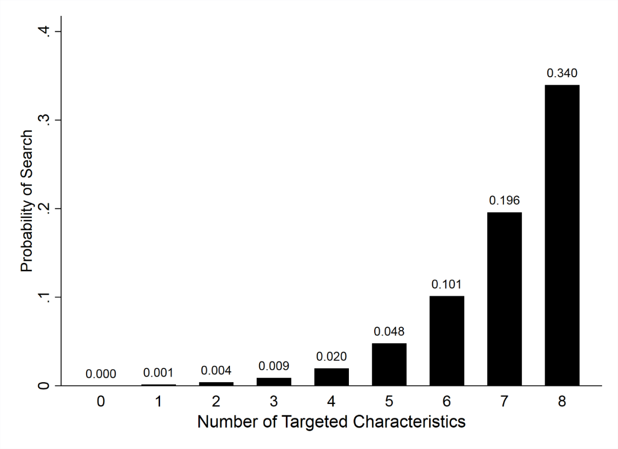
Example of a graph with an explanation
Targets:
Black, not white
Young, not old
Male, not female
Officer White Male, not other
Officer inexperienced, not veteran
Stop for investigation, not safety
Stop in rest of city, not three safest areas
Stop in Metro district, not rest of the city

Slide 7
Conclusions
Conclusion 1
Sub-idea
Another idea
Conclusion 2
So forth
So on
Conclusion 3

Slide 8
Thank you
Name 1, email
Name 2, email
Name 3, email

